Slide 1
CS 35L – Section 2
01/22/2014
Jack Xue
xuezijun@cs.ucla.edu
Office Hour:
Thursday
01:00PM-02:00PM
04:30PM-05:30PM
BH 2432

Slide 2
Course Overview
Linux
  As an OS for software developer
Treat OS as
  a resource abstraction (week1)
  a platform for collaboration (week 4,5,6,8)
  a programmable system (week 2,3)
  an implementation of the standard (week 7,9)

Slide 3
The Chain of Installation
Make the source code
  Usually done by programmer
  Version control
  Testing
  Documentation
Get the source code
  Buy it or download directly(freeware)
  Compile(configure,make,install)
Upgrade
  patch

Slide 4
How to Install Software
Windows
  Installshield
  Microsoft/Windows Installer
Linux
    Package Management systems – packages contain source or binaries, dependency list, and install scripts. Install software with one command.
    RedHat Linux (.rpm) – RPM, yum
    Debian Linux, Ubuntu Linux (.deb) – apt, dpkg
    Good old build process
      configure, make, make install

Slide 5
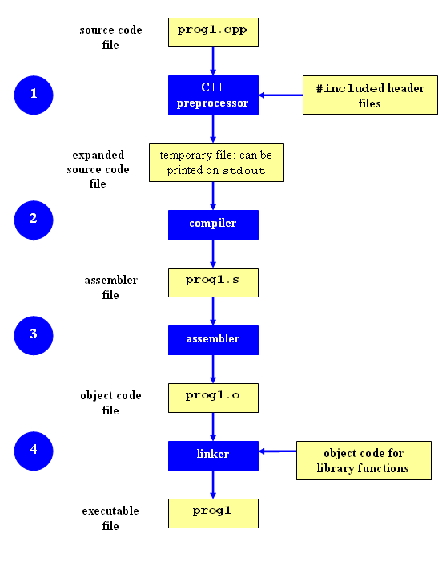
Compilation Process
Compilation

Slide 6
Make
  Utility for managing large software projects
  Automates build process
  Build not invoked unless needed to be
    > efficient

Slide 7
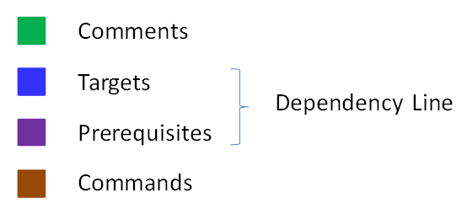
Makefile Example
# Makefile - A Basic Example
all : shop #usually first
shop : Item.o ShoppingList.o shop.o
g++ -g -Wall -o shop Item.o ShoppingList.o shop.o
Item.o : Item.cpp Item.h
g++ -g -Wall -c Item.cpp
ShoppingList.o : ShoppingList.cpp Item.h ShoppingList.h
g++ -g -Wall -c ShoppingList.cpp
shop.o : shop.cpp Item.h ShoppingList.h
g++ -g -Wall -c shop.cpp
clean :
rm -f Item.o ShoppingList.o shop.o shop
<tab>

Slide 8
Build Process
configure
  Check details about the machine before installation
  Dependencies between software
  Creates ‘Makefile’
make
  Requires ‘Makefile’ to run
  Compiles all the program code and creates executables in current directory
make install
  make utility searches for a label named install within the Makefile, and executes only that section of it
  executables are copied into the final directories (system directories)

Slide 9
Lab 3
Coreutils 7.6 ls program has a problem
  Different users see different date formats
  ls –l /bin/bash
    -rwxr-xr-x 1 root root 729040 2009-03-02 06:22 /bin/bash
    -rwxr-xr-x 1 root root 729040 Mar 2 2009 /bin/bash
Why?
  Different locales
Want the traditional Unix format for all users
Fix the ls program

Slide 10
Getting Set Up
Download coreutils-7.6 to your home directory
  Use ‘wget’
  http://ftp.gnu.org/gnu/coreutils/coreutils-7.6.tar.gz
Untar and Unzip it
  tar –xzvf coreutils-7.6.tar.gz
Make a directory coreutilsInstall in your home directory (this is where you’ll be installing coreutils)
  mkdir ~/coreutilsInstall

Slide 11
Building coreutils
Go into coreutils-7.6 directory. This is what you just unzipped.
Read the INSTALL file in how to configure “make”, especially --prefix flag
Run the configure script using the prefix flag so that when everything is done, coreutils will be installed in the directory ~/coreutilsInstall
Compile it: make
Install it: make install (usually must be root; won’t work on Linux server without proper prefix!)

Slide 12
Decompressing Files
Generally you would get Linux software in the zipped tar format (tar.gz)
Decompress file in current directory:
tar –xzvf filename.tar.gz
  Option –z: --gzip
  Option –x: --extract, --get
  Option –v: --verbose
  Option –f: --file

Slide 13
Decompressing Files (cont’d)
Tar gzip: Windows equivalent – WinRar
Unzip
  tar -xvf <archive_file.tar>
  tar –zxvf archive_file.tar.gz
  gzip –d archive_file.gz
  tar –Jxvf archive_file.xz
  Zip
  tar -czvf <output_archive.tar.gz> <file1> <directory2> < file3>
    c = create
    z=gzip

Slide 14
Patching
A patch is a piece of software designed to fix problems with or update a computer program.
It’s a diff file that includes the changes made to a file
A person who has the original (buggy) file can use the patch command with the diff file to add the changes to their original file

Slide 15
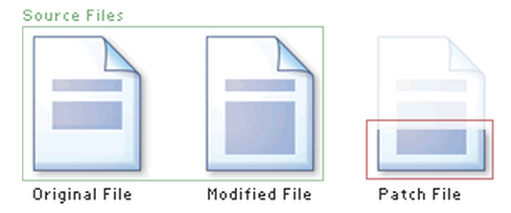
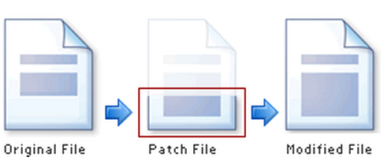
Applying a Patch

Slide 16
diff Unified Format
--- path/to/original_file
+++ path/to/modified_file
@@ -l,s +l,s @@
  @@: beginning and end of a hunk
  l: beginning line number
  s: number of lines the change hunk applies to for each file
  A line with a:
    - sign was deleted from the original
    + sign was added in the new file
    ‘ ‘ stayed the same

Slide 17
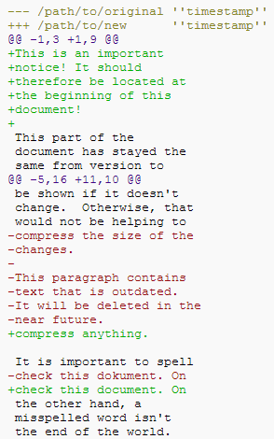

Slide 18
Patching
cd coreutils-7.6
vim or emacs patch_file: copy and paste the patch content
patch –pnum <patch_file
  ‘man patch’ to find out what pnum does and how to use it
cd into the coreutils-7.6 directory and type make to rebuild patched ls.c

Slide 19
Homework 3

Slide 20
What is Python?
Not just a scripting language
Object-Oriented language
  Classes
  Member functions
Compiled and interpreted
  Python code is compiled to bytecode
  Bytecode interpreted by Python interpreter
Not as fast as C but easy to learn, read and use

Slide 21
Optparse Library
Powerful library for parsing command-line options
  Argument:
    String entered on the command line and passed in to the shell
    Elements of sys.argv[1:] (sys.argv[0] is the name of the program being executed)
  Option
    An argument that supplies extra information to customize the execution of a program
  Option Argument
    An argument that follows an option and is closely associated with it. It is consumed from the argument list when the option is

Slide 22
Lists
Common data structure in Python
A python list is like a C array but much more:
  Dynamic: expands as new items are added
  Can hold heterogeneous data: objects with different types
How to access elements?
  List_name[index]

Slide 23
Example
>>> t = [123, 3.0, ‘hello!’]
>>> print t[0]
  123
>>> print t[1]
  3.0
>>> print t[2]
  hello!

Slide 24
for loops
list = [‘Mary’, ‘had’, ‘a’, ‘little’, ‘lamb’]
for i in list:
print i
Result:
Mary
had
a
little
lamb
for i in range(len(list)):
print i
Result:
0
1
2
3
4

Slide 25
If and While
# Multi-way decision
# x is a real number
if x<0:
x=0
print "Negative changed to zero”
elif x==0:
print "Zero"
else:
print "More”
# Loops List
a = ['cat', 'window', 'defenestrate']
for x in a:
print x, len(x)

Slide 26
Define Functions
# Define and invoke function.
def sum(a,b):
return a+b
func = sum
r = func(5,6)
print r
# Defines function with default argument
def add(a,b=2):
return a+b
r=add(1)
print r
r=add(1,5)
print r

Slide 27
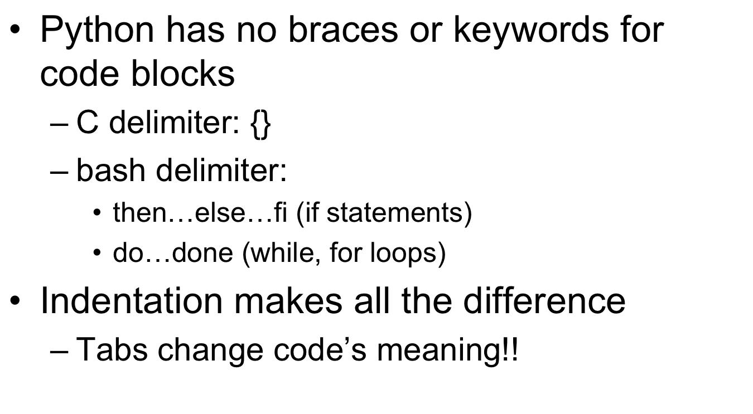
Indentation

Slide 28
Running Python scripts
python hellowrold.py
Make sure it has executable permission:
  chmod +x helloworld.py
  Run it: ./helloworld.py

Slide 29
Running randline.py
Run it
  ./randline.py –n 3 filename (need execute permission)
  python randline.py –n 3 filename (no execute permission)
randline.py has 3 arguments:
  n: the number of lines to write
    option
  3: number of lines
    argument option to n
  filename: file to choose lines from
    argument to script
Output: n random lines from the input file

Slide 30
Python Walk-Through
#!/usr/bin/python
import random, sys
from optparse import OptionParser
class randline:
def __init__(self, filename):
f = file (filename, 'r')
self.lines = f.readlines ()
f.close ()
def chooseline(self):
return random.choice(self.lines)
def main():
version_msg = "%prog 2.0"
usage_msg = """%prog [OPTION]...
FILE Output randomly selected lines from FILE."""
Tells the shell which interpreter to use
Import statements, similar to include statements
Import OptionParser class from optparser module
The beginning of the class statement: randline
The constructor
Creates a file handle
Reads the file into array of strings called lines
Close the file
The beginning of a function belonging to randline
Randomly select a number between 0 and the size of lines and returns the line corresponding to the randomly selected number
The beginning of main function
version message
usage message

Slide 31
Python Walk-Through
parser = OptionParser(version=version_msg, usage=usage_msg) parser.add_option("-n", "--numlines", action="store", dest="numlines", default=1, help="output NUMLINES lines (default 1)")
options, args = parser.parse_args(sys.argv[1:])
try:
numlines = int(options.numlines)
except:
parser.error("invalid NUMLINES: {0}". format(options.numlines))
if numlines < 0:
parser.error("negative count: {0}". format(numlines))
if len(args) != 1:
parser.error("wrong number of operands")
input_file = args[0]
try:
generator = randline(input_file)
for index in range(numlines):
sys.stdout.write(generator.chooseline())
except IOError as (errno, strerror):
parser.error("I/O error({0}): {1}". format(errno, strerror))
if __name__ == "__main__":
main()
Creates OptionParser instance
Start defining options, action “store” tells optparse to take next argument and store to the right destination which is “numlines”. Set the default value of “numlines” to 1 and help message.
options, an object containing values for all of your options
args, the list of positional arguments leftover after parsing options
Try block
get numline from args
Exception handling
error message if numlines is not integer type, replace {0 } w/ input
If numlines is negative
error message
If length of args is not 1 (no file name or more than one file name)
error message
Assign the last and only operand to variable input_file
Try block
instantiate randline object with parameter input_file
for loop, iterate from 0 to numlines – 1
print the randomly chosen line
Exception handling
error message in the format of “I/O error (errno):strerror
In order to make the Python file reusable module or standalone program

Slide 32
Python3
export PATH=$PATH:/usr/local/cs/bin

Slide 33
Presentation
Fill the form on google docs
  https://docs.google.com/spreadsheet/ccc?key=0AvpN8o_kP0GadGM3a0ZRX3VmR1J3anVmb1JUdTZlTnc&usp=sharing
  http://tinyurl.com/oo7ed9h
  First come, First serve
How to fill
  Choose your slot
  Fill the topic, name, UID and Email
Brief Presentation
  ~10min
Submit your report and slides (If you have)
  No later than Friday 24:00 in the week you do your presentation

