Slide 1
Verifying and Publishing a Backported Change
Homework 4

Slide 2
Git Example
Project
games: pacman.c, pacman.h, README
Create repository to track new project
git init (creates .git dir w/ all necessary repo files)
Is the project tracked?
No, need to add files and do an initial commit
git add pacman.c pacman.h README
git commit –m “initial commit of my project”

Slide 3
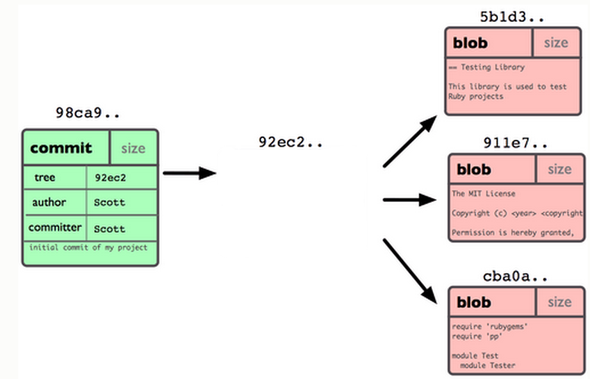
Git Repo Structure
Snapshot
tree |  | size
blob | 5b1d3 | README
blob | 911e7 | pacman.c
blob | cba0a | pacman.h

Slide 4
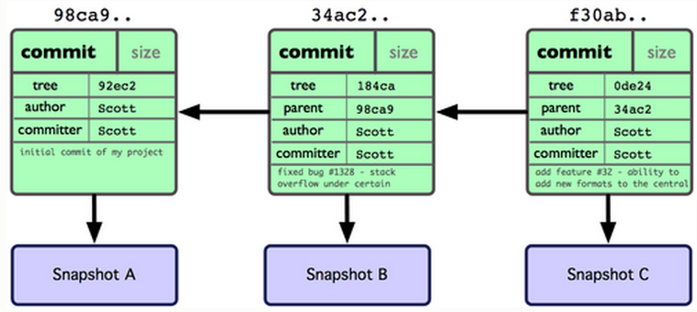
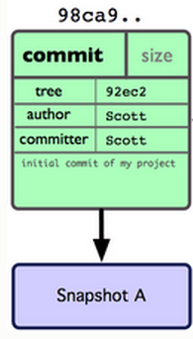
After 2 More Commits…

Slide 5
What Is a Branch?
A pointer to one of the commits in the repo
When you first create a repo, are there any branches?
Default branch named ‘master’
The default master branch
points to last commit made
moves forward automatically, every time you commit

Slide 6
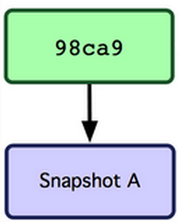
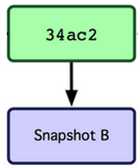
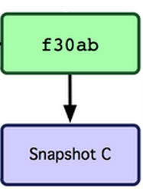
Where Is Master?
master
master

Slide 7
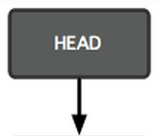
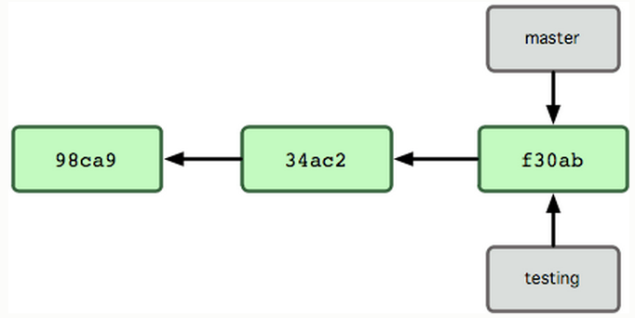
New Branch
Creating a new branch = creating new pointer
git branch testing
Where is new branch created?
Current commit
Where is current commit?
HEAD

Slide 8
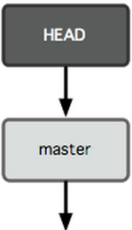
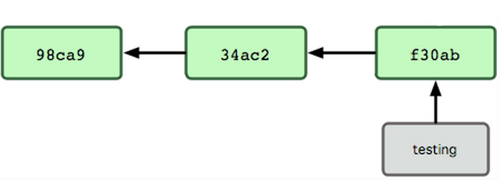
New Commit
What happens if we make another commit?
345f5

Slide 9
Switching to New Branch
Check out new branch
$ git checkout <branch_name>
$ git checkout testing

Slide 10
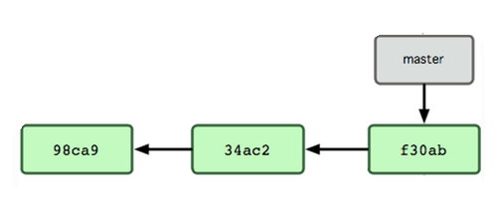

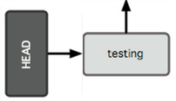
Commit After Switch

Slide 11
Why Branching?
Experiment with code without affecting main branch
Separate projects that once had a common code base
2 versions of the project

Slide 12
Homework 4
Publish patch you made in lab 4
Create a new branch “quote” off of version 3.0
Branch command + checkout command
git checkout v3.0 -b quote
Use patch from lab 4 to modify this branch
Patch command
patch –pnum < quote-3.0-patch.txt
Commit changes to the new branch
git add . git commit –m <Changelog entry>
Generate a patch that other people can use to get your changes
git format-patch -[num] --stdout > formatted-patch.txt
Test your patch
Check out version 3.0 into a tmp branch
Apply patch with git am command: git am < quote-3.0-patch.txt
Build and test with make check

