Slide 1
Project Report
Mancala game
MTAT.03.083 Systems Modeling, Fall 2010
Taavet Loogväli, Mihkel Jõhvik, Allan Reinhold, Martti Vasar
Tartu 2010

Slide 2
Introduction
Mancala game overview
Model and MVC
Implementation and code used
Demo

Slide 3
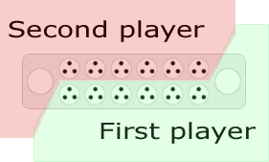
Mancala game
Two player game
Player has 6 pits and
1 store
Each pit has same
amount seeds
Pit cointains 3 to 6 seeds,
depends on rules
In turns, players takes seeds from pit and “sows” them to other pits in counter-clockwise

Slide 4
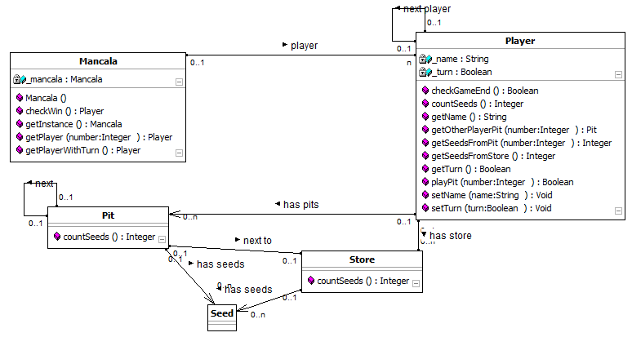
Model

Slide 5
Implementation
Objects first design method
MVC used for user and game interactions
40 user stories and 40 object diagrams
Automatic generation of user stories and object diagrams (dia format)
JSwing with JFrame to draw content for user
JFrame is double buffered to avoid flickering
Mouse Listeners are used to capture user input
Sockets are used for network gaming

Slide 6
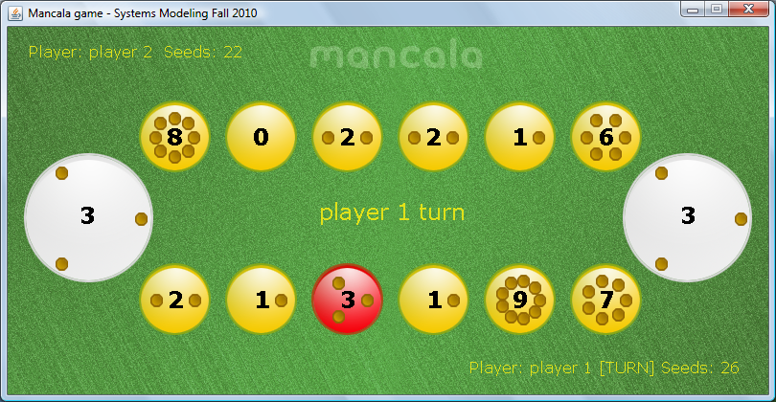
Game in action

Slide 7
Demo

