Slide 1
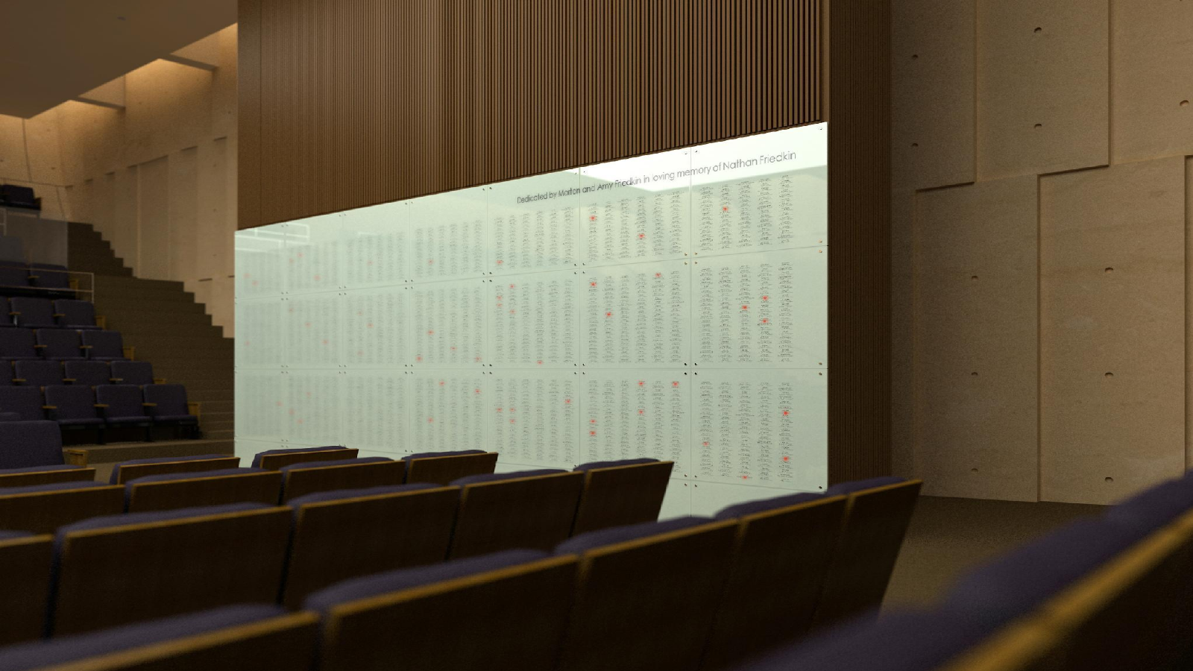
Yahrzeit Wall
Modernization & Maintenance Plan
Congregation Beth Sholom • 2026
Allan Schwartz
Notes:
Open personally and briefly. This is a stewardship presentation, not a technical deep dive. Emphasize continuity: the wall has served the congregation, and the goal is to keep it reliable and maintainable.

Slide 2
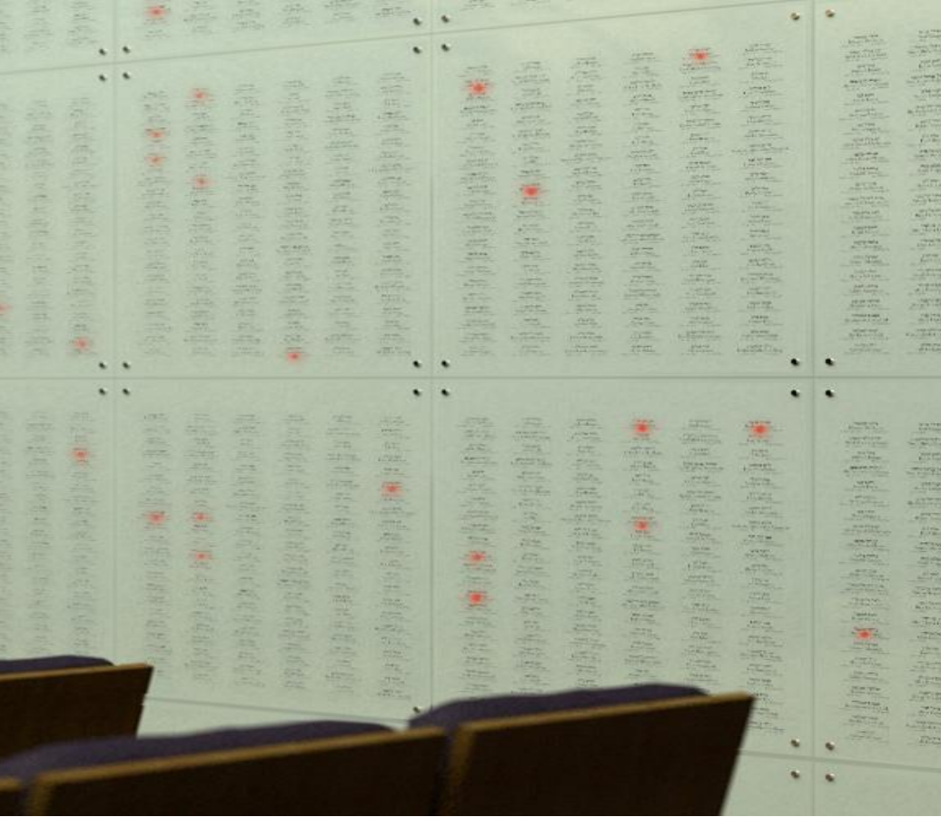
What the wall does
A ritual object supported by a technical system
Honors loved ones through etched names and lights
Lights memorials during the appropriate Yahrzeit week
Illuminates the wall for Yizkor observances
Combines glass, lighting electronics, database, and automation
Congregation Beth Sholom • Yahrzeit Wall modernization
Notes:
Keep this accessible. The wall is not just hardware; it is a ritual and memorial system. Avoid excess technical detail here.

Slide 3
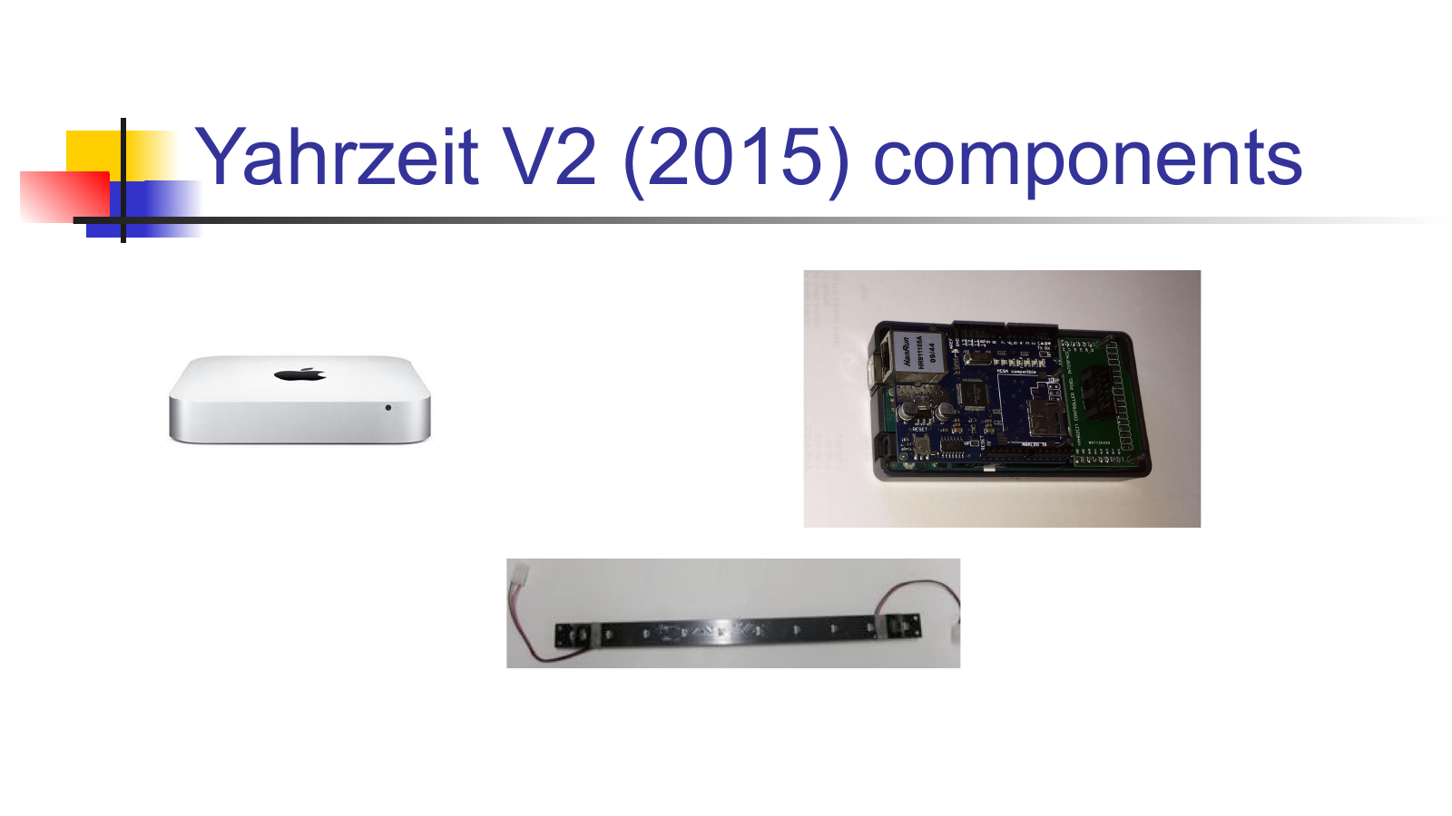
Why attention is needed now
The system served well; now it needs a maintainable future
Server/appliance environment and
Institutional knowledge is fragile
Maintenance needs a small, repeatable path
The goal is renewal, not redesign
2015: Mac Mini + Arduino-era controller + legacy PHP
Congregation Beth Sholom • Yahrzeit Wall modernization
Notes:
Use careful tone: do not say the old system is bad. Say it has served the synagogue and deserves a supportable maintenance path.

Slide 4
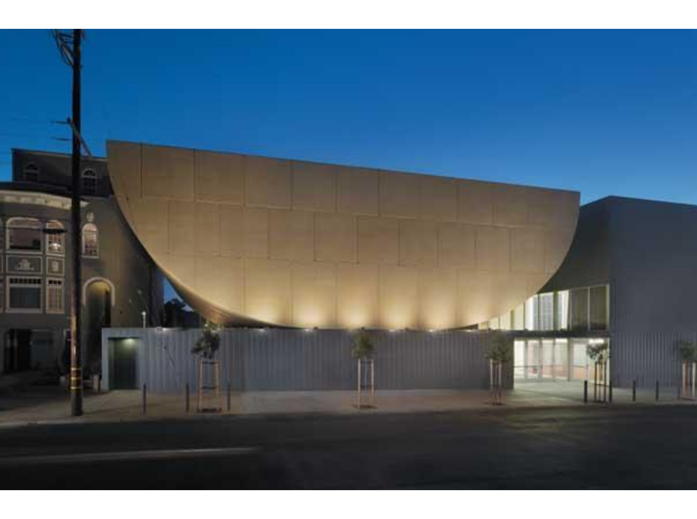
Design goals still hold
The 2015 goals remain the right north star
Simplicity, elegance, ease of use, database integration, automation — and a system that can be maintained.
Preserve the architectural and ritual intent
Make operation clearer for staff and facilities
Keep technical complexity behind the scenes
Document for future maintainers
Congregation Beth Sholom • Yahrzeit Wall modernization
Notes:
Reference the 2015 deck briefly. The message: the original goals were sound; the 2026 project is to restore and protect those goals.

Slide 5
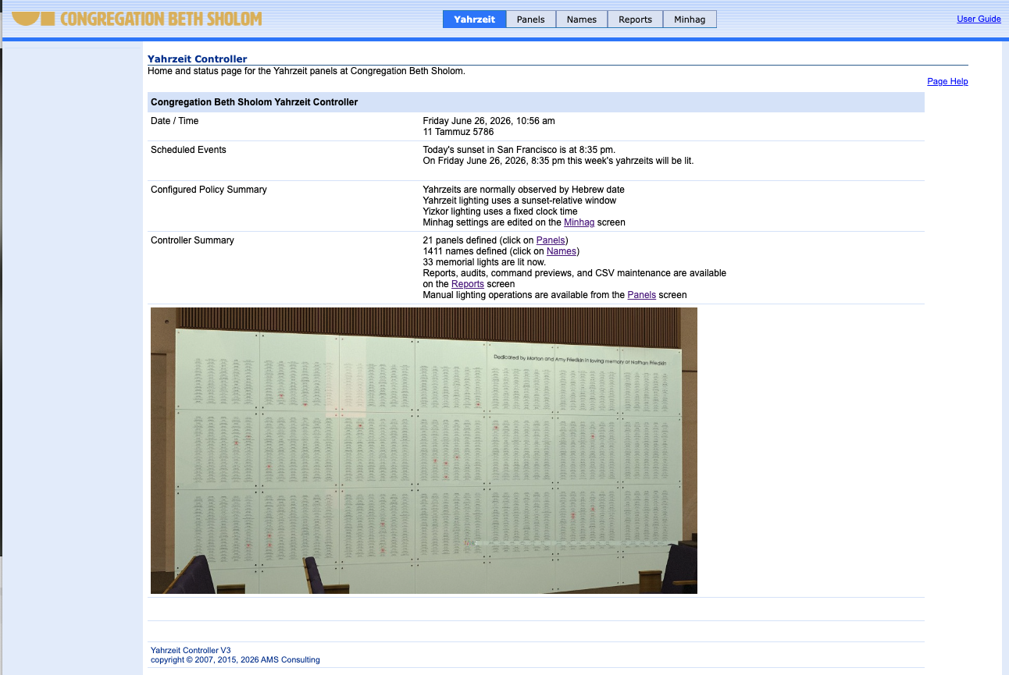
What has already been done
Recent preparation has moved from idea to working prototype
Reviewed and modernized server-side PHP screens
Added shared lighting-policy logic used by UI and engine
Improved dashboard and panel-level status visibility
Built a Linux Ubuntu appliance install path
Bench-tested replacement controller/interface pieces
Congregation Beth Sholom • Yahrzeit Wall modernization
Notes:
This slide is credibility. Do not dwell on code names unless asked. Mention that the work is already in a repository and tested locally.

Slide 6
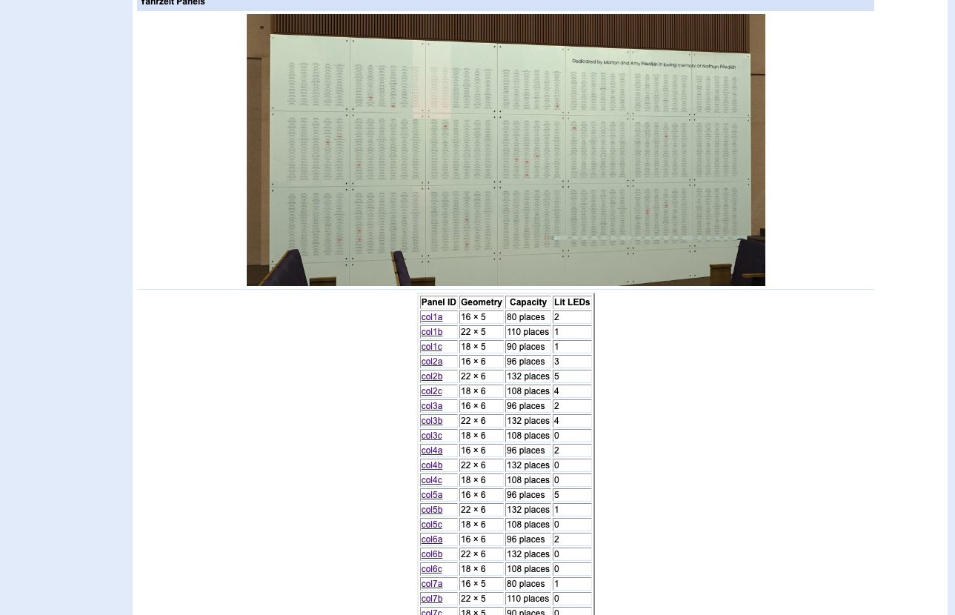
Visible improvement: wall-level view
The panel overview now gives operational context
Panel geometry and capacity are visible
Lit-light counts appear by physical panel
Manual operations are grouped and labeled
A maintainer can orient themselves quickly
Congregation Beth Sholom • Yahrzeit Wall modernization
Notes:
Preface the single-panel screen with this one. It shows the wall as a whole and introduces lit-light counts. “This gives staff and maintainers a wall-level view, including panel-geometry and lit-light counts”

Slide 7
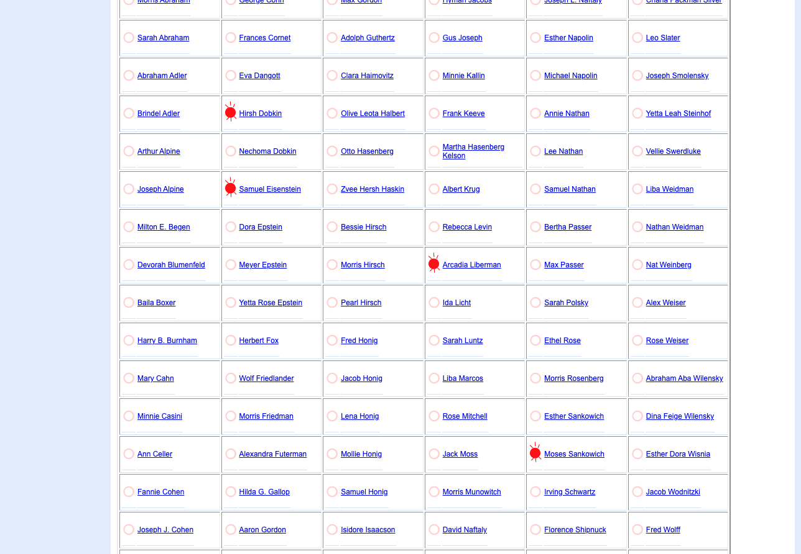
Visible improvement: single-panel view
A maintainer can see which memorial lights should be lit now
Example: col5a
Names remain clickable
LED icon marks a calculated lit memorial
Summary line: “5 memorial lights should be lit now on this panel”
Congregation Beth Sholom • Yahrzeit Wall modernization
Notes:
This is the strongest concrete example for nontechnical people. Say: This now shows exactly which memory lights should be lit today. it turns the wall from a black box into something staff and maintainers can inspect.

Slide 8
Proposed modernization path
A staged, low-risk maintenance project
1
2
3
4
5
Prepare
Assess onsite
Bench test
Cut over
Handoff
Finalize appliance and docs
Confirm current server, wiring, access
Validate controller path safely
Scheduled install with rollback
Document operation and support
Principle: preserve the current wall; do not disturb it until the replacement path is tested.
Congregation Beth Sholom • Yahrzeit Wall modernization
Notes:
This is the plan slide. Make it clear the project is staged and reversible. Facilities and leadership should hear: no surprises, no casual tinkering with the wall.

Slide 9
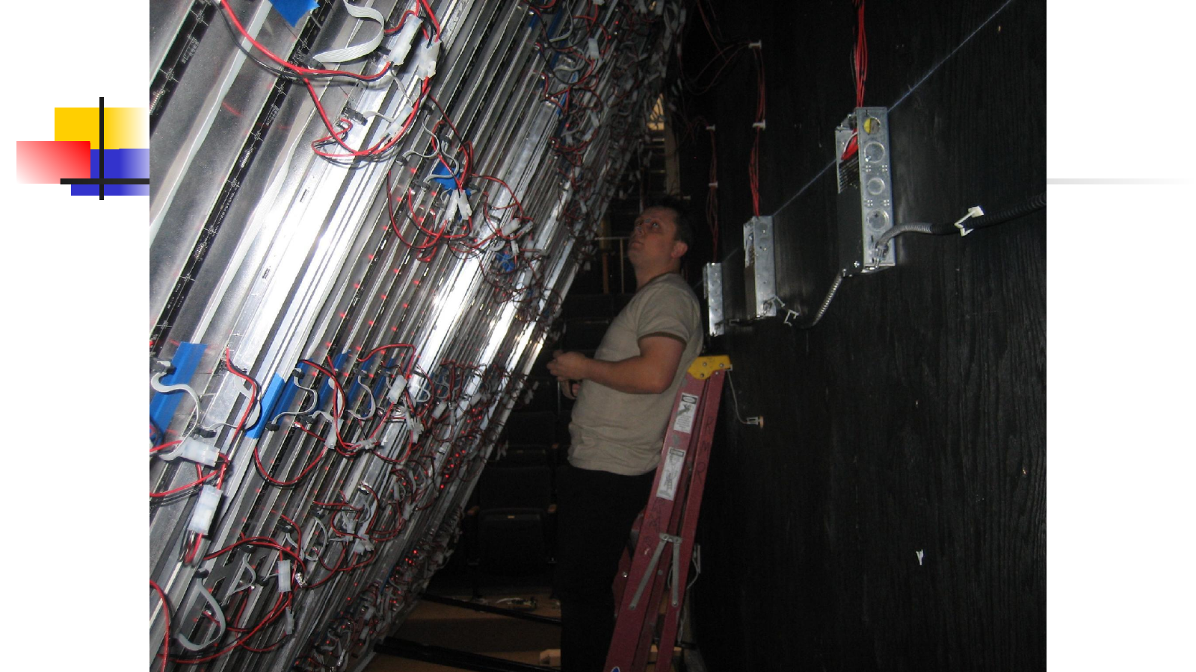
Small working team
The project needs coordination, not a large committee
Engineering lead
Allan: historical knowledge, software, controller path
Engineering helper
Second technical person for review and onsite work
Facilities lead
Access, scheduling, physical installation coordination
CBS technical contact
Local knowledge of current server, IP network & passwords
Clergy / office stakeholder
Ritual policy and operational acceptance
Congregation Beth Sholom • Yahrzeit Wall modernization
Notes:
Say that the engineering work can be pro bono, but the site work needs CBS coordination.

Slide 10
What I am asking CBS to do next
A focused first step
Identify the current CBS point people: facilities, office, clergy, and technical contact
Authorize this working group
Provide access to inspect the current server, network path, and controller wiring
Schedule a planning meeting, then a controlled onsite work window
Goal: preserve the Yahrzeit Wall as a reliable, maintainable memorial system for the congregation.
Congregation Beth Sholom • Yahrzeit Wall modernization
Notes:
End the main deck with a clear ask. Avoid drifting into technical appendix unless the audience wants it.

Slide 11
Technical Appendix
Architecture • controller • appliance • screens • deployment
Notes:
Transition: the next slides are for the technical/facilities audience. They can be skipped or used as backup.

Slide 12
System architecture
APPENDIX
The wall is physical, electronic, and software
Glass panels
Pixel chain
Controller
Appliance
Etched names + LEDs
DATA • CLOCK • LATCH • OE
Arduino-class embedded logic
Apache/PHP + database + scheduler
The UI and reports show calculated policy state
The controller sends only lighting commands to the wall
The project preserves the wall and renews maintainability
Technical appendix
Notes:
Use this to orient facilities and technical people. Important distinction: UI calculated status is not the same as querying the live controller.

Slide 13
Embedded controller upgrade path
APPENDIX
Modern controller, same hard-wired reliability principle
2026 replacement path
Ubuntu server LTS
Arduino UNO R4 Minima -- modern, 32-bit ARM controller
Roughly an order-of-magnitude more capable platform
New Ethernet hardware and improved connection behavior
New pixel interface shield and case
Exact same “PIXEL” board interface
2015 controller path
Arduino Mega-era design
Legacy Ethernet stack
Field-proven but aging
Technical appendix
Notes:
Say “roughly order of magnitude” rather than promising 12x unless someone asks. If technical audience asks, explain 16 MHz to 48 MHz plus architecture improvement as a rough estimate.

Slide 14
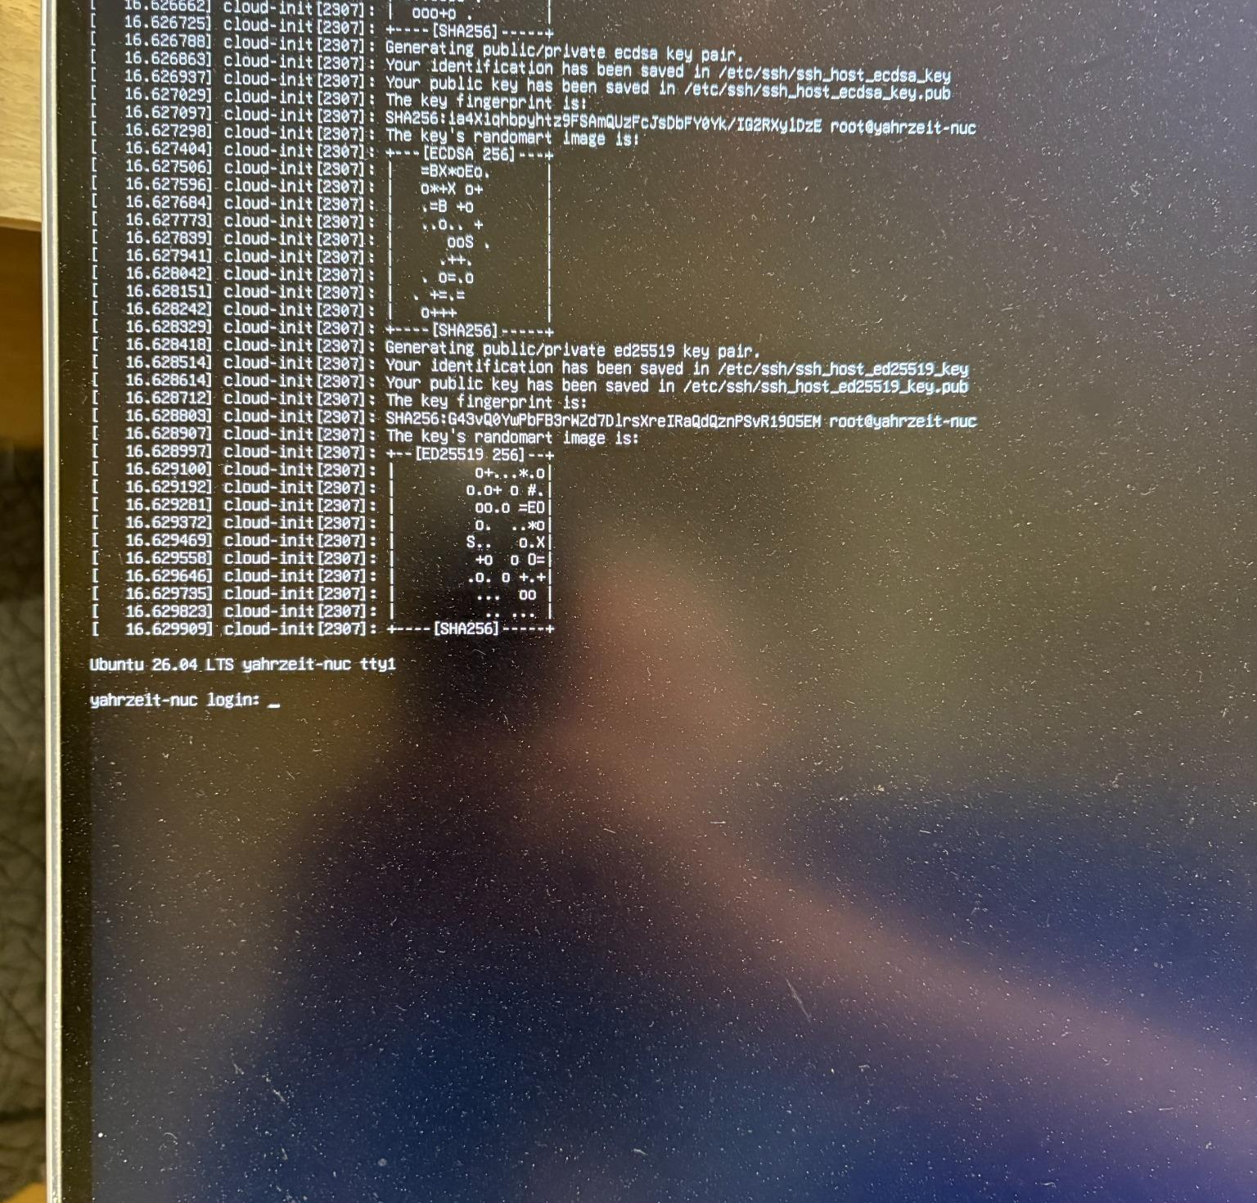
Replacement appliance path
APPENDIX
Fresh, documented, repeatable
Fresh Ubuntu NUC appliance instead of an aging Mac Mini
Apache + PHP runtime with documented installer
Public source repository and project instructions
No live controller transmission during install tests
Cron phases documented rather than hidden
Example: fresh NUC booted to Ubuntu with SSH enabled
Technical appendix
Notes:
This is about deployment hygiene. Emphasize reproducibility and supportability, not just newer hardware.

Slide 15
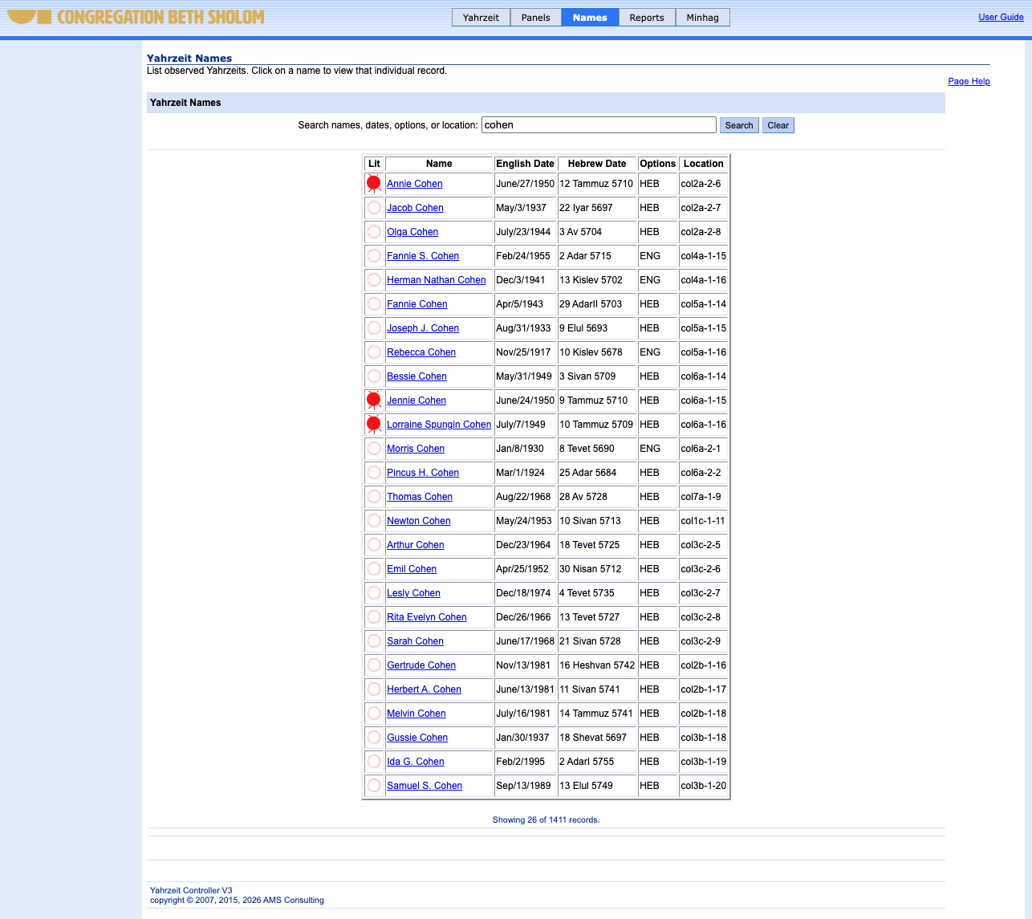
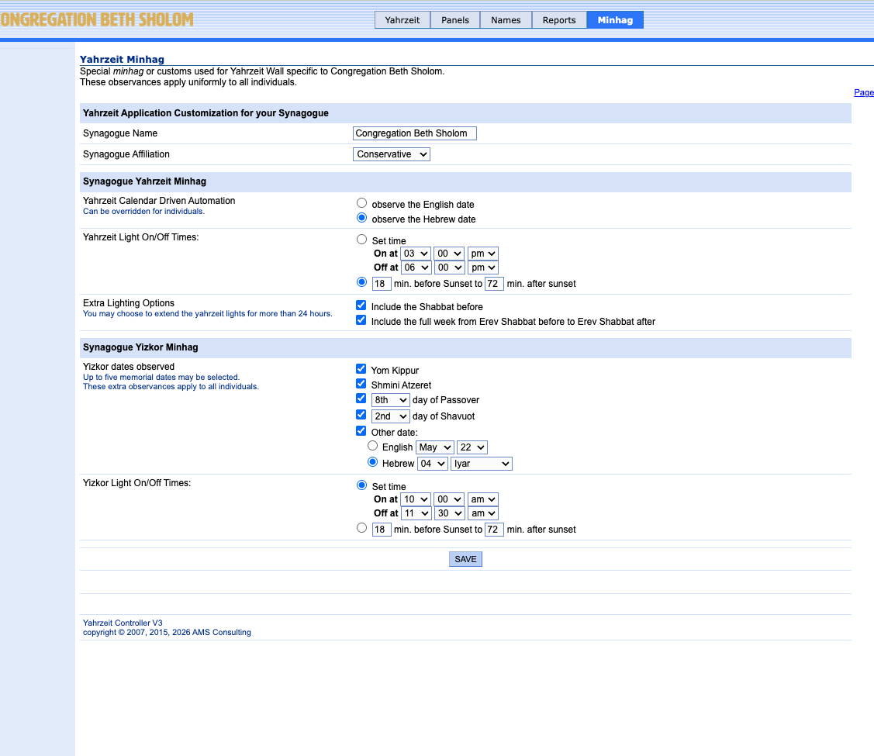
UI screen tour
APPENDIX
Cleaner screens make the system easier to operate and maintain
Dashboard
Names
Minhag policy
Dashboard: current policy and calculated lit count
Names: searchable, read-only memorial database view
Minhag: documented ritual policy settings
Technical appendix
Notes:
Screen-by-screen tour should be short. The important point: the app now explains itself better.

Slide 16
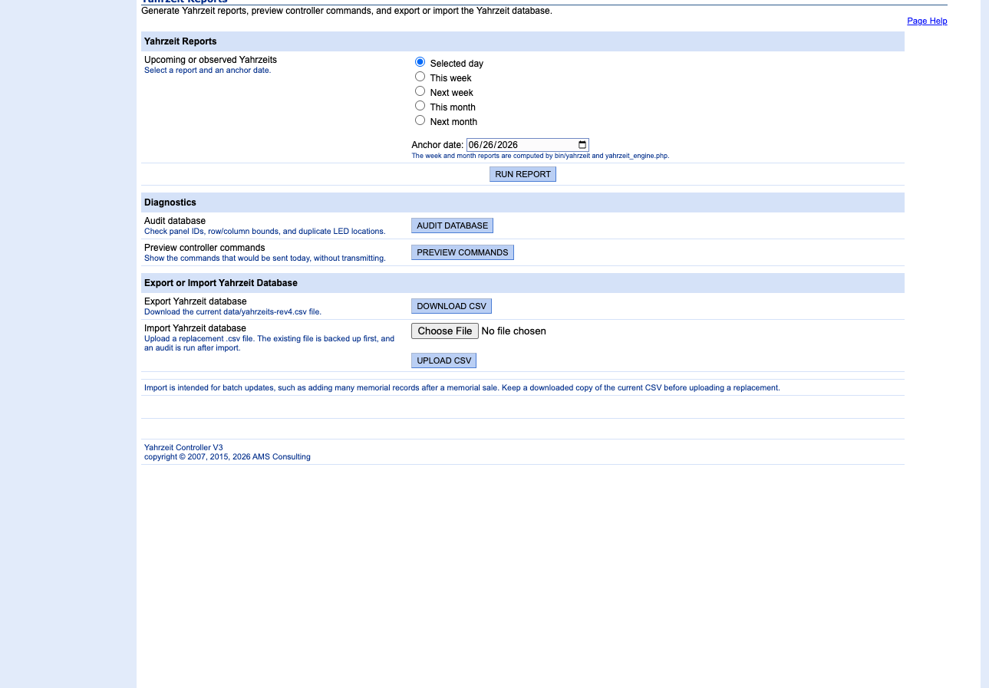
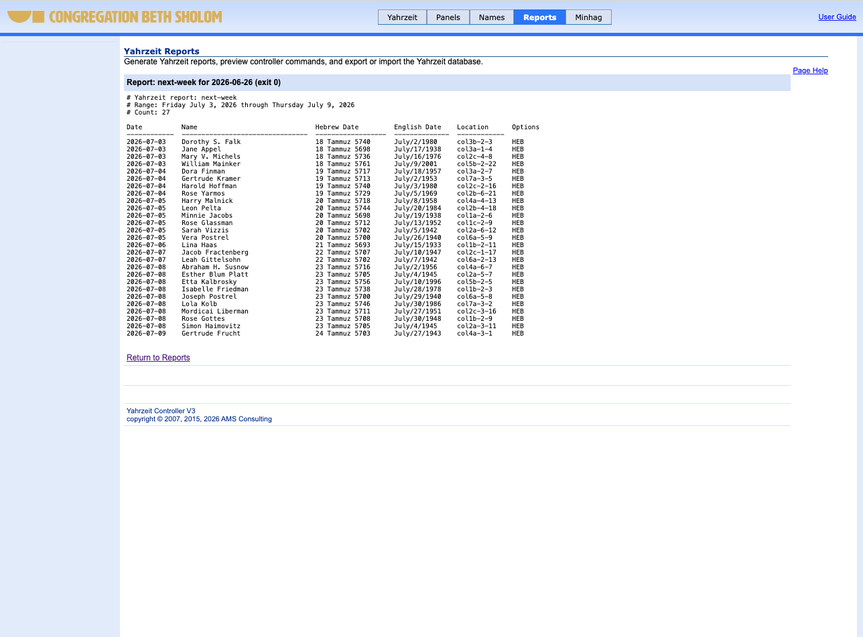
Reports and scheduling
APPENDIX
Verify behavior before touching hardware
Reports show today, this week, next week, Yizkor, audits, and command previews
Scheduler model remains simple: cron invokes short phases; no daemon or long sleeps
Yizkor policy is explicit and testable inside the app
Technical appendix
Notes:
This slide is about confidence. Reports and command previews let the team verify expected behavior before live wall operations.

Slide 17
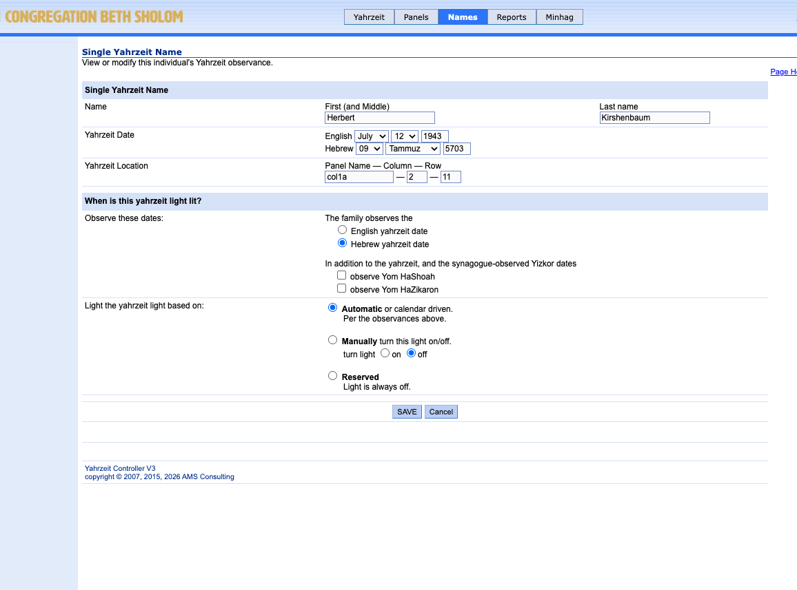
Safer memorial database maintenance
APPENDIX
Single-record changes without rewriting the whole CSV
Edit path is intended for correction, especially date-of-death issues
Only one physical CSV line is replaced
Original line identity is checked before save
Backup/audit path reduces maintenance risk
Technical appendix
Notes:
This may be too technical for the main audience but important for engineering credibility. It addresses the risk of staff or maintainers corrupting the database.

Slide 18
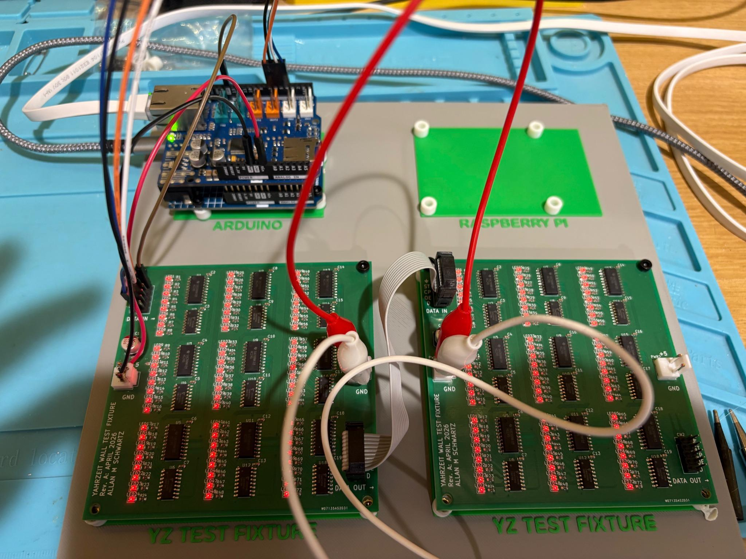
Testing and rollback plan
APPENDIX
No live wall change until the replacement path is proven
Bench-test replacement controller and interface
Run non-transmit server tests (--dry-run) and command previews
Inspect current onsite server and wiring before cutover
Preserve current working system until replacement is validated
Maintain a cold-spare appliance/server
Technical appendix
Notes:
Stress that testing precedes installation. The test fixture work is a confidence-builder, not a distraction.

Slide 19
Known risks and mitigations
APPENDIX
Acknowledge uncertainty; reduce it with process
Risk
Mitigation
Unknown current onsite state
Onsite assessment before changes
Aging server or OS
Fresh appliance plus documented install
Controller/network mismatch
Bench test + onsite non-destructive validation
Database maintenance error
Single-record editing + backup/audit
Future loss of knowledge
Repository, docs, support handoff
Technical appendix
Notes:
This is the trust slide for leadership. Be honest that onsite unknowns exist, and then show that every risk has a mitigation.

Slide 20
A maintainable future
for a memorial wall
Next step: name the working group and schedule the onsite assessment.
Thank you
Notes:
Close by returning to purpose. This is not about technology for its own sake. It is about preserving a memorial system for CBS.

