Slide 1

Current topics in ML
Naive Bayes Classifiers
allarassemjj20@gcc.edu

Slide 2
Outline
Bayes Rule
Origin of Bayes Rule
Bayes Rule and its applications
The naïve Bayes classifier (quick review of the theory)
Application 1: Gender classifier based on first name
Application 2: Newspapers classifier
Application 3: Chatbot

Slide 3
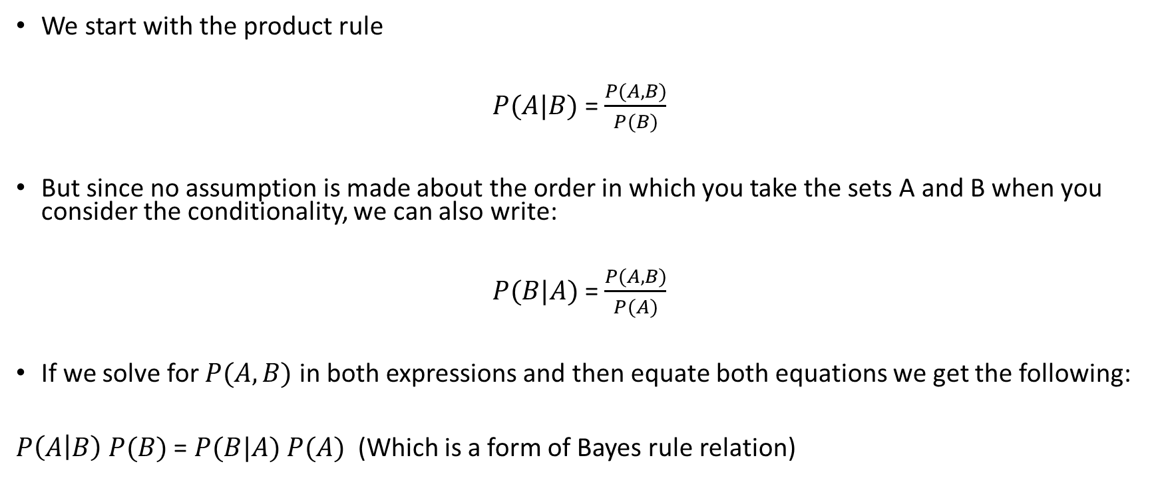
Origin of Bayes Rule
We start with the product rule
$P(A|B)$= $\frac{P(A,B)}{P(B)}$
But since no assumption is made about the order in which you take the sets A and B when you consider the conditionality, we can also write:
$P(B|A)$= $\frac{P(A,B)}{P(A)}$
If we solve for $P(A,B)$ in both expressions and then equate both equations we get the following:
$P\left(A | B\right) P(B)$ = $P(B|A) P(A)$ (Which is a form of Bayes rule relation)

Slide 4
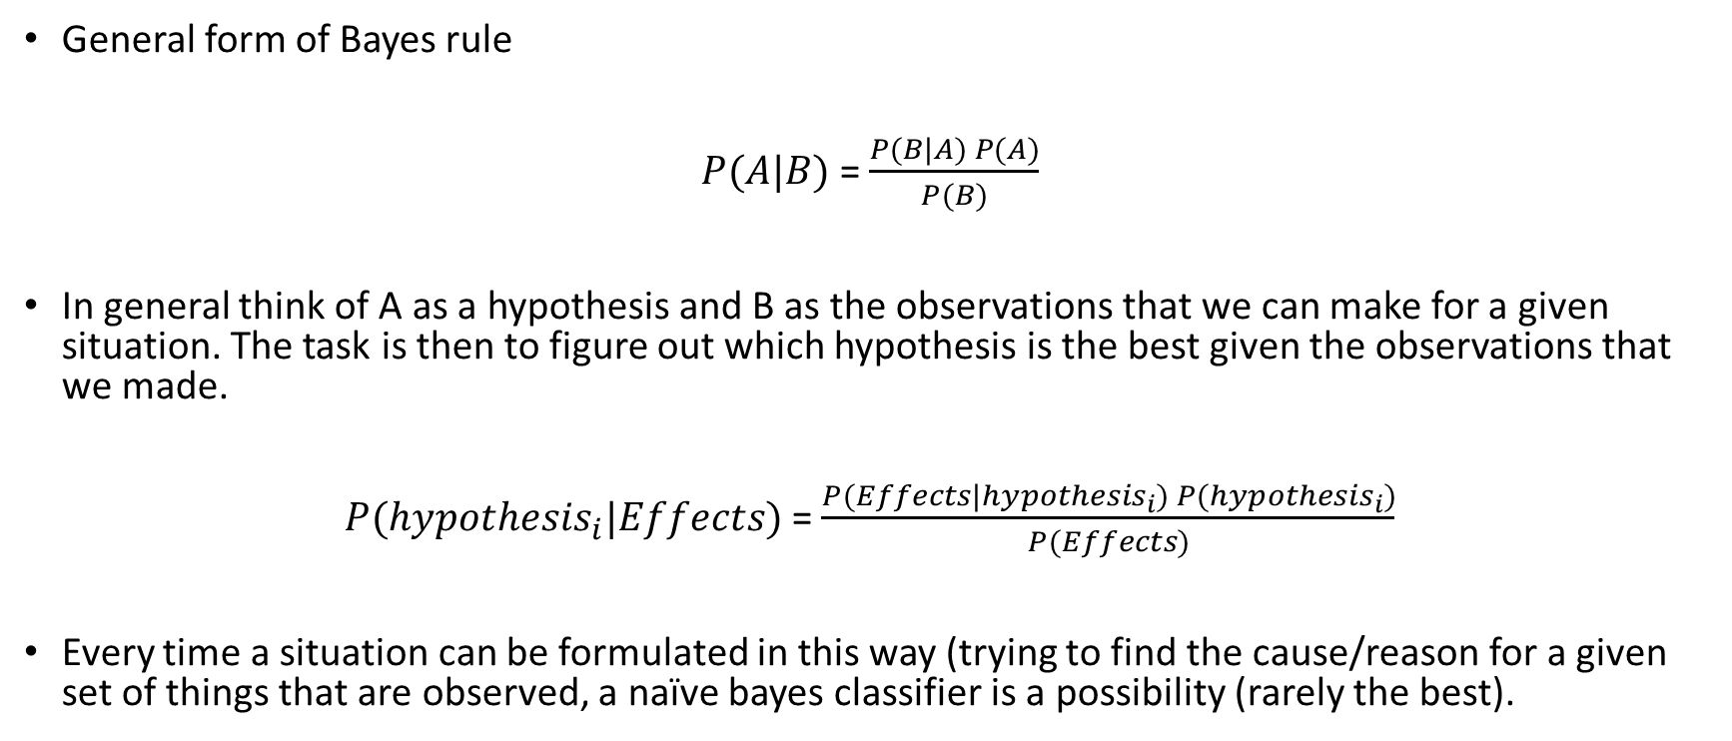
Bayes Rule and its applications
General form of Bayes rule
$P(A|B)$= $\frac{P(B|A) P(A)}{P(B)}$
In general think of A as a hypothesis and B as the observations that we can make for a given situation. The task is then to figure out which hypothesis is the best given the observations that we made.
$P({hypothesis}_{i}|Effects)$= $\frac{P(Effects|{hypothesis}_{i}) P({hypothesis}_{i})}{P(Effects)}$
Every time a situation can be formulated in this way (trying to find the cause/reason for a given set of things that are observed, a naïve bayes classifier is a possibility (rarely the best).

Slide 5
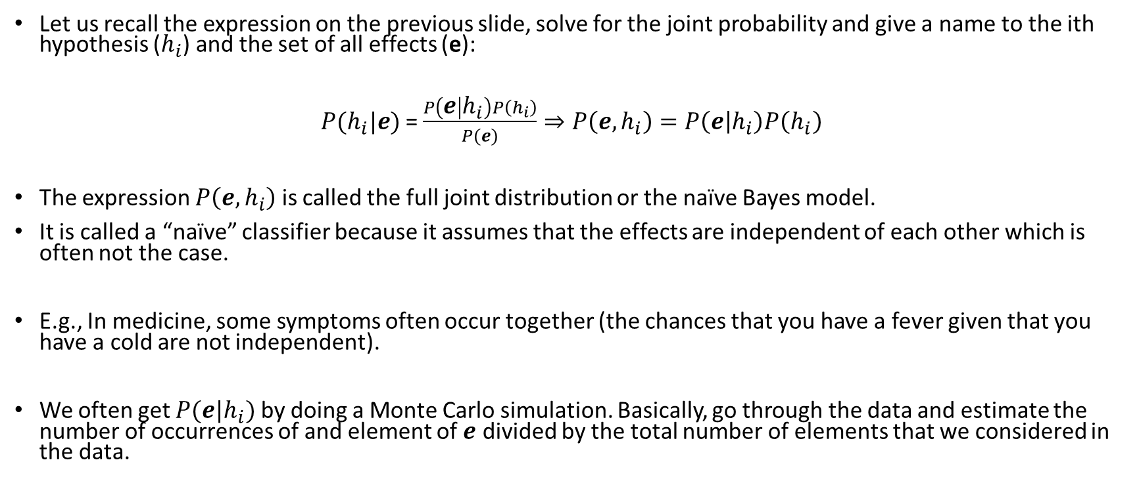
The naive Bayes classifier
Let us recall the expression on the previous slide, solve for the joint probability and give a name to the ith hypothesis ($h_{i}$) and the set of all effects (e):
$P(h_{i}|e)$= $\frac{P\left(e | h_{i}\right)P\left(h_{i}\right)}{P(e)}⇒P\left(e,h_{i}\right)=P\left(e | h_{i}\right)P\left(h_{i}\right)$
The expression $P\left(e,h_{i}\right)$ is called the full joint distribution or the naïve Bayes model.
It is called a “naïve” classifier because it assumes that the effects are independent of each other which is often not the case.
E.g., In medicine, some symptoms often occur together (the chances that you have a fever given that you have a cold are not independent).
We often get $P(e|h_{i})$ by doing a Monte Carlo simulation. Basically, go through the data and estimate the number of occurrences of and element of $e$ divided by the total number of elements that we considered in the data.

Slide 6
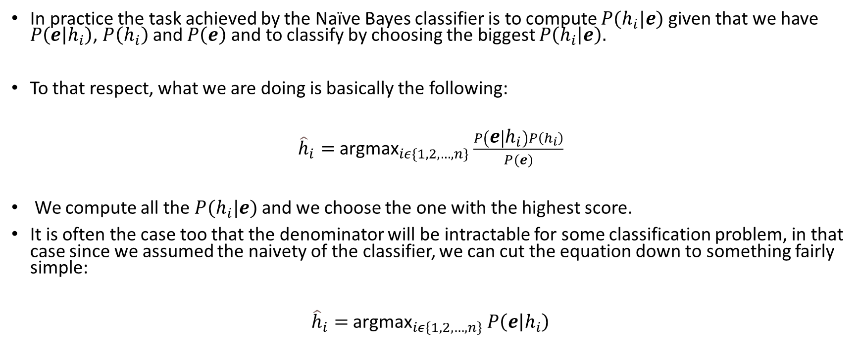
The naive Bayes classifier
In practice the task achieved by the Naïve Bayes classifier is to compute $P(h_{i}|e)$given that we have $P\left(e | h_{i}\right)$, $P\left(h_{i}\right)$ and $P\left(e\right)$ and to classify by choosing the biggest $P\left(h_{i} | e\right).$
To that respect, what we are doing is basically the following:
${\hat{h}}_{i}=$ ${\text{argmax}}_{iε\{1,2,…, n\}}$ $\frac{P\left(e | h_{i}\right)P\left(h_{i}\right)}{P(e)}$
We compute all the $P(h_{i}|e)$ and we choose the one with the highest score.
It is often the case too that the denominator will be intractable for some classification problem, in that case since we assumed the naivety of the classifier, we can cut the equation down to something fairly simple:
${\hat{h}}_{i}=$ ${\text{argmax}}_{iε\{1,2,…, n\}}$ $P\left(e | h_{i}\right)$

Slide 7
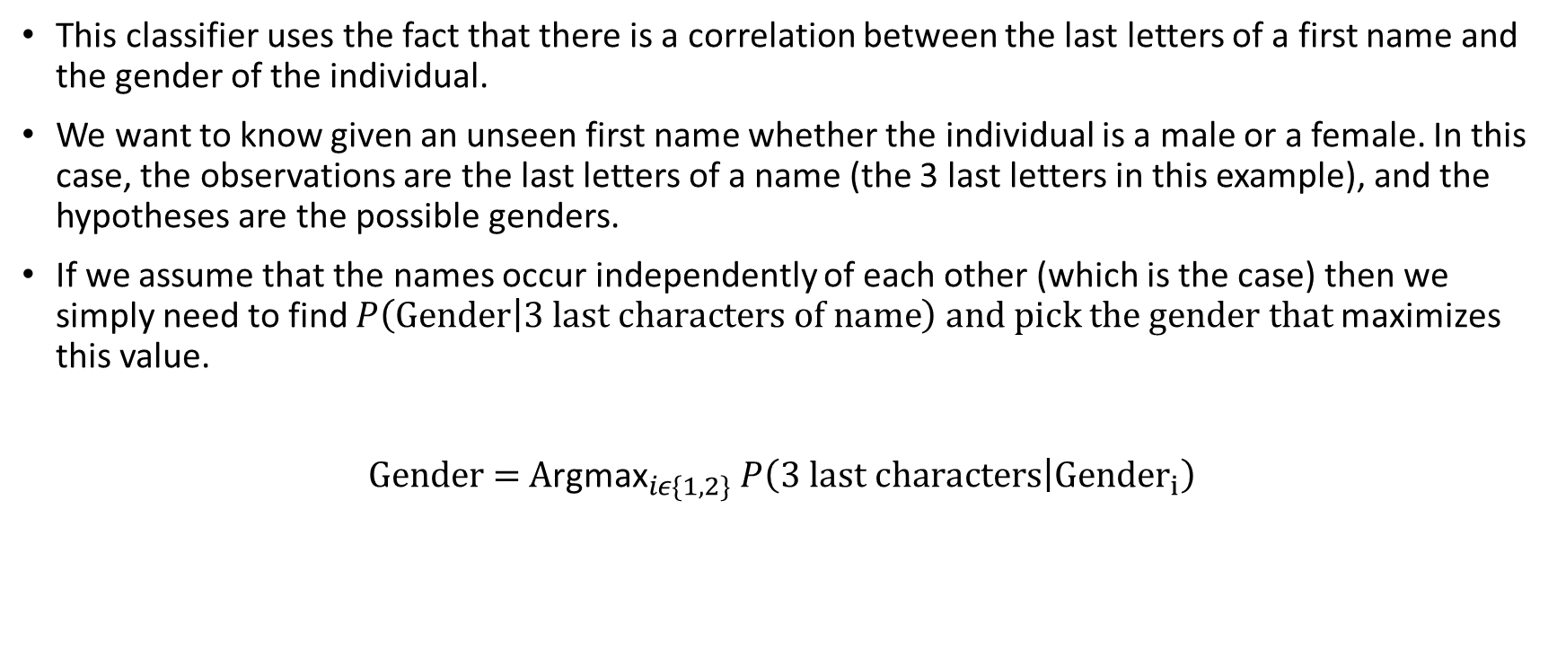
Gender classifier based on first names
This classifier uses the fact that there is a correlation between the last letters of a first name and the gender of the individual.
We want to know given an unseen first name whether the individual is a male or a female. In this case, the observations are the last letters of a name (the 3 last letters in this example), and the hypotheses are the possible genders.
If we assume that the names occur independently of each other (which is the case) then we simply need to find $P\left(Gender | 3 last characters of name\right) and pick the gender that$maximizes this value.
${\text{Gender}\text{ = }\text{A}\text{rgmax}}_{iε\{1,2\}}$ $P\left(3 last characters | {Gender}_{i}\right)$

Slide 8
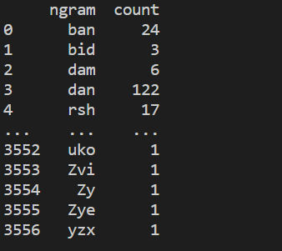
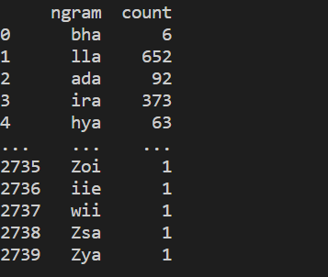

Gender classifier based on first names
We can find $P\left(3 last characters | {Gender}_{i}\right)$ by counting the number of times that 3 characters in a name occur given that the name is from specific gender (the dataset I used contained 96000 names for example). The more the better.
From a regular CSV file, we try to get two tables with the 3 last characters and the number of times they occur in a female versus male last name.

Slide 9
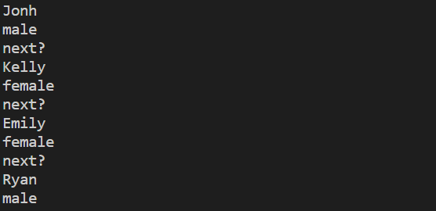

Gender classifier based on first names
From there things get very simple. For a given gender, the number of occurrences of a trigram divided by the number of occurrences of all the trigrams in the dataset will give you $P\left(3 last characters | {Gender}_{i}\right)$ for whichever gender you picked.
At this point, we just need to compare the $P\left(3 last characters | {Gender}_{1}\right)$ and $P\left(3 last characters | {Gender}_{2}\right)$ and pick whichever is maximal.
Below are examples of guesses made by the program:

Slide 10
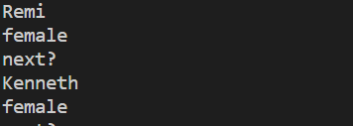
Gender classifier based on first names
Unfortunately, it is not perfect. Even though picking the dataset has a big impact on the result that one will get, it is obvious that the classifier will break down when confronted with a name that does not follow the general rule of the count.
Below are a couple of examples of my classifier breaking down:
A French dataset might have done a better job at realizing that Remi is a male first name.
Kenneth is the perfect example to show that sometimes guessing based on the number of occurrences is not the way to go (because female names like Elizabeth are very common, the program guessed female instead of male)

Slide 11
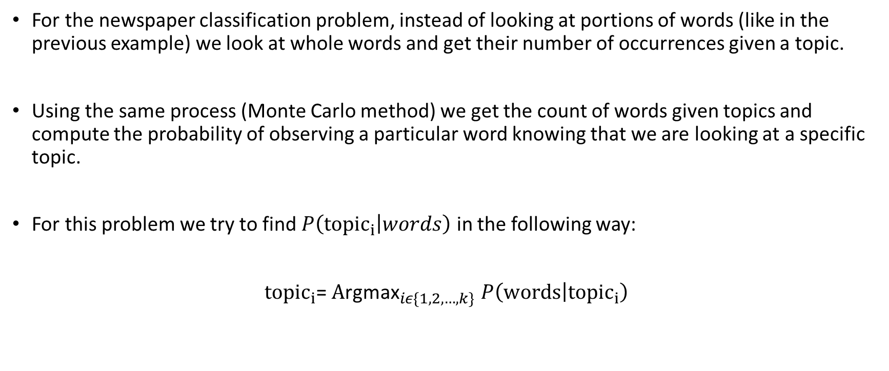
Newspaper classification
For the newspaper classification problem, instead of looking at portions of words (like in the previous example) we look at whole words and get their number of occurrences given a topic.
Using the same process (Monte Carlo method) we get the count of words given topics and compute the probability of observing a particular word knowing that we are looking at a specific topic.
For this problem we try to find $P\left({topic}_{i} | words\right)$ in the following way:
${topic}_{i}$= ${\text{A}\text{rgmax}}_{iε\{1,2,…,k\}}$ $P\left(words | {topic}_{i}\right)$

Slide 12
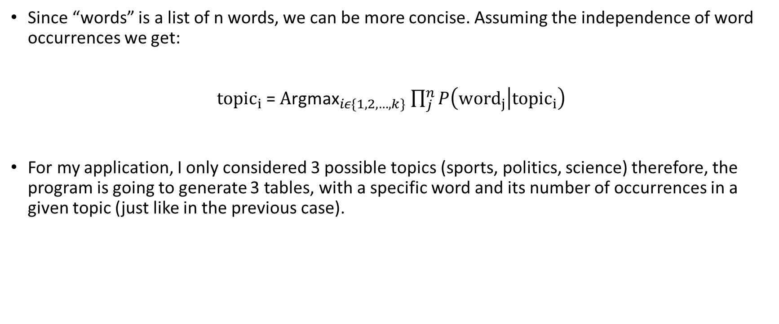
Newspaper classification
Since “words” is a list of n words, we can be more concise. Assuming the independence of word occurrences we get:
${topic}_{i}$= ${\text{A}\text{rgmax}}_{iε\{1,2,…,k\}}$ $\prod_{j}^{n}{P\left({word}_{j} | {topic}_{i}\right)}$
For my application, I only considered 3 possible topics (sports, politics, science) therefore, the program is going to generate 3 tables, with a specific word and its number of occurrences in a given topic (just like in the previous case).

Slide 13
Newspaper classification
Example: For the sentence “The election went well.”
We compute the following and then pick the max
score_politics = P(election|politics)*P(went|politics)*P(well|politics)
score_science = P(election|science)*P(went|science)*P(well|science)
score_sport = P(election|sport)*P(went|sport)*P(well|sport)
We find P(word|topic) by doing a table lookup. Compare all three values and make a guess on the topic of the newspaper article.

Slide 14
Chatbot (if there is time left)
We can use naive Bayes to rank different columns of a database and then query the one with the highest score.
This problem is very similar to the newspaper classification problem i.e, you are being given a list of words and you must fit the sentence(s) into one category.
The difference is in the way that we are getting P(words|topic) or in this example P(words|column of database).
It will be extremely hard here to count the number of times that one word is used to refer to a specific column. We would need to have a database that accounts for that which we do not.
An alternative would be to use the vector representations of a word and to normalize the similarity between two vectors to get an idea of how a set of words is more related to one column versus another.

Slide 15
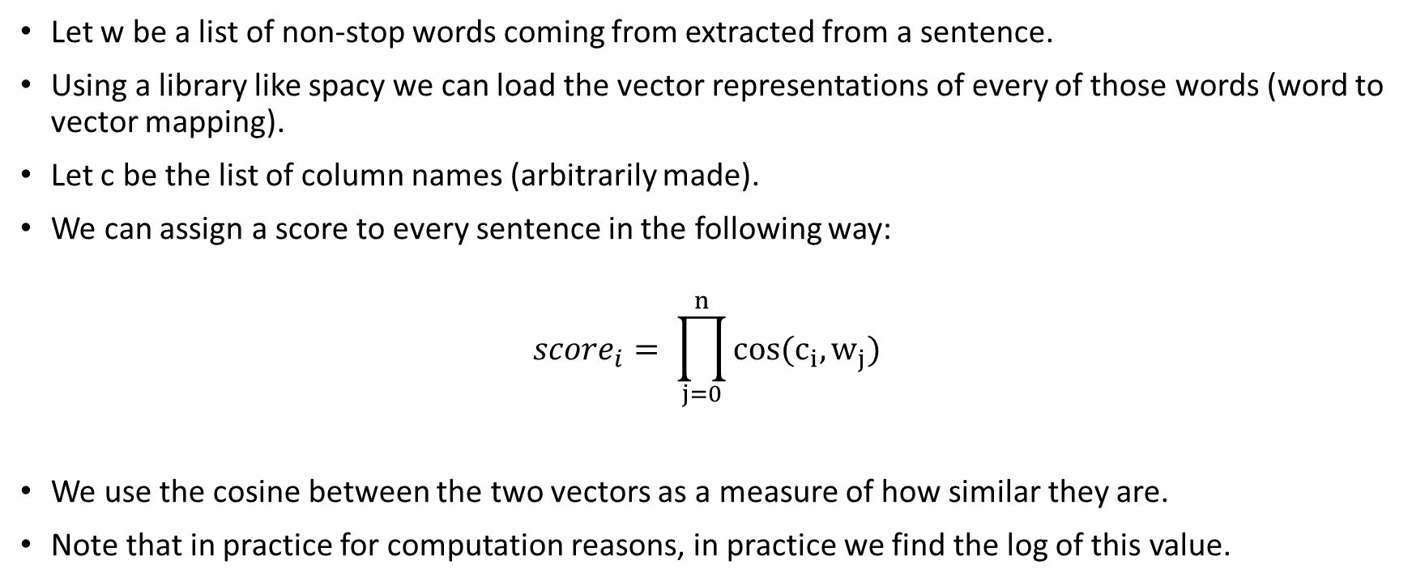
Chatbot
Let w be a list of non-stop words coming from extracted from a sentence.
Using a library like spacy we can load the vector representations of every of those words (word to vector mapping).
Let c be the list of column names (arbitrarily made).
We can assign a score to every sentence in the following way:
$${score}_{i}= \prod_{j=0}^{n}{cos(c_{i},w_{j})}$$
We use the cosine between the two vectors as a measure of how similar they are.
Note that in practice for computation reasons, in practice we find the log of this value.

Slide 16
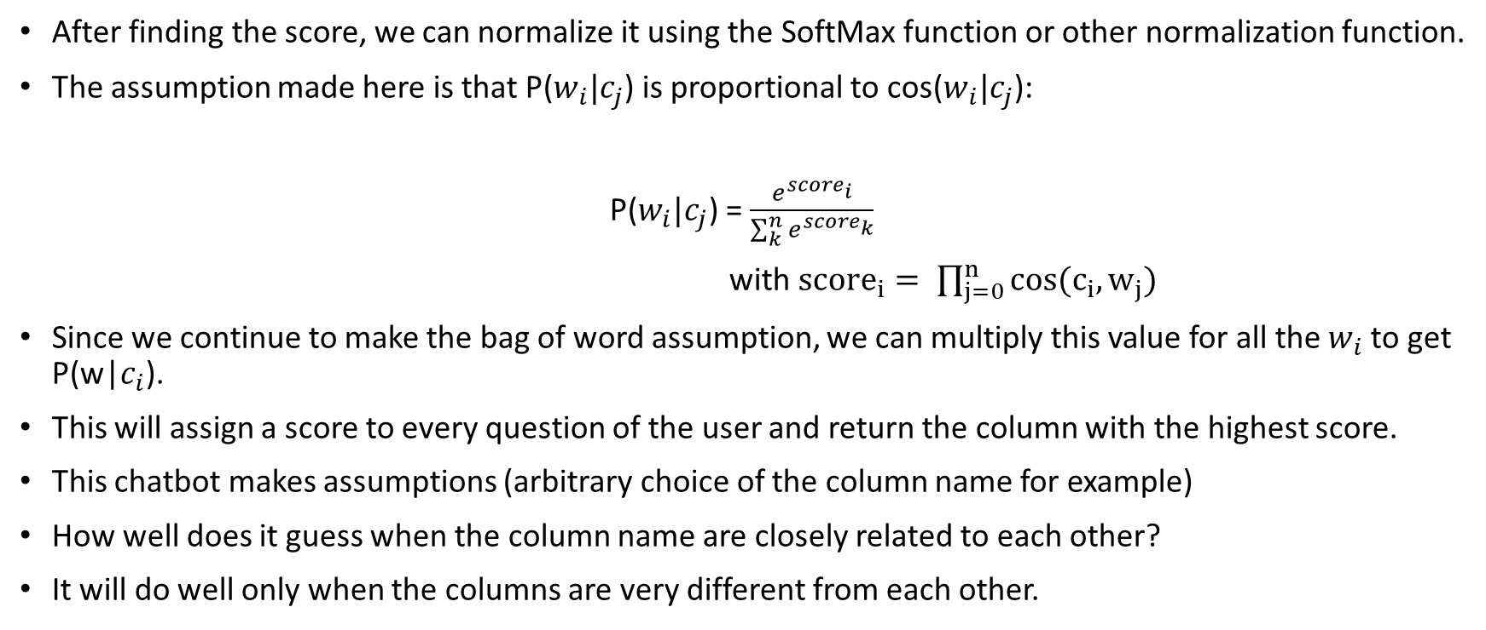
Chatbot
After finding the score, we can normalize it using the SoftMax function or other normalization function.
The assumption made here is that P($w_{i}|c_{j}$) is proportional to cos($w_{i}|c_{j}$):
P($w_{i}|c_{j}$) = $\frac{e^{{score}_{i}}}{\sum_{k}^{n}{e^{{score}_{k}}}}$
with ${score}_{i}= \prod_{j=0}^{n}{cos(c_{i},w_{j})}$
Since we continue to make the bag of word assumption, we can multiply this value for all the $w_{i}$ to get P(w|$c_{i}$).
This will assign a score to every question of the user and return the column with the highest score.
This chatbot makes assumptions (arbitrary choice of the column name for example)
How well does it guess when the column name are closely related to each other?
It will do well only when the columns are very different from each other.

Slide 17
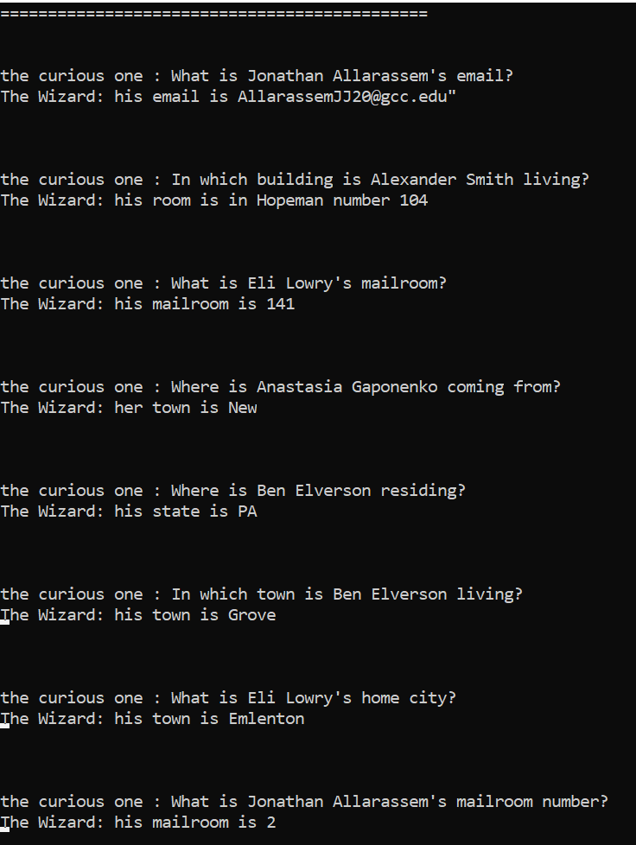

Slide 18
Chatbot
Although the Naives bayes classifier is the core of this chatbot, I added other things on top to make it respond properly to questions.

