Slide 1
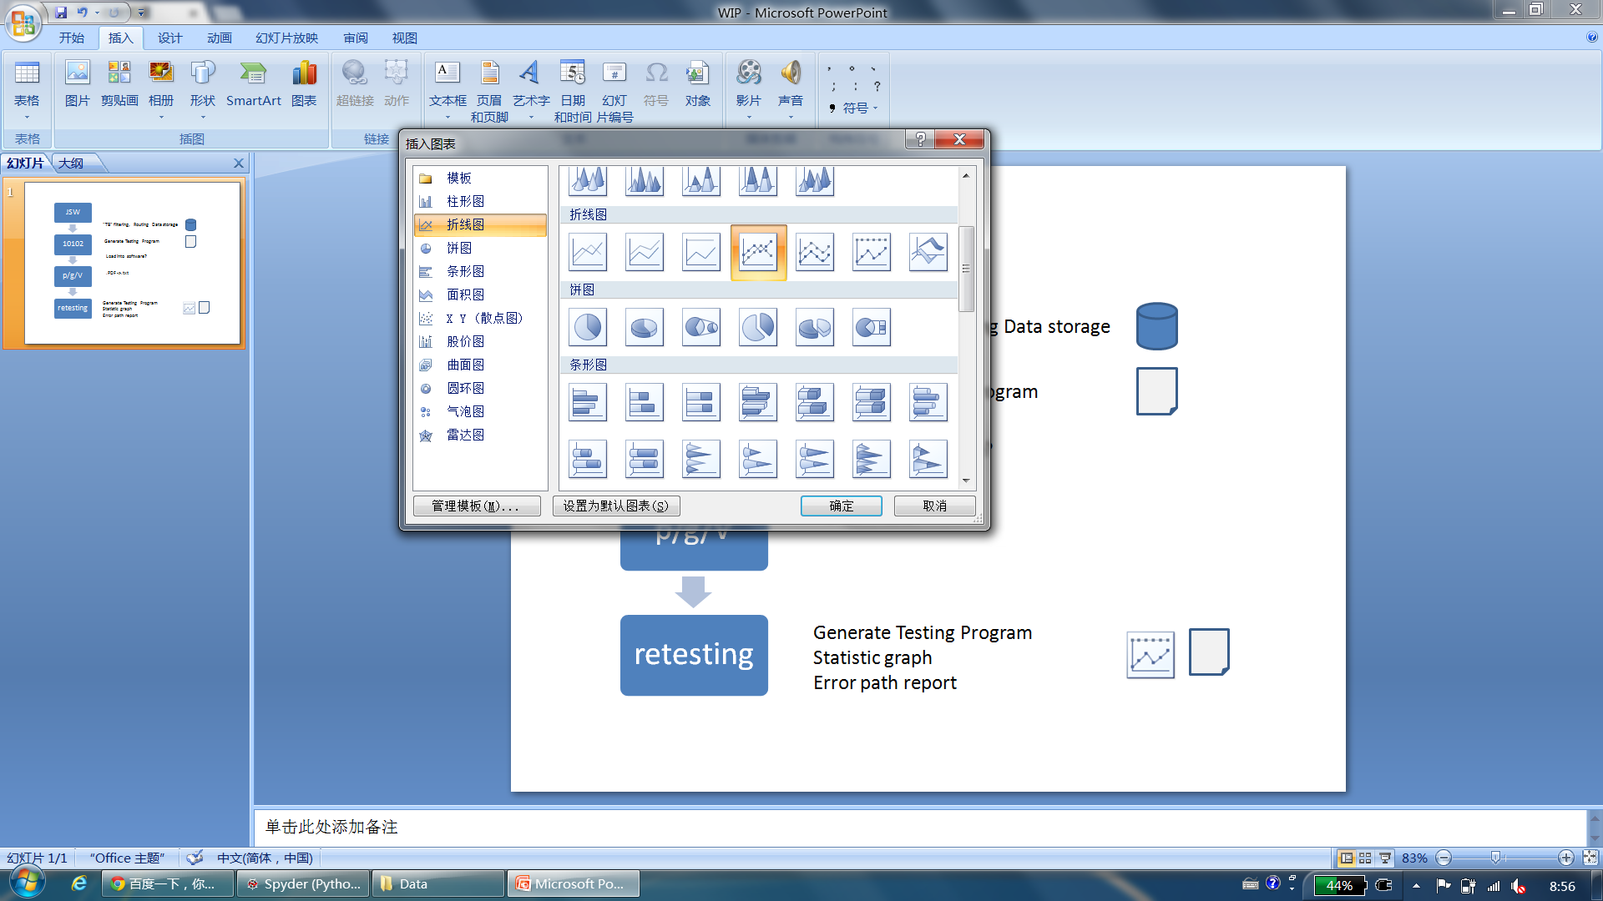
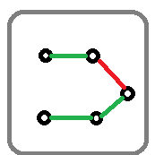
WIT workflow
JSW
10102
p/g/V
retesting
analysis
Received from process designer
“TB” filtering,
Routing Data storage
Generate Testing Program
Load into software manually?
.PDF ->.txt manually?
Submit to Splunk
Generate Testing Program
Statistic graph
Error path report
Load into equipment
Check list, and then Run program

Slide 2
System structure
Engineer
Operator
Splunk
Dashboard
JSW
Check list
Troubleshot
Text Analyzer
Graph
Analyzer
Result report
Testing
program
Instrument
Routing
pool
INPUT
OUTPUT

Slide 3
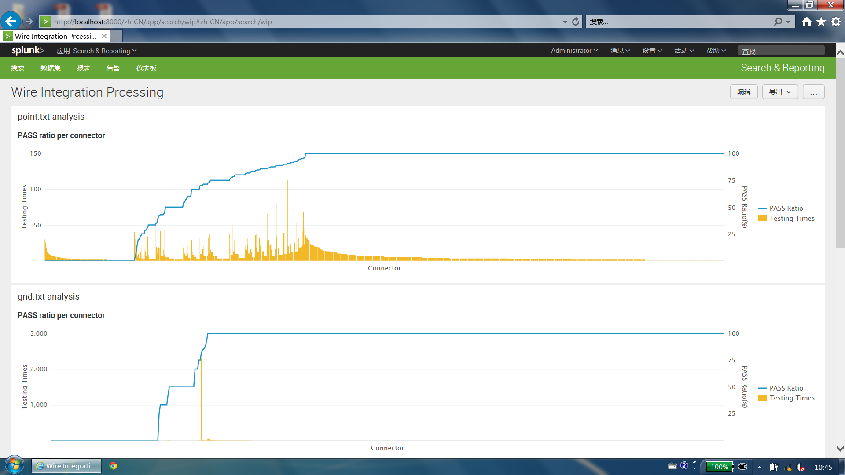
Progress

Slide 4
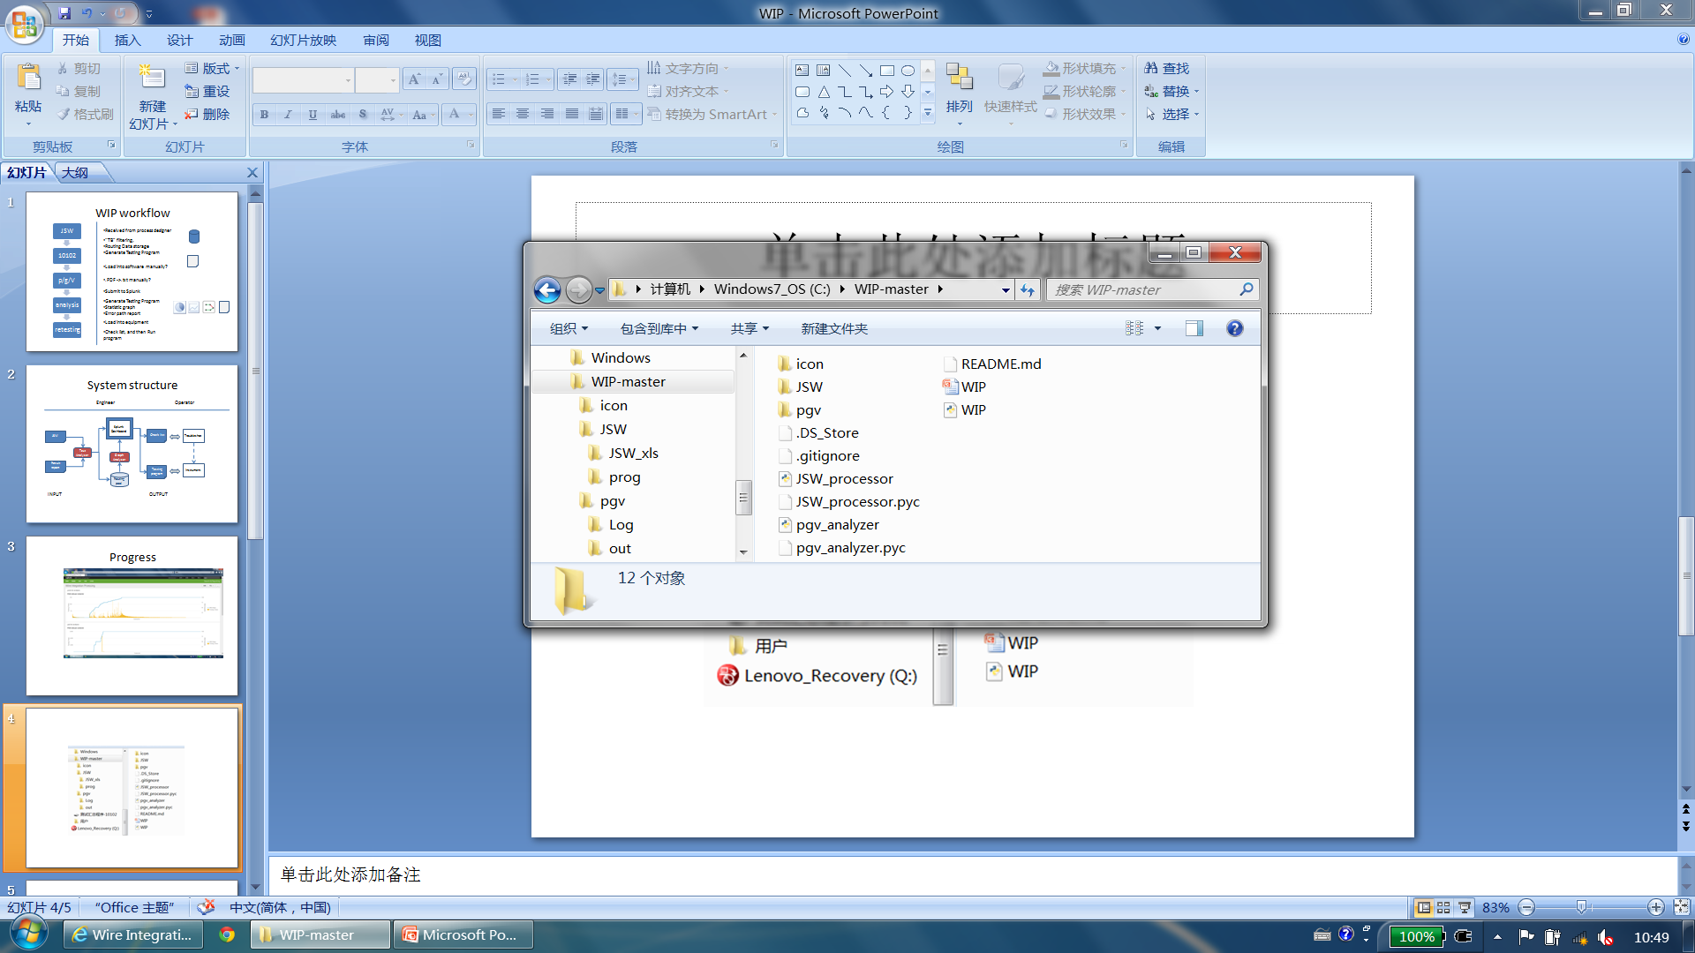
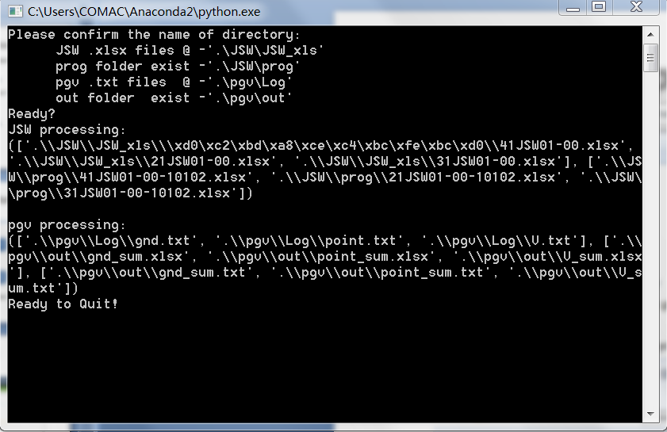
Progress

Slide 5
Road map
Nov.
Dec.
Jan.-Feb.
Mar.
Apr.
System design
Artifact buildup for primary testing
Working flow
Splunk based Dashboard
Data storage scheme
Stat. result from PGV .txt file
Connection analysis based on spark GraphX/Neo4j
Full Cycle testing
Documentation
Program from JSW .xlsx file
Dynamic PGV stat. Dashboard
Fail Positioning Dashboard
GUI for
Process & WF
Training
Program from PGV .txt file
Full JSW&PGV testing
Fail reasoning testing
Qualification
Stakeholder identification, and Input collections
Release Ver 0.1
Release Ver 0.2
Release Ver 1.0
Concept
MVP1
MVP2
on-site testing
Delivery

Slide 6
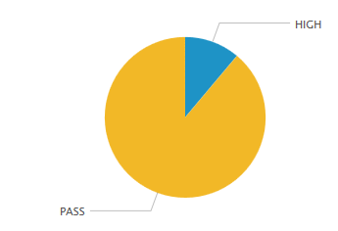
Status summary of pin testing
JSW → Total
PGV → HIGH
PASS = Total - HIGH

Slide 7
Top N connector
Step1. Calculate the gap of HIGH number between desired and realized
Step2. Sort connectors based on HIGH number per unit
C4
C5
Step3. Select top 5 and show it on pie chart
C3
C2
Step4. List connectors
C1
Connector | Impact(%)
C1 | 10
… | …
HIGH

Slide 8
Graph data structure for WIT
Node | example
Label | Pin
connector name | 1M-21R-P2
pin index | K
full name | 1M-21R-P2-K
Dashboard
Created by JSW info.
…
Relationship | example
Lable | C
status | PASS/NULL/HIGH
chapter | 21-00-00
times | n
New Program
Updated by testing result Info.
Operation Check List
Relationship | example
Label | F
status | PASS/NULL/HIGH
chapter | 21-00-00
times | n
sequence | k

Slide 9
info=[connector1,pin1,connector2,pin2,testingtype,\
charpter,sequence,status,value,unit,addr1,addr2,times]

Slide 10
pin
continuity
pin
pin
insulation
pin
Connector,

