Slide 1
AN ANDROID APP ON SMART NOTES
BY SUSHMITHA REDDY ALLA
W9546108
Module Leader: Julien Cordry

Slide 2
Introduction And Target Users
Simple notes is an application basically developed to ensure your mandatory data secure confidentially. This is an application where in you can save all your creative thoughts and ideas. Also, you can store any of your project details which are critical and you can access them at a fingertap.
This Notes can be stored privately but cannot share with anyone. Any data which is provided in the Simple Notes application will be stored in firebase and cannot be viewed by anyone unless we provide user credentials. It is a very simple app but looks very clean. User can login to this application by providing login credentials.

Slide 3
Social, Legal And Ethical Issues
This App should adhere to all the rules that are required to guard user personal data. Any information provided here will not be shared to anyone and none of your personal data is collected from the user.
Data which is collected from the user is very secure and stored privately in the firebase database. Any data like email address, passwords or mobile numbers are only recorded by the app and this info will not be shared.

Slide 4
Professional Tools Used for Development
Android Studio
Firebase
Mobile Phone

Slide 5
App Work Flow:
Login Screen:
New User! Signup to Login
Forgot Password
Main Activity
Add Notes
Edit/Delete
Logout

Slide 6
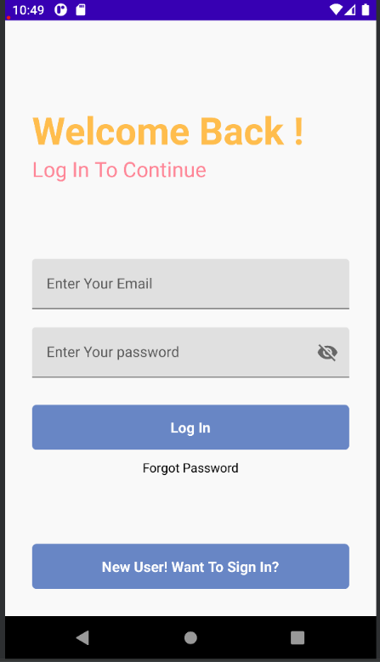
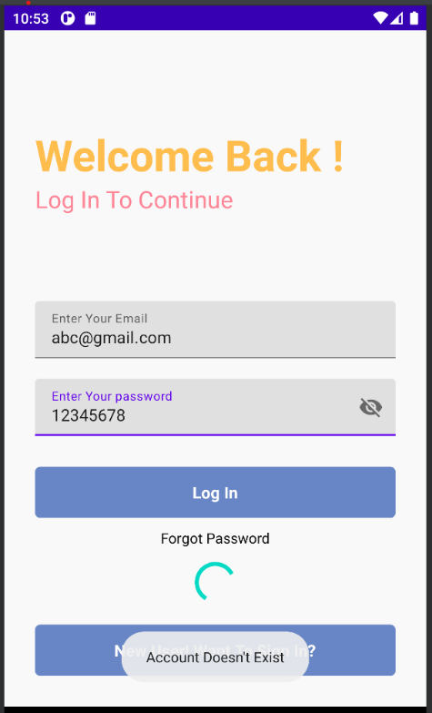
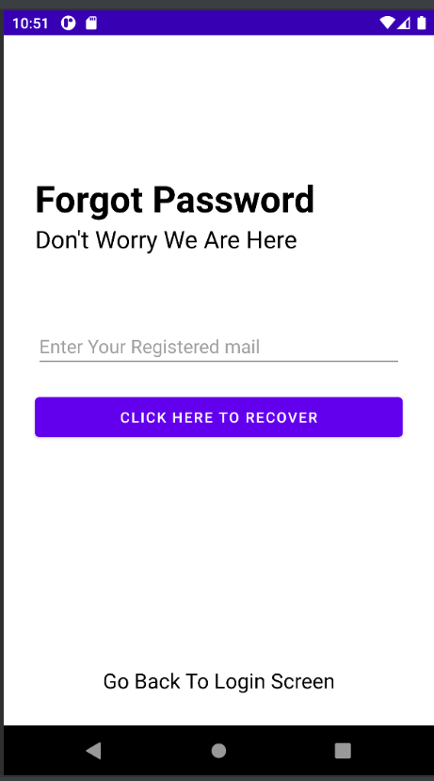
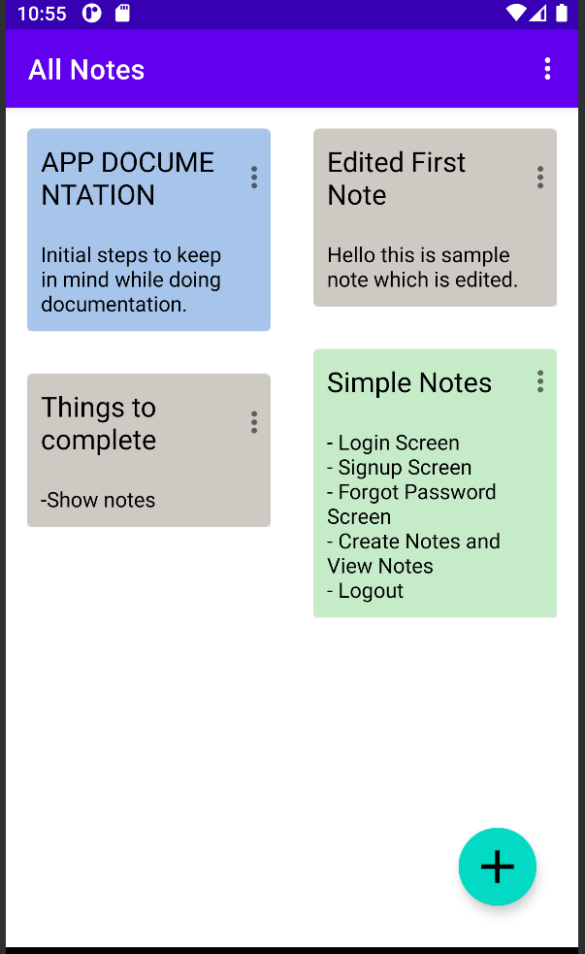
Mobile App Screenshots

Slide 7
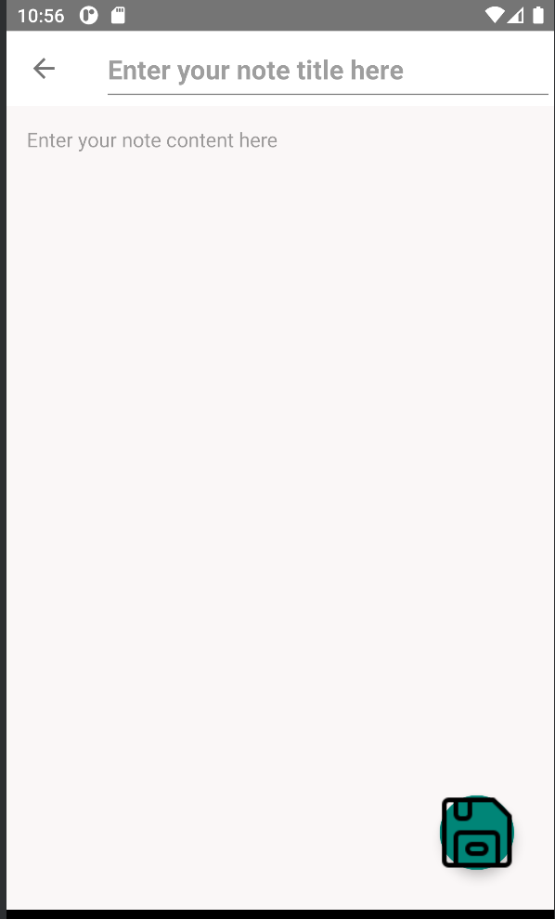
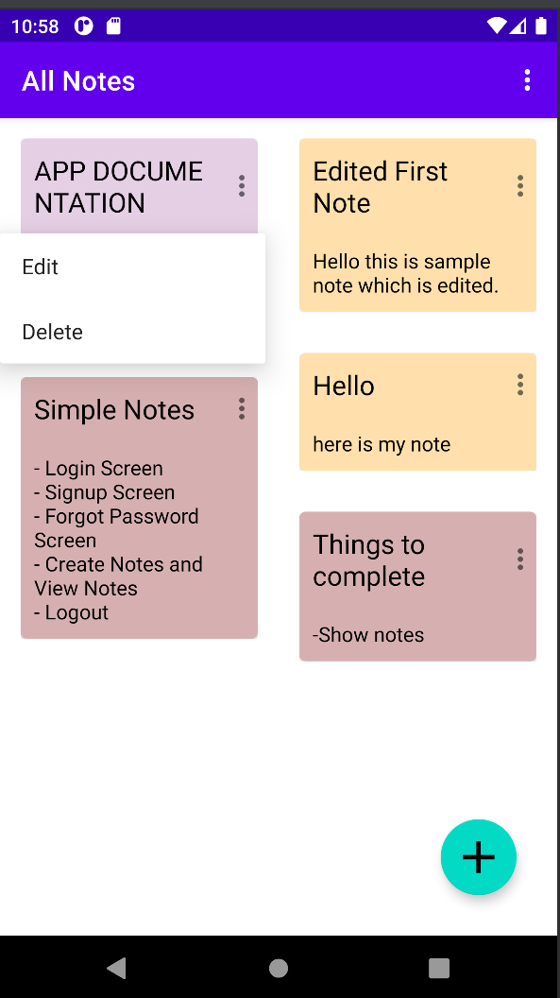
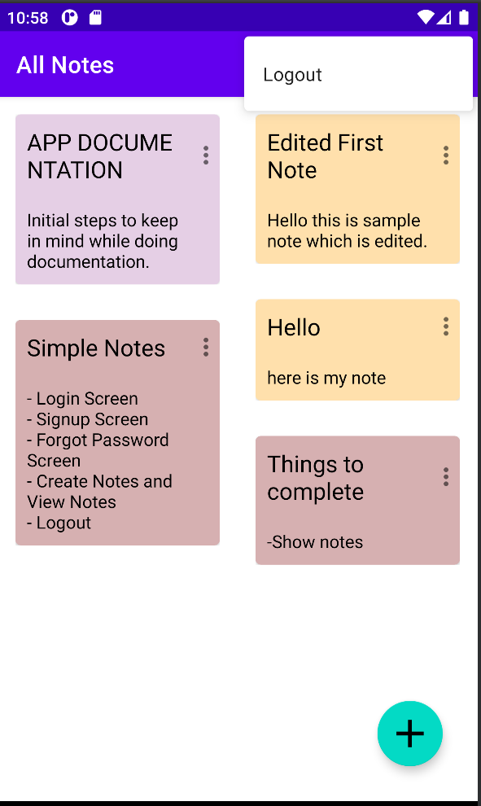

Slide 8
Thank you!!

