Slide 1
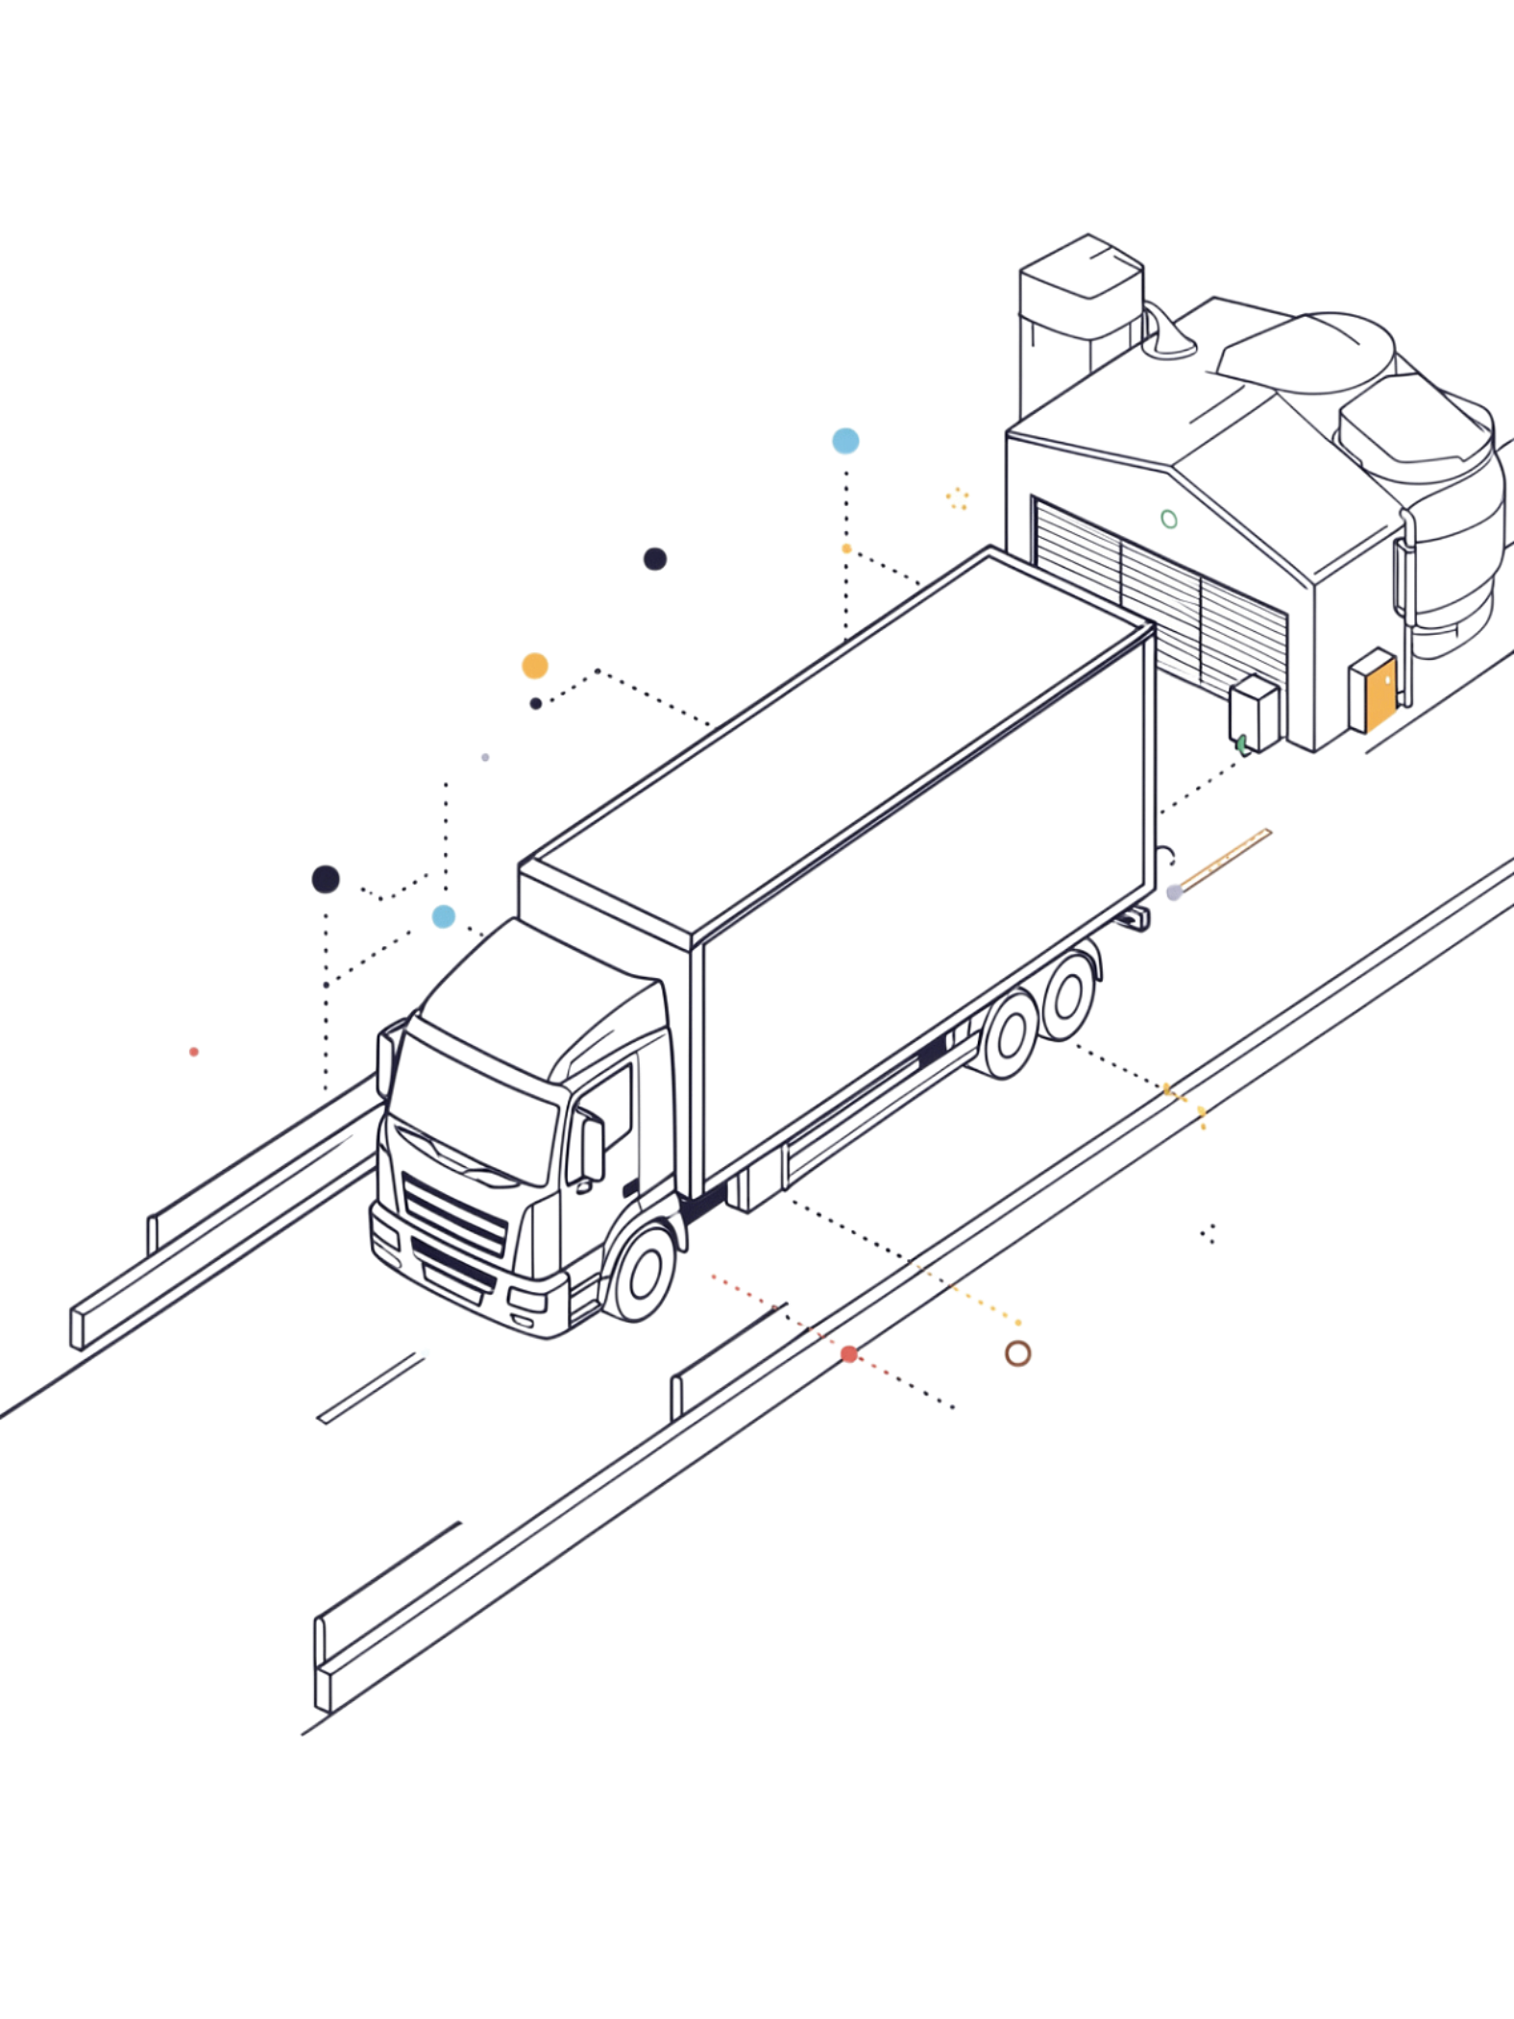
IoT-Based Cold Storage and Food Transportation Temperature Monitoring System with Real-Time Alerts
An IoT-based system for continuously monitoring environmental conditions during cold storage and food transportation — maintaining correct temperature conditions to preserve food quality, prevent spoilage, and deliver real-time alerts when abnormal conditions arise.
AMATAPU VENKATA NAGA ROHITH
323129520026

Slide 2
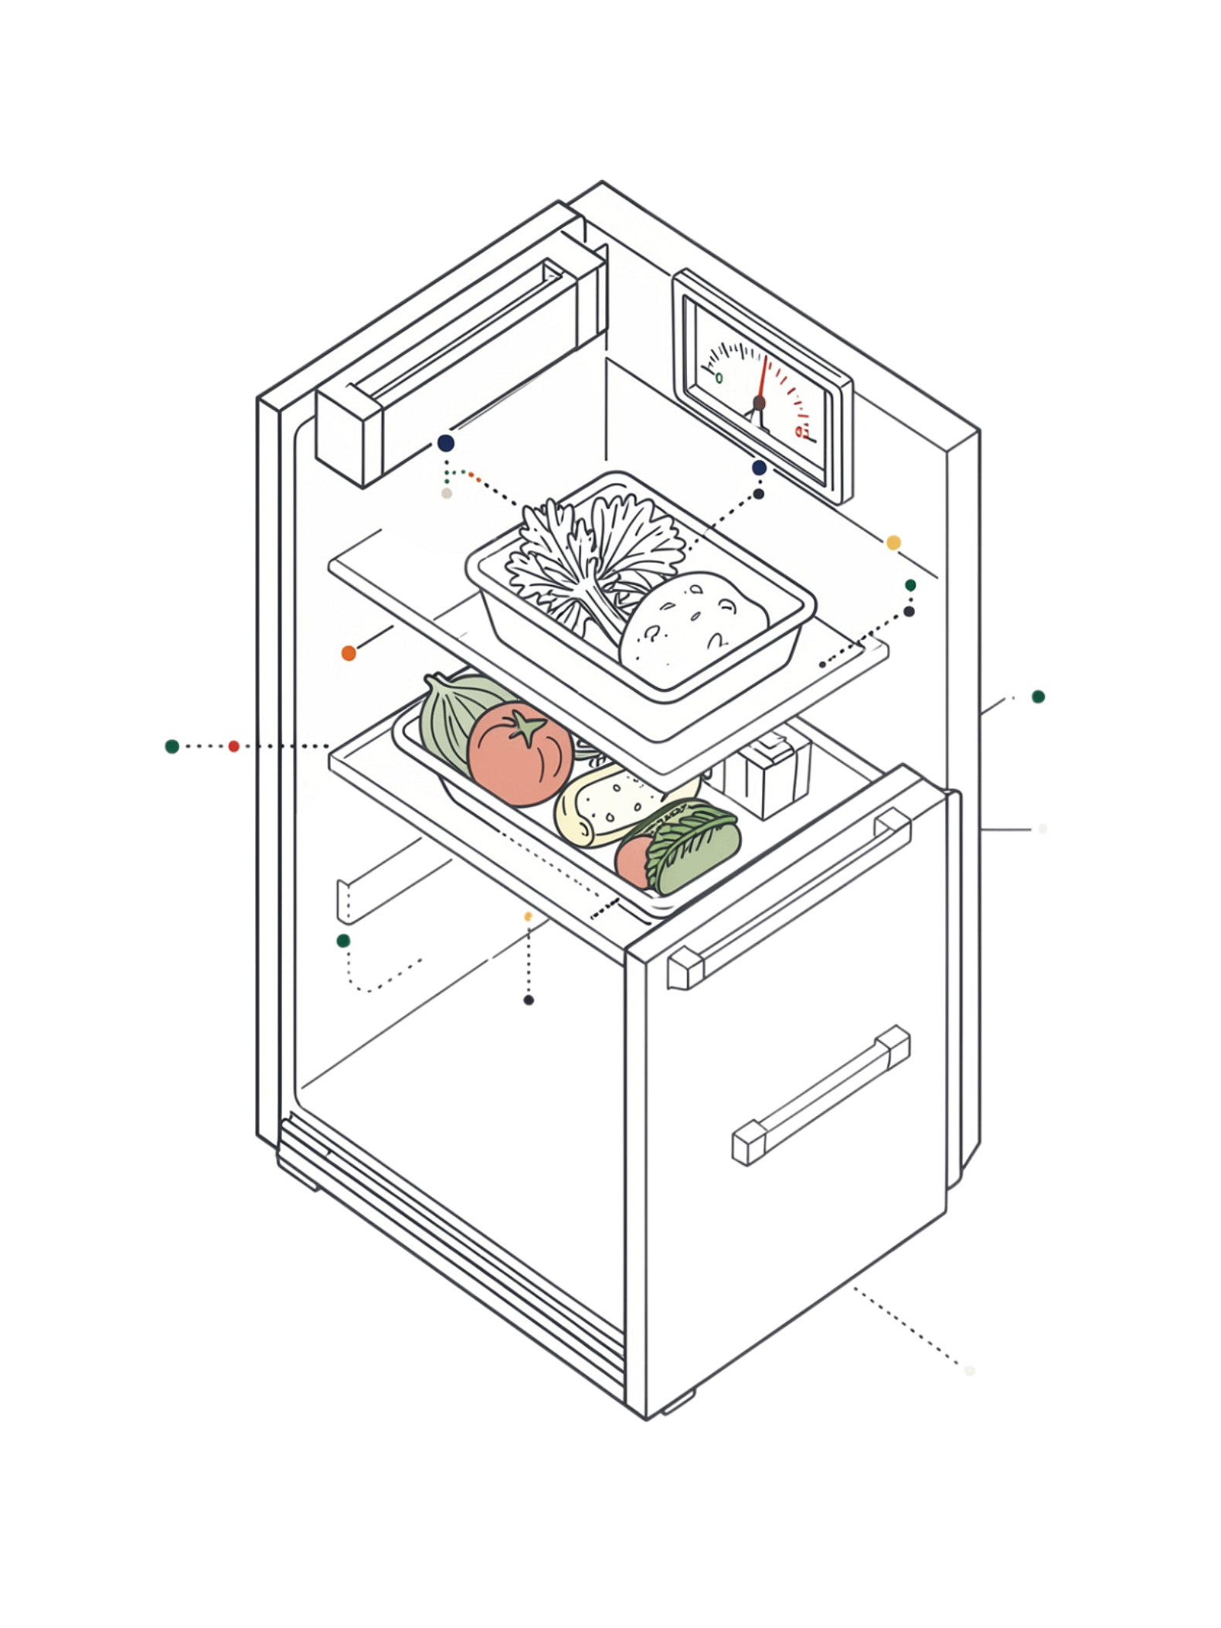
Problem Statement
Critical Temperature Requirements
Maintaining the correct temperature during cold storage and food transportation is critical for preserving food quality and preventing spoilage.
Limitations of Traditional Methods
Traditional monitoring depends on manual inspections and periodic measurements, making it difficult to detect temperature fluctuations immediately.
Need for Intelligent Systems
Food storage facilities and logistics providers require intelligent systems that continuously monitor environmental conditions and provide immediate alerts when abnormal temperatures occur.

Slide 3
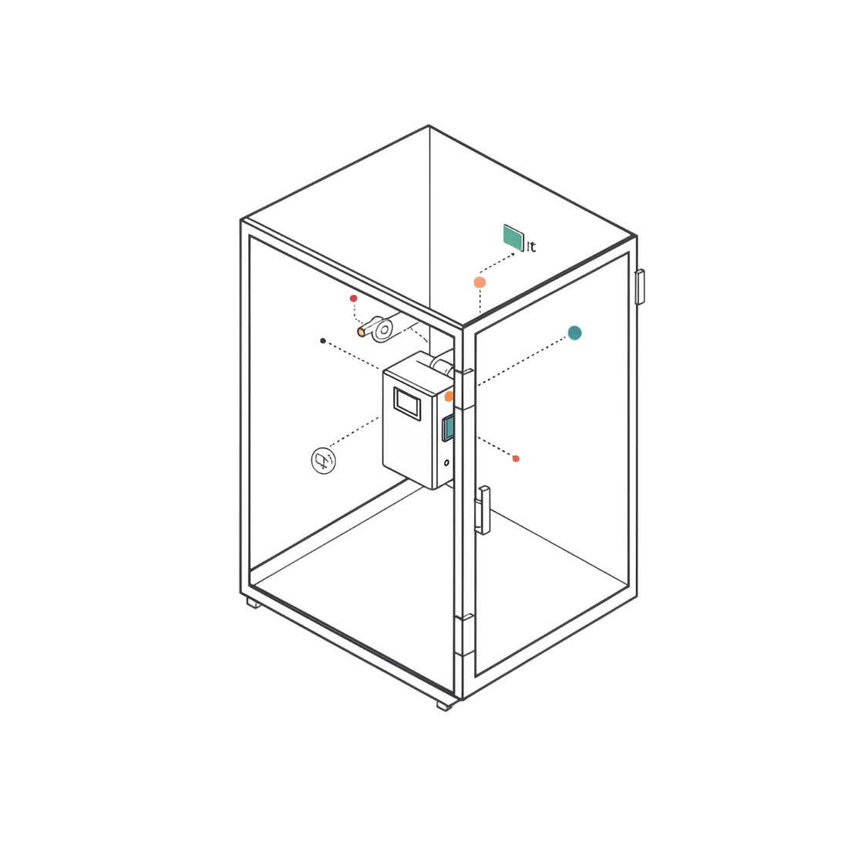
Proposed Solution
IoT-Based Temperature Monitoring System
The proposed system deploys IoT sensors to continuously monitor temperature conditions throughout cold storage and food transportation environments.
Environmental data is collected and monitored through a centralized, secure, and user-friendly platform.
Real-time alerts are triggered automatically when temperature conditions exceed predefined safe limits.
Continuous monitoring enables responsible personnel to take timely corrective action before spoilage occurs.

Slide 4
Objectives
Continuous Monitoring
Automated Alerts
Continuously monitor temperature and environmental conditions during cold storage and transportation in real time.
Detect abnormal temperature fluctuations and provide automated alerts when readings exceed predefined safe limits.
Historical Records
Food Safety
Maintain historical environmental records to support analysis, compliance, and effective cold chain management.
Improve food safety, minimize product spoilage, and improve monitoring efficiency compared with manual inspections.

Slide 5
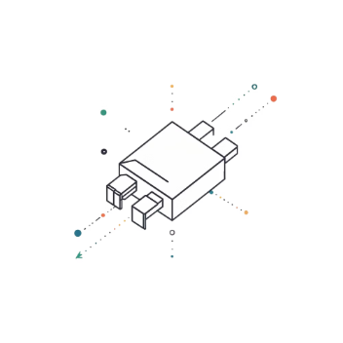
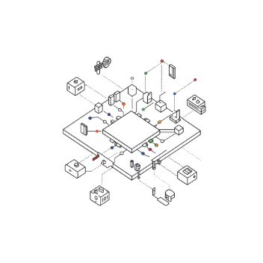
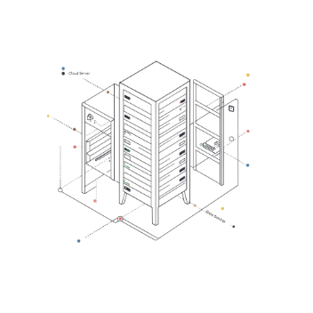
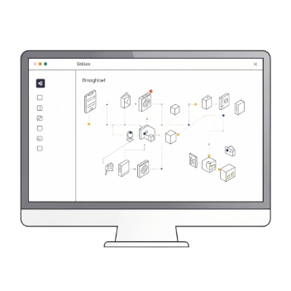
IoT Sensors and System Components
The system integrates the following major components to collect, transmit, monitor, and analyze environmental conditions:
Sensors
IoT Communication
Centralized Platform
Interactive Dashboard
Temperature sensors for continuous measurement and humidity sensors for environmental monitoring.
IoT communication modules transmit sensor data and cloud connectivity enables centralized access.
A centralized monitoring platform with a real-time monitoring system and automated notification mechanism.
An interactive dashboard provides live readings, trends, alerts, and equipment status at a glance.

Slide 6

System Working Process
Sensors Installed
Continuous Measurement
Readings Collected
Cloud Transmission
The end-to-end workflow ensures that every temperature reading is captured, evaluated against safe limits, and acted upon — with all data retained for historical analysis and compliance.

Slide 7
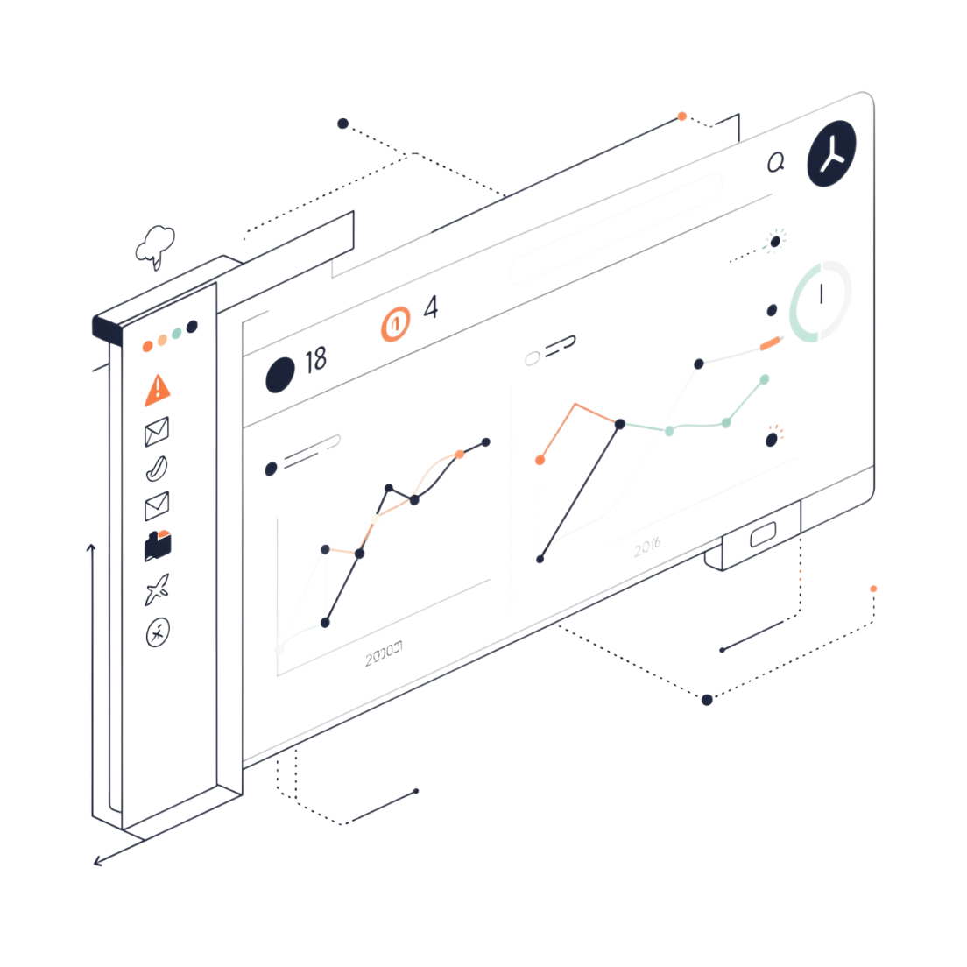

Real-Time Monitoring Dashboard
What the Dashboard Provides
Live temperature readings and environmental condition information
Historical temperature trends for pattern analysis
Alert history and real-time abnormal-condition notifications
Equipment status and recorded environmental data
The interactive dashboard enables responsible personnel to monitor conditions continuously, identify problems quickly, and take corrective actions without delay.

Slide 8
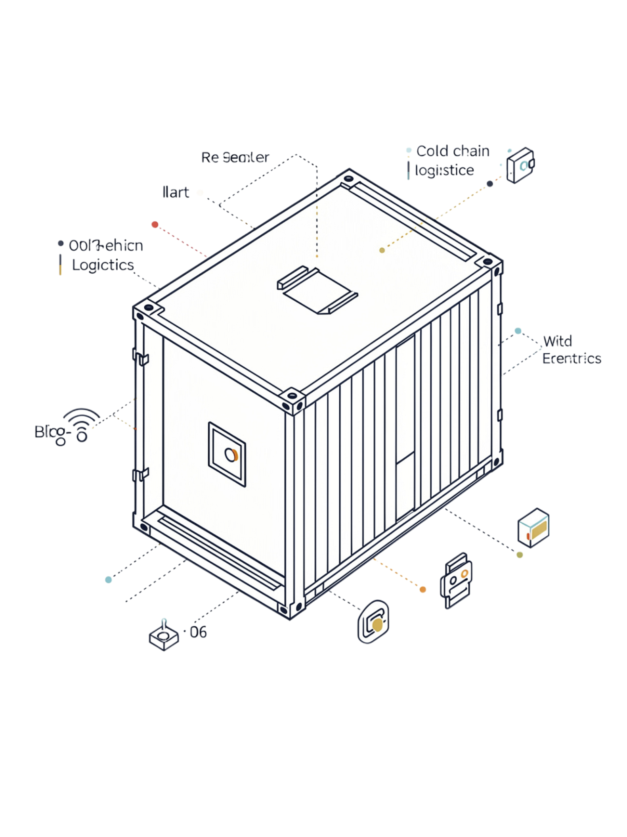
Alerts, Safety, and Benefits
Real-Time Alert Mechanism
Major Benefits
01
Improves food safety and reduces product spoilage
Provides continuous environmental monitoring
Reduces dependence on manual inspections
Enables faster response to abnormal conditions
Maintains historical environmental records
Enhances cold chain management
Supports regulatory compliance
Define safe temperature limits for monitored environments.
02
Continuously compare sensor readings with predefined limits.
03
Detect conditions outside the safe range automatically.
04
Notify responsible personnel and enable timely corrective action.

Slide 9
Applications and Scope
Where the System Applies
System Scope
The system can be deployed throughout storage and transportation to continuously monitor environmental conditions and support reliable cold chain management.
The platform is designed to be:
Cold Storage Facilities
Food Processing Industries
Continuous monitoring across large-scale cold storage environments.
Monitoring during processing and packaging stages.
Supermarkets
Pharmaceutical Storage
Retail cold chain monitoring for perishable goods.
Temperature-sensitive pharmaceutical and medical product storage.
Refrigerated Transport
In-transit monitoring for refrigerated transportation services.
🔒 Secure
📈 Scalable
🔄 Continuous
Protected data transmission and access control.
Suitable for organizations of any size requiring controlled environmental conditions.
Always-on monitoring without gaps or manual intervention.

Slide 10
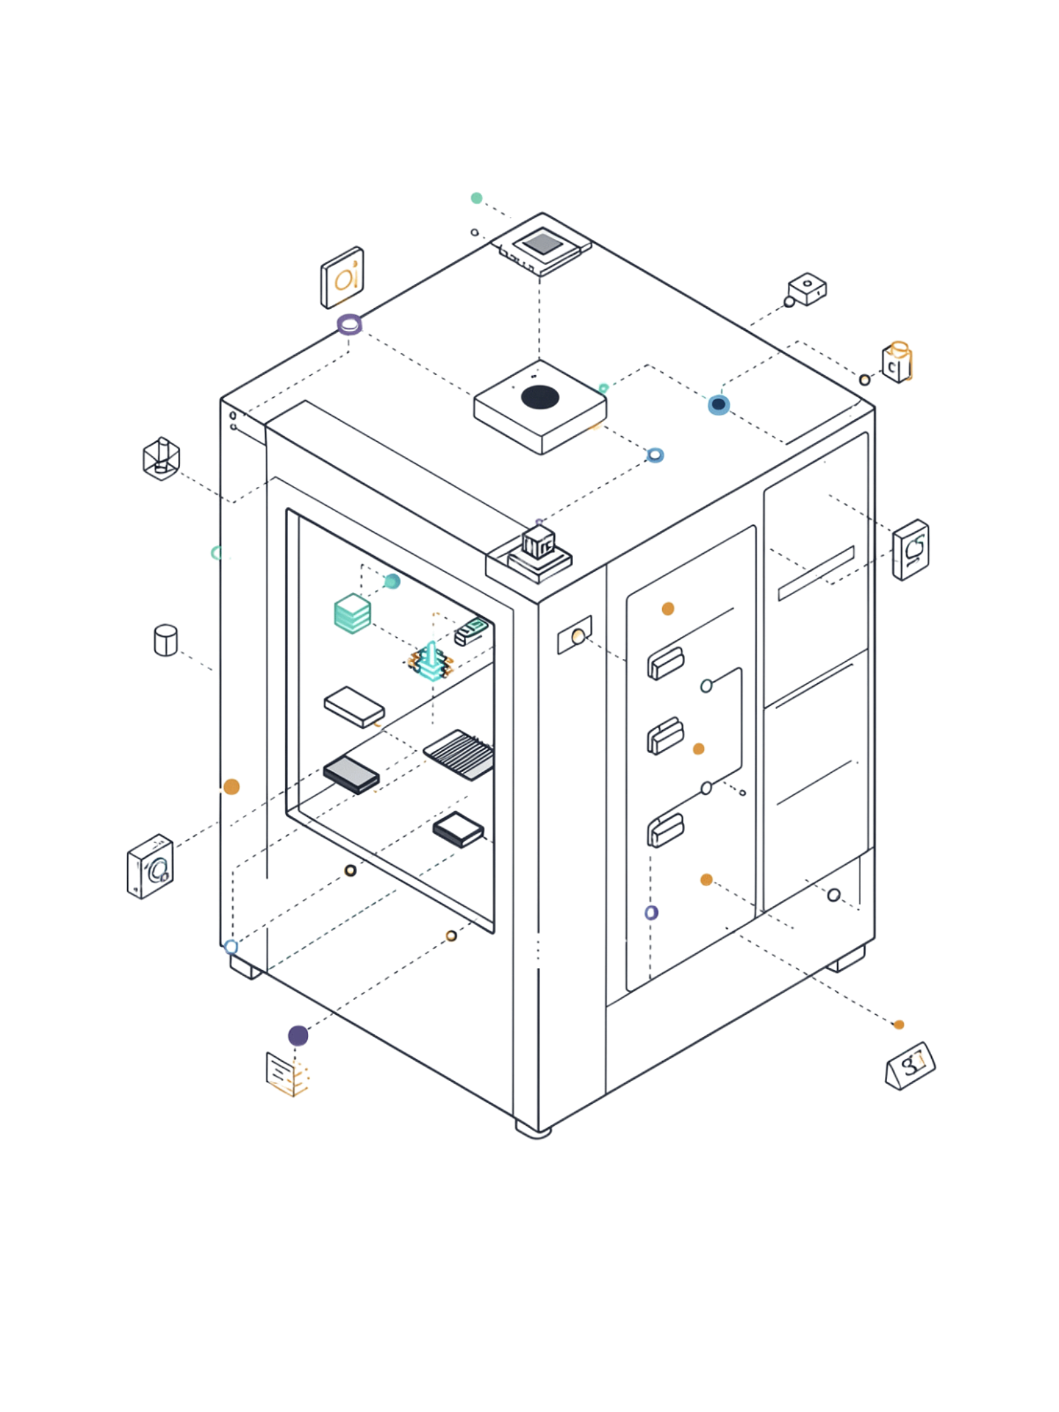
Conclusion
The IoT-Based Cold Storage and Food Transportation Temperature Monitoring System provides an intelligent approach to environmental monitoring:
Temperature and humidity sensors continuously collect environmental data throughout storage and transportation.
IoT communication and cloud connectivity enable centralized real-time monitoring via interactive dashboards with live readings, historical trends, alert history, and equipment status.
Automated alerts notify responsible personnel when temperature exceeds predefined safe limits, enabling timely corrective actions.
The system improves food safety, minimizes product spoilage, supports regulatory compliance, and enhances cold chain management.
"Continuous IoT-based temperature monitoring and real-time alerts help maintain safe conditions, protect product quality, and strengthen cold chain management."

