Slide 1
CRYPTOGRAPHY & NETWORK SECURITY
Hashing Algorithms, Digital Signatures
& Public Key Infrastructure
SHA • MD5 • Digital Signatures • Digital Certificates • PKI
Presented by: [Your Name] | [Course / Date]

Slide 2
ROADMAP
Agenda
Hashing Fundamentals
MD5 & SHA Algorithms
01
02
What hashing is, and the properties every good hash function needs
Internal process flow, strengths, weaknesses, and where each stands today
Digital Signatures
Digital Certificates
03
04
How hashing + asymmetric keys prove authenticity and integrity
Binding a public key to a verified identity
Public Key Infrastructure
Real-World Applications
05
06
The ecosystem (CA, RA, repository) that makes trust scalable
HTTPS, email security, code signing & more
Hashing • Digital Signatures • PKI
2

Slide 3
HASHING FUNDAMENTALS
What Is a Hash Function?
A hash function takes an input (or 'message') of any size and returns a fixed-size string of characters — the hash value or digest. It is a one-way function: easy to compute forward, practically impossible to reverse.
HASH FUNCTION
INPUT (any size)
FIXED-SIZE DIGEST
MD5 / SHA-1 / SHA-256 ...
"Transfer $500 to A/c 12345"
or an entire 4 GB video file
(one-way, deterministic)
e.g. 128 bits (MD5) or
256 bits (SHA-256), always
1
2
3
4
5
Deterministic
Fast to Compute
Preimage Resistant
Avalanche Effect
Collision Resistant
Same input always produces the same hash
Digest generated quickly for any input size
Can't reverse-engineer input from the hash
Tiny input change → drastically different hash
Extremely hard to find two inputs, one hash
Hashing • Digital Signatures • PKI
3

Slide 4
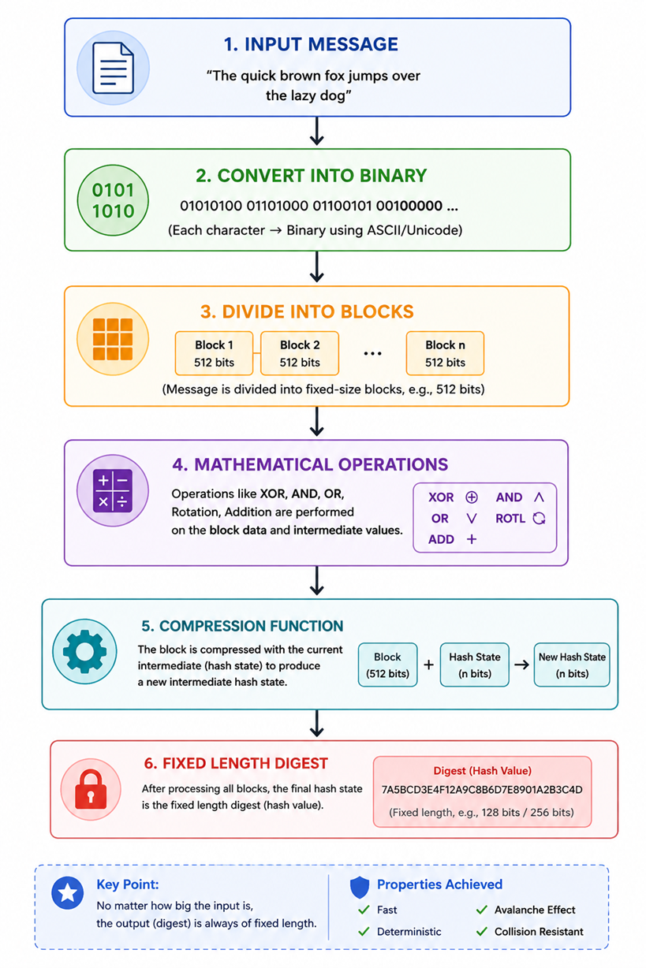

Slide 5
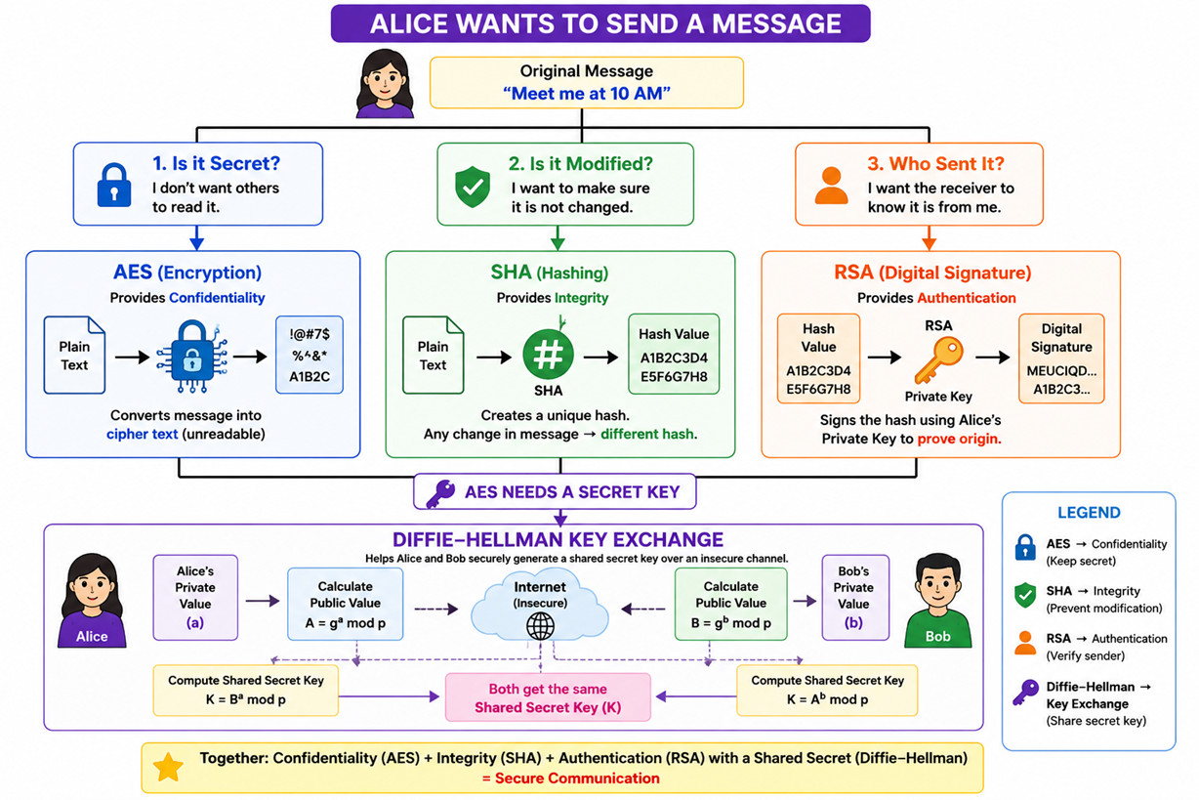

Slide 6
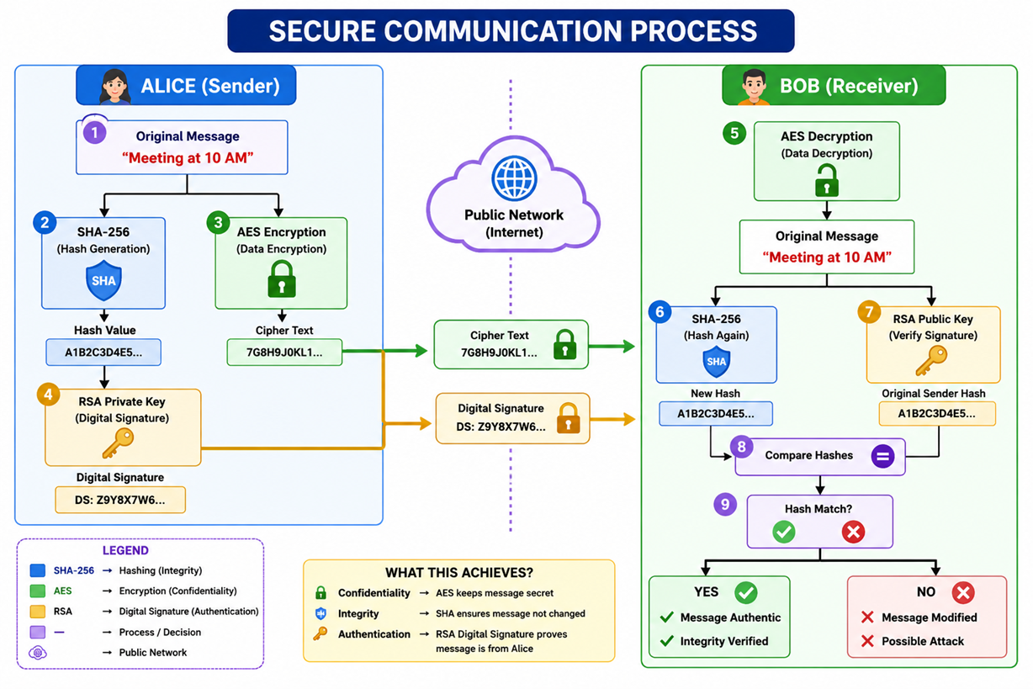

Slide 7
HASHING ALGORITHMS
MD5 — Message Digest Algorithm 5
Designed by Ronald Rivest in 1991. Produces a 128-bit (32 hex character) digest. Once the default for checksums and password storage — now considered cryptographically broken.
1. Padding
2. Append Length
3. Init Buffers
4. Process Blocks
5. Output Digest
Message padded so length ≡ 448 mod 512 bits
64-bit original length appended
4 buffers (A,B,C,D) set to fixed constants
Each 512-bit block run through 4 rounds of 16 ops (64 total)
Final buffer values chained → 128-bit hash
Inside each 512-bit block: 4 rounds × 16 operations, using non-linear functions F, G, H, I
Round 1
Round 2
Round 3
Round 4
F(B,C,D)=(B∧C)∨(¬B∧D)
G(B,C,D)=(B∧D)∨(C∧¬D)
H(B,C,D)=B⊕C⊕D
I(B,C,D)=C⊕(B∨¬D)
Example: MD5("hello") = 5d41402abc4b2a76b9719d911017c592
Hashing • Digital Signatures • PKI
4

Slide 8
Q1. How many rounds are there in MD5?
MD5 consists of 4 rounds.
Q2. How many operations are performed in total?
MD5 performs a total of 64 operations.
Q3. How many operations are there in each round?
Each round consists of 16 operations.4 Rounds × 16 Operations = 64 Operations
Q4. What is the size of each register?
Each register (A, B, C, and D) is 32 bits.
Q5. What is the total size of all registers?
There are four 32-bit registers.
4 × 32 bits = 128 bits
Q6. Which registers are used in the MD5 functions (F, G, H, I)?
The functions use only three registers: B, C, and D.
Example:
F(B, C, D)
G(B, C, D)
H(B, C, D)
I(B, C, D)

Slide 9
Q7. What is the role of Register A?
Register A is not used directly inside the functions. Instead, it is added to the function result along with the message word and constant before performing the left circular shift.
Formula:
A + F(B, C, D) + M[i] + K[i]
Q8. On which value is the Left Circular Shift performed?
The Left Circular Shift is performed on the 32-bit intermediate result generated in each operation.
It is not performed on the entire message or on a 16-bit value.
Q9. How is the final MD5 hash generated?
After completing all 64 operations, the final values stored in the four registers (A, B, C, and D) are concatenated to produce the 128-bit MD5 hash.
Final MD5 Hash
=
A || B || C || D
=
128-bit Message Digest

Slide 10
MD5 Algorithm (Core Internal Working)
🔹 Step 4: Initialize Buffers (A, B, C, D)
🔹 Why A, B, C, D are needed?
🔹 F, G, H, I Functions
🔹 4 Rounds (16 Operations each = 64 Operations)
🔹 Left Circular Shift
🔹 Modulo 2³² Addition
🔹 Final 128-bit Message Digest
🔹 Complete 2D Color Diagram
🔹 PPT Notes + Real-time Examples
🔹 MD5 Weaknesses and why SHA replaced MD5

Slide 11
Message
│
▼
1. Convert Message into Binary
▼
2. Padding
▼
3. Append Original Length
▼
4. Divide into 512-bit Blocks
▼
5. Initialize A, B, C, D
▼
6. Process Block-1 (64 Operations)
▼
7. Get New A, B, C, D
▼
8. Process Block-2 (using previous A, B, C, D)
▼
9. Repeat for all Blocks
▼
10. Combine Final A+B+C+D
▼
128-bit MD5 Hash

Slide 12
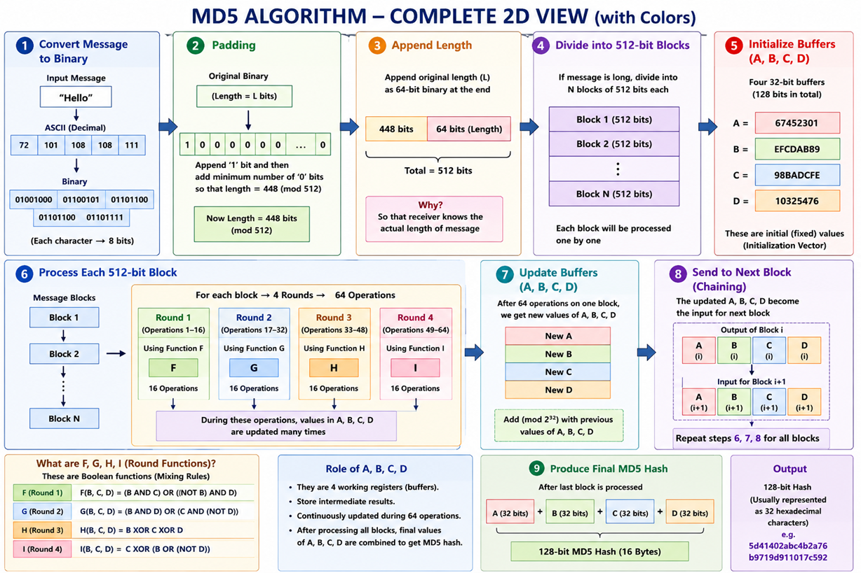

Slide 13
HASHING ALGORITHMS
MD5 — Advantages & Disadvantages
ADVANTAGES
DISADVANTAGES
Very fast to compute — low CPU overhead
Small 128-bit digest, saves storage and bandwidth
Simple to implement across all platforms/languages
Still fine for non-security uses (checksums, dedup, file-integrity vs accidental corruption)
Widely supported by legacy tools and libraries
Collision resistance broken — researchers can craft two different inputs with the same hash (since 2004)
Vulnerable to chosen-prefix collision attacks (forged certificates, malware disguised as safe files)
Not safe for password hashing (fast speed helps brute-force/rainbow-table attacks)
Deprecated by NIST and major security standards
Should never be used for digital signatures or SSL/TLS certificates
Hashing • Digital Signatures • PKI
5

Slide 14
HASHING ALGORITHMS
SHA — Secure Hash Algorithm Family
Developed by NSA / published by NIST. A family of hash functions, each generation adding digest length and structural security.
Variant | Digest Size | Year | Status | Notes
SHA-1 | 160 bits | 1995 | Broken (deprecated) | Collision demonstrated in 2017 ("SHAttered")
SHA-224 / 256 | 224 / 256 bits | 2001 | Secure — current standard | Used in TLS, Bitcoin, Git (newer)
SHA-384 / 512 | 384 / 512 bits | 2001 | Secure — high margin | Used where extra security margin is needed
SHA-3 (Keccak) | 224–512 bits | 2015 | Secure — different design | Sponge construction, backup standard to SHA-2
SHA-2 (256/512) is today's industry default; SHA-1 and MD5 remain only for non-cryptographic checksums.
Relative Digest Size (bits)
MD5
128
SHA-1
160
SHA-256
256
SHA-512
512
Hashing • Digital Signatures • PKI
6

Slide 15
HASHING ALGORITHMS
SHA-256 — Process Flow
1. Padding
2. Append Length
3. Init Hash Values
4. Compress Blocks
5. Output Digest
Message padded to a multiple of 512 bits (append 1-bit + zeros)
64-bit big-endian length of original message appended
8 words (H0..H7) set from fractional parts of √ of first 8 primes
Each 512-bit block → 64 rounds mixing via Σ, Ch, Maj functions
8 chained 32-bit words concatenated → 256-bit hash
Inside one compression round (repeated 64×):
a,b,c,d,e,f,g,h
Σ1(e) + Ch(e,f,g)
+ Wt + Kt
Rotate & Update
8 working variables loaded from current hash state
Compression functions mix the variables non-linearly
Message schedule word + round constant added
Variables rotate; new 'a' & 'e' computed for next round
Example: SHA-256("hello") = 2cf24dba5fb0a30e26e83b2ac5b9e29e1b161e5c1fa7425e73043362938b9824
Hashing • Digital Signatures • PKI
7

Slide 16
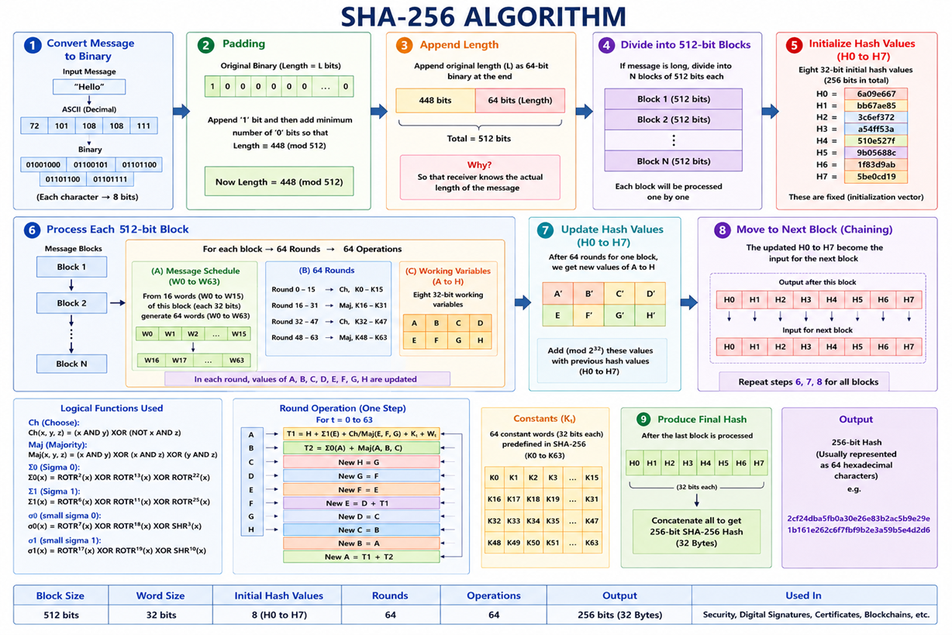

Slide 17
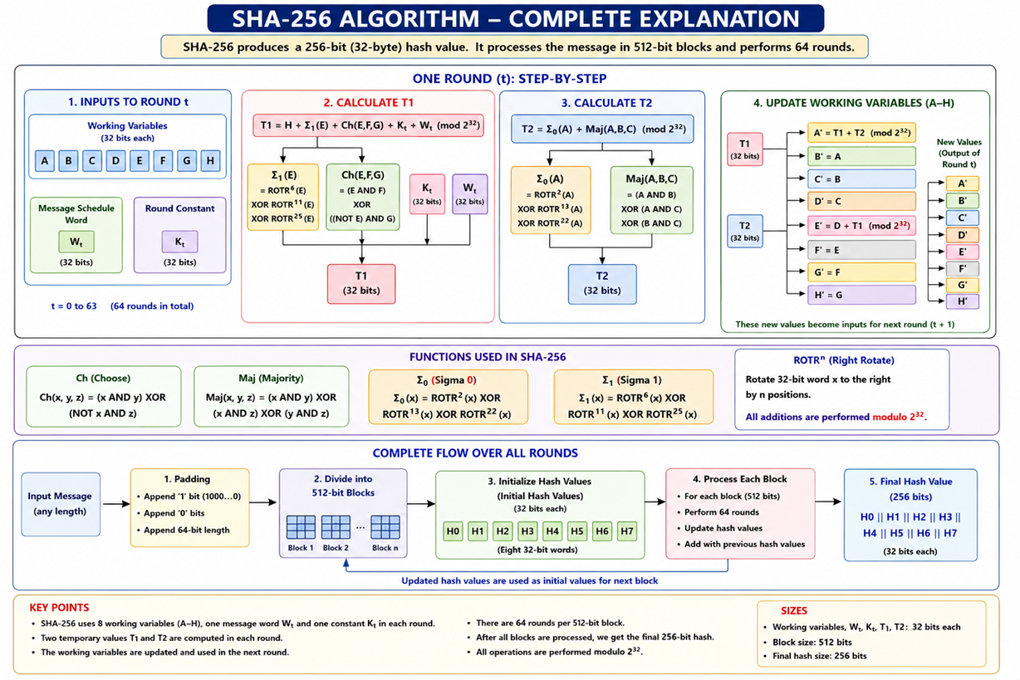

Slide 18
T1 and T2 are mixing values.
T1 → brings information from H, E, F, G + message Wt + constant Kt
T2 → brings information from A, B, C
T1 + T2 → produces the new A
D + T1 → produces the new E
NEW A = T1 + T2
NEW B = A
NEW C = B
NEW D = C
NEW E = D + T1
NEW F = E
NEW G = F
NEW H = G

Slide 19
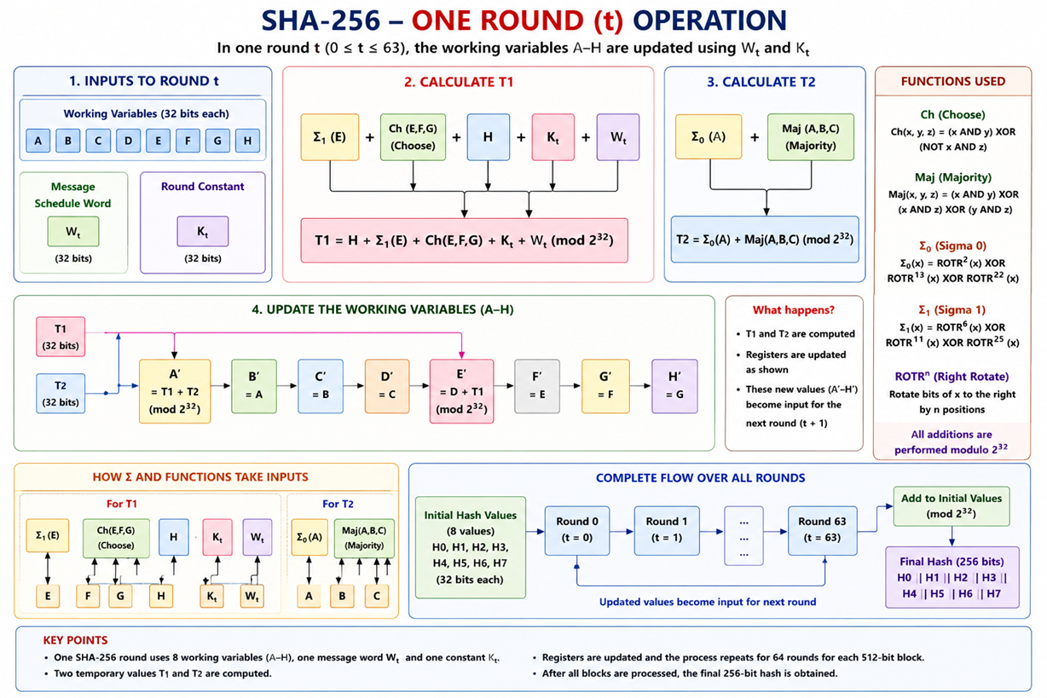

Slide 20
HASHING ALGORITHMS
SHA-2 / SHA-3 — Advantages & Disadvantages
ADVANTAGES
DISADVANTAGES
Strong collision resistance — no practical attacks known on SHA-256/512
Larger digest sizes make brute-force attacks computationally infeasible
Backed by NIST; mandated in modern security standards (TLS 1.3, FIPS 140-2)
SHA-3 uses a completely different sponge construction — protects against any future SHA-2 weakness
Actively maintained and vetted by the global cryptography community
Slower and more resource-intensive than MD5/SHA-1
Larger digest = more storage & bandwidth overhead
SHA-1 (older family member) is already broken — must specify SHA-2/3 explicitly
More complex to implement correctly from scratch (implementation bugs = vulnerabilities)
Still not designed for password hashing directly — needs salting + slow KDFs (bcrypt/Argon2)
Hashing • Digital Signatures • PKI
8

Slide 21
HASHING ALGORITHMS
MD5 vs SHA-256 — Head to Head
Attribute | MD5 | SHA-256
Digest length | 128 bits | 256 bits
Designed by | Ronald Rivest (1991) | NSA / NIST (2001)
Speed | Faster | ~2-3x slower
Collision resistance | Broken since 2004 | No known practical attack
Security status | Not recommended for security | Industry standard
Typical use today | Checksums, dedup, legacy systems | TLS/SSL, digital signatures, blockchain
Rule of thumb: use SHA-256 (or better) for anything security-related; MD5 only where cryptographic security is irrelevant.
Hashing • Digital Signatures • PKI
9

Slide 22
DIGITAL SIGNATURES
Why Do We Need Digital Signatures?
Hashing alone proves a message wasn't accidentally altered — but it can't prove WHO sent it, or stop a sender from later denying it. Digital signatures combine hashing with asymmetric (public-key) cryptography to solve this.
1
2
3
Authentication
Integrity
Non-repudiation
Proves the message genuinely came from the claimed sender
Confirms the message was not altered in transit
Sender cannot later deny having signed the message
Key idea: a digital signature is the message's hash, encrypted with the sender's private key.
Analogy: Think of it like a wax seal on a letter — only you own the unique stamp (private key), but anyone can check the seal's pattern against your known public stamp (public key) to confirm it's really from you and hasn't been tampered with.
Hashing • Digital Signatures • PKI
10

Slide 23
DIGITAL SIGNATURES
Digital Signature Process — Signing (Sender)
Original
Message
Hash
Function
Message
Digest
Encrypt with
Sender's Private Key
Digital
Signature
e.g. contract.pdf
SHA-256
fixed-size hash
signing operation
attached to message
Sender then transmits:
Original Message + Digital Signature
Sent over the network to the Recipient — anyone intercepting it sees the message and signature, but cannot forge a new valid signature without the sender's private key.
Why encrypt the HASH and not the whole message? — the digest is small and fixed-size, so asymmetric encryption (which is slow) stays fast regardless of the original message's size.
Hashing • Digital Signatures • PKI
11

Slide 24
DIGITAL SIGNATURES
Digital Signature Process — Verification (Receiver)
Received
Message
Hash Function
(same algorithm)
Newly Computed
Digest (H2)
Compare
H1 = H2 ?
Received
Signature
Decrypt with Sender's
PUBLIC Key
Digest
(H1)
✓ MATCH → Signature Valid
✗ MISMATCH → Signature Invalid
Message is authentic and unaltered — confirmed to come from the claimed sender.
Message was altered in transit, or does not come from the claimed sender — reject it.
Only the sender's matching public key can correctly decrypt a signature made with their private key — proving authorship without ever sharing the private key.
Hashing • Digital Signatures • PKI
12

Slide 25
DIGITAL SIGNATURES
Digital Signatures — Advantages & Disadvantages
ADVANTAGES
DISADVANTAGES
Strong authentication — verifies the true sender of a message
Ensures message integrity — any tampering is detected immediately
Provides non-repudiation — legally binding proof of origin
Scales well: only the small hash is encrypted, not the whole message
Enables secure e-governance, e-commerce, and paperless contracts
Relies on the private key staying secret — if stolen, identity can be forged
Requires a trusted way to distribute public keys (solved by PKI/certificates)
Computationally heavier than simple checksums
Legal recognition of digital signatures varies by country/jurisdiction
Doesn't provide confidentiality by itself — message content is still readable unless separately encrypted
Hashing • Digital Signatures • PKI
13

Slide 26
DIGITAL CERTIFICATES
Digital Certificates — What & Why
Problem: Verification only works if you truly trust that a given public key belongs to the claimed person or organization. What stops an attacker from publishing a public key and pretending to be your bank?
Solution: A Digital Certificate — an electronic document issued by a trusted Certificate Authority (CA) — binds a public key to a verified identity, and is itself digitally signed by the CA.
Certificate
Authority (CA)
trusted third party
issues signed
certificate
CA's public key
verifies signature
Entity
(e.g. website)
Relying Party
(e.g. your browser)
requests certificate
verifies certificate
Hashing • Digital Signatures • PKI
14

Slide 27
DIGITAL CERTIFICATES
Anatomy of a Digital Certificate (X.509)
Version
X.509 format version (e.g. v3)
DIGITAL CERTIFICATE
Serial Number
Unique ID assigned by the CA
🔑
Signature Algorithm
e.g. SHA-256 with RSA
Issuer
Name of the Certificate Authority
Public Key + Identity
bound together,
signed by a CA
Validity Period
"Not Before" / "Not After" dates
Subject
Identity the certificate is issued to
Subject Public Key
The public key being certified
Signed: Certificate Authority
CA's Digital Signature
CA's signature over all the above fields
Hashing • Digital Signatures • PKI
15

Slide 28
DigiCert
Sectigo
GlobalSign
Let's Encrypt

Slide 29
DIGITAL CERTIFICATES
Digital Certificates — Advantages & Disadvantages
ADVANTAGES
DISADVANTAGES
Establishes verifiable trust between strangers over an open network
Prevents impersonation / man-in-the-middle attacks (e.g. fake websites)
Enables HTTPS padlock, secure email, and code-signing trust chains
Certificates can be revoked quickly if a key is compromised
Standardized (X.509) — interoperable across browsers, OSs, and devices
Entire system depends on trusting the issuing CA — a compromised CA undermines all its certificates
Certificates expire and must be renewed / tracked, adding operational overhead
Revocation checking (CRL/OCSP) can be slow or skipped by clients
Cost and process of obtaining certificates from a trusted CA
Misissued or fraudulent certificates have happened (CA breaches)
Hashing • Digital Signatures • PKI
16

Slide 30
PUBLIC KEY INFRASTRUCTURE
Public Key Infrastructure (PKI) — Components
PKI is the complete framework of policies, roles, hardware, software, and procedures needed to create, manage, distribute, use, store, and revoke digital certificates and public keys at scale.
1
Certificate Authority (CA)
2
Registration Authority (RA)
3
Certificate Repository
Trusted entity that issues and signs digital certificates
Verifies identity of applicants before CA issues a certificate
Public database storing issued certificates
4
Certificate Revocation List (CRL/OCSP)
5
End Entities
6
Key Management System
Lists certificates revoked before expiry
Users, servers, or devices that hold certificates
Generates, stores, and archives cryptographic key pairs
Hashing • Digital Signatures • PKI
17

Slide 31
PUBLIC KEY INFRASTRUCTURE
PKI — Certificate Issuance & Verification Flow
1. Applicant
2. RA
3. CA
4. Repository
5. Relying Party
Generates key pair;
requests certificate
Verifies identity
& forwards request
Signs & issues
the certificate
Publishes certificate
(publicly available)
Verifies cert chain
before trusting
How the Relying Party verifies trust — the Chain of Trust:
Root CA
(self-signed, pre-installed
in OS/browser)
Intermediate CA
(signed by Root)
End-Entity Certificate
(e.g. www.bank.com,
signed by Intermediate)
Trust flows down from a small set of Root CAs that operating systems and browsers trust by default — each link in the chain vouches for the next.
Hashing • Digital Signatures • PKI
18

Slide 32
PUBLIC KEY INFRASTRUCTURE
PKI — Advantages & Disadvantages
ADVANTAGES
DISADVANTAGES
Enables secure communication at internet scale without pre-shared secrets
Provides confidentiality, integrity, authentication, and non-repudiation together
Centralized trust model simplifies verifying unknown parties
Supports revocation, renewal, and lifecycle management of keys
Foundation for HTTPS, VPNs, email security, e-signatures, and IoT device identity
Complex to design, deploy, and administer correctly
Single point of failure risk if a Root/Intermediate CA is compromised
Key management (secure storage, backup, recovery) is operationally demanding
Certificate/CA costs and renewal overhead for organizations
Users often ignore certificate warnings, weakening real-world security
Hashing • Digital Signatures • PKI
19

Slide 33
REAL-WORLD APPLICATIONS
Where This All Comes Together
HTTPS / TLS-SSL
Email Security (S/MIME, PGP)
Code Signing
Browser padlock relies on hashing, signatures & PKI to secure web traffic
Digitally signs & encrypts emails to prove sender identity
Verifies software/updates haven't been tampered with before install
Blockchain & Cryptocurrency
Digital Documents / e-Signatures
VPNs & Secure Messaging
SHA-256 secures Bitcoin blocks; signatures authorize transactions
Legally binding contracts signed and verified electronically
Certificates authenticate endpoints before establishing a tunnel
Hashing • Digital Signatures • PKI
20

Slide 34
KEY TAKEAWAYS
Summary
1
Hashing creates a fixed-size fingerprint of data — MD5 (128-bit) is fast but broken; SHA-2/3 (256-bit+) is today's secure standard
2
Digital Signatures combine hashing with private-key encryption to prove a message's authenticity, integrity, and non-repudiation
3
Digital Certificates bind a public key to a verified identity, issued and signed by a trusted Certificate Authority
4
PKI is the full ecosystem — CA, RA, repositories, revocation — that makes public-key trust workable at global scale
5
Together, these three layers are the backbone of virtually all secure digital communication today (HTTPS, email, code signing, blockchain)
Thank You

