Slide 1
SSG4Env WP4
Semantic Integrator Proposal & WP2 Collaboration

Slide 2
WP4
Design & implement Semantic Integrator Service
D4.1
Related work on Semantic data integration, Ontology-based data access
Semantic queries over streaming data
Proposal of Ontology-base integration model for heterogeneous streaming and stored data

Slide 3

Requirements
Based on use-cases
Integrate stored and streaming data sources
Integrate sources through unified view
Pose declarative queries over integrated view
Sensor Network
Decl. Query
Integrate
Database Data
Integrated view
Stream Data

Slide 4
Background
Ontology based data access
Ontology-based data integration
Streaming data access
Distributed query processing
SNEE/SNEEql
R₂O/ODEMapster
SPARQL streaming extensions

Slide 5
Ontology-based data access & integration
ODEMapster
SquirrelRDF
RDBToOnto
Relational.OWL
SPASQL
Virtuoso
D2RQ
MASTRO
R₂O + ODEMapster
ODEMQL
MySQL
Oracle
...others
Ontological query
Transform
relational query
Ontological model
Database
OWL
Mapping
R₂O
OBSERVER
SIMS
Carnot
DWQ
PICSEL
MOMIS
Ontological query
Ontological model
Transform
relational query
Databases
Mappings

Slide 6
Streaming Data Access
Continuously appended data
Potentially infinite
Time-stamped tuples
Continuous queries
Latest information used in queries
Windows: time and tuple based
Archival data
(t9, a1, a2, ... , an)
(t8, a1, a2, ... , an)
(t7, a1, a2, ... , an)
...
...
(t1, a1, a2, ... , an)
...
...
Window [t7 - t9]
Streaming Data
SNEE
Sensor Networks characteristics
Low computational, power resources, storage
Distributed query execution
Routing, Optimization
Query
SNEEql

Slide 7
SPARQL streaming extensions
SPARQL RDF query language
Language limitations for streams
Windows, time, tuple
Data model
Aggregates, stream operators
Streaming SPARQL
C-SPARQL

Slide 8
Approach
Establish global ontological view
Mapping global to local views
Mapping ontological model to stream/stored sources
Define semantic streaming queries over ontological model
Transform semantic queries to inter-lingua streaming query language
Distributed query evaluation in distributed sources
Integration and transformation of results

Slide 9
Semantic Integrator
Ontology-to-Ontology mappings
S₂O mappings
Client
q
Query reconciliation
q^{r}
Query canonisation
Q^{c}
SNEEql (S₁ S₂ S_{n})
SPARQL_{STR} (O_{g})
SPARQL_{STR} (O_{g})
Query Processing
D^{l}
Data reconciliation
Data decanonisation
[tuple_{l1 l2 l3}]
[tuple]
d
d^{r}
[triple_{Og}]
[triple_{O1O2On}]
Ontology-based Streaming Data Access Service

Slide 10
Semantic Integrator
S₂O mappings
Client
SPARQL_{STR} (O_{g})
Query reconciliation
Ontology-to-Ontology mappings
SPARQL_{STR} (O₁ O₂ O_{n})
Query translation
Ontology-to-Source mappings
Sensor Network
(S₁)
SPARQL_{STR} algebra (S₁ S₂ S_{m})
Relational DB
(S₂)
Distributed Query Processing
Rewriter
Optimiser
Query
Evaluator
Stream
Engine
(S₃)
RDF Store
(S_{m})
Ontology-based Streaming Integration Service

Slide 11
Semantic Integrator
q
Query translation
Client
Q^{c}
SNEEql (S₁ S₂ S_{n})
SPARQL_{Stream} (O_{g})
S₂O mappings
Query Processing
d
D^{l}
Data translation
[tuple]
[triple_{Og}]
[tuple_{l1 l2 l3}]
Ontology-based Streaming Data Access Service

Slide 12
Distributed Query Processing
Abstract Syntax Tree
Logical Algebraic Form
PhysicalAlgebraic Form
Distributed Algebraic Form
Parse
Logical rewrite
Physical optimization
Partition
Leaf specific scans
Parse query string, using grammar, produce AST
Produce logical plan
Produce physical plan including optimizations
Identify exchange points, add to the distribute plan
Retrieve data from external sources

Slide 13
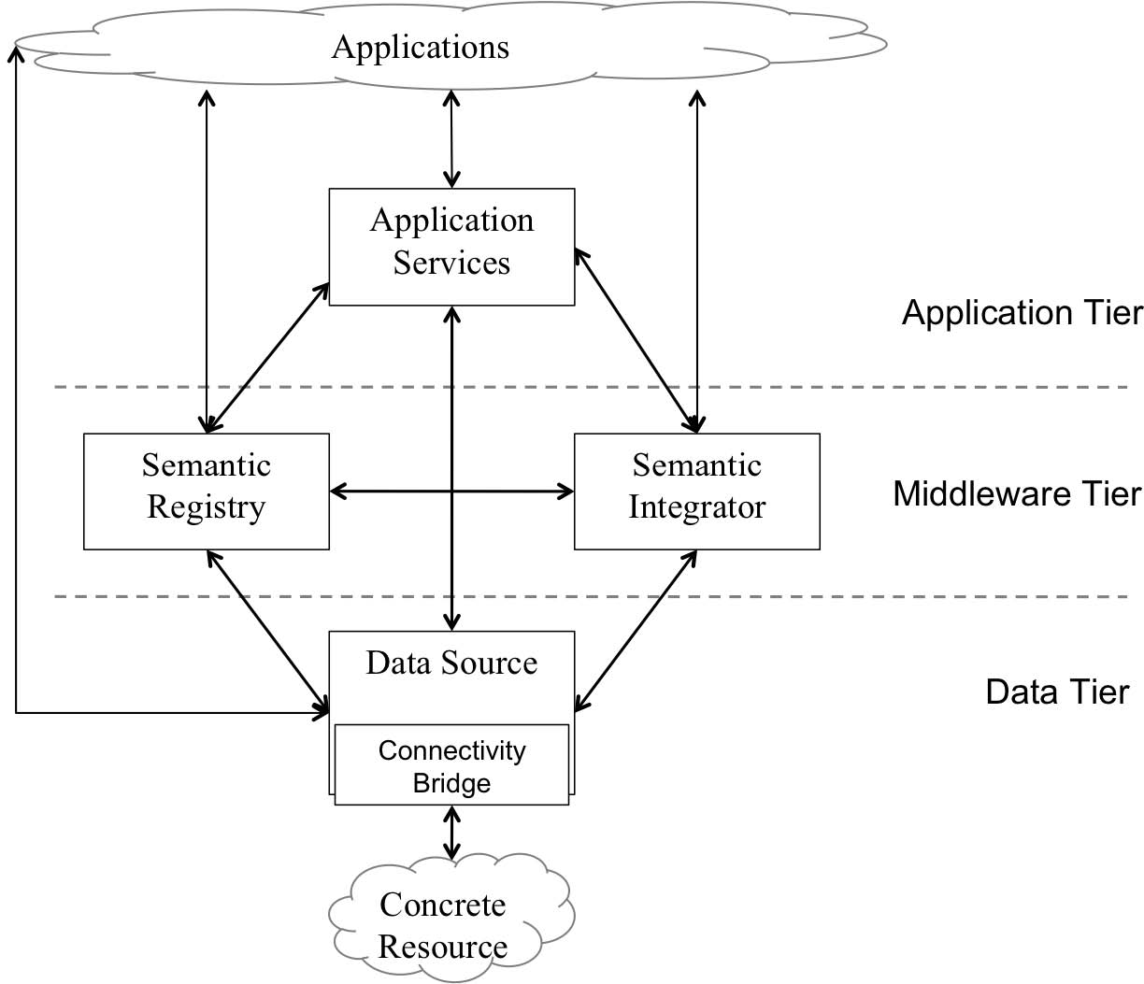
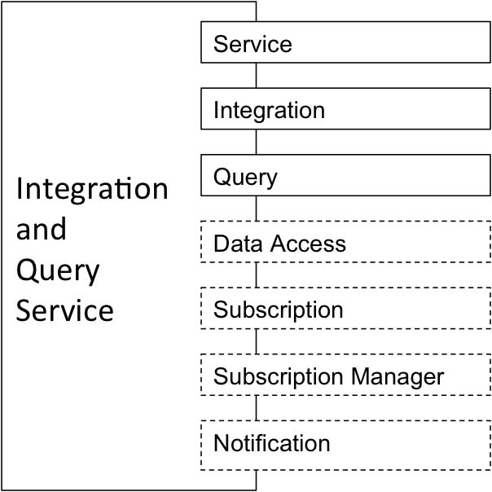
Architecture

Slide 14
Integration Interface
IntegrateAs operation
Reference to sources
Mapping Global-to-Local ontologies
Sources have an ontological view registered
Mappings from ontological views to inter-lingua
Returns reference to integrated data resource

Slide 15
Query Interface
ExecuteQuery
One shot queries
ExecuteQueryFactory
Used for most streaming queries
Pull/push in config document
Push delivery -> use Subscription
Pull delivery -> use Data Access
Typically StreamExecuteFactory

Slide 16
Cross-cutting issues
Identify queries from both use-cases
Characterization of queries
Represent queries in global query language
Study the query semantics of QL for RDF Streams compared to SNEEql semantics

Slide 17
R₂O + ODEMapster
Starting with SPARQL support
Define «S2O » extensions for R2O
Define SPARQL_{STR} language syntax and semantics
Engine support for « S2O » documents, SPARQL_{STR} queries
Engine support for SNEEql translation and connection

Slide 18
Thanks...
windsamples

Slide 19
conceptmap-def WindSpeedMeasurement
virtualStream <http://ssg4env.eu/Readings.srdf>
uri-as concat('ssg4env:WindSM_',
windsamples.sensorid,windsamples.ts)
attributemap-def hasSpeed
operation constant
has-column windsamples.speed
dbrelationmap-def isProducedBy
toConcept Sensor
joins-via condition equals
has-column sensors.sensorid
has-column windsamples.sensorid
conceptmap-def Sensor
uri-as concat('ssg4env:Sensor_',sensors.sensorid)
attributemap-def hasSensorid
operation constant
has-column sensors.sensorid
WindSpeed
Measurement
s:windsamples
sensorid: int PK
ts: datetime PK
speed: float
hasSpeed
isProducedBy
xsd:float
t:sensors
Sensor
sensorid: int PK
sensorname: st
hasSensorid
xsd:int
Streams
S₂O Mapping
Ontologies

Slide 20
Extras

Slide 21
Thru the example…
Consider a simple query: obtain the current measured wind speed and direction, measurement time and sensor location.
Speed and direction retrieved from sensor network. Sensor location found on a table.

Slide 22
SPARQL_{STR} Query
Not restricted to C-SPARQL or Streaming SPARQL limitations (no reason)
Join of two distributed sources
Join of stream and stored sources
REGISTER …
PREFIX fire <http://.../integratedOntology>
SELECT ?long ?lat ?speed ?dir ?ts
FROM STREAM <integratedOntologicalView> [NOW]
WHERE { ?id a fire:WindSensor;
fire:hasLong ?long;
fire:hasLat ?lat;
fire:hasSpeed ?speed
fire:hasDir ?dir
fire:hasTS ?ts. }

Slide 23
SPARQL_{STR} on Local Ontologies
REGISTER …
PREFIX wind <http://.../WindOntology>
PREFIX loc <http://.../LocationOntology>
SELECT ?long ?lat ?speed ?dir ?ts
FROM STREAM <WindSensor> [NOW]
WHERE { ?wind a wind:Sensor;
wind:hasSpeed ?speed;
wind:hasDirection ?dir;
wind:hasTS ?ts.
?locid a loc:Location;
loc:hasLong ?long;
loc:hasLat ?lat. }

Slide 24
SNEEql query
RSTREAM SELECT p.long, p.lat, w.speed, w.dir, w.ts
FROM Wind [NOW] as w, Placement [NOW] as p
WHERE p.id=w.id

