Slide 1
SAMPL8 Challenge MSKCC: Chodera, Isik UCI: Mobley, Bergazin GSK: Bahr, Graves, Kenna, McQueen, Nandkeolyar, Nevins

Slide 2
List of Completed pH Solubility Compounds
This is the completed list of compounds processed through Britton-Robinson pH solubility to determine pKa
SAMPL Set 1 SAMPL8-1 SAMPL8-2 SAMPL8-3 SAMPL8-4 SAMPL8-5 SAMPL8-6 | SAMPL Set 2 SAMPL8-7 SAMPL8-8 SAMPL8-9 SAMPL8-10 SAMPL8-11 SAMPL8-12 | SAMPL Set 3 SAMPL8-13 SAMPL8-14 SAMPL8-15 SAMPL8-16 SAMPL8-17 | SAMPL Set 4 SAMPL8-18 SAMPL8-19 SAMPL8-20 SAMPL8-21 SAMPL8-22 SAMPL8-23

Slide 3
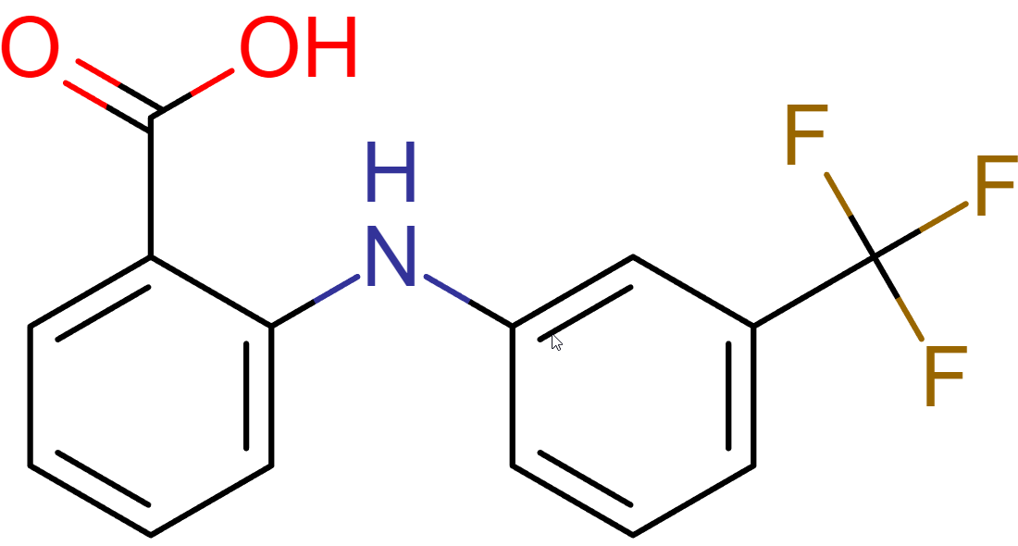
SAMPL8-1

Slide 4
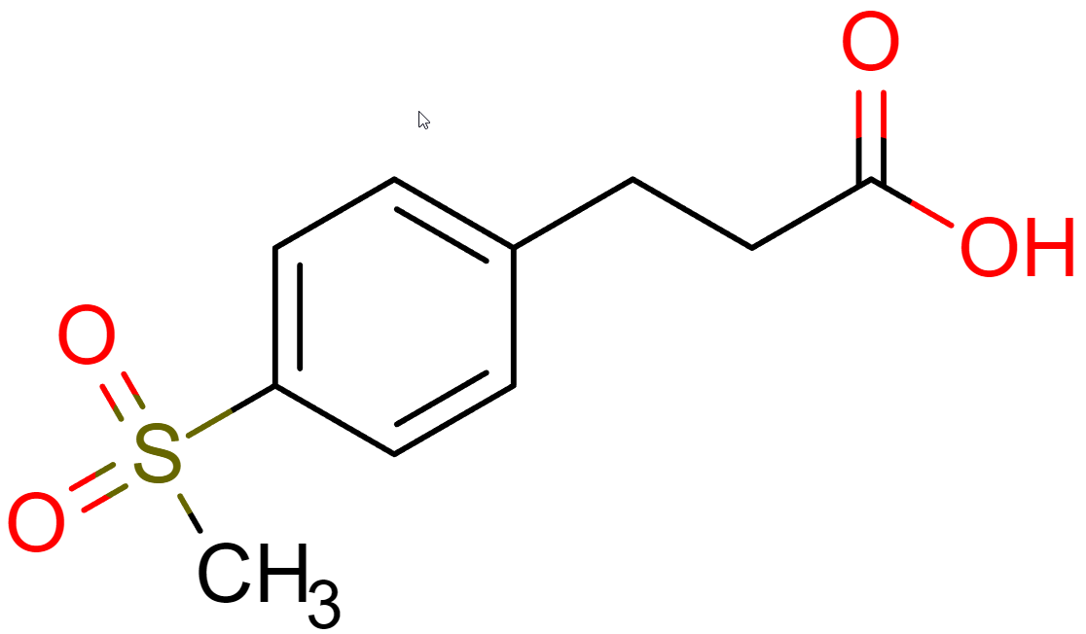
SAMPL8-2

Slide 5
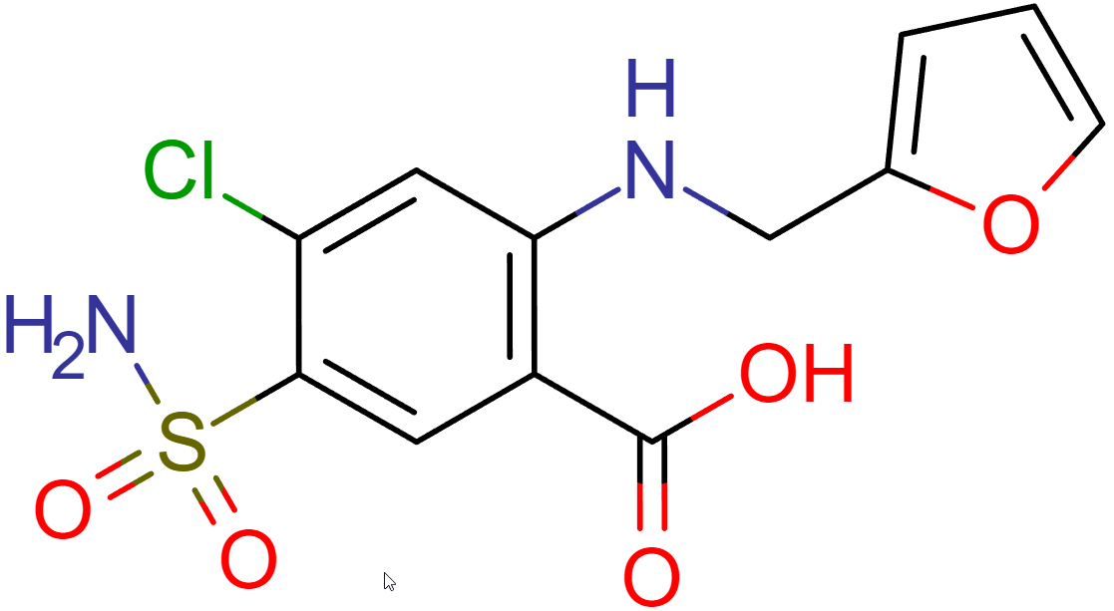
SAMPL8-3

Slide 6
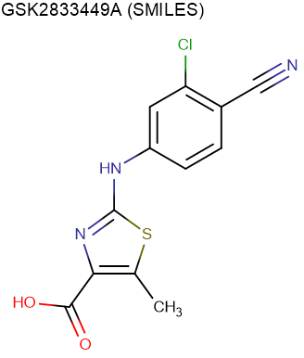
SAMPL8-4

Slide 7
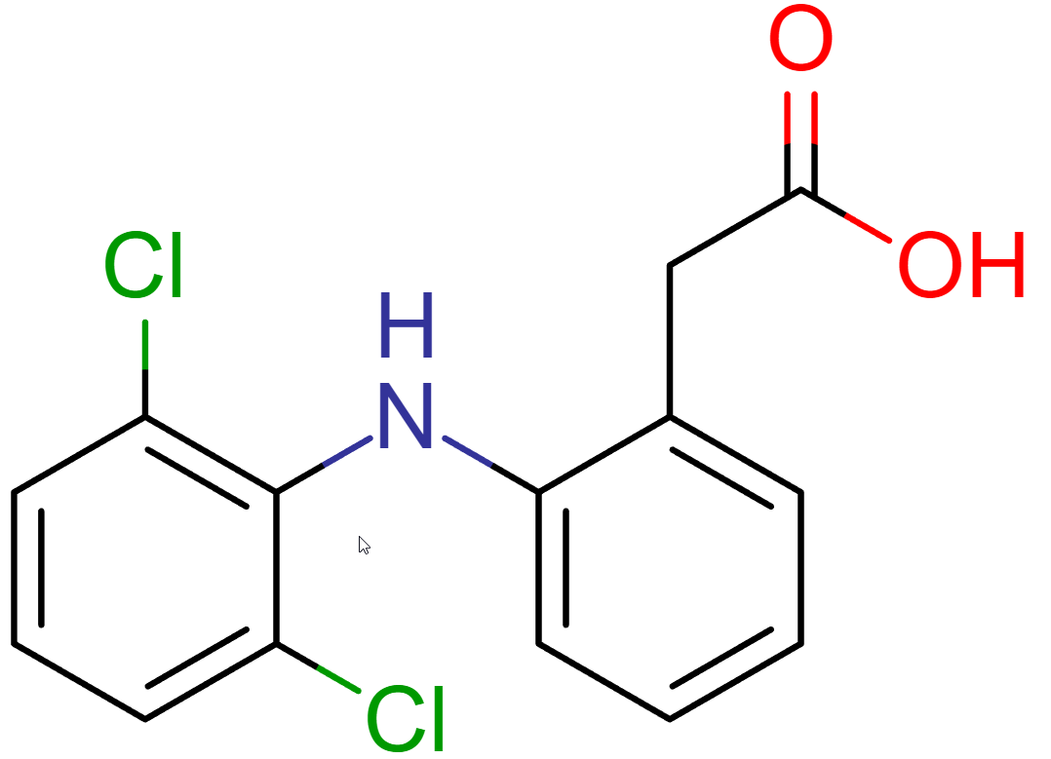
SAMPL8-5

Slide 8
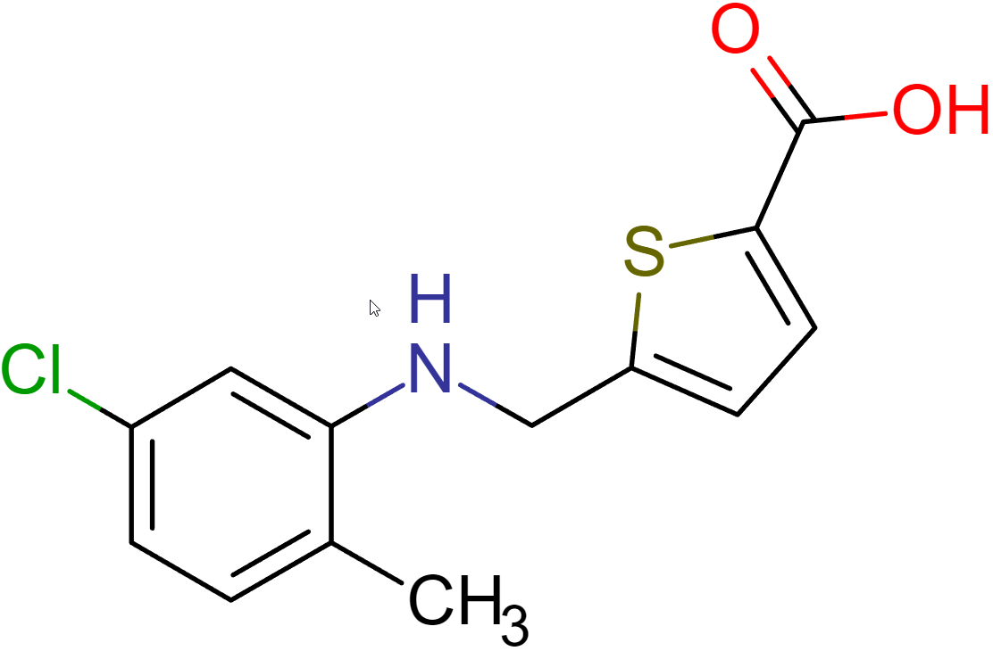
SAMPL8-6

Slide 9
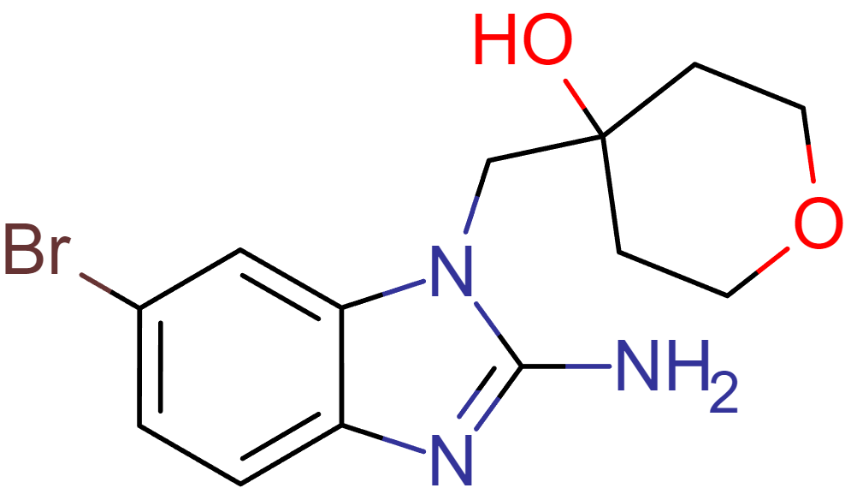
SAMPL8-7

Slide 10
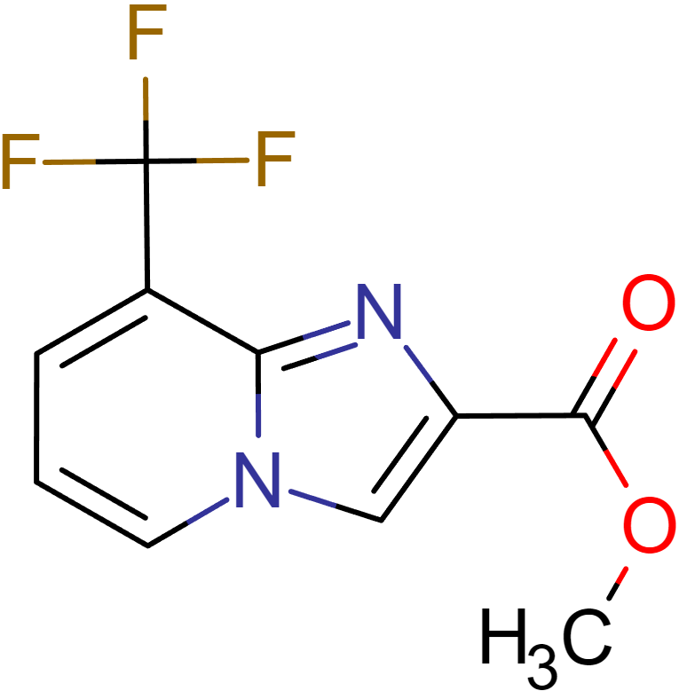
SAMPL8-8

Slide 11
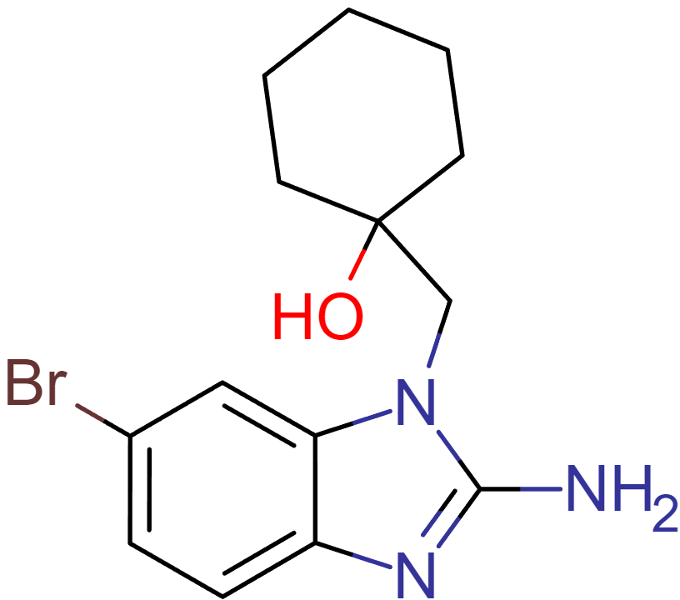
SAMPL8-9

Slide 12
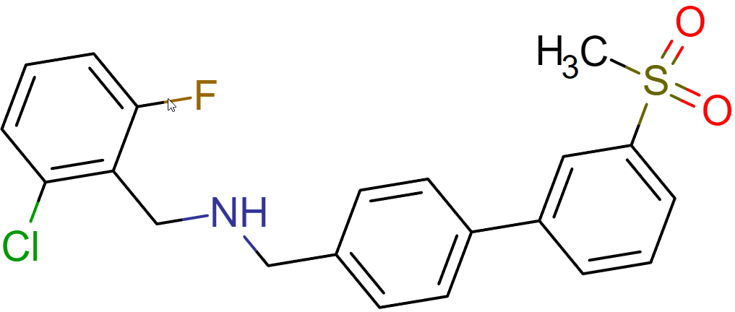
SAMPL8-10

Slide 13
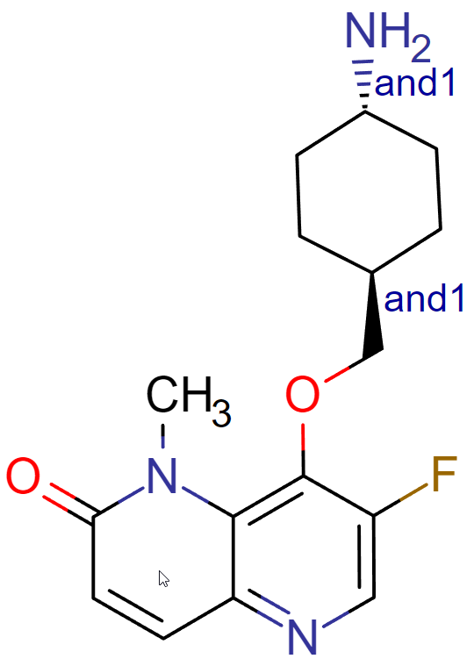
SAMPL8-11
pKa not determined

Slide 14
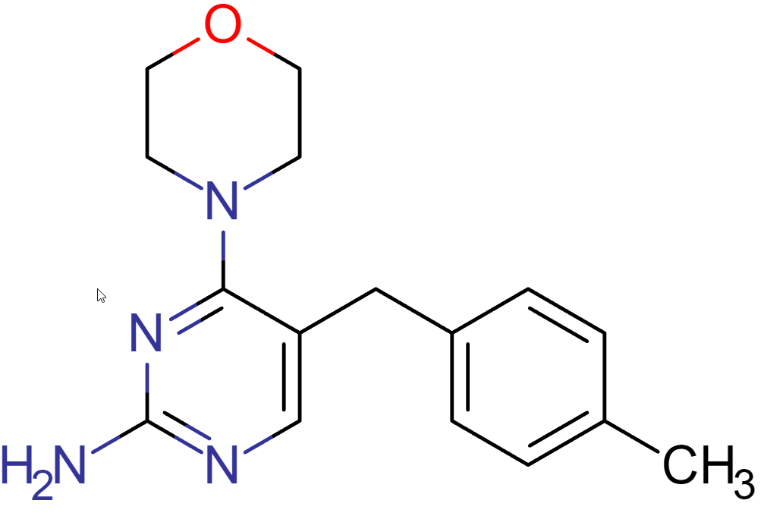
SAMPL8-12

Slide 15
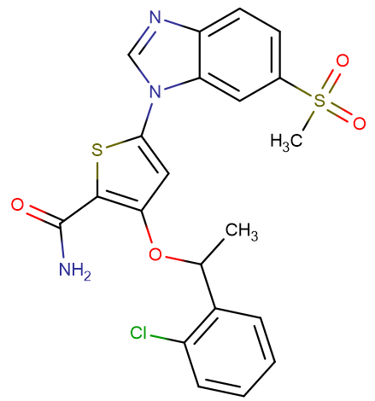
SAMPL8-13
pKa not determined

Slide 16
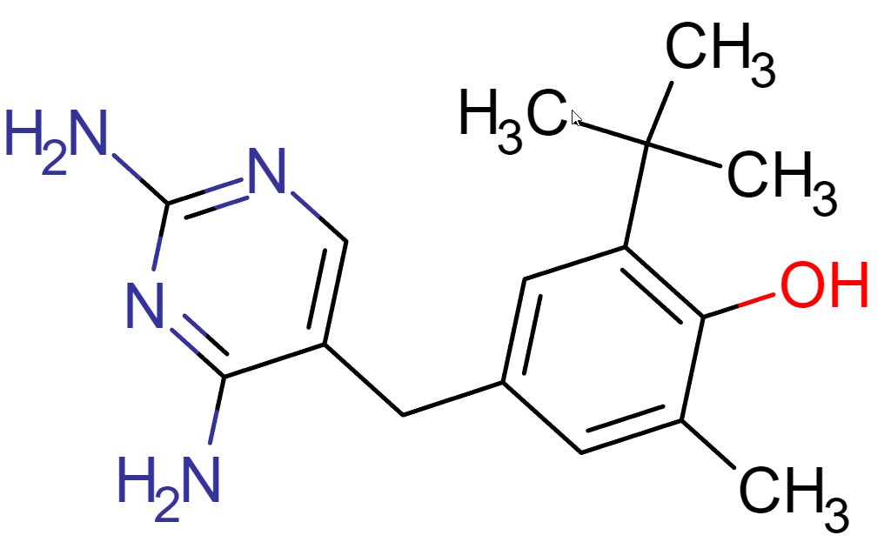
SAMPL8-14

Slide 17
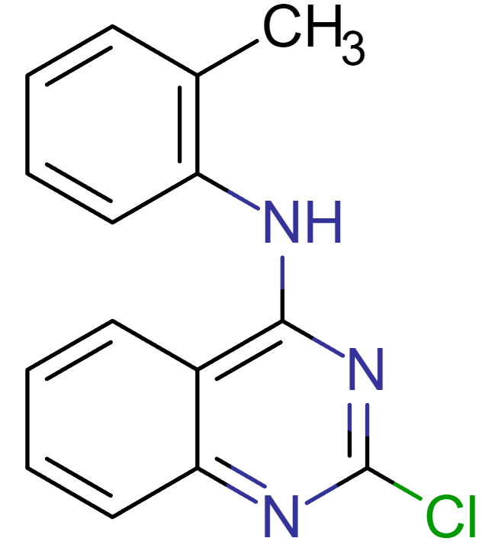
SAMPL8-15

Slide 18
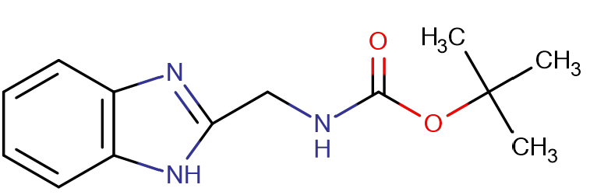
SAMPL8-16

Slide 19
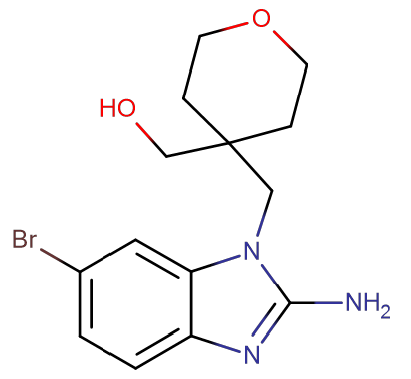
SAMPL8-17
pKa not determined

Slide 20
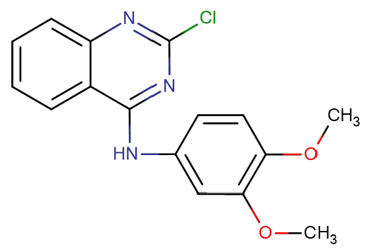
SAMPL8-18

Slide 21
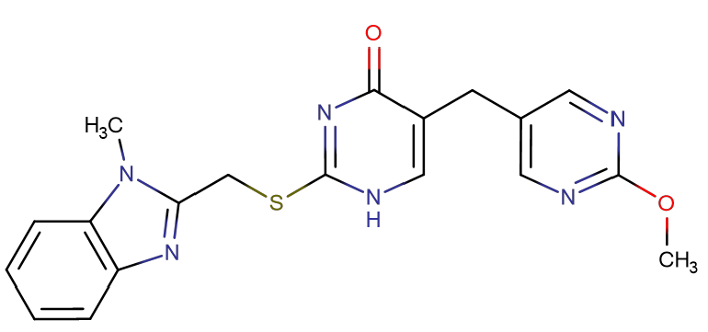
SAMPL8-19

Slide 22
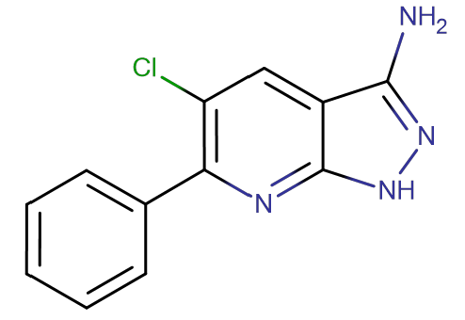
SAMPL8-20

Slide 23
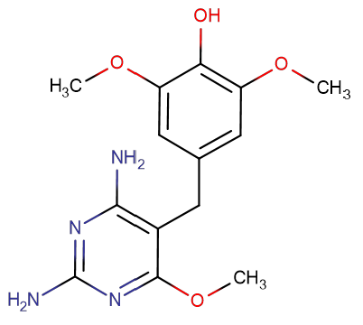
SAMPL8-21

Slide 24
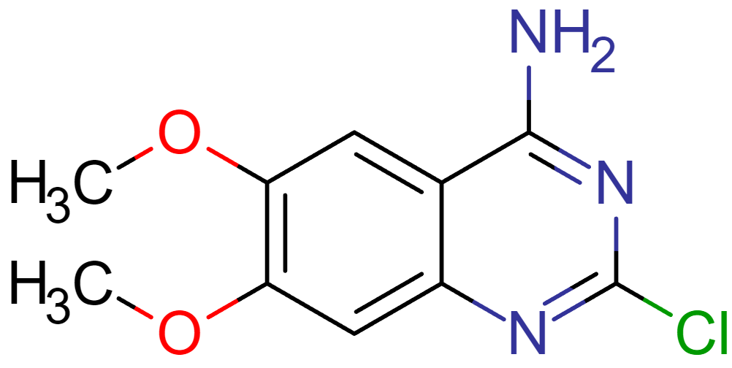
SAMPL8-22

Slide 25
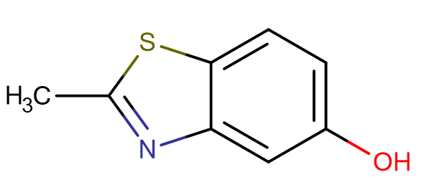
SAMPL8-23

