Slide 1
High-Level Design
Dr. Kamal Beydoun
Faculty of Sciences I
Lebanese University
Design is not just what it looks like and feels like. Design is how it works.
—Steve Jobs
Design is easy. All you do is stare at the screen until drops of blood form on
your forehead.
—Marty Neumeier

Slide 2
Introduction
High‐level design provides a view of the system at an abstract level.
It shows how the major pieces of the finished application will fit together and interact with each other.
The high‐level design does not focus on the details of how the pieces of the application will work.
Software development as a process that chops up the system into smaller and smaller pieces until the pieces are small enough to implement.
high‐level design is the first step in the chopping up process

Slide 3
WHAT TO SPECIFY
Exactly what you should specify in the high‐level design varies somewhat, but some things are constant for most projects.
Security
Hardware
User Interface
Internal Interfaces
External Interfaces
Architecture
Reports
Database

Slide 4

Security
The first thing you see when you start most applications is a login screen.
obvious sign of the application’s security
Operating system security—This includes the type of login procedures, password expiration policies, and password standards.
Application security : may use a separate application username and password. It also means providing the right level of access to different users.
Data security: You need to make sure your customer’s credit card information doesn’t fall into the hands of Eastern European hackers.
Network security—Even if your application and data are secure, cyber banditos might steal your data from the network.
Physical security—Many software engineers overlook physical security.
Your application won’t do much good if the laptop it runs on is stolen from an unlocked office.
Notes:
All these forms of security interact with each other, sometimes in non‐obvious ways.

Slide 5

Hardware
You can build systems to run on desktops, laptops, tablets, and phones wristbands, bracelets, watches, eyeglasses, and headsets.
Additional hardware that you need to specify might include the following:
Printers
Network components (cables, modems, gateways, and routers)
Servers (database servers, web servers, and application servers)
Specialized instruments (scales, microscopes, programmable signs, and GPS units)
Audio and video hardware (webcams, headsets, and VOIP)

Slide 6
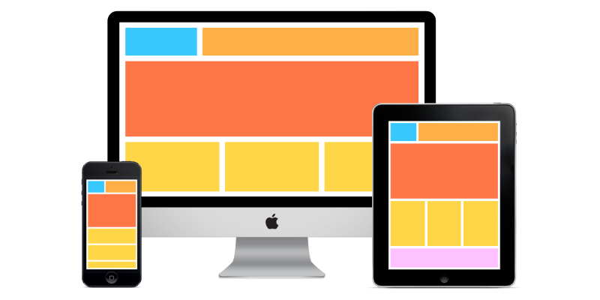
User Interface
Indicate the main methods for navigating through the application (the application’s basic navigational style).
Can describe special features such as
clickable maps,
important tables, or
methods for specifying system settings (such as sliders, scrollbars, or text boxes).
Can address general appearance issues such as color schemes, company logo placement, and form skins.

Slide 7
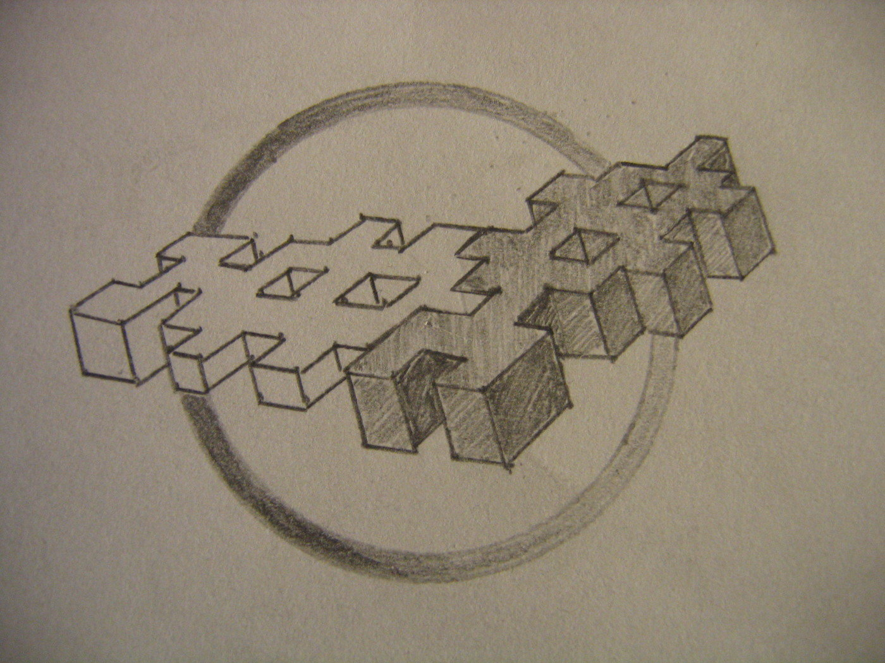
Internal Interfaces
When you chop the program into pieces, you should specify how the pieces will interact.
Then the teams assigned to the pieces can work separately without needing constant coordination.
Unfortunately, you may not be able to define the interfaces before writing at least some code.
It’s important that the high‐level design specifies these internal interactions clearly and unambiguously so that the teams can work as independently as possible.
Notes:
It’s important that the high‐level design specifies these internal interactions clearly and unambiguously so that the teams can work as independently as possible. If two teams that need
to interact don’t agree on how that interaction should occur, they can waste a huge amount of time. They may waste time squabbling about which approach is better. They will also waste time
if one team needs to change the interface and that forces the other team to change its interface, too. The problem increases dramatically if more than two teams need to interact through the same
interface.

Slide 8

External Interfaces
Many applications must interact with external systems.
In a way, external interfaces are often easier to specify than internal ones because you usually don’t have control over both ends of the interface.
Try to make your interface simple and flexible so that you don’t get flooded with change requests.

Slide 9
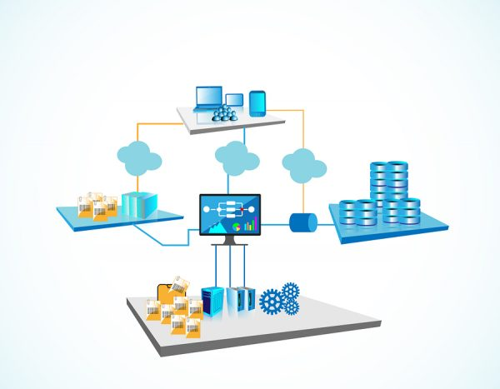
Architecture
An application’s architecture describes how its pieces fit together at a high level.
Developers use a lot of “standard” types of architectures.
Many of these address particular characteristics of the problem being solved.
Monolithic
Client/Server
Component‐Based
Service‐Oriented
Data‐Centric
Event‐Driven
Rule‐Based
Distributed

Slide 10
Architecture : Monolithic
In a monolithic architecture , a single program does everything.
It displays the user interface,
accesses data,
processes customer orders,
prints invoices, launches missiles, and
does whatever else the application needs to do.
Notes:
Monolithic architectures do have some advantages. Because everything is built into a single
program, there’s no need for complicated communication across networks.

Slide 11
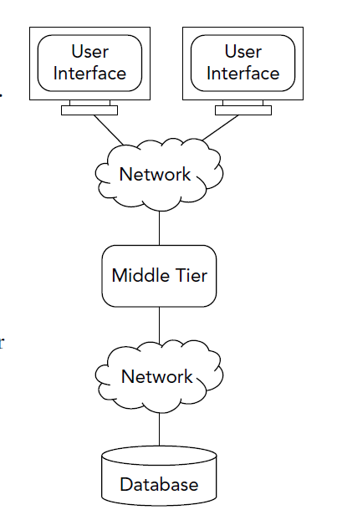
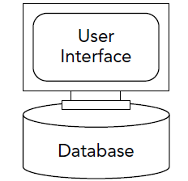
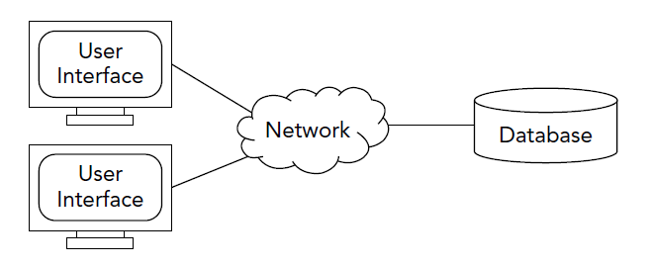
Architecture : Client/Server
A client/server architecture separates pieces of the system that need to use a function (clients) from parts of the system that provide those functions (servers).
That decouples the client and server pieces of the system so that developers can work on them separately.
Notes:
In a three‐tier architecture, the middle tier provides insulation between the clients and server. In this example, it provides an interface that can map data between the format provided by the server
and the format needed by the client. If you need to change the way the server stores data, you need to update only the middle tier so that it translates the new format into the version expected by the
client.

Slide 12
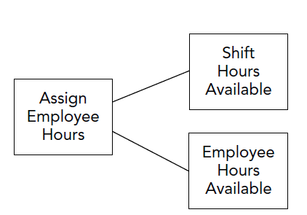
Architecture : Component‐Based
In component‐based software engineering (CBSE ), you regard the system as a collection of loosely coupled components that provide services for each other.

Slide 13
Architecture : Service‐Oriented
A service‐oriented architecture ( SOA ) is similar to a component‐based architecture except the pieces are implemented as services.
Sometimes, services are implemented as web services . Those are simply programs that satisfy certain standards, so they are easy to invoke over the Internet.
A service is a self‐contained program that runs on its own and provides some kind of service for its clients.

Slide 14
Architecture : Data‐Centric
Data‐centric or database‐centric architectures come in a variety of flavors that all use data in some central way.
Storing data in a relational database system.
Using tables instead of hard‐wired code to control the application.
Using stored procedures inside the database to perform calculations and implement business logic.

Slide 15
Architecture : Event‐Driven
In an event‐driven architecture ( EDA ), various parts of the system respond to events as they occur.
Notes:
A car dealer's system architecture may treat this state change as an event whose occurrence can be made known to other applications within the architecture. From a formal perspective, what is produced, published, propagated, detected or consumed is a (typically asynchronous) message called the event notification, and not the event itself, which is the state change that triggered the message emission. Events do not travel, they just occur. However, the term event is often used metonymically to denote the notification message itself, which may lead to some confusion. This is due to Event-Driven architectures often being designed atop message-driven architectures, where such communication pattern requires one of the inputs to be text-only, the message, to differentiate how each communication should be handled.

Slide 16
Architecture : Rule‐Based
A rule‐based architecture uses a collection of rules to decide what to do next.
These systems are sometimes called expert systems or knowledge‐based systems .
Rule‐based systems work well if you can identify the rules necessary to get the job done.
It is often used in artificial intelligence applications and research.
For example, an expert system might help a doctor choose the correct diagnosis based on a cluster of symptoms, or select tactical moves to play a game.
Notes:
In computer science, a rule-based system
A classic example of a rule-based system is the domain-specific expert system that uses rules to make deductions or choices. For example, an expert system might help a doctor choose the correct diagnosis based on a cluster of symptoms, or select tactical moves to play a game.
Rule-based systems can be used to perform lexical analysis to compile or interpret computer programs, or in natural language processing.
is used to store and manipulate knowledge to interpret information in a useful way. It is often used in artificial intelligence applications and research.

Slide 17
Architecture : Distributed
In a distributed architecture, different parts of the application run on different processors and may run at the same time.
The processors could be on different computers scattered across the network, or they could be different cores on a single computer.
Service‐oriented and multitier architectures are often distributed, with different parts of the system running on different computers.
Component‐oriented architectures may also be distributed, with different components running on different cores on the same computer.

Slide 18
Reports
Almost any nontrivial software project can use some kinds of reports.
Business applications might include reports that deal with
customers (who’s buying, who has unpaid bills, where customers live),
products (inventory, pricing, what’s selling well), and
users (which employees are selling a lot, employee work schedules).

Slide 19
Other Outputs
The application could generate :
printouts (of reports and other things),
web pages,
data files,
image files,
audio (to speakers or to audio files),
video,
output to special devices (such as electronic signs),
e‐mail,
or text messages (which is as easy as sending an e‐mail to the right address).
It could even send messages to pagers, if you can find any that aren’t in museums yet.

Slide 20
Database
The first part of database design is to decide what kind of database the program will need.
You need to specify whether the application will store data in
text files,
XML files,
a fulfill edged relational database, or
something more exotic such as a temporal database or object store.
Even a program that doesn’t use any database still needs to store data, perhaps inside the program within arrays, lists, or some other data structure.
Notes:
Often the tables in the database correspond to classes that you need to build in the code. At this point, it makes sense to write down any important classes you defi ne.
Those might include fairly obvious classes such as E mployee, Customer , Order , WorkAssignment , and Report . You’ll have a chance to refi ne those classes and add others during low‐level design
and implementation. For example, you might create subclasses that add refi nement to the basic high‐level classes. You could create subclasses of the Customer class such as P referredCustomer , C orporateCustomer , and I mpulseBuyer.

