Slide 1
Relational Model
  Structure of Relational Databases
  Database implementation - Case study

Slide 2

Example of a Relation

Slide 3
Basic Structure
Formally, given sets D1, D2, …. Dn
a relation r is a subset of D1 x D2 x … x Dn
Thus a relation is a set of n-tuples (a1, a2, …, an) where ai ∈ Di
Example: if
customer-name = {Jones, Smith, Curry, Lindsay}
customer-street = {Main, North, Park}
customer-city = {Harrison, Rye, Pittsfield}
        Then r = { (Jones, Main, Harrison),
        (Smith, North, Rye),
        (Curry, North, Rye),
        (Lindsay, Park, Pittsfield)
        }
is a relation over
customer-name x customer-street x customer-city

Slide 4
Attribute Types
Each attribute of a relation has a name
The set of allowed values for each attribute is called the domain of the attribute
Attribute values are (normally) required to be atomic, that is, indivisible
  E.g. multivalued attribute values are not atomic
  E.g. composite attribute values are not atomic
The special value null is a member of every domain
The null value causes complications in the definition of many operations
  we shall ignore the effect of null values in our main presentation and consider their effect later

Slide 5
Relation Schema
A1, A2, …, An are attributes
R (A1, A2, …, An ) is a relation schema
E.g. Customer-schema
(customer-name, customer-street, customer-city)
r(R) is a relation on the relation schema R
E.g. customer (Customer-schema)

Slide 6
Relation Instance
The current values (relation instance) of a relation are specified by a table
An element t of r is a tuple, represented by a row in a table
attributes
customer-name
customer-street
customer-city
Jones
Smith
Curry
Lindsay
Main
North
North
Park
Harrison
Rye
Rye
Pittsfield
tuples
customer

Slide 7
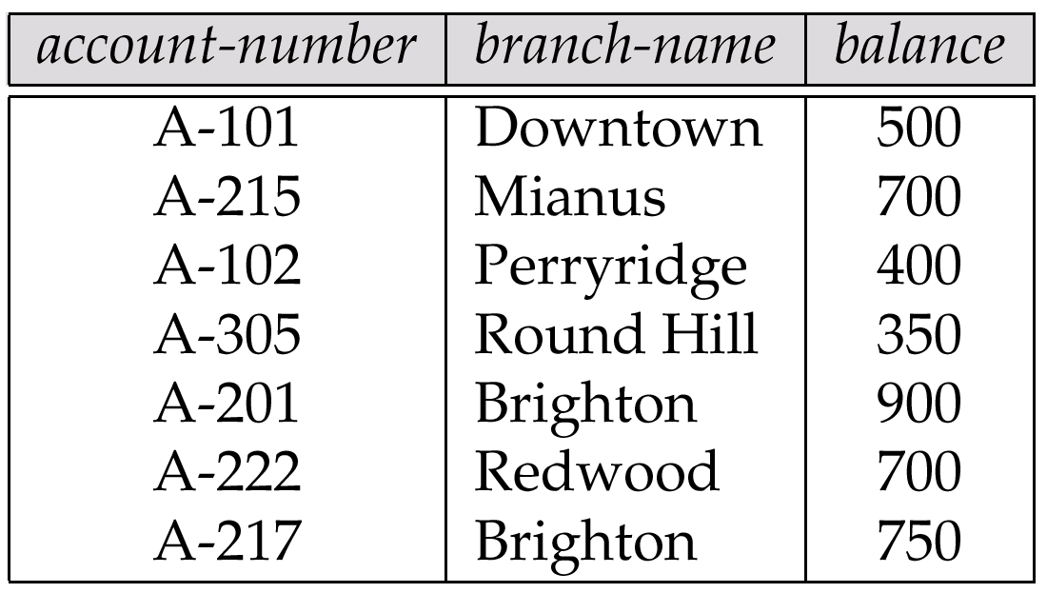
Relations are Unordered
Order of tuples is irrelevant (tuples may be stored in an arbitrary order)
E.g. account relation with unordered tuples

Slide 8
Database
A database consists of multiple relations
Information about an enterprise is broken up into parts, with each relation storing one part of the information
E.g.: account : stores information about accounts
depositor : stores information about which customer owns which account
customer : stores information about customers
Storing all information as a single relation such as
bank (account-number, balance, customer-name, ..)
results in
  repetition of information (e.g. two customers own an account)
  the need for null values (e.g. represent a customer without an account)
Normalization theory deals with how to design relational schemas

Slide 9
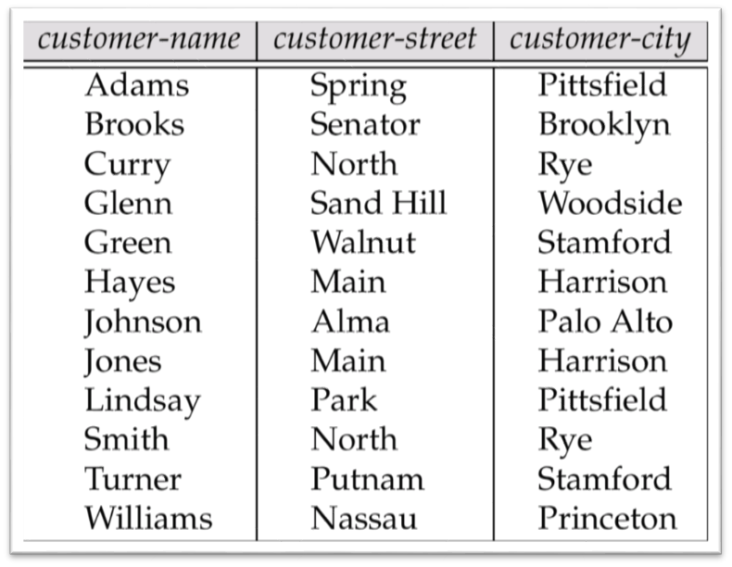
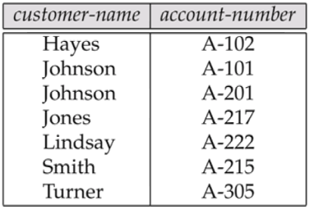
Example of Relations
The depositor Relation
The customer Relation

Slide 10
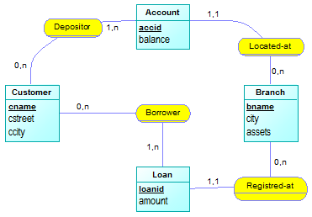
E-R Diagram for the Banking Enterprise

Slide 11
Keys
Let K ⊆ R
K is a superkey of R if values for K are sufficient to identify a unique tuple of each possible relation r(R) by “possible r” we mean a relation r that could exist in the enterprise we are modeling.
Example: {customer-name, customer-street} and
{customer-name}
are both superkeys of Customer, if no two customers can possibly have the same name.
K is a candidate key if K is minimal
Example:
      {customer-name} is a candidate key for Customer, since it is a superkey (assuming no two customers can possibly have the same name), and no subset of it is a superkey.

Slide 12
Determining Keys from E-R Sets
Strong entity set:
The primary key of the entity set becomes the primary key of the relation.
Weak entity set:
The primary key of the relation consists of the union of the primary key of the strong entity set and the discriminator of the weak entity set.
Relationship set:
The union of the primary keys of the related entity sets becomes a super key of the relation.
  For binary many-to-one relationship sets, the primary key of the “many” entity set becomes the relation’s primary key.
  For one-to-one relationship sets, the relation’s primary key can be that of either entity set.
  For many-to-many relationship sets, the union of the primary keys becomes the relation’s primary key

Slide 13
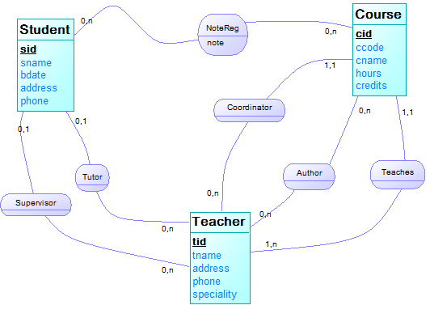
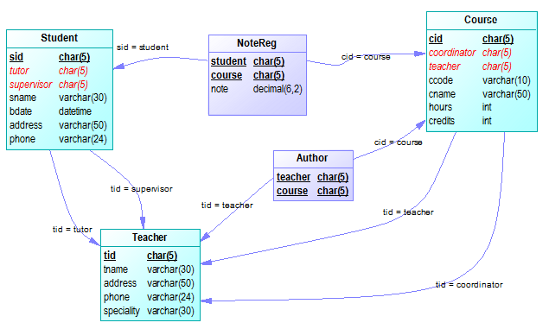
ER-Diagram to PD-Model / An example
Entity-Relationship Diagram
Conceptual Data Model
CASE Tool
Power Designer
Physical Data Model
Database Schema
Set of inter-related relations (tables)

Slide 14
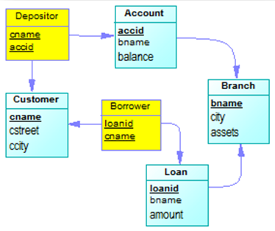
Schema Diagram for the Banking Enterprise
E.R.Diagram
Database schema
branch (brname, city, assets)
customer (cname, cstreet, ccity)
account (accid, #branch, balance)
loan (loanid, #branch, amount)
depositor (#customer, #account)
borrower (#customer, #loan)
P.D.Model

Slide 15
Case study - University Library
  Database design
    ER modeling
    Mapping ERDiagram to Database schema (Physical Data Model)
  DDL to create the database

Slide 16
University Library
Consider a typical university library to borrow books; the database-application of the library considers information about books, students, teachers, authors, publishers (publishing houses), and about borrowing operations.
The managers of the library enforce that a student will not be allowed to borrow more than three books simultaneously (during the same period). The library indicates that a book can be written by several authors.
Note that, there are several copies by book.
Questions:
Give the corresponding ER-diagram.
Transform the above ER-diagram into relational model; draw-up the corresponding physical diagram.
Give the DDL scripts leading to create the tables.

Slide 17
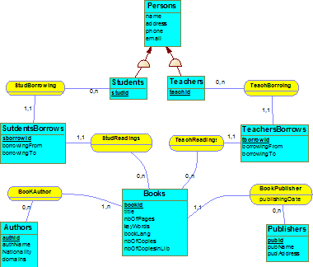
ERDiagram - 1

Slide 18
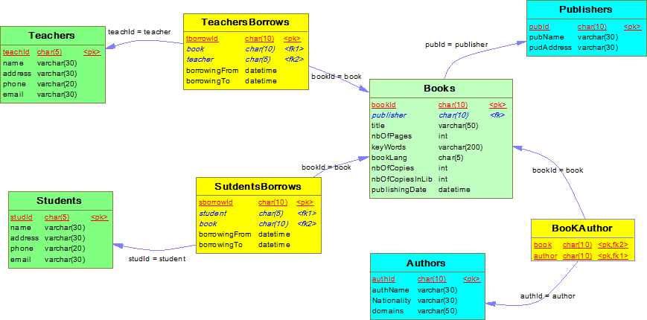
Physical Data model

Slide 19
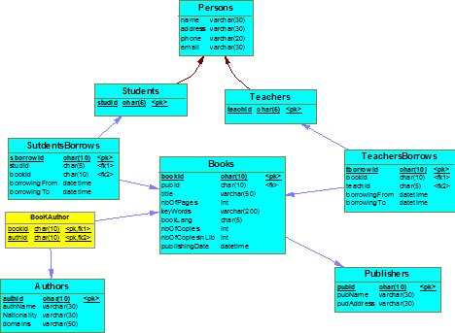
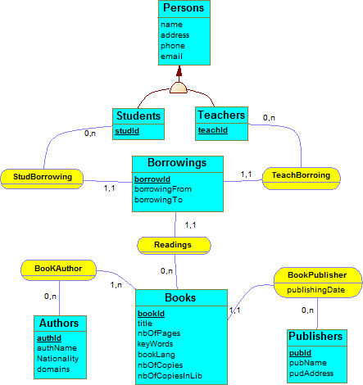
ERDiagram - 2

Slide 20
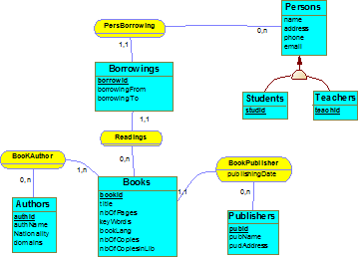
ERDiagram - 3

Slide 21
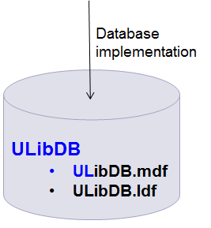
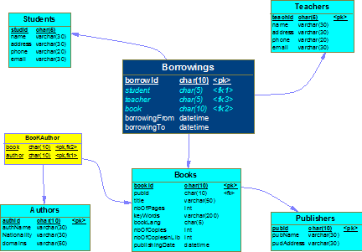
Database creation (1/2)
create table Books (
bookId char(10) not null,
publisher char(10) not null,
title varchar(50) null,
nbOfPages int null,
keyWords varchar(200) null,
bookLang char(5) null,
nbOfCopies int null,
nbOfCopiesInLib int null,
publishingDate datetime null,
-- key constraints
primary key (bookId),
foreign key (publisher)
references Publishers (pubId)
)
go
create table Students (
studId char(5) not null,
name varchar(30) null,
address varchar(30) null,
phone varchar(20) null,
email varchar(30) null,
-- key constraints
primary key (studId)
)
go
create table Authors (
authId char(10) not null,
authName varchar(30) null,
Nationality varchar(30) null,
domains varchar(50) null,
-- key constraints
primary key (authId)
)
go
create table Publishers (
pubId char(10) not null,
pubName varchar(30) null,
pudAddress varchar(30) null,
-- key constraints
primary key (pubId)
)
go
create table Teachers (
teachId char(5) not null,
name varchar(30) null,
address varchar(30) null,
phone varchar(20) null,
email varchar(30) null,
-- key constraints
primary key (teachId)
)
go

Slide 22
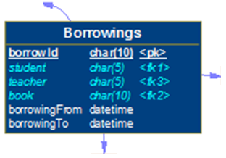

Database creation (2/2)
create table Borrowings (
borrowId char(10) not null,
student char(5) null,
teacher char(5) null,
book char(10) not null,
borrowingFrom datetime null,
borrowingTo datetime null,
-- key constraints
primary key (borrowId),
foreign key (student) references Students (studId),
foreign key (book) references Books (bookId),
foreign key (teacher) references Teachers (teachId)
)
create table BooKAuthor (
book char(10) not null,
author char(10) not null,
-- key constraints
primary key (book, author),
foreign key (book) references Books (bookId),
foreign key (author) references Authors(authId)
)

