Slide 1
Database Systems Introduction
Outlines
Database application architecture – an overview
Database Management System – an overview
Evolution of Database Technology
Centralized database system – topics & issues

Slide 2
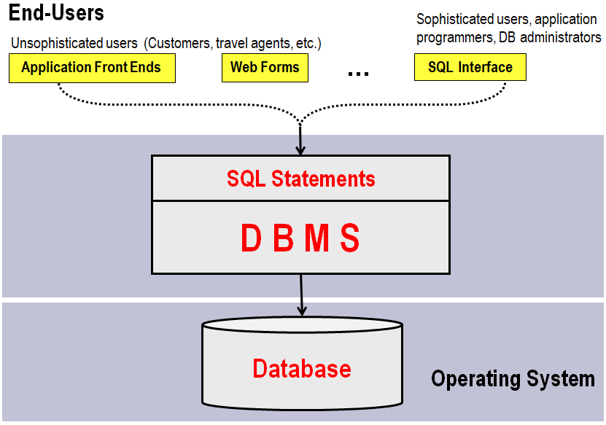
Simplified Database application architecture
Advanced Database Systems - Introduction

Slide 3
Database Management System DBMS – an overview
Advanced Database Systems - Introduction
What is DBMS?
A DBMS is a software package designed to store and manage databases.
DBMS provides an environment that it both convenient and efficient to use
Purposes - Why Use a DBMS?
DBMS were developed to handle the following issues/difficulties of typical file-processing systems supported by conventional operating systems:
Data independence and efficient access.
Difficulty in accessing data
Data integrity and security.
Data redundancy and inconsistency
Replication control
Uniform data administration.
Concurrent access, recovery from crashes.
Data isolation
…
Reduced application development time.

Slide 4
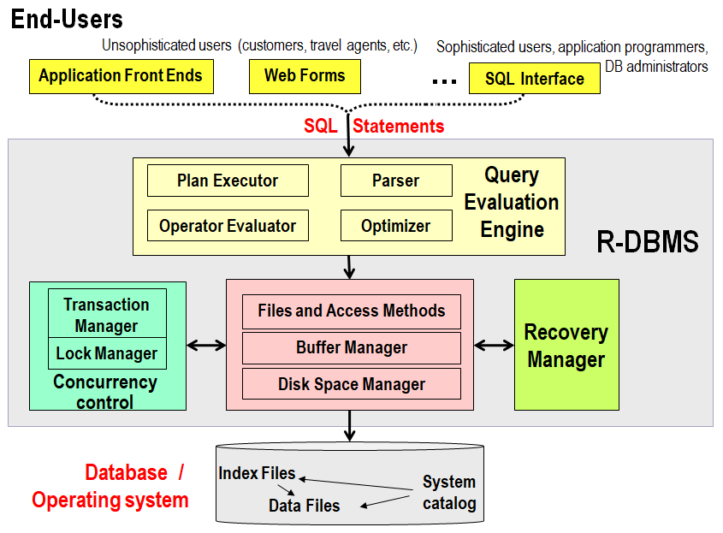
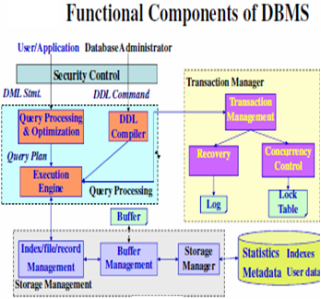
Structure of a DBMS
Advanced Database Systems - Introduction

Slide 5
Structure of a DBMS
Advanced Database Systems - Introduction

Slide 6
Evolution of Database Technology
Advanced Database Systems - Introduction
1960s: Hierarchical (IMS) & network (CODASYL) DBMS.
1970s: Relational data model, relational DBMS implementation.
1980: RDBMS rules the earth
1985: Advanced data models (extended-relational, OO, deductive, etc.)
Application-oriented DBMS (spatial, scientific, engineering, etc.).
1990s: ORDB, OLAP, Data mining, data warehousing, multimedia databases, and network databases.
2000s: Databases for XML, bioinformatics, stream data and sensor network data
The scientific revolution started in 1970 by Edgar (Ted) F. Codd (1923 - 2003 )
at the IBM San Jose Research Laboratory

Slide 7
database system related issues
Advanced Database Systems - Introduction
Storage and File Structure
Indexing and Hashing
Query Processing & optimization
Database Security and Authorization
Transaction Fundamentals @ concurrent transactions
Triggers
Stored Procedures / Functions
Cursor
Object-Oriented Databases

Slide 8
File Organizations, Indexing and Query Processing
Centralized database system related issues
Storage and File Structure
Physical Storage Media
Storage and File Organization
Indexing and Hashing
Ordered Indexes-Clustered / Un-clustered
Multi-level Indexes
Static/ Dynamic Hashing
Grid Files
Bitmap Indices
Index Definition in SQL
How file records are mapped onto disk blocks.
Indexing: speed up access of data.
Hashing: generate address of data record.
Parses, Validates and optimizes a given query before generating a low-level code
Query Processing
Basic Steps in Query Processing – an overview
Measures of Query Cost
Query Processing- Several algorithms
Query Optimization using Heuristics
Query tree, Graph tree
Transformation of Relational Expressions
Choice of Evaluation Plans
Structure of Query Optimizers
Evaluation of Expressions – Materialization, etc.
Statistics for Cost Estimation

Slide 9
Database Security and Authorization
Introduction to DB Security
Access Controls
Database Security and the DBA
Discretionary Access Control
Mandatory Access Control
Discretionary Access Control vs. Mandatory Access Control
Introduction to Statistical Database Security
Notes:
1

Slide 10
Transaction & Concurrency Control
Centralized Database Systems - Introduction
Transaction Fundamentals
Transaction Concept - ACID properties - States
Concurrent Executions – Schedules
Recoverability: Why recovery? Cascading rollback
Concurrency Control - Levels of Consistency
Transaction Definition in SQL
Database Concurrency Control Techniques
Purpose of Concurrency Control
Lock Protocols - serializability
The Two-Phase Locking (2PL) Protocol
Timestamp-Based Protocols - Recoverability and Cascade Freedom
Deadlock Handling
Locking and Insert, Delete Operations
Database Recovery
Database Recovery
Recovery and Atomicity
Log-Based Recovery
Checkpoints
Buffer Management - Log Record Buffering
Failure with Loss of Nonvolatile Storage
Shadow Paging
Notes:
ACID: atomicity, consistency, isolation, durability.

Slide 11
Object-Oriented Databases
Motivation
Engineering Database Design-overview
Object-oriented concepts
The Object-Oriented Data Model – An example of a class in UML
Object-Oriented Data Modelling - rapid overview
OO Data Modelling: Example

