Slide 1


Storage and File Structure
Overview of Physical Storage Media
Storage Access
File Organization
Organization of Records in Files
Data-Dictionary Storage
Storage Structures for Object-Oriented Databases

Slide 2
Classification of Physical Storage Media
Speed with which data can be accessed
Cost per unit of data
Reliability _{fiabilité}
  data loss on power failure or system crash
  physical failure of the storage device
Can differentiate storage into:
  volatile storage: loses contents when power is switched off
  non-volatile storage:
    Contents persist even when power is switched off.
    Includes secondary and tertiary storage.

Slide 3
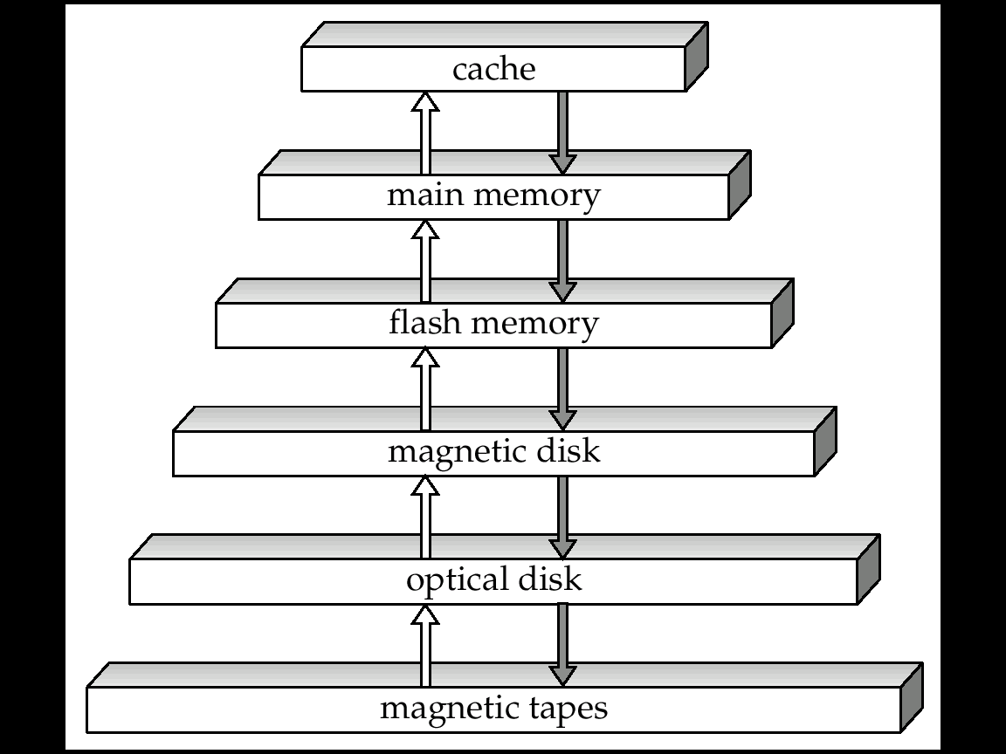
Storage Hierarchy
Speed
Capacity

Slide 4
Physical Storage Media
Cache – fastest and most costly form of storage;
  volatile; managed by the computer system hardware.
Main memory:
  fast access (10s to 100s of nanoseconds; 1 nanosecond = 10^{–9} seconds)
  generally too small (or too expensive) to store the entire database
    Capacities of up to a few Gigabytes widely used currently
    Capacities have gone up and per-byte costs have decreased steadily and rapidly (roughly factor of 2 every 2 to 3 years)
  Volatile — contents of main memory are usually lost if a power failure or system crash occurs.

Slide 5
Physical Storage Media (Cont.)
Flash memory
  Data survives power failure
  Data can be written at a location only once, but location can be erased and written to again
    Can support only a limited number of write/erase cycles.
    Erasing of memory has to be done to an entire bank of memory
  Reads are roughly as fast as main memory
  But writes are slow (few microseconds), erase is slower
  Cost per unit of storage roughly similar to main memory
  Widely used in embedded devices such as digital cameras
  also known as EEPROM (Electrically Erasable Programmable Read-Only Memory)

Slide 6
Physical Storage Media (Cont.)
Magnetic-disk
  Data is stored on spinning disk, and read/written magnetically
  Primary medium for the long-term storage of data; typically stores entire database.
  Data must be moved from disk to main memory for access, and written back for storage
    Much slower access than main memory (more on this later)
  direct-access – possible to read data on disk in any order, unlike magnetic tape
  Hard disks vs floppy disks
  Capacities range up to roughly 100 GB currently
    Much larger capacity and cost/byte than main memory/flash memory
    Growing constantly and rapidly with technology improvements (factor of 2 to 3 every 2 years)
  Survives power failures and system crashes
    disk failure can destroy data, but is very rare

Slide 7
Physical Storage Media (Cont.)
Optical storage
  non-volatile, data is read optically from a spinning disk using a laser
  CD-ROM (640 MB) and DVD (4.7 to 17 GB) most popular forms
  Write-one, read-many (WORM) optical disks used for archival storage (CD-R and DVD-R)
  Multiple write versions also available (CD-RW, DVD-RW, and DVD-RAM)
  Reads and writes are slower than with magnetic disk
  Juke-box systems, with large numbers of removable disks, a few drives, and a mechanism for automatic loading/unloading of disks available for storing large volumes of data

Slide 8
Physical Storage Media (Cont.)
Tape storage
  non-volatile,
  used primarily for backup (to recover from disk failure), and for archival data
  sequential-access – much slower than disk
  very high capacity (40 to 300 GB tapes available)
  tape can be removed from drive ⇒ storage costs much cheaper than disk, but drives are expensive
  Tape jukeboxes available for storing massive amounts of data
    hundreds of terabytes (1 terabyte = 10⁹ bytes) to even a petabyte (1 petabyte = 10¹² bytes)

Slide 9
Storage Hierarchy (Cont.)
primary storage: Fastest media but volatile (cache, main memory).
secondary storage: next level in hierarchy, non-volatile, moderately fast access time
  also called on-line storage
  E.g. flash memory, magnetic disks
tertiary storage: lowest level in hierarchy, non-volatile, slow access time
  also called off-line storage
  E.g. magnetic tape, optical storage

Slide 10
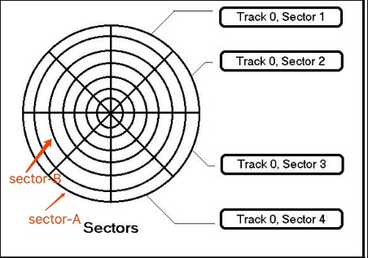
Optimization of Disk-Block Access
Block – a contiguous sequence of sectors from a single track
  data is transferred between disk and main memory in blocks
  sizes range from 512 bytes to several kilobytes
    Smaller blocks: more transfers from disk
    Larger blocks: more space wasted due to partially filled blocks
    Typical block sizes today range from 4 to 16 kilobytes
Disk-arm-scheduling algorithms order pending accesses to tracks so that disk arm movement is minimized
  elevator algorithm : move disk arm in one direction (from outer to inner tracks or vice versa), processing next request in that direction, till no more requests in that direction, then reverse direction and repeat

Slide 11
Optimization of Disk Block Access (Cont.)
File organization: optimize block access time by organizing the blocks to correspond to how data will be accessed
  E.g. Store related information on the same or nearby cylinders.
  Files may get fragmented over time
    E.g. if data is inserted to/deleted from the file
    Or free blocks on disk are scattered, and newly created file has its blocks scattered over the disk
    Sequential access to a fragmented file results in increased disk arm movement
  Some systems have utilities to de-fragment the file system, in order to speed up file access

Slide 12
Optimization of Disk Block Access (Cont.)
Nonvolatile write buffers speed up disk writes by writing blocks to a non-volatile RAM buffer immediately
  Non-volatile RAM: battery backed up RAM or flash memory
    Even if power fails, the data is safe and will be written to disk when power returns
  Controller then writes to disk whenever the disk has no other requests or request has been pending for some time
  Database operations that require data to be safely stored before continuing can continue without waiting for data to be written to disk
  Writes can be reordered to minimize disk arm movement
Log disk – a disk devoted to writing a sequential log of block updates
  Used exactly like nonvolatile RAM
    Write to log disk is very fast since no seeks are required
    No need for special hardware (e.g. NV-RAM)
File systems typically reorder writes to disk to improve performance
  keeps track of changes not yet committed to the file system's main part by recording the goal of such changes in a data structure known as a "journal“
  Journaling file systems write data in safe order to NV-RAM or log disk (circular log)
  Reordering without journaling: risk of corruption of file system data

Slide 13
  Storage Access
    Buffer Manager,
    Buffer-Replacement Policies
  File Organization
    Organization of Records in Files
    Un ordered, Ordered files
    Hashed files
  Data-Dictionary Storage

Slide 14
Storage Access
A database file is partitioned into fixed-length storage units called blocks. Blocks are units of both storage allocation and data transfer.
Database system seeks to minimize the number of block transfers between the disk and memory. We can reduce the number of disk accesses by keeping as many blocks as possible in main memory.
Buffer – portion of main memory available to store copies of disk blocks.
Buffer manager – subsystem responsible for allocating buffer space in main memory.

Slide 15
Buffer Manager
Programs call the buffer manager when they need a block from disk.
If the block is already in the buffer, buffer manager returns the address of the block in main memory
If the block is not in the buffer, the buffer manager
  Allocates space in the buffer for the block
    Replacing (throwing out) some other block, if required, to make space for the new block.
    Replaced block written back to disk only if it was modified since the most recent time that it was written to/fetched from the disk.
  Reads the block from the disk to the buffer, and returns the address of the block in main memory to requester.
disk page
Buffer pool
free frame
Data must be in RAM for DBMS to operate on it!
Table of <frame#, pageid> pairs is maintained.
Main Memory
Disk
DB
choice of frame dictated
by replacement policy

Slide 16
When a Page is Requested ...
If requested page is not in pool:
    Choose a frame for replacement
    If frame is not free, write it to disk
    Read requested page into chosen frame
Pin the page and return its address.
Requestor of page must unpin it, and indicate whether page has been modified: dirty bit is used for this.
Page in pool may be requested many times, a pin count is used. A page is a candidate for replacement if pin count = 0.

Slide 17
Buffer-Replacement Policies
Policy can have big impact on number of I/Os
Frame/Block is chosen for replacement by a replacement policy: Least-recently-used (LRU), Clock, MRU, etc.
Sequential flooding: Nasty situation caused by LRU + repeated sequential scans.
  # buffer blocks < # pages in file means each page request causes an I/O.
  MRU much better in this situation
Pinned block – memory block that is not allowed to be written back to disk.
Toss-immediate strategy – frees the space occupied by a block as soon as the final tuple of that block has been processed
Most recently used (MRU) strategy – system must pin the block currently being processed. After the final tuple of that block has been processed, the block is unpinned, and it becomes the most recently used block.
Buffer manager
  can use statistical (in memory) information regarding the probability that a request will reference a particular relation
  E.g., the data dictionary is frequently accessed
  also support forced output of blocks for the purpose of recovery

Slide 18
File Organization
The database is stored as a collection of files.
  A file is a sequence of records.
  A record is a sequence (collection) of fields (data values).
  A file descriptor (or file header) includes information that describes the file, such as the field names and their data types, and the addresses of the file blocks on disk.
  Records are stored on disk blocks.
  The blocking factor bfr for a file is the (average) number of file records stored in a disk block.
  A file can have fixed-length records or variable-length records.
    Fields themselves may be fixed length or variable length
    Variable length fields can be mixed into one record: Separator characters or length fields are needed so that the record can be “parsed.”
A file Must support:
  insert/delete/modify record
  read a particular record (specified using record id)
  scan all records (possibly with some conditions on the records to be retrieved)

Slide 19
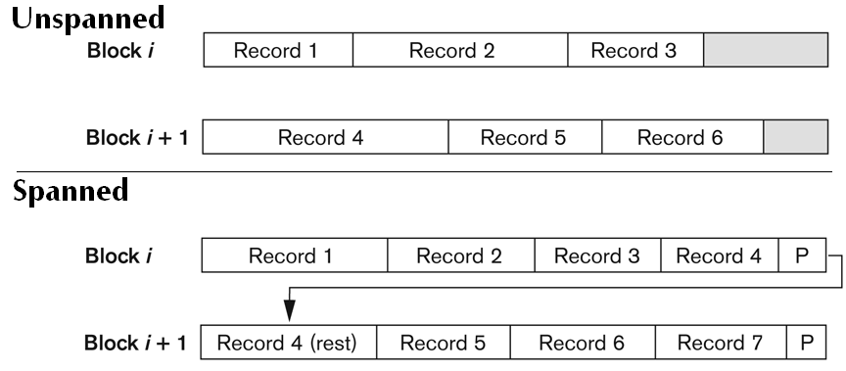
Files and records
File records can be unspanned or spanned
  Unspanned:
  no record can span two blocks
  Spanned: a record can be stored
  in more than one block
The physical disk blocks that are allocated to hold the records of a file can be contiguous, linked, or indexed.
Files and record-lengths:
  In a file of fixed-length records, all records have the same format. Usually, unspanned blocking is used with such files.
  Files of variable-length records require additional information to be stored in each record, such as separator characters and field types (Usually spanned blocking is used with such files).

Slide 20
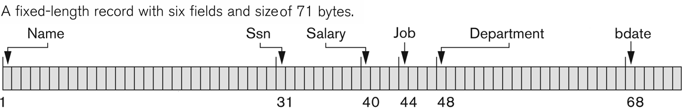
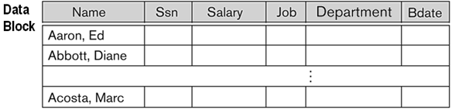
Fixed length Records
EMPLOYEE (name, ssn, salary job, department, bdate)
Fixed-length format
Easiest approach to implement:
assume record size is fixed
each file has records of one particular type only different files are used for different relations
Simple approach:
  Store record i starting from byte n ∗ (i – 1), where n is the size of each record.
  Record access is simple but records may cross blocks
Managing deleted records: Free Lists (at the file level)
Store the address of the first deleted record in the file header.
Use this first record to store the address of the second deleted record, and so on

Slide 21
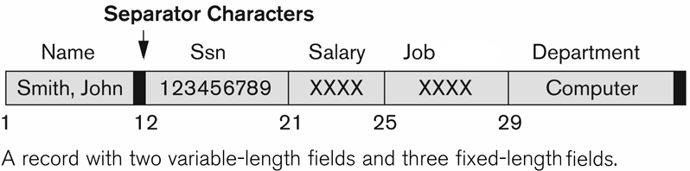
Variable-Length Records
Slotted Page Structure
Variable-length records arise in database systems in several ways:
  Storage of multiple record types in a file.
  Record types that allow variable lengths for one or more fields.
Employee (name, ssn, salary job, department,…)
Slotted page header (directory) contains:
  number of record entries
  start / end of free space in the block
  location and size of each record
Records can be moved around within a page to keep them contiguous with no empty space between them; entry in the header must be updated.
Pointers should not point directly to record — instead they should point to the entry for the record in header.
Slot directory- Number of Slots (entries) NE
1
2
i
19
20
NE=20
15
24
…
32
…
16
Rid=1, size 15
pointer
Rid=i, size 32
Occupied space
Free space
Start of free space

Slide 22
Organization of Records in Files
Unordered (Heap or a pile) files - Suitable when typical access is a file scan retrieving all records.
Sequential (ordered) files – store records in sequential order, based on the value of the search key of each record
Hashing files – a hash function computed on some attribute of each record; the result specifies in which block of the file the record should be placed
Special case :
  Records of each relation may be stored in a separate file.
  In a multitable clustering file organization records of several different relations can be stored in the same file
  Motivation: store related records on the same block to minimize I/O

Slide 23
Unordered (Heap) Files
Organization of Records in Files
Also called Heap or a pile files - Simplest file structure contains records in no particular order.
  Basically, new records are inserted at the end of the file, but a record can be placed anywhere in the file where there is space
  Record insertion is quite efficient.
  A linear search through the file records is necessary to search for a record.
  Reading the records in order of a particular field requires sorting the file records.
As file grows and shrinks, disk pages are allocated and de-allocated.
To support record level operations, we must:
  keep track of the pages in a file
  keep track of free space on pages
  keep track of the records on a page
There are many alternatives for keeping track of this.

Slide 24
Unordered File – different implementations
Organization of Records in Files
Implemented as a List
Using a Page Directory
Data
Page
Data
Page
Data
Page
Full Pages
  The header page id and Heap file name must be stored someplace.
  Each page contains 2-“pointers” plus data.
Header
Page
Data
Page
Data
Page
Data
Page
Pages with
Free Spaces
Data
Page 1
Header
Page
The entry for a page can include the number of free bytes on the page.
The directory is a collection of pages; linked list implementation is just one alternative.
  Much smaller than linked list of all heap file pages!
Data
Page 2
Data
Page N
DIRECTORY

Slide 25
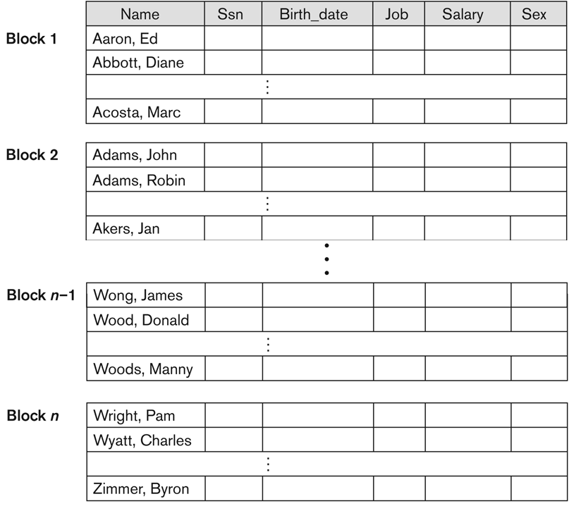
Sequential (Ordered) File Organization
Organization of Records in Files
The records in the file are ordered (sorted) by a search-key (ordering field)
    “Name” in the enclosed sample
Suitable for applications that require sequential processing of the entire file
A binary search can be used to search for a record on its ordering field value.
Deletion – use pointer chains
Insertion (is expensive):
  locate the position where the record is to be inserted
  if there is free space insert there
  if no free space, insert the record in an overflow block
  In either case, pointer chain must be updated
Need to reorganize the file from time to time to restore sequential order

Slide 26
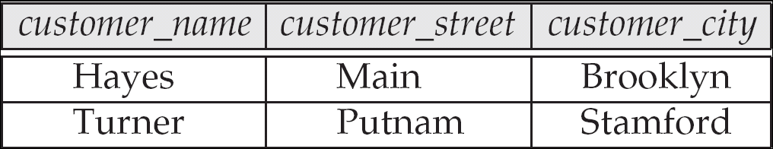
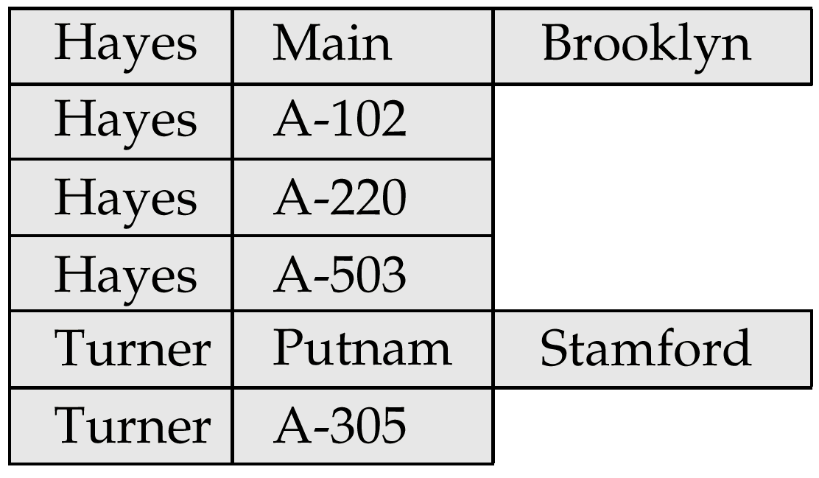
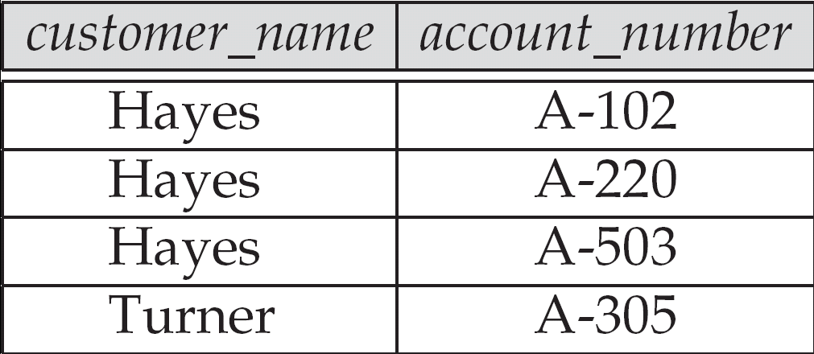
Clustering File Organization
Organization of Records in Files
Simple file structure stores each relation in a separate file
Clustering File:
Store several relations in one file using a multitable clustering file organization
A good for queries involving depositor joined-to customer, and for queries involving one single customer and his accounts
Bad for queries involving only customer
Multitable clustering organization of customer and depositor:
customer
depositor

Slide 27
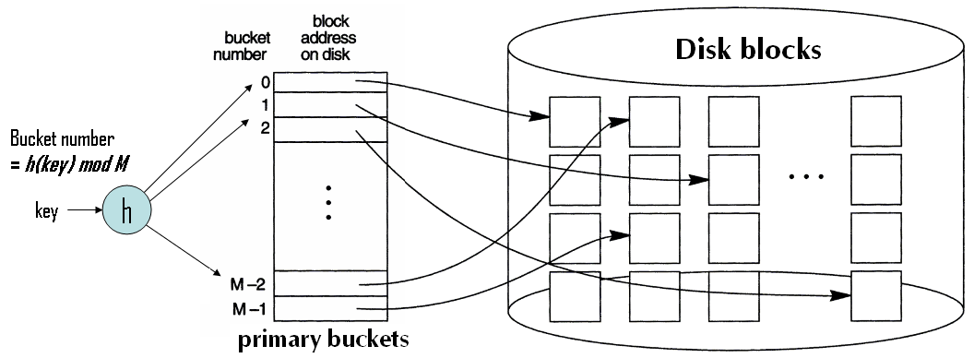
Hashed Files
Hashing for disk files is called External Hashing
  The file blocks are divided/arranged into M equal-sized buckets,
  numbered: bucket₀, bucket₁, ..., bucket_{M-1}.
  Typically, a bucket corresponds to one (or a fixed number of) disk block(s)
  Buckets contain data entries
One of the file fields is designated to be the hash key of the file.
Record with hash key value K is stored in bucket i, where
i=h(K), and h is the hashing function.
Search is very efficient on the hash key.

Slide 28
Hashed Files - Static Hashing
Number of primary buckets fixed, allocated sequentially, overflow buckets if needed.
Collisions occur when a new record hashes to a bucket that is already full.
  An overflow bucket is kept for storing such records.
  Overflow records that hash to each bucket can be linked together.
There are numerous methods for collision resolution, including the following:
  Open addressing: Proceeding from the occupied position specified by the hash address, the program checks the subsequent positions in order until an unused (empty) position is found.
  Chaining: various overflow locations are kept, usually by extending the array with a number of overflow positions. In addition, a pointer field is added to each record location. A collision is resolved by placing the new record in an unused overflow location and setting the pointer of the occupied hash address location to the address of that overflow location.
  Multiple hashing: The program applies a second hash function if the first results in a collision. If another collision results, the program uses open addressing or applies a third hash function and then uses open addressing if necessary.

Slide 29
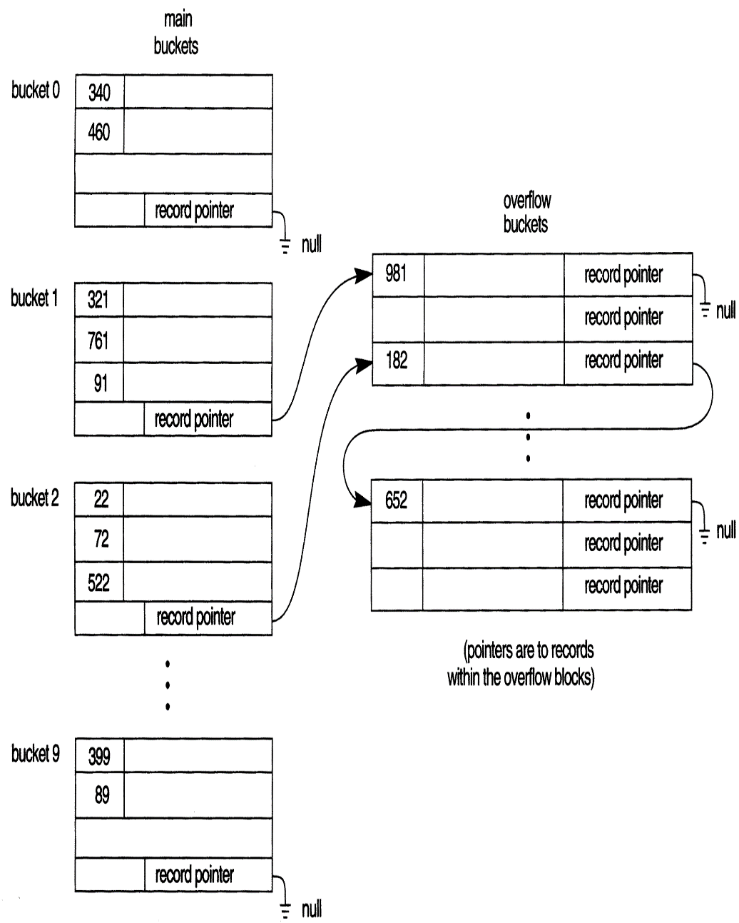
Hashed Files - Static Hashing
Overflow handling
The hash function h should distribute the records uniformly among the buckets
  Otherwise, search time will be increased because many overflow records will exist.
Main disadvantages of static external hashing:
  Fixed number of buckets M is a problem if the number of records in the file grows or shrinks.
  Ordered access on the hash key is quite inefficient (requires sorting the records).
Long overflow chains can develop and degrade performance.
  Extendible and Linear Hashing: Dynamic techniques to fix this problem.

