Slide 1

Capstone III
Statistical Analysis of Patient Health Outcomes
Allison Lawrence

Slide 2
Data Background Information
The dataset I used is from SmartviewMD.
This health device metric receiving application is utilized by a clinic in Miami, FL.
The data I used for this analysis is their testing environment data but the framework is the same so they will be able to implement the code for use with their actual patient data.

Slide 3
Data
There are 3690 records across 8 fields of data, but I will focus on the following for this analysis:
Cohort
Readings
Reading Types:
Glucose
Weight

Slide 4
Data
Reading Type | Count of Readings
Glucose | 410
Lower | 410
Peak Flow | 410
PI | 410
PR | 410
Pulse | 410
SpO2 | 410
Upper | 410
Weight | 410
Grand Total | 3690

Slide 5
Data
Cohort | Count of Patients
Cohort 1 | 35
Cohort 2 | 35
Reading Type: Glucose
Cohort | Count of glucose readings | Percent
Cohort 1 | 206 | 50.2%
Cohort 2 | 204 | 49.8%
Grand Total | 410 | 100%

Slide 6
Research Questions
Is there any correlation between glucose and weight?
Is there a significant difference between 2 cohort’s glucose readings?
One will represent a control group and the other an intervention group.

Slide 7
Hypotheses
Null Hypothesis 1:
There is no correlation between weight and glucose.
Alternate Hypothesis 1:
There is a correlation between weight and glucose.
Null Hypothesis 2:
There is no difference in glucose between cohort 1 and cohort 2.
Alternate Hypothesis 2:
There is a difference in glucose between cohort 1 and cohort 2.

Slide 8
How will the data test the hypotheses?
A Pair plot will be used to visually explore correlation between weight and glucose of patients.
This will be coupled with a Pearsonr Correlation test to examine if there is a statistically significant relationship as well as if there is a linear relationship.

Slide 9
How will the data test the hypotheses?
A Box plot will be used to examine where the glucose data falls between each cohort.
This will be coupled with a t-test to show if there is a statistically significant difference.

Slide 10
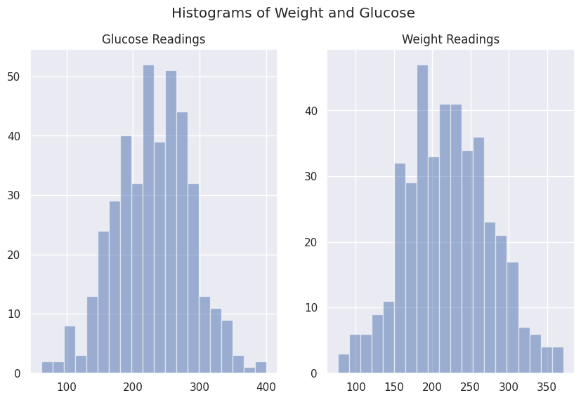
Analysis – Normal Distribution
Both variables are normally distributed, so it is reasonable to use the statistical testing results.

Slide 11
Rubric for Correlation Coefficient
Size of Correlation | Interpretation
.90 to 1.00 (-.90 to -1.00) | Very High Positive (Negative) Correlation
.70 to .90 (-.70 to -.90) | High Positive (Negative) Correlation
.50 to .70 (-.50 to -.70) | Moderate Positive (Negative) Correlation
.30 to .50 (-.30 to -.50) | Low Positive (Negative) Correlation
.00 to .30 (.00 to -.30) | Negligible Correlation

Slide 12
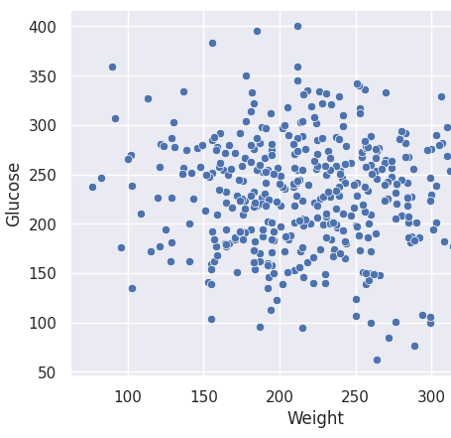
Analysis- Hypothesis 1: Correlation between Weight and Glucose
Fail to Reject the Null Hypothesis.
The correlation coefficient is -.056, which indicates a negligible correlation between the two variables.
p-value=0.258
.003% of the variability in weight is explained by the variability in glucose readings. (R-squared value: 0.003)
There is no significant or linear relationship between the 'Weight' and 'Glucose' variables.

Slide 13
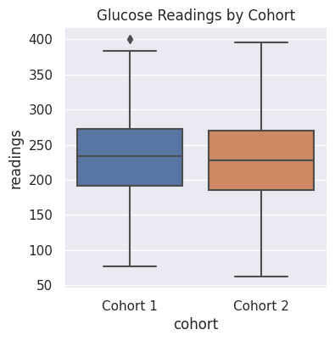
Analysis- Hypothesis 2: Significant Difference between Cohorts
There is no statistically significant difference in Glucose readings of Cohort 1 and Cohort 2
p-value=0.312
Fail to Reject the Null Hypothesis.

Slide 14

Final Message and Recommendations
Hypothesis 1
The Statistical Analysis shows there is no statistically significant or linear relationship between weight and glucose.
Recommendations
Doctors should continue to monitor their patient's weight and glucose levels on a case-by-case basis. Knowing that weight does not appear to be impacting glucose levels directly in this group of patients.

Slide 15

Final Message and Recommendations
Hypothesis 2
There is no statistically significant difference in Glucose readings of Cohort 1 and Cohort 2
Recommendations
Since there is no significant difference between cohort’s glucose readings, doctors should consider a different intervention for improving glucose levels in patients.

Slide 16

Final Message and Recommendations
Further Research
Another avenue for research could be inclusion of patient history. Correlations can be tested on patient’s lifestyles and their health metrics.
Ex. Smoking, diet, exercise, alcohol intake and other lifestyle choices can be compared to their health metrics.
For reference:
The proposal is here.
The Colab Notebook is here.

Slide 17

Questions

