Slide 1
Empty Code First
ADO data model

Slide 2


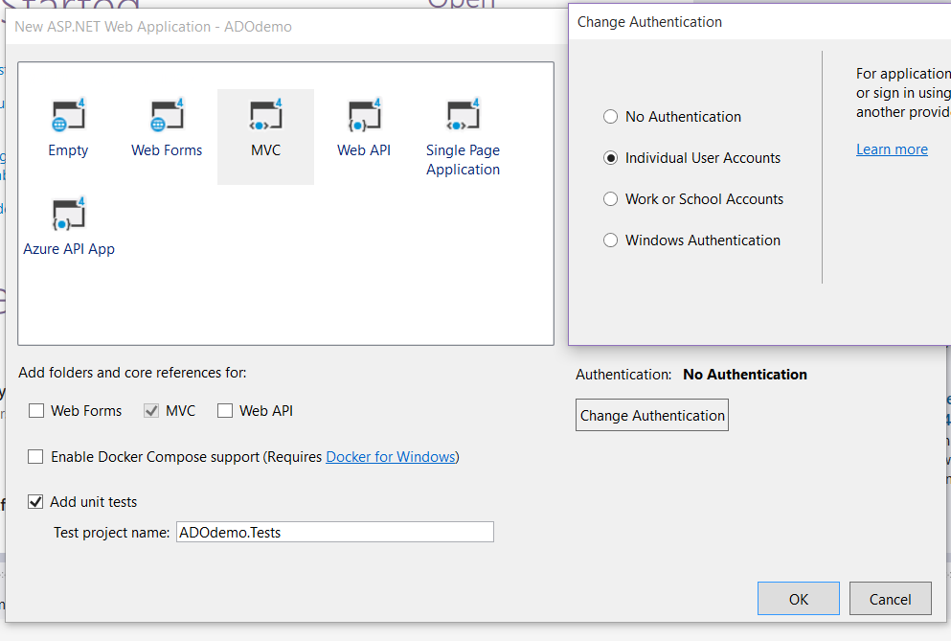



Create MVC Project
File ▶ New Project ▶
Asp.Net Web Application
Name it as you see fit
Select the MVC template
Check the box for the MVC’s references
Add unit tests
Change Authentication to Individual User Accounts

Slide 3
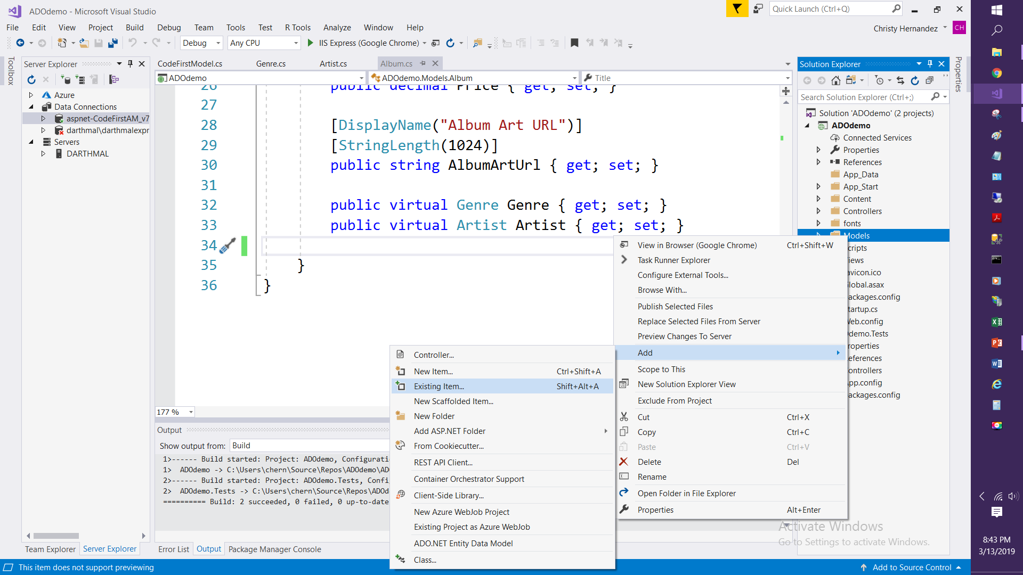

Add Existing Items (Classes)
Right click the Models folder and Add Existing items.
Navigate to the classes you want to use
OR
Add New Item
Add and Name Class
Add Code to the Class

Slide 4
Classes needed to get started
public class Artist
{
public int ArtistId { get; set; }
public string Name { get; set; }
}
public class Album
{
[ScaffoldColumn(false)]
public int AlbumId { get; set; }
public int GenreId { get; set; }
public int ArtistId { get; set; }
public string Title { get; set; }
public decimal Price { get; set; }
public string AlbumArtUrl { get; set; }
public virtual Genre Genres { get; set; }
public virtual Artist Artists { get; set; }
}
public class Genre
{
public int GenreId { get; set; }
public string Name { get; set; }
public string Description { get; set; }
public List<Album> Albums { get; set; }
}

Slide 5
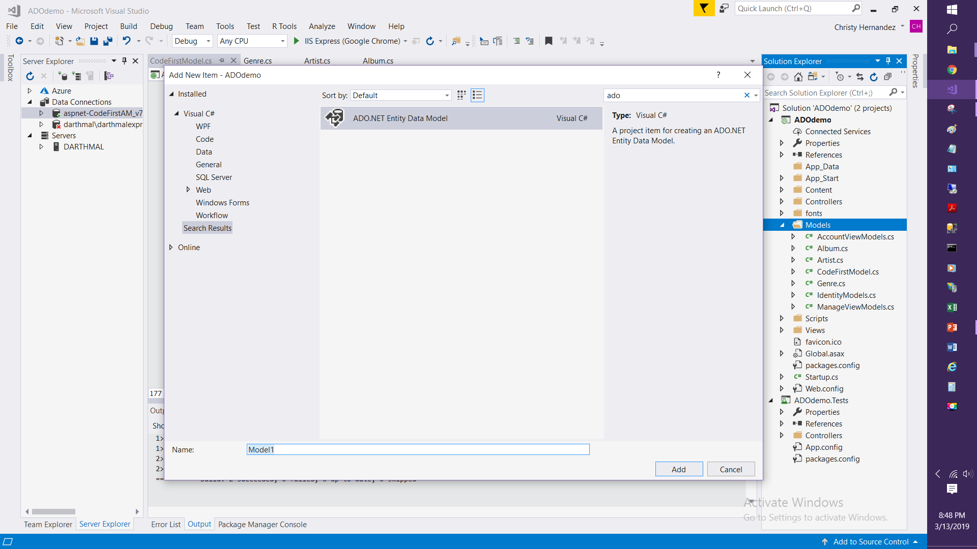
Add ADO Data Model
Right click
Models Folder
Add New Item
Search ADO
Name the Data Model

Slide 6
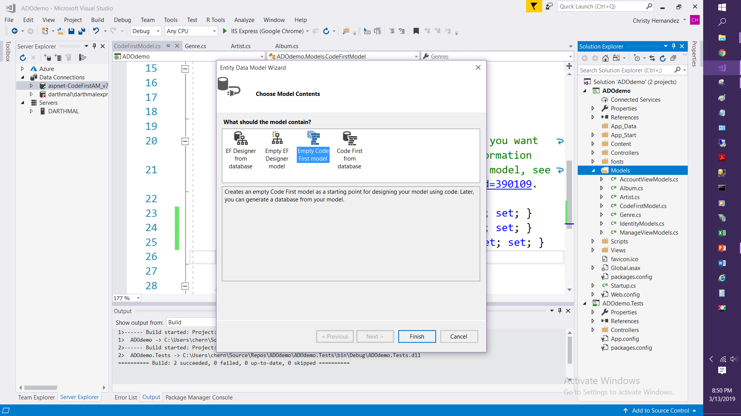
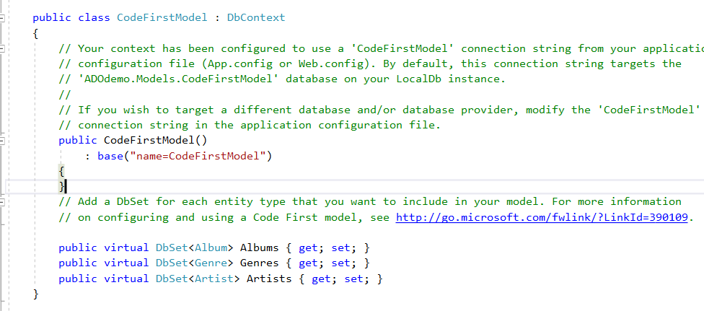
Creating the Data Model
Select Empty Code First Model
Open the Class that was created
Around line 20 you will see
// public virtual DbSet<MyEntity> MyEntities { get; set; }
Uncomment the code and change the code to reflect the classes you just added to the project

Slide 7
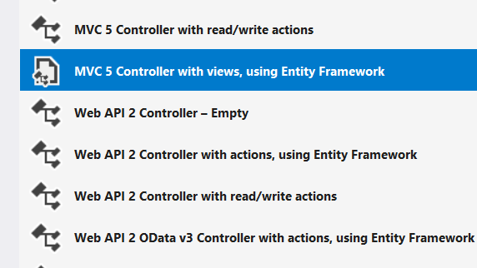
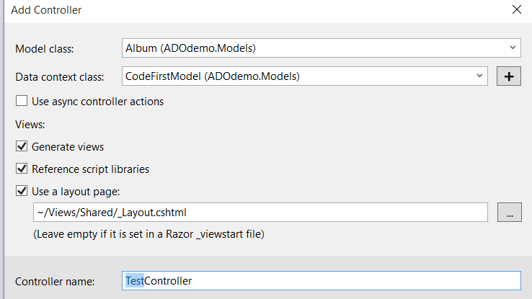
Build Project & Test
Image 1:
Image 1:
After a successful Build
Right click the Controllers Folder
Add Controller
Select: MVC 5 Controller with views , using Entity Framework
Image 2:
Model Class select Album
Data Context Class is the ADO Model class you just made in slide 4 and 5
Name it TestController
Image 2:

Slide 8
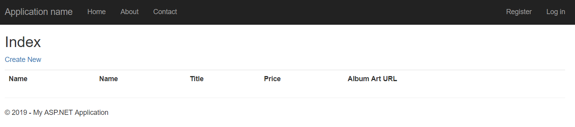
View in Browser
After the TestController is done Scaffolding the Views
Right click the Index View of the TestController
And view in Browser
Index View is located, inside the Views Folder, sub folder Test then Index. .

