Slide 1
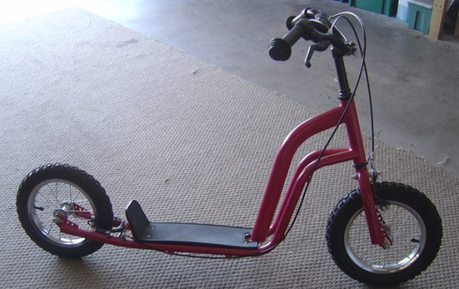
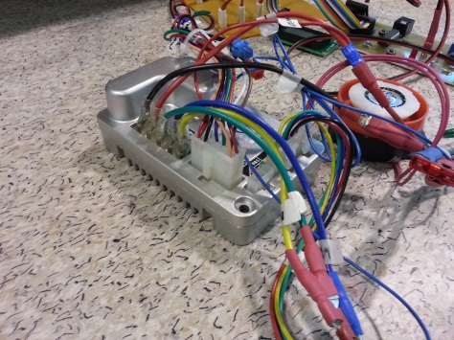
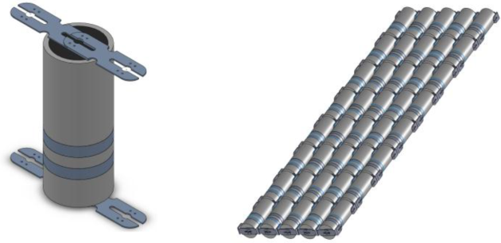
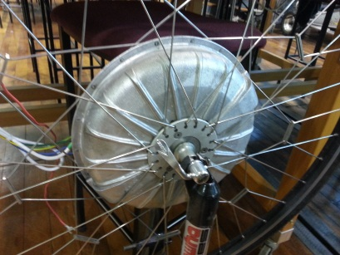

Direct Drive Electric Scooter
Goal
Design and develop a Direct Drive
Electric Scooter as an alternative
form of urban transportation.
Specifications
Use a BLDC motor, Golden Gate Motor Controller from previous “E-Bike” project along with 40 $LiFePO_{4}$ Cells.
Implement a “boost feature” Using Current Feedback and creating an $I^{2}t$profile.
Integrate current signal to estimate remaining battery charge.
Supervisor - Dr. Paul Gaynor
Student - Matt Kokshoorn

Slide 2
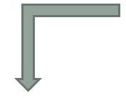
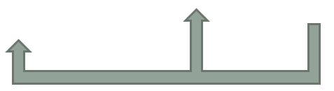
System Overview
Supply
LCD Display:
Remaining Battery.
Motor Speed.
Current Signal
Current Transducer Board
User Control:
Throttle
Break
Boost
μContoller:
Over Current Management.
Throttle
Signal
Motor Speed Controller
BLDC
Motor
Speed Signal

Slide 3
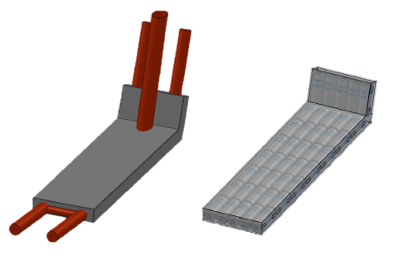
Mechanical & Electrical Design

Slide 4


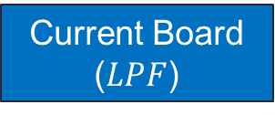





Signal Conditioning
1st Order RC Filter
2nd Order Sallen-Key Filter
$$f_{c}=\frac{1}{2πτ}=\frac{1}{2πRC}$$
$f_{c}=\frac{1}{2π\sqrt{R_{1}R_{2}C_{1}C_{2}}}$
Normal Control Strategy
$$0−5V$$
$$PWM$$
$$0−5V$$
$$Motor \\ Speed \\ Contoller$$
Throttle Input
$$μControler$$
Current Board ($LPF$)
Current Signal Feedback

Slide 5



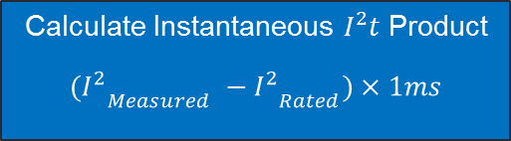


Overcurrent Algorithm
Basis - Can run motor at twice the rated current for 60 seconds when boost is activated.
Note: $I_{measuerd}$ is also used
for remaining charge calculation.
Initilise $I^{2}t$product to zero
millisecond interrupt
Measure Current
Disable Overcurrent by Reducing Output Speed Signal
Re-enable Overcurrent if
$I^{2}t \text{P}\text{roduct}$ < $\frac{I^{2}t Limit}{2}$
Calculate Instantaneous $I^{2}t$ Product
$$({I_{}^{2}}_{Measured} −{I_{}^{2}}_{Rated})×1ms$$
NO
Add Difference to $I^{2}t$product
$$I^{2}t \text{P}\text{roduct}$$
$\text{Limit}$
Exceeded ?
YES

Slide 6

Demonstration Set-up Values
Motor Specifications
In standard operation the motor rating are,
- 400W Rated Power (15.15A at 26.4V).
- 800W Peak Power (30.3A at 26.4V).
Capable of 60 seconds of peak power
i.e. An $I^{2}t$ product limit of 38640${ A}^{2}s.$
For the purpose of this demonstration:
- 92.4W Rated Power (3.5A at 26.4V).
- 184.8W Peak Power (7A at 26.4V).
Capable of 10 seconds of peak power
i.e. An $I^{2}t$ product limit of $245A^{2}s.$
Supply
8 series sets of 5 Parallel giving,
26.4V
11.5 Ahr
303.6 Whr.

Slide 7
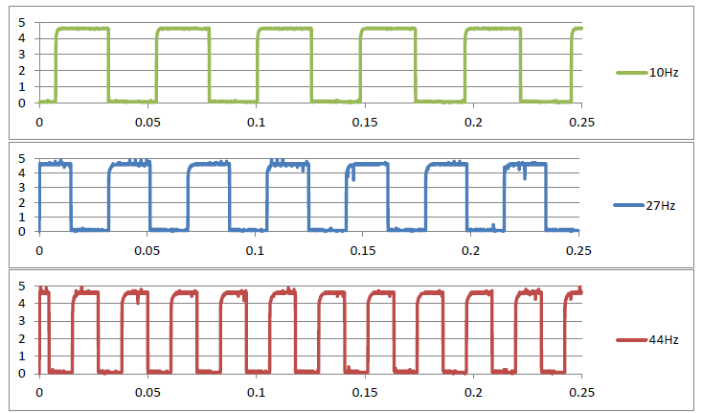






Speed Waveform
$$V_{scooter}= \frac{C_{\left(ms^{−1} → kmhr^{−1}\right)}×2πr_{wheel}×f_{signal}}{N_{Hall Effect Sensors }}$$
$$4 km hr^{−1}$$
$$C_{\left(ms^{−1} → kmhr^{−1}\right)}×=3.6$$
$2πr_{wheel}$ $= 94cm$
$$11 km hr^{−1}$$
$N_{Hall Effect Sensors }$ $= 8$
$$18 km hr^{−1}$$

Slide 8
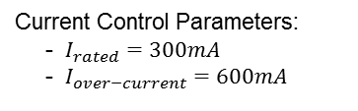
Motor Current Waveform (No Load)

Slide 9
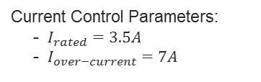
Motor Current Waveform (Loaded)
Current Control Parameters:
- $I_{rated}=3.5A$
- $I_{over−current}=7A$

Slide 10
Encountered Problems & Solutions
Regenerative breaking not working -> Pull down resistor added.
Throttle malfunction -> Hall Effect sensor replaced.
Unstable Current Limiting -> PID Controller.
Future Work
Insulation and Protection.
Regenerative Breaking Current Testing.
Charging Connection.
Optimization of PID Gains.
Increased Acceleration.
Acknowledgements:
Dave Healy (Mechanical Fabrication).
Ken Smart (Workshop Assistance / Mechanical Load).

