Slide 1

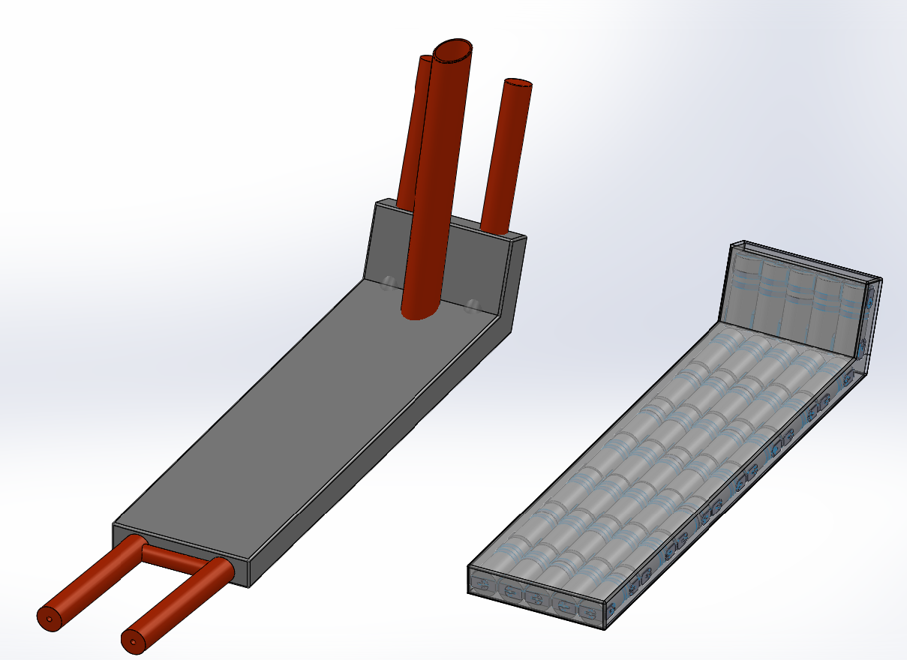
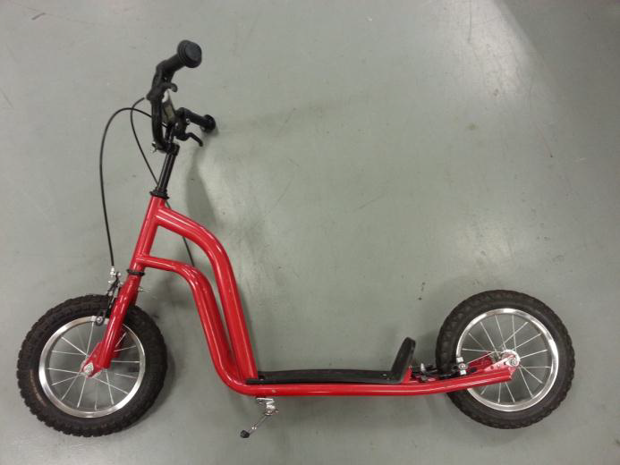
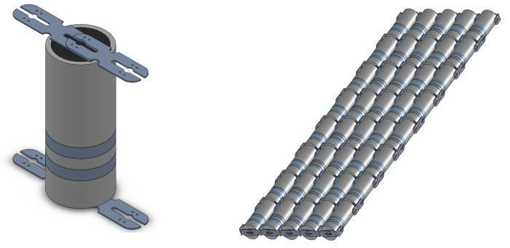
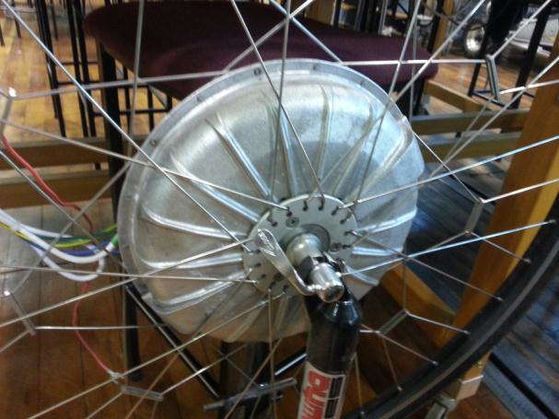

Direct-Drive Electric Scooter Development
Matt Kokshoorn PT Gaynor mlk28@uclive.ac.nz paul.gaynor@canterbury.ac.nz
3rd Professional Year Project Department of Electrical & Computer Engineering, UC
The Concept
The concept of the Direct Drive Electric Scooter is to provide an alternative form of transport for short range urban transport. This addresses concerns for sustainability in two main ways. The first is by providing a road efficient form of transportation capable of being stored indoors. The second is by providing a clean and renewable means of transportation at a affordable initial and on going cost.
A lot of commercially available electric scooters tend to be slow and inefficient. This concept utilizes a set of new generation Lithium Iron Phosphate ($LiFePO_{2}$) batteries and a brushless direct current (BLDC) Hub Motor. The batteries and motor
are capable of high power densities
(power/kg) and therefore make them
ideal for light weight vehicles such as
this. By using this technology, we
hope to overcome some of the
weight issues associated with other
electric scooters and therefore
improve the speed and efficiency.
Initial Designs
The Direct Drive Electric Scooter Project aims convert a commercially available children’s scooter into a fully functionally electric scooter. To do this a number of mechanical and electrical and modifications need to me made.
The initial designs involve the integration of the battery cell array into the frame of the scooter itself. This will reduce the overall weight gain and avoid taking up excess volume. An interface will need to be developed to allow the user to interact safely with the motor speed controller and activate features such as regenerative breaking and a ‘boost’ function.
Scooter
Lithium Iron Phosphate Battery
Required Battery Structure
Proposed Battery Casing
BLDC Hub Motor
Notes:
Title of poster should be in 90pt Bold Verdana
All Text should either be Black or White.
The logo and the title must stay in the brand space at the top of the poster.

