Slide 1
Jefferson SURP 2023
R for Beginners
Workshop 2
😱
😎
Tess Cherlin, PhD
tess.cherlin@pennmedicine.upenn.edu
@alldayscientess

Slide 2
R for Beginners
This is going to be hands-on and hopefully fun!
It’s not going to be perfect or exhaustive (I don’t know everything!!!)
There are many ways to do everything – when in doubt GOOGLE “how do I ______ in R?” (or ChatGPT!!!)
Notes:
I’m not an expert

Slide 3
R Workshop Overview
Week 1: R For Beginners
Week 2: More advanced and relevant data analysis and plotting
Week 3: Make publication-ready figure

Slide 4
Objectives
Goal
To become familiar and comfortable with the basics of using R packages to make reproducible custom tables and plots that are can be shared in a report format.
Go over everyone’s barplots from last time
Provide a brief introduction to RMarkdown
Learn how to create and manipulated different tables in R
Learn the basics of the ggplot package
Create custom ggplot
Make (knit) Rmarkdown report
Discuss final project

Slide 5
Barplot time!!!
Notes:
I’m not an expert

Slide 6
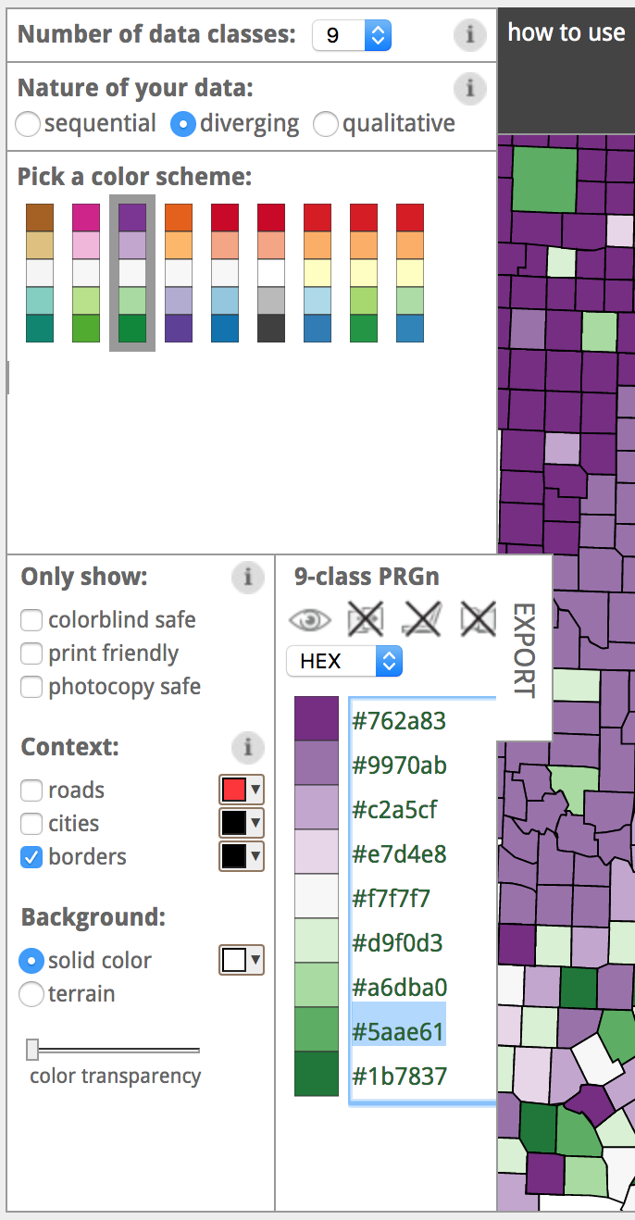
https://colorbrewer2.org/

Slide 7
https://colorbrewer2.org/

Slide 8
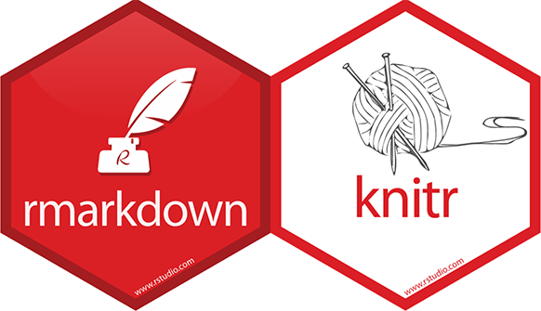
What is R Markdown?
R Markdown is a document format that combines the features of Markdown, a lightweight markup language, with embedded R code and its output. It allows you to create dynamic documents that seamlessly integrate text, code, and visualizations. R Markdown files have the extension .Rmd.
Notes:
I’m not an expert

Slide 9
Why use R Markdown?
Reproducible Research: R Markdown supports reproducible research by providing a framework to combine code and results in a single document. This enables others to easily reproduce your analysis and ensures transparency.
Dynamic Reports: R Markdown allows you to generate reports, presentations, dashboards, and other types of documents dynamically. The content can be automatically updated by re-knitting the document when the underlying data or code changes.
Interactivity and Customization: R Markdown supports interactive elements such as Shiny applications, HTML widgets, and JavaScript libraries. You can customize the appearance, layout, and formatting of your documents using CSS, HTML, and LaTeX.
Collaboration and Sharing: R Markdown documents can be easily shared, collaborated on, and version-controlled using platforms like GitHub or through file-sharing services. They can be rendered into various output formats, including HTML, PDF, Word, PowerPoint, and more.
Notes:
I’m not an expert

Slide 10
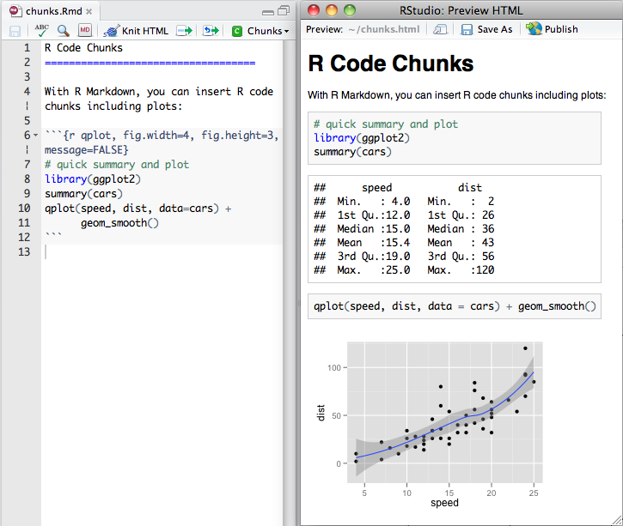
What does R Markdown look like?
YOUR TURN!!!
https://rmarkdown.rstudio.com/authoring_quick_tour.html
Notes:
I’m not an expert

Slide 11
Step 1: RMarkdown
Open Posit
Start a new Project
Learn basic RMarkdown commands
Learn basics of commenting
Make R Markdown report
Notes:
I’m not an expert

Slide 12
Step 2: Making tables
Upload RNAseq_Data_1.csv and RNAseq_Data_2.csv file2
Get to know the data
Try out different types of tables
Notes:
I’m not an expert

Slide 13
Step 3: Making ggplot
Learn the basics off ggplot2
Make a basic ggplot boxplot
Make some example plots based on data
Notes:
I’m not an expert

Slide 14
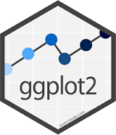
What is ggplot2?
ggplot2 is a popular data visualization package in R that allows users to create visually appealing and customizable graphics. It is based on the principles of the Grammar of Graphics, which provides a structured framework for building visualizations by combining different components.
Notes:
I’m not an expert

Slide 15
Next Time

Slide 16
References
Data used was from a project done in 2020 with Dr. Jeff Rappaport

Slide 17
Thank you!!!
Tess Cherlin, PhD
tess.cherlin@pennmedicine.upenn.edu
@alldayscientess

