Slide 1
[509497] WEB AND SOCIAL NETWORKS SEARCH AND ANALYSIS
Reddit Community
Analysis :
A Network & Content Approach
Alexandra Dumitrescu - 516397
Sailina Singh Chaudhary - 514586

Slide 2
Introduction
This project is focused on analyzing the Reddit community's reaction and discussion to the announcement of Taylor Swift's 1989 (Taylor's Version), on August 9, 2023.
It aims to understand engagement patterns, identify influential users, examine thematic conversations, and evaluate sentiment across discussions.

Slide 3
Project Overview
Data Gathering & Analysis
Sentiment Analysis
Network Analysis
Centrality Analysis
Community Detection
Thematic Analysis
Engagement Patterns

Slide 4
Objective of the Analysis
Understand user interaction patterns in a Reddit discussion community. Identify influential users and distinct fan communities. Explore the key conversation themes (e.g., clowning, hints, imagery). Evaluate the sentiment of users across themes and communities.

Slide 5
Data Collection
Data Source: Subreddits related to the artist (e.g., r/TaylorSwift) Collected Data: Comments & metadata including author, score, body, sentiment score. Interaction graph mapping comment replies to edges. Textual content used for thematic and sentiment analysis.

Slide 6
Data Collection Results
2,585 unique posts found before filtering.
52 posts within the target date range.
4,528 comments collected from 2,468 unique users.

Slide 7
Sentiment Analysis
Used VADER (Valence Aware Dictionary and sEntiment Reasoner) for sentiment analysis.
VADER is designed for social media text; it scores each comment as positive, neutral, or negative.
Each comment’s sentiment was categorized based on its compound score.

Slide 8
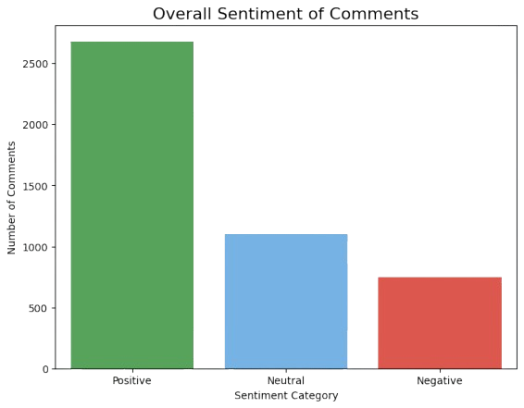
Sentiment Analysis : Results
Positive: 59.2% of comments
Neutral: 24.3%
Negative: 16.5%
The community’s response was overwhelmingly positive.

Slide 9
Network Analysis
Built a user network, where :
each user is a node,
edges connect users who commented on the same post.
Used NetworkX for graph construction.
Calculated network density and visualized user connections.

Slide 10
Network Analysis : Results
2,468 nodes (unique users)
334,659 edges (connections)
Graph density: 0.1099 (moderately connected)
Indicates a well-connected, interactive community.

Slide 11
Centrality Analysis
Calculated degree centrality: measures how many other users each user interacted with.
High degree centrality = highly influential or well-connected user.
Identified top 10 most central users.
These users acted as key connectors in the network.

Slide 12
Community Detection
Used the Louvain algorithm to detect communities.
The Louvain algorithm groups nodes to maximize modularity, finds communities with more internal connections than expected by chance.
Each user assigned to a community based on their connections.

Slide 13
Community Detection : Results
12 distinct communities detected.
Largest community: 809 members
Second largest: 728 members
Communities represent different sub-groups within the fanbase.

Slide 14
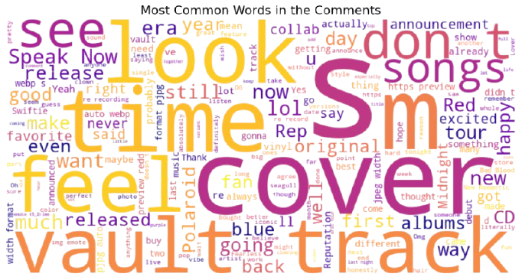
Thematic Analysis
Tracked keywords in comments to identify major discussion themes.

Slide 15
Engagement Patterns
Posts about vault tracks and album details generated the most discussion.
Comments ranged from short reactions to detailed thoughts.
High engagement and participation across the community.

Slide 16
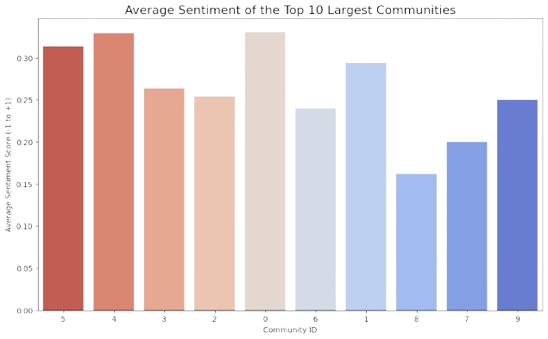

Slide 17
Conclusion
This analysis provided comprehensive insights into how the Reddit community reacted to Taylor Swift's 1989 (Taylor's Version) announcement, revealing patterns in sentiment, community formation, and thematic discussions across different fan communities.

Slide 18
Thank you!

