Slide 1
Chapter 7, 8, 9
Modules, Testing, Exceptions

Slide 2
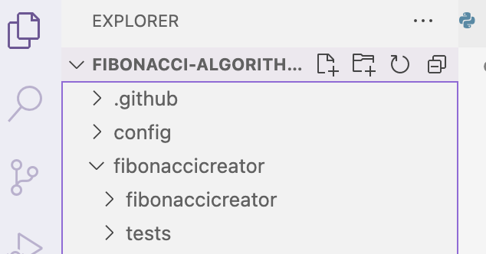
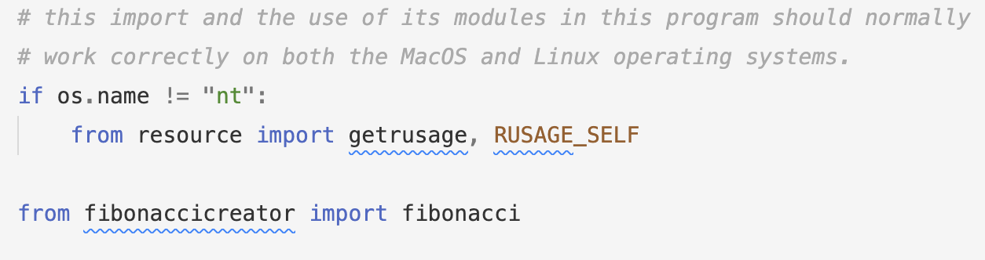
File structure
Larger programs cannot be written in one script
Modular programming: breaking large coding tasks into smaller, manageable subtasks.
In python, multiple files can be connected using import
e.g. Current Lab: Fibonacci Engineering Effort

Slide 3
Terms
Module: .py file
  fibonacci.py
  main.py
  test_fibonacci.py
symbol: anything that is defined or assigned in the global scope of a module
  functions
    fibonacci_recursivelist (function in fibonacci.py)
  classes
  global variables
    FIBONACCI_FUNCTION_BASE (global variable in main.py)
namespace: refers to the name of the original module
fully-qualified name:using a name that has the namespace and the symbol name separated with .
  fibonacci.fibonacci_recursivelist
  main.FIBONACCI_FUNCTION_BASE
Package: directory
  any directory that will be used like a package must also contain a file named __init__.py
Library: a package with subpackages

Slide 4
Imports
from MODULE import SYMBOL
import MODULE
import MODULE as ALIAS
import PACKAGE
from PACKAGE import MODULE
from PACKAGE import MODULE.SYMBOL
import PACKAGE.SUBPACKAGE
etc

Slide 5
Package vs Module Example
fibonaccicreator: package
fibonacci: Module inside the package
Package is a fancy term for directory
  any directory that will be used like a package must also contain a file named __init__.py

Slide 6
Colab - importing
https://forms.gle/vD1yNqgcKjbPksiv8

Slide 7
Chapter 8 - Testing and Debugging
"Testing is the process of running a program to try and ascertain whether it works as intended. Debugging is the process of trying to fix a program that you already know does not work as intended."
Testing often refers to testing whether the specifications are met
i.e. did the function is_prime actually return true for primes and false for non-primes?
Black-box testing

Slide 8
Testing logic
If you want to test something based on specifications
examine the inputs and outputs as stated in the specs
  Docstrings usually contain the specifications
  Make sure you write good docstrings
partition the input/output space into all meaningful categories
test simplest thing in each partitioned category
if the test fails…then
DEBUG!

Slide 9
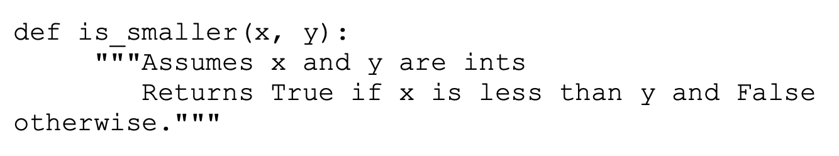
Example
boundary condition!
spec: inputs are x,y
spec: output true if x is less than y…
Partitions:
  x less than y → true
  y less than x → false
  x == y → false
simple tests: x = 1, y = 0 | x = 0, y = 1 | x = 0, y = 0

Slide 10
Example
x positive, y positive, x < y
x positive, y positive, y < x
x negative, y negative, x < y
x negative, y negative, y < x
x negative, y positive
x positive, y negative
x = 0, y = 0
x = 0, y ≠ 0
x ≠ 0, y = 0

Slide 11
Testing continued
testing can also refer to testing the code - if you have knowledge and access to the implementation
glass-box testing
  ideal test is: "path-complete" meaning all possible branches and stack frame arrangements created while using the code will be tested
  practical test is: as path-complete as possible

Slide 12
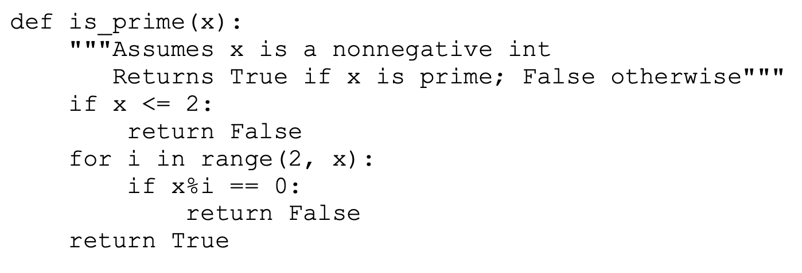
Glass-box
spec says non-neg → 0 and up
notice the branches of the implementation
  if else etc

Slide 13
"Rules of thumb are usually worth following:
Exercise both branches of all if statements.
Make sure that each except clause (see Chapter 9) is executed. For each for loop, have test cases in which
  The loop is not entered (e.g., if the loop is iterating over the elements of a list, make sure that it is tested on the empty list).
  The body of the loop is executed exactly once.
  The body of the loop is executed more than once.
For each while loop
  Look at the same kinds of cases as when dealing with for loops.
  Include test cases corresponding to all possible ways of exiting the loop. For example, for a loop starting with
    while len(L) > 0 and not L[i] == e
  find cases where the loop exits because len(L) is greater than zero and cases where it exits because L[i] == e.
For recursive functions, include test cases that cause the function to return with no recursive calls, exactly one recursive call, and more than one recursive call.

Slide 14
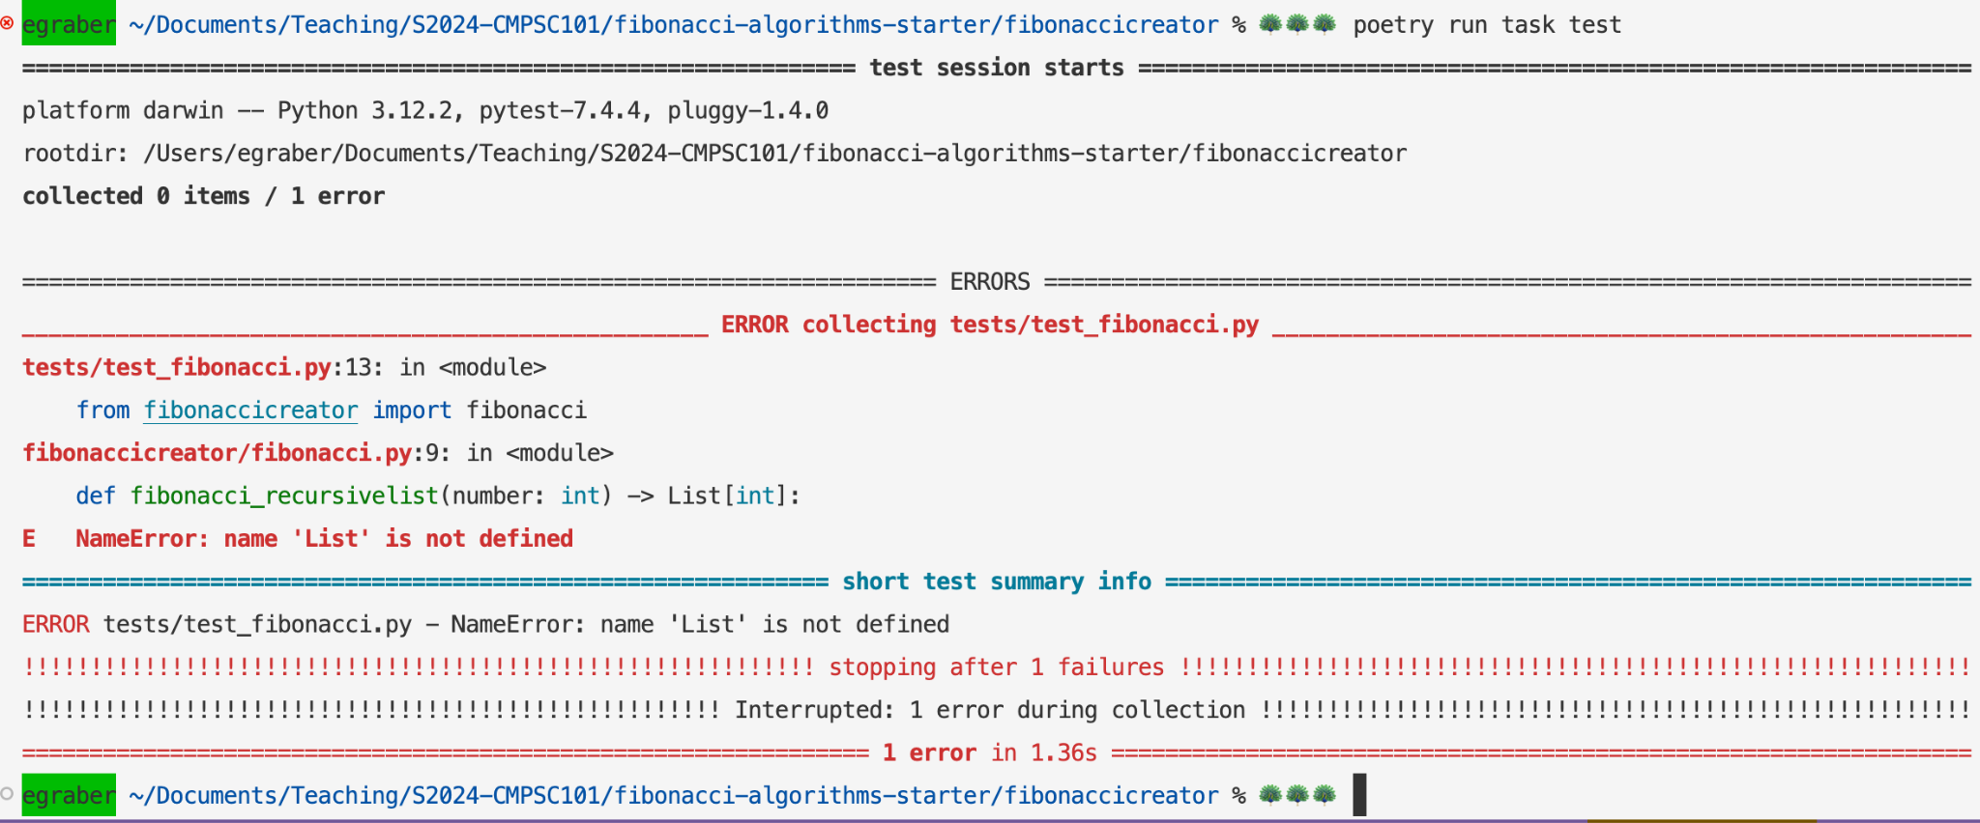
Tools - Pytest - `poetry run task test`

Slide 15
After testing fails….
"Debugging starts when testing has demonstrated that the program behaves in undesirable ways. Debugging is the process of searching for an explanation of that behavior. "
be able to explain the test, and what failed
take note if something was too big, too small, wrong type, too long etc
look at the code and read it slowly to come up with a theory that would explain the test results

Slide 16
Build intuition
but also - you can peek into your code using breakpoints or print statements
if you begin doing code surgery, use git to commit various versions (not push, just add, commit)
write REAL commit messages that explain the progress or problem still existing
these commit bookmarks will help you!

Slide 17
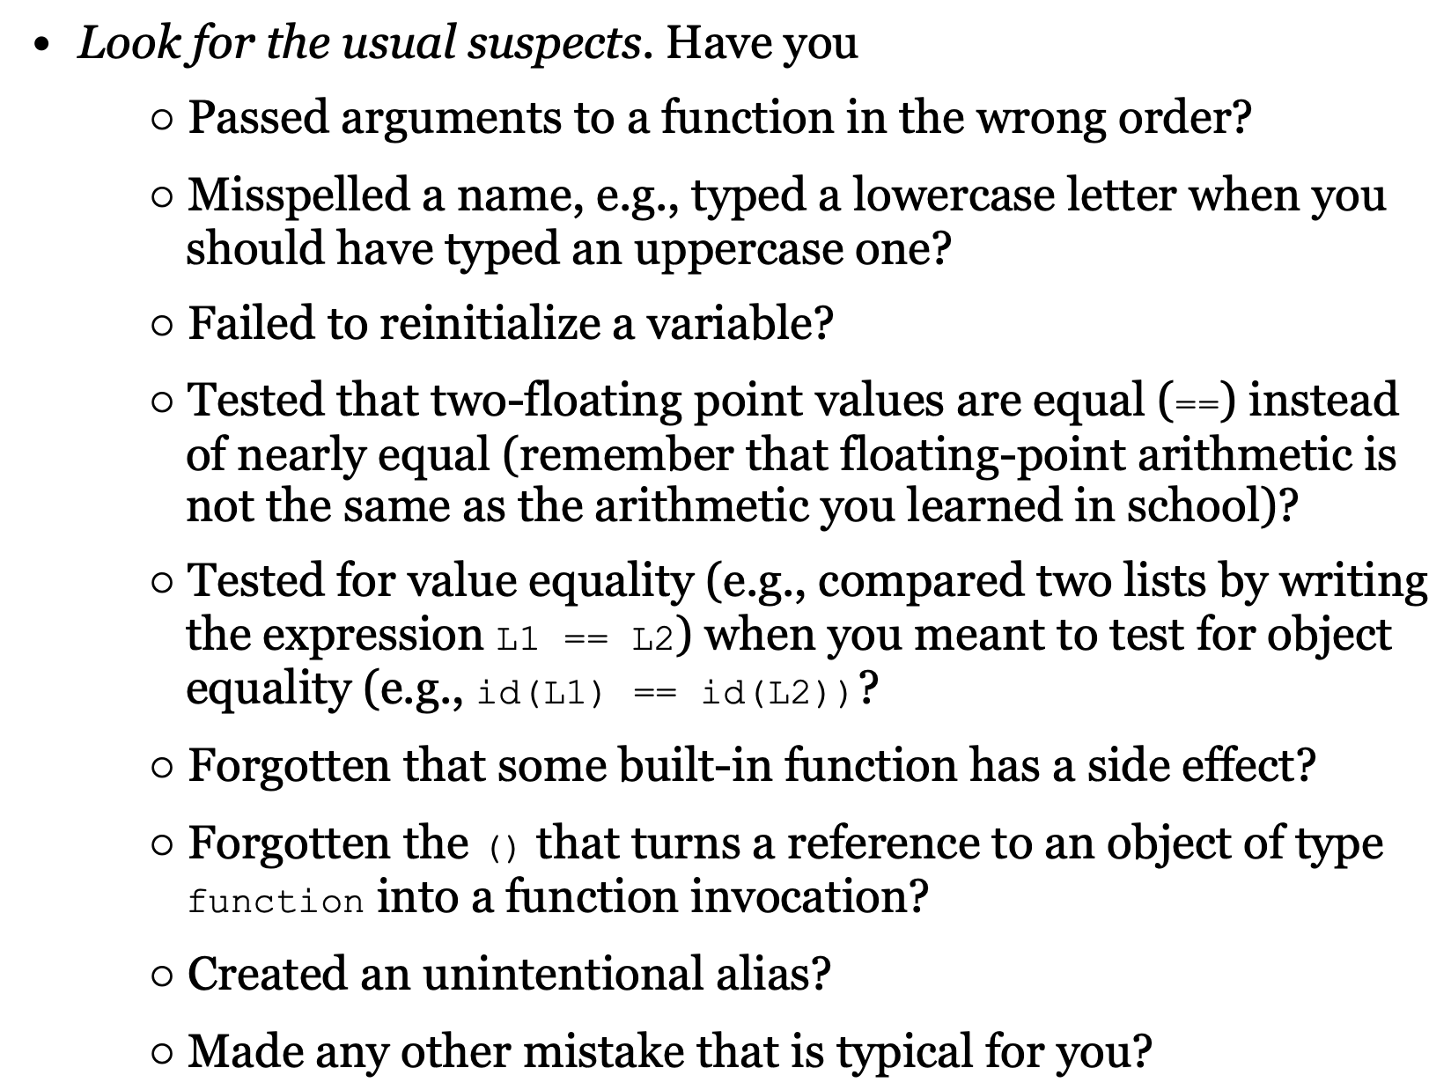

Slide 18
Bisection approach
Explain the code/algorithm to someone else
Colab - testing
Did the code break before or after this point?
  decide if it was before or after
  "adjust" the search space, i.e. move your breakpoints or print statements
Pretend you are teaching someone what you have done - don't necessarily explain the test failure, but what logic you MEANT to use.

Slide 19
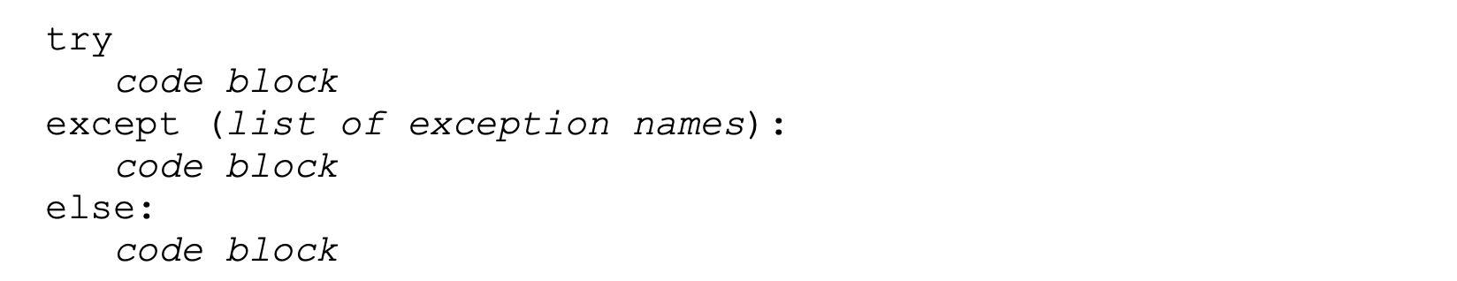
Chapter 9 - Exceptions
ZeroDivisionError
TypeError
ValueError
IndexError
NameError
UnboundLocalError
https://docs.python.org/3/library/exceptions.html
All of these and many more are built in exception. Python knows these names like they are global variables

Slide 20
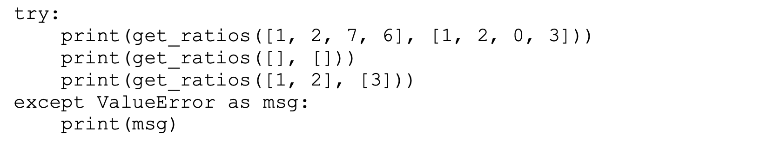
Exceptions prevent crashes
something goes wrong here
but…this code does NOT crash!!!
it simply prints the string in msg, and then continues

Slide 21
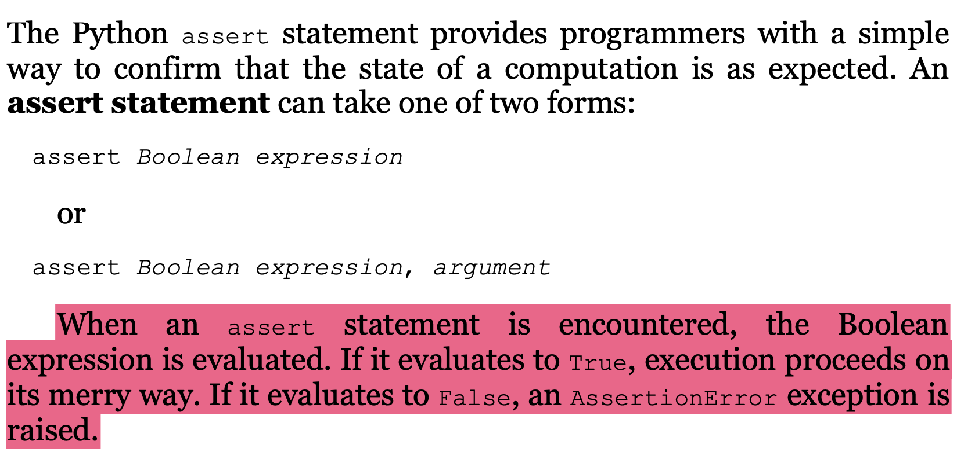
Assert

Slide 22
Colab - Exceptions

