Slide 1
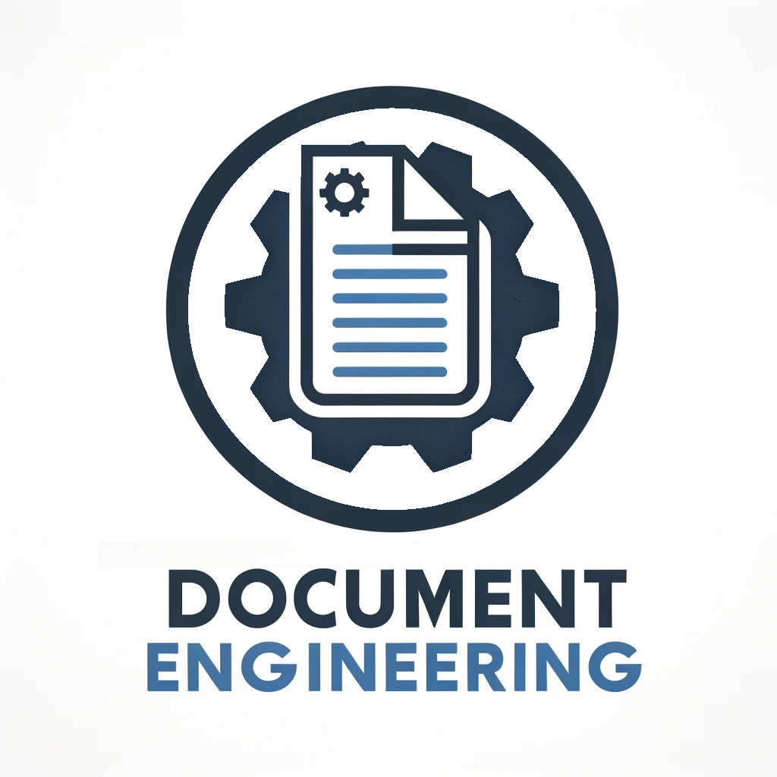
CMPSC 104 – Document Engineering Prof. Hang Zhao

Slide 2
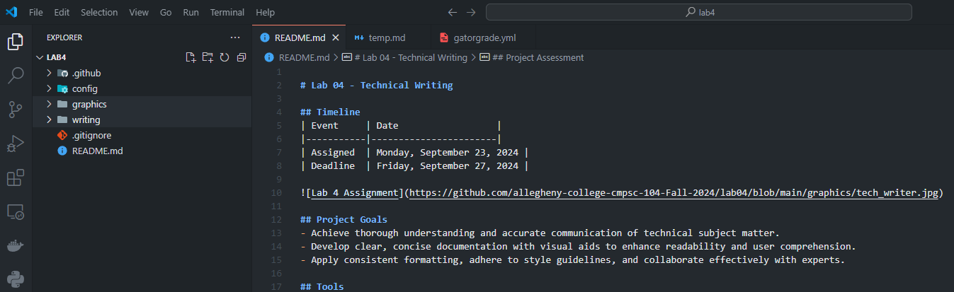
Overview
What is Markdown?
Markdown is a lightweight markup language designed for simplicity, allowing users to format plain text with easy-to-read syntax, such as using # for headings and ** for bold text (e.g., **bold**).

Slide 3
Overview
Why Use Markdown?
Versatile: Use it for anything from websites to presentations. (websites, documents, notes, books, presentations, email messages, and technical documentation.)
Portable: Works across all apps and devices. Easy to switch between Markdown apps without losing data.
Universal: Compatible with any operating system.
Future-Proof: Your files remain readable forever, even if the app you use stops working.
Widely Accepted: Supported on major platforms like Reddit and GitHub.

Slide 4
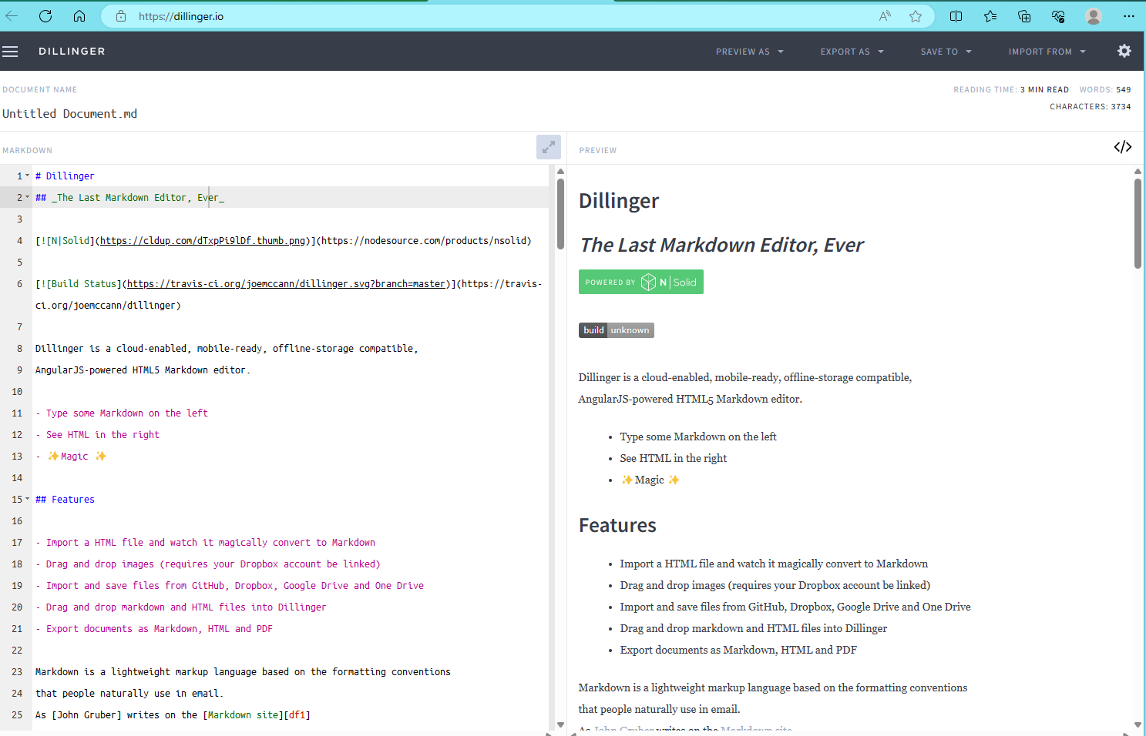
Getting Started with Markdown
To start using Markdown, try it online without downloading anything. For example, use Dillinger (https://dillinger.io/), a free online Markdown editor where you can type on the left side and see a preview on the right.

Slide 5
How Does it Work?
Markdown text is saved in files with an .md or .markdown extension.
A Markdown application processes the file, converting the Markdown-formatted text into HTML, suitable for web browsers or print-ready documents.
Markdown applications use something called a Markdown processor (also commonly referred to as a “parser” or an “implementation”) to take the Markdown-formatted text and output it to HTML format or convert it to another file format, like PDF.
Notes:
File Format: Markdown text is saved in files with an .md or .markdown extension.
Conversion Process: A Markdown application processes the file, converting the Markdown-formatted text into HTML, suitable for web browsers or print-ready documents.
Markdown Processor: This component, also known as a parser, transforms Markdown text to HTML, allowing the document to be viewed in browsers or styled and printed.

Slide 6
What’s Markdown Good For?
Markdown is ideal for note-taking, creating web content, and producing print-ready documents.
The Markdown syntax is simple to pick up, allowing for widespread use across various applications.
Used for everything from web content and email messages to grocery lists.
Notes:
Versatile Use: Markdown is ideal for note-taking, creating web content, and producing print-ready documents.Easy to Learn: The Markdown syntax is simple to pick up, allowing for widespread use across various applications.Broad Applications: Used for everything from web content and email messages to grocery lists.

Slide 7
Websites
Markdown is especially useful for creating website content.
Blot.im (https://blot.im/) allows you to easily convert Markdown files to a website by dragging them into a Dropbox folder.
Jekyll (https://jekyllrb.com) is a powerful static site generator that integrates with GitHub Pages for free hosting.
Ghost (https://ghost.org/) offers a free, open-source blogging platform with Markdown support.

Slide 8
Documents
Here are some Markdown document authoring applications I recommend:
Mac: MacDown, iA Writer, or Marked 2
iOS / Android: iA Writer
Windows: ghostwriter or Markdown Monster
Linux: ReText or ghostwriter
Web: Dillinger or StackEdit

Slide 9
Reference and Resources
Markdown guide (https://www.markdownguide.org/getting-started/)
John Gruber’s Markdown documentation. The original guide written by the creator of Markdown.
Markdown Tutorial. An open source website that allows you to try Markdown in your web browser.
Awesome Markdown. A list of Markdown tools and learning resources.
Typesetting Markdown. A multi-part series that describes an ecosystem for typesetting Markdown documents using pandoc and ConTeXt.

