Slide 2


















$$Follower i$$
$$Formation is achived$$
$$when h_{i} is equal to r_{L}$$
$$Follower 1$$
1
$$Direction$$
$$of movement$$
$$r_{i}$$
$$d_{i}$$
$$Target relative position$$
$$of the follower i$$
1
2
L
3
$$Direction$$
$$of movement$$
$$h_{i}$$
$$d_{i}$$
$$Leader$$
$$Follower 3$$
$$y$$
$$Follower 2$$
$$Leader$$
$$r_{L}$$
2
L
3
$$x$$
1
$$Direction$$
$$of movement$$
2
L
3

Slide 3
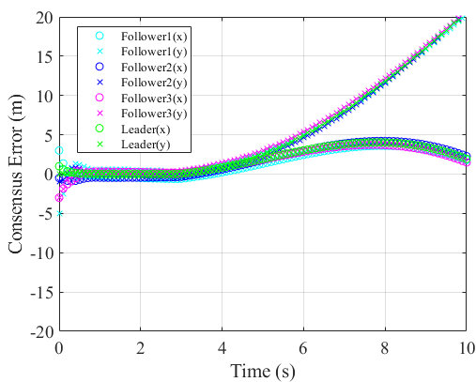
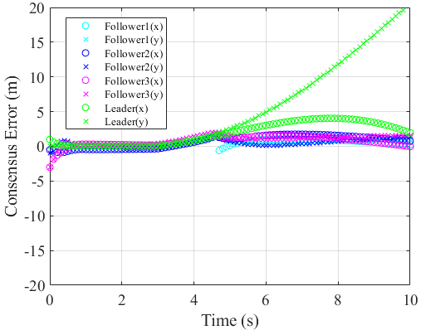

Slide 4
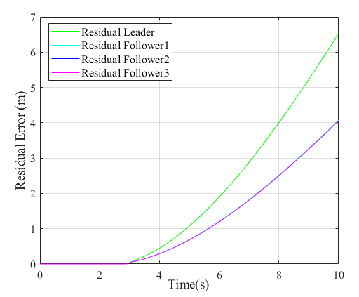
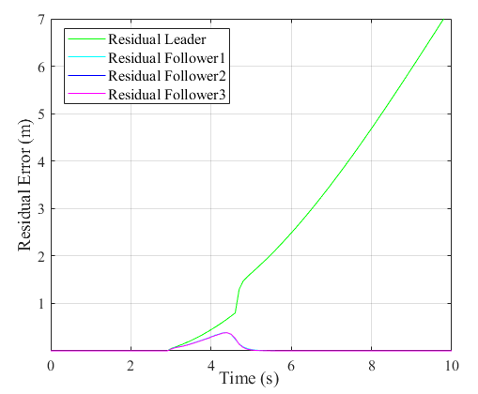
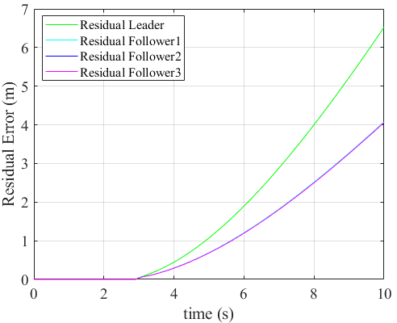
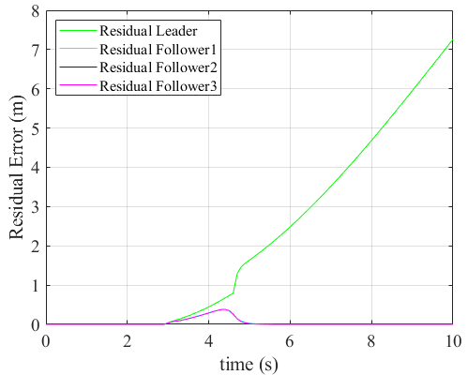

Slide 5
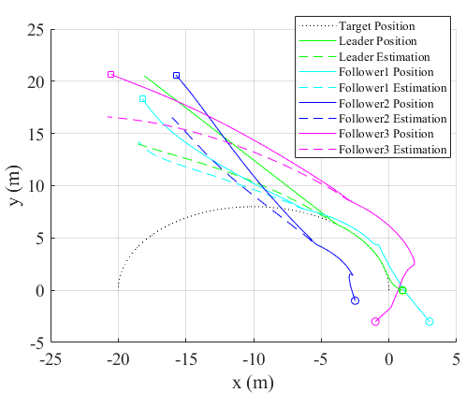
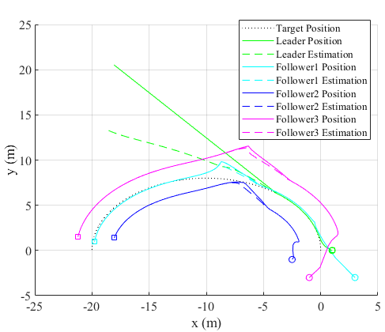

Slide 6
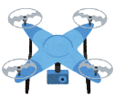
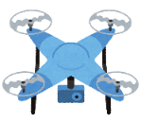
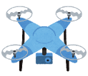
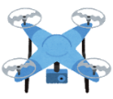




B is not working well.
Bが動いてない
Bが動いてない
A
Leader
1
Leader
A
Goal
Leader
3
2
B
C
C
B
Failure Occurance
Failure has occurred
New Leader
Goal!
1
Leader
Assign as a new leader
New leader
Leader
2
3
2
3
2
3
Leader failure
Local
Observation
New Leader
Physical
1
Assign as a new leader
2
3
New Leader
2
3
2
3
Fig. 2. Image of distributed observer
Leader
Ex-Leader
Leader failure

Slide 7
















$$Formation is achived when$$
$$h_{i} is equal to r_{L}$$
$$Follower i$$
$$r_{i}$$
$$d_{i}$$
$$Target position of$$
$$the follower i$$
1
$$Direction$$
$$of movement$$
$$d_{i}$$
$$y$$
$$h_{i}$$
$$Leader$$
$$r_{L}$$
2
L
3
$$x$$
1
$$Direction$$
$$of movement$$
$$Follower 1$$
1
$$Direction$$
$$of movement$$
2
L
3
2
L
3
$$Follower 2$$
$$Leader$$
$$Follower 3$$

Slide 8
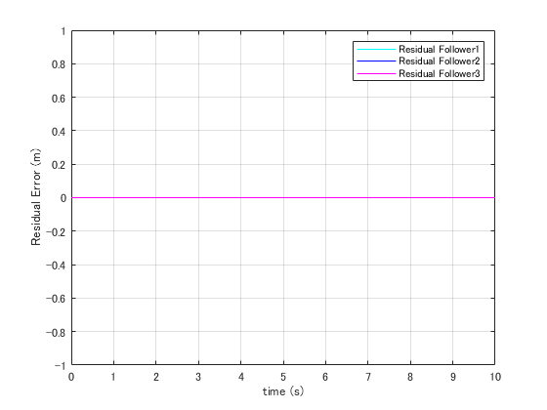
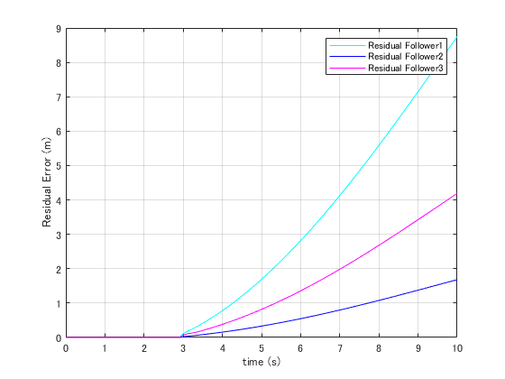

Slide 9
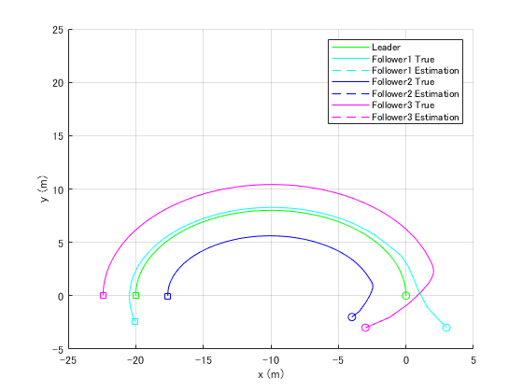
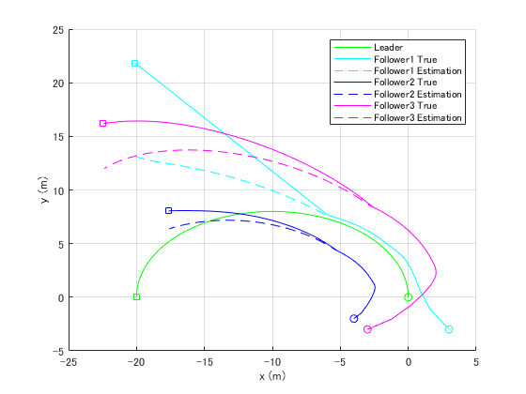

Slide 10
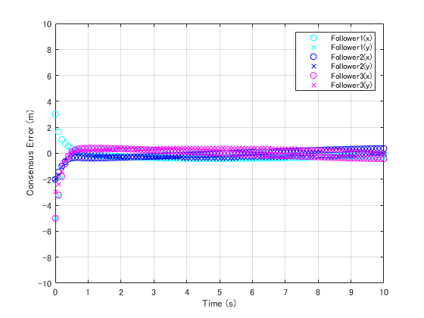
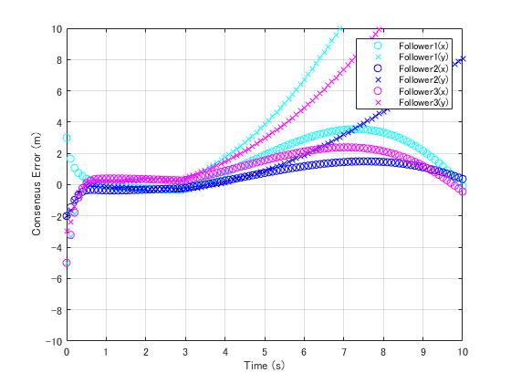

Slide 11
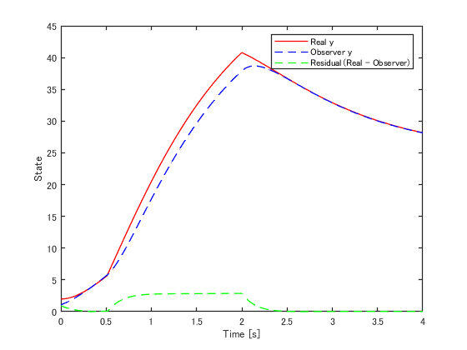
Fault Signal is input from 0.5s to 2s
There is a residual difference during fault .

Slide 12
φ
y
θ
x
ψ
z

