Slide 1
Programming for Bioinformatics
Module 2

Slide 2
Substitution matrices PAM and BLOSUM

Slide 3
Substitution matrices: PAM

Slide 4
Substitution matrices: PAM
In this framework different matrices can be derived.
The fundamental difference resides in the sets of alignments adopted for building the matrices.
PAM: (Point Accepted Mutation) Margaret Oakley Dayhoff (1972 Atlas of protein sequences and structures)
A point accepted mutation is the replacement of a single amino acid in the primary structure of a protein with another single amino acid, which is accepted by the processes of natural selection.
PAMx: substitution matrix referring to the sequences undergoing x PAMs every 100 residues

Slide 5
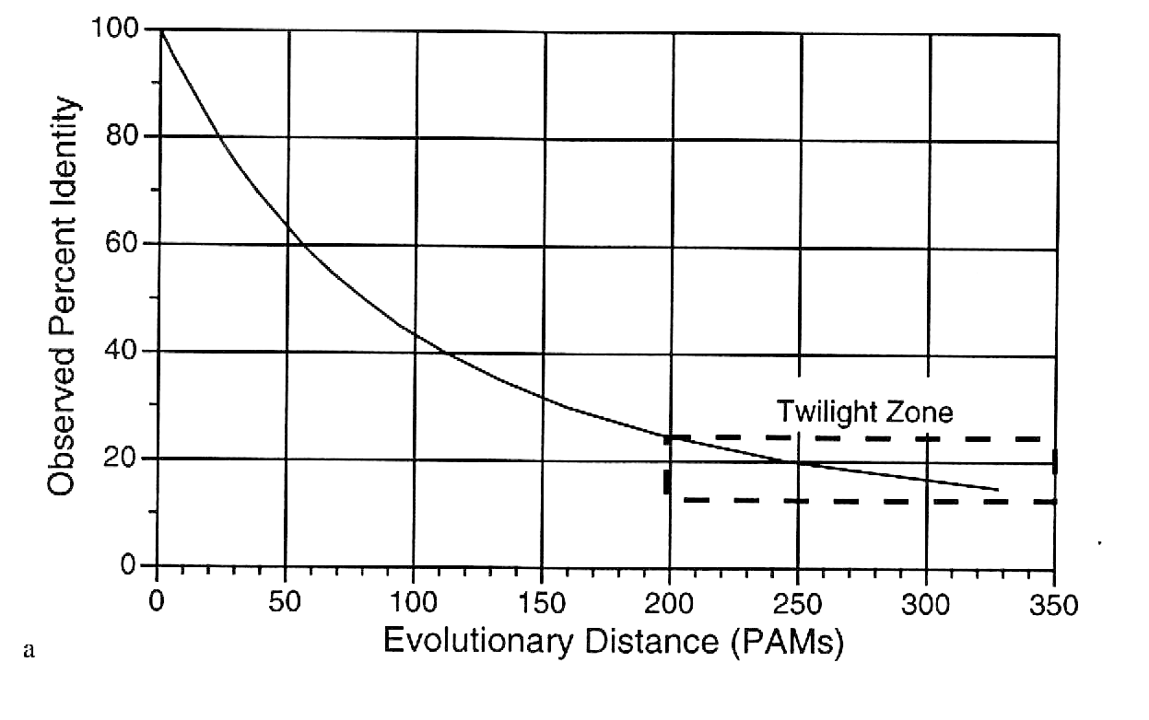
Relationship between the PAM and the identity between two sequences
The number of mutational events (PAM) does NOT correspond to the number of different residues between two sequences, when mutations accumulates.

Slide 6
Substitution matrices: PAM
PAMx: Margaret Oakley Dayhoff (1978)
1,572 changes in 71 groups of closely related proteins (85% min sequence identity)
Each pair of sequences differed by no more than 15% of their residues
Original formulation considers manually built phylogenetic trees where hypothetical ancestor sequences are inferred.

Slide 7
Substitution matrices: PAM
They started by building hypothetical phylogenetic trees relating the sequences in the 71 families.
Parsimony method, which provides a list of the residues that are most likely to have occurred at each position in each ancestral sequence.
From this they could accumulate a matrix A_{ab} containing the frequencies of all pairings of residues a and b between sequences and their immediate ancestors on the tree.

Slide 8
Substitution matrices: PAM
PAMx: Margaret Oakley Dayhoff (1978)
1,572 changes in 71 groups of closely related proteins (85% min sequence identity)
General formulation can consider manually built sequence alignments without referring to phylogenesis.
With highly similar sequences, alignments are easily compiled.

Slide 9
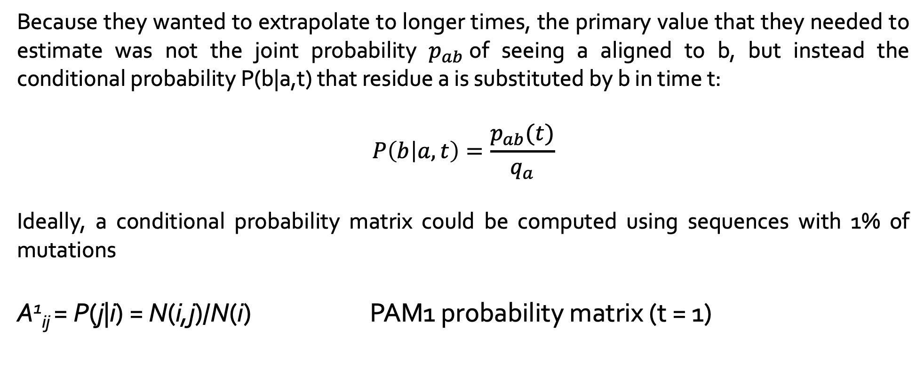
Substitution matrices: PAM1 probability matrix
Because they wanted to extrapolate to longer times, the primary value that they needed to estimate was not the joint probability $p_{ab}$of seeing a aligned to b, but instead the conditional probability P(b|a,t) that residue a is substituted by b in time t:
$$P\left(b | a,t\right)=\frac{p_{ab}(t)}{q_{a}}$$
Ideally, a conditional probability matrix could be computed using sequences with 1% of mutations
A¹_{ij} = P(j|i) = N(i,j)/N(i) PAM1 probability matrix (t = 1)

Slide 10
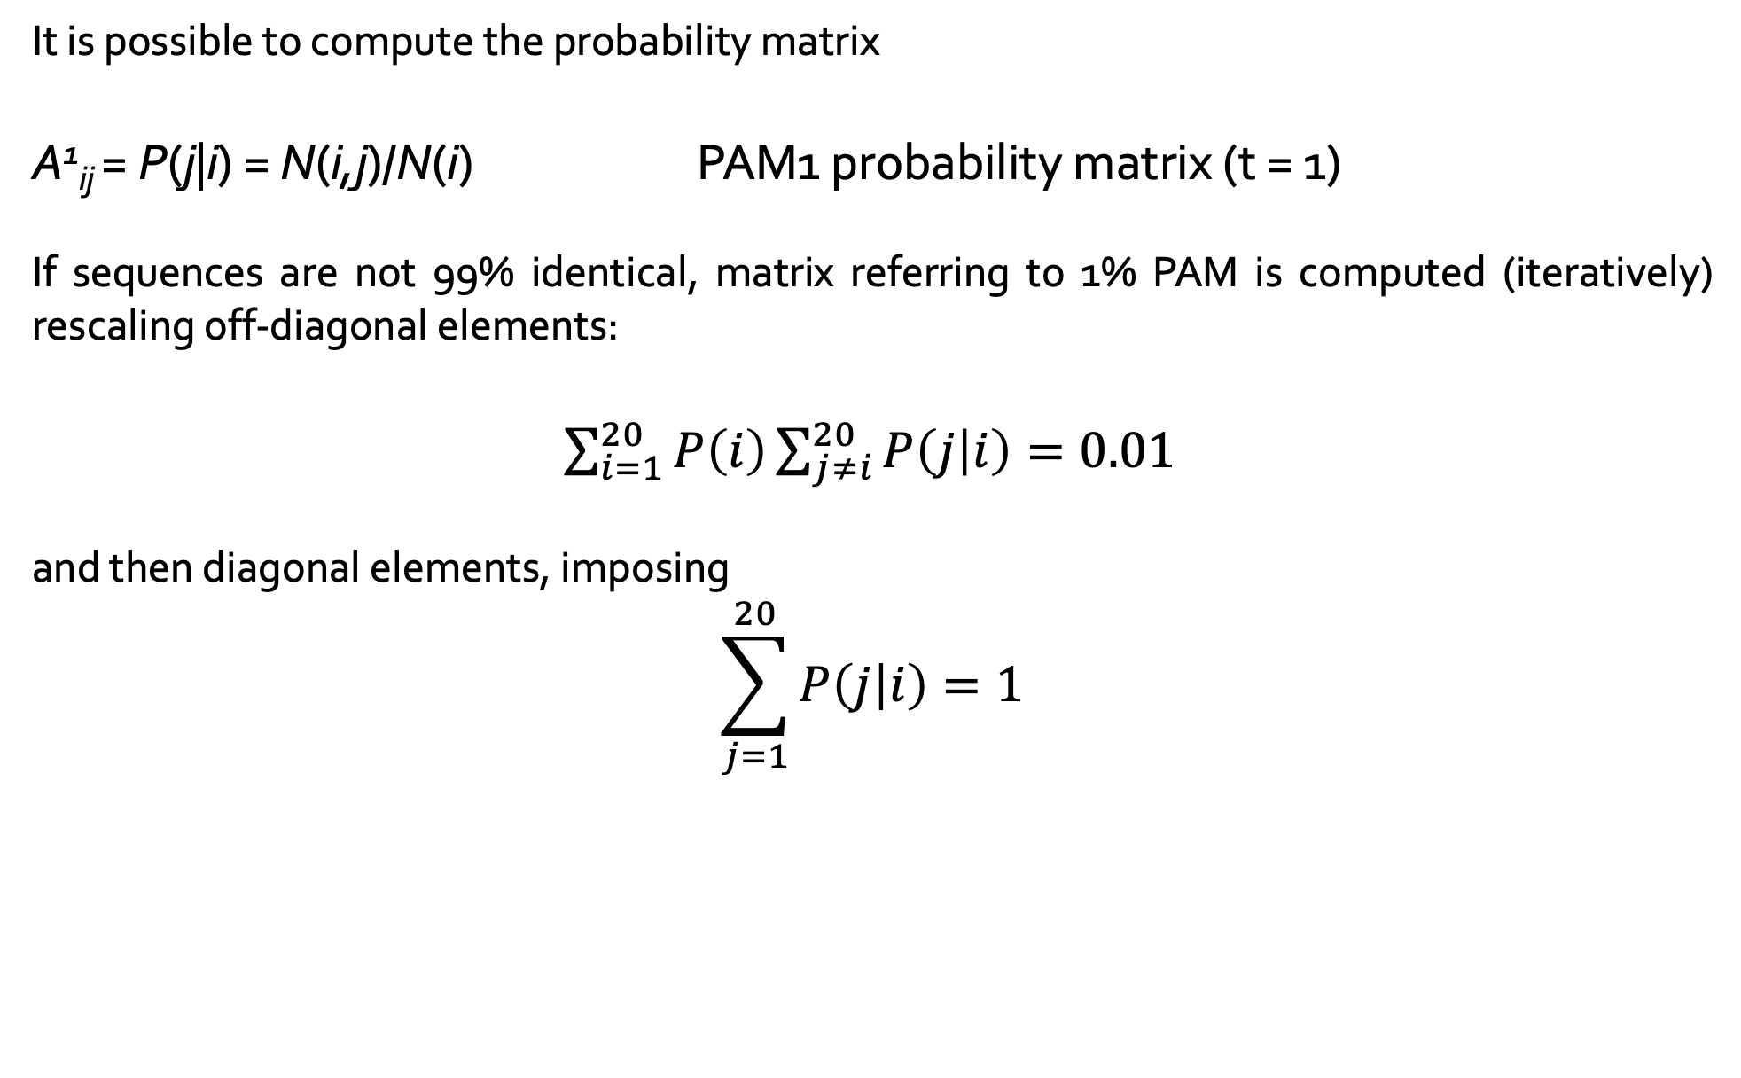
Substitution matrices: PAM1 probability matrix
It is possible to compute the probability matrix
A¹_{ij} = P(j|i) = N(i,j)/N(i) PAM1 probability matrix (t = 1)
If sequences are not 99% identical, matrix referring to 1% PAM is computed (iteratively) rescaling off-diagonal elements:
$\sum_{i=1}^{20}{P\left(i\right)\sum_{j≠i}^{20}{P\left(j | i\right)}=0.01}$
and then diagonal elements, imposing
$$\sum_{j=1}^{20}{P\left(j | i\right)}=1$$

Slide 11
Substitution matrices: PAM
PAMx: Margaret Oakley Dayhoff (1978)
1,572 changes in 71 groups of closely related proteins (85% min sequence identity)
It is possible to compute the probability matrix
A¹_{ij} PAM1 probability matrix
Score(PAM1) _{ij} = K Log(A¹_{ij} /P_{i}) PAM1 log-odd matrix

Slide 12
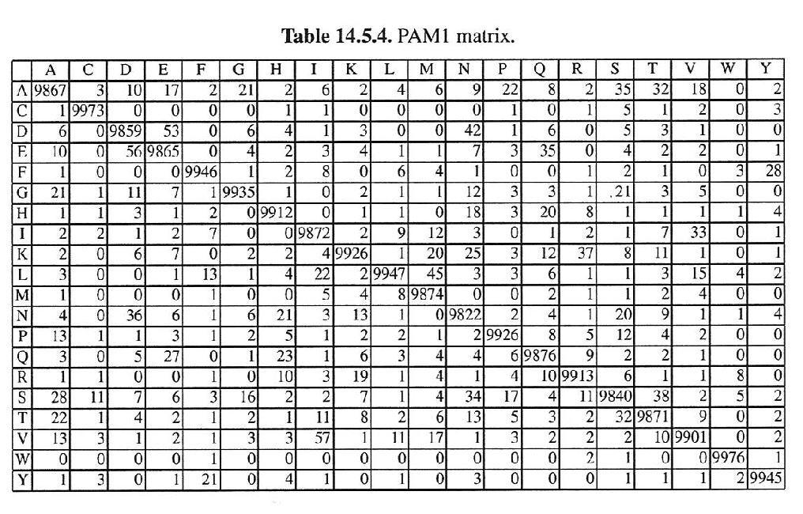
PAM 1 Probability matrix : P(j|i)
Very stringent matrix: very low values off diagonal

Slide 13
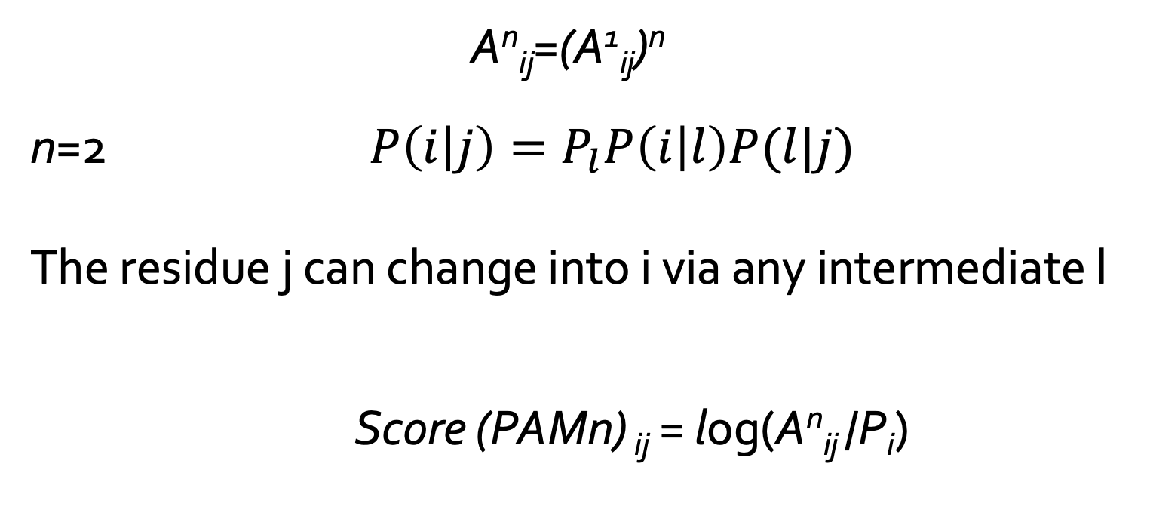
Substitution matrices: PAM
To derive a score matrix for sequences undergone to n mutational events every 100 residues:
A^{n}_{ij}=(A¹_{ij})^{n}
n=2 $P\left(i | j\right)=P_{l}P\left(i | l\right)P(l|j)$
The residue j can change into i via any intermediate l
Score (PAMn) _{ij} = log(A^{n}_{ij} /P_{i})

Slide 14
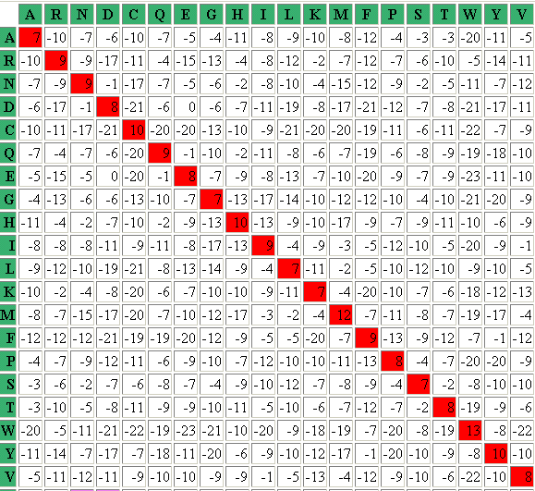
PAM10 log odd matrix
Very stringent matrix: no positive value out of the diagonal

Slide 15
Substitution matrices: PAM
To derive a score matrix for sequences undergone to n mutational events every 100 residues
n % mutational events does not mean that n out of 100 residue are different among the two sequences:
as the number of mutational events increases, different mutations can occur in the same position
then 100 mutational events in a 100-residue sequence leave some unvaried position

Slide 16
Relationship between the PAM and the identity between two sequences
The number of mutational events (PAM) does NOT correspond to the number of different residues between two sequences, when mutations accumulates.

Slide 17
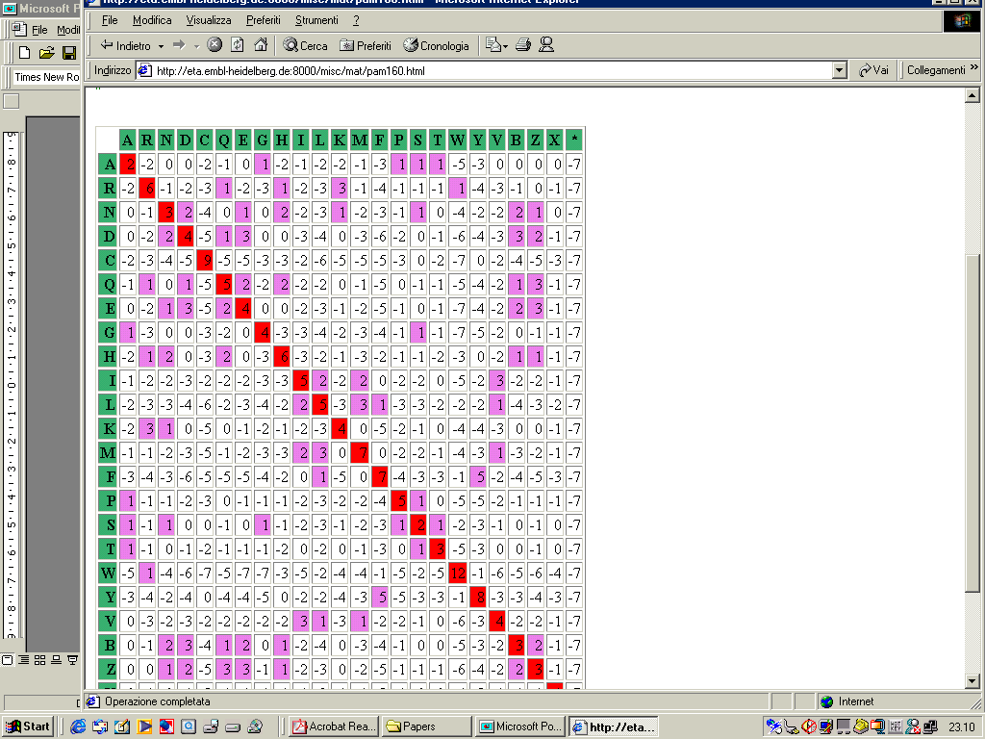
PAM160 log odd matrix
Some positive values out of the diagonal: residue pairs endowed with positive scores are SIMILAR

Slide 18

PAM250 log odd matrix
Often adopted

Slide 19
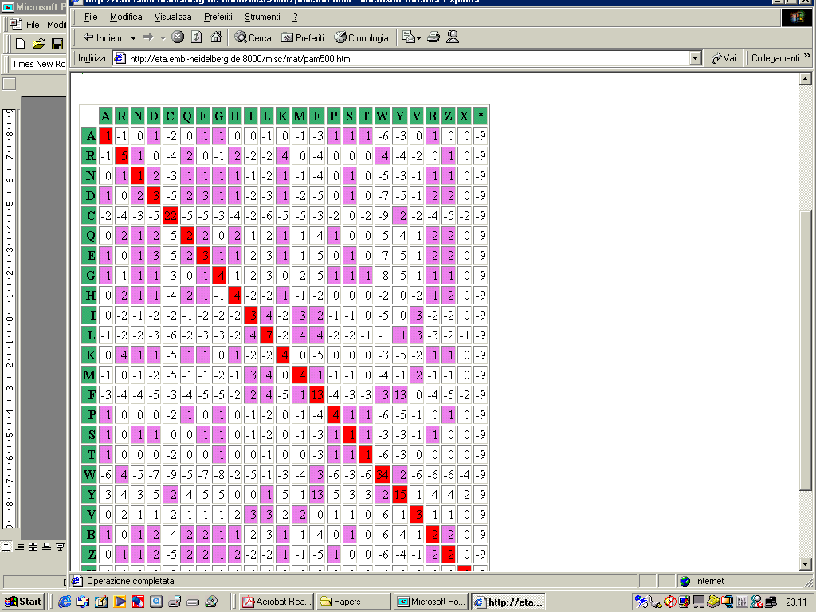
PAM500 log odd matrix

Slide 20
Substitution matrices
PAM matrices are computed under the hypothesis that substitution scores for distant sequences can be derived from the rate of mutation observed in pairs of very similar sequences.
BLOSUMx: BLOck Substitution Matrix (Henikoff and Henikoff (1992)
Family of matrices computed directly starting from curated alignments of sequences with at most x% of identical residues
For highly similar sequences low PAMs or high BLOSUMs have to used. The contrary, for distant sequences

Slide 21
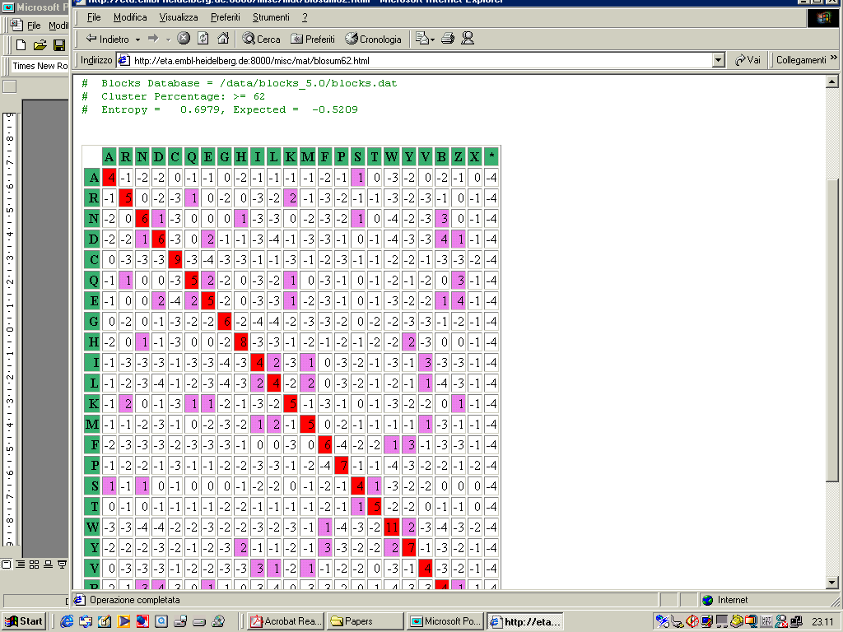
BLOSUM62
Often adopted

Slide 22
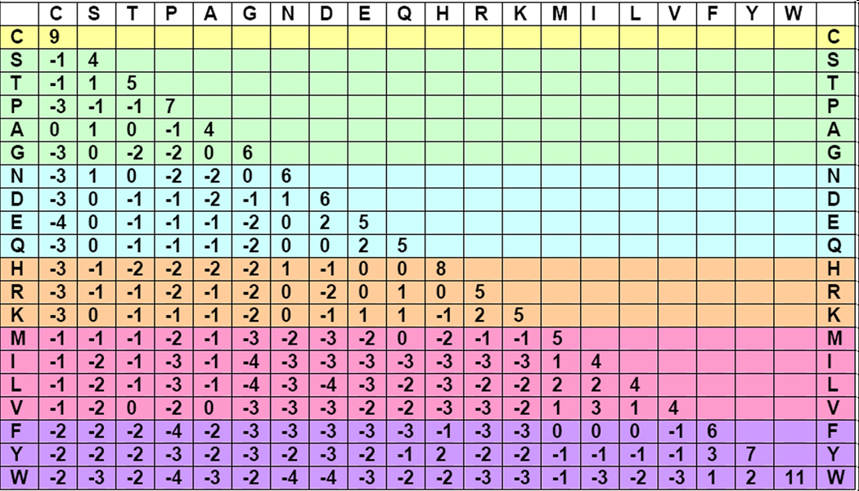
BLOSUM62 Matrix
Small hydrophylic
Acid, acid amide and hydrophilic
Basic
Small hydrophobic
Aromatic

Slide 23
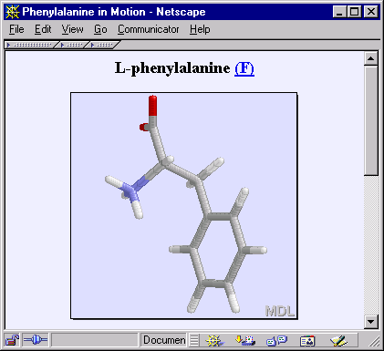
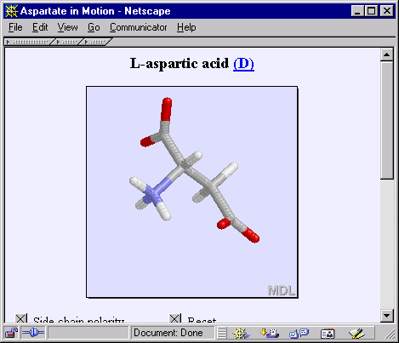
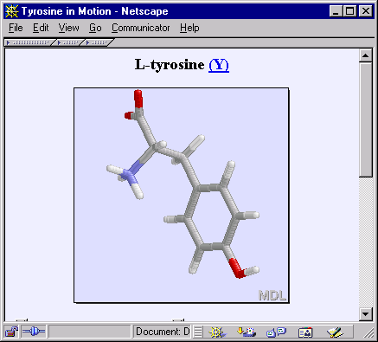
BLOSUM62 Substitution Matrix
Scoring Systems - Proteins
NCBI FieldGuide
A 4
R -1 5
N -2 0 6
D -2 -2 1 6
C 0 -3 -3 -3 9
Q -1 1 0 0 -3 5
E -1 0 0 2 -4 2 5
G 0 -2 0 -1 -3 -2 -2 6
H -2 0 1 -1 -3 0 0 -2 8
I -1 -3 -3 -3 -1 -3 -3 -4 -3 4
L -1 -2 -3 -4 -1 -2 -3 -4 -3 2 4
K -1 2 0 -1 -3 1 1 -2 -1 -3 -2 5
M -1 -1 -2 -3 -1 0 -2 -3 -2 1 2 -1 5
F -2 -3 -3 -3 -2 -3 -3 -3 -1 0 0 -3 0 6
P -1 -2 -2 -1 -3 -1 -1 -2 -2 -3 -3 -1 -2 -4 7
S 1 -1 1 0 -1 0 0 0 -1 -2 -2 0 -1 -2 -1 4
T 0 -1 0 -1 -1 -1 -1 -2 -2 -1 -1 -1 -1 -2 -1 1 5
W -3 -3 -4 -4 -2 -2 -3 -2 -2 -3 -2 -3 -1 1 -4 -3 -2 11
Y -2 -2 -2 -3 -2 -1 -2 -3 2 -1 -1 -2 -1 3 -3 -2 -2 2 7
V 0 -3 -3 -3 -1 -2 -2 -3 -3 3 1 -2 1 -1 -2 -2 0 -3 -1 4
X 0 -1 -1 -1 -2 -1 -1 -1 -1 -1 -1 -1 -1 -1 -2 0 0 -2 -1 -1 -1
A R N D C Q E G H I L K M F P S T W Y V X
Common amino acids have low weights
Rare amino acids have high weights
Negative for less likely substitutions
Positive for more likely substitutions
From NCBI field guides

Slide 24
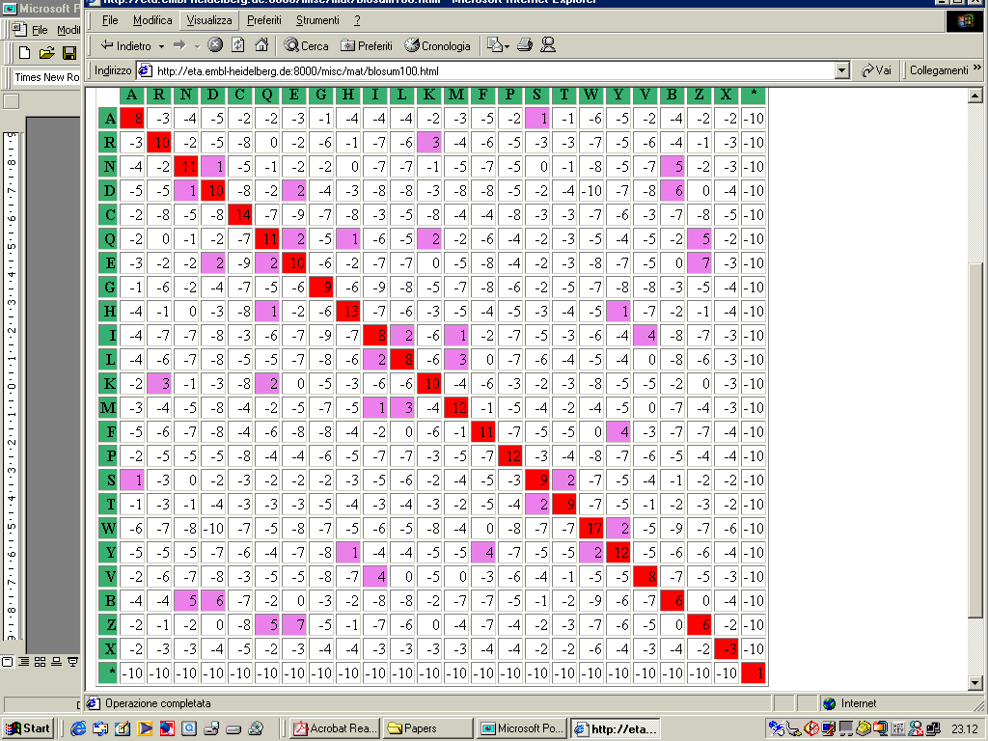
BLOSUM90

Slide 25
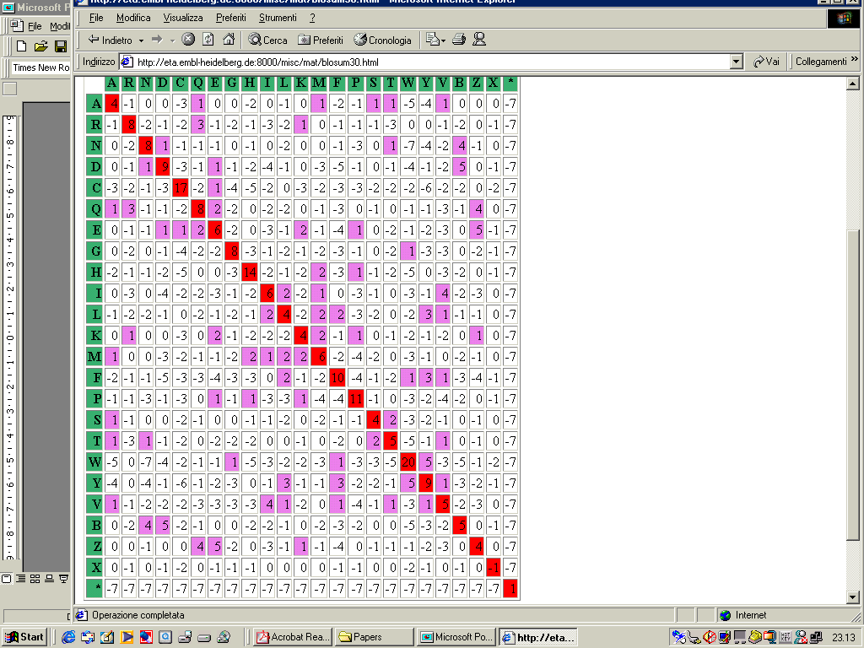
BLOSUM30

Slide 26
