Slide 1
Programming for Bioinformatics
Module 2

Slide 2
Protein comparison
Algorithms for computing and evaluating sequence alignments
Local alignments

Slide 3
Local alignments
We are looking for the best alingment between subsequences of x and y
Examples:
- Two protein sequences share a common domain
- When comparing extended sections of genomic DNA sequences

Slide 4
Local alignments
Since now, GLOBAL alignment (involving the entire sequences) have been considered.
Sometimes it is useful to detect the portions of the sequences that can be better superimposed (functional or structural motifs, common exons….)
We adopt exactly the same strategy, with just a modification:
Negative scores are not accepted: better to start a new alignment than to have negative score alignment

Slide 5
Smith and Waterman algorithm
Local alignment of sequences, linear gap penalty
Given two sequences A and B, with lenghts a and b, we introduce the (a+1)(b+1) matrix F(i,j) storing the score of the best LOCAL alignment between the substrings
0A¹A²A³…….A^{i} and 0B¹B²B³…….B^{j}.
Initialization F(0,0) = 0
Iteration F(i,j) = Max
Termination The maximum value of matrix F(i,j) that corresponds to the best local alignment
F(i-1,j-1) + s(A^{i},B^{j})
F(i-1,j) - d
F(i,j-1) - d
0

Slide 6
Smith and Waterman algorithm
d = 2

Slide 7
Smith and Waterman algorithm
Gap in sequenza 2
Gap in sequenza 1
Match
0 A C T
0 A T T

Slide 8
Smith and Waterman algorithm
Termination:
If we want the best local alignment:
F_{opt} = max_{i,j} F(i,j)
If we want ALL local alingments scoring > T
For all i,j find F(i,j) > T and trace back

Slide 9
 | 0 | H | E | A | G | A | W | G | H | E | E
0 | 0 | 0 | 0 | 0 | 0 | 0 | 0 | 0 | 0 | 0 | 0
P | 0 | 0 | 0 | 0 | 0 | 0 | 0 | 0 | 0 | 0 | 0
A | 0 | 0 | 0 | 5 | 0 | 5 | 0 | 0 | 0 | 0 | 0
W | 0 | 0 | 0 | 0 | 2 | 0 | 20 | 12 | 4 | 0 | 0
H | 0 | 10 | 2 | 0 | 0 | 0 | 12 | 18 | 22 | 14 | 6
E | 0 | 2 | 16 | 8 | 0 | 0 | 4 | 10 | 18 | 28 | 20
A | 0 | 0 | 8 | 21 | 13 | 5 | 0 | 4 | 10 | 20 | 27
E | 0 | 0 | 6 | 13 | 18 | 12 | 4 | 0 | 4 | 16 | 26

Slide 10
 | 0 | H | E | A | G | A | W | G | H | E | E
0 | 0 | 0 | 0 | 0 | 0 | 0 | 0 | 0 | 0 | 0 | 0
P | 0 | 0 | 0 | 0 | 0 | 0 | 0 | 0 | 0 | 0 | 0
A | 0 | 0 | 0 | 5 | 0 | 5 | 0 | 0 | 0 | 0 | 0
W | 0 | 0 | 0 | 0 | 2 | 0 | 20 | 12 | 4 | 0 | 0
H | 0 | 10 | 2 | 0 | 0 | 0 | 12 | 18 | 22 | 14 | 6
E | 0 | 2 | 16 | 8 | 0 | 0 | 4 | 10 | 18 | 28 | 20
A | 0 | 0 | 8 | 21 | 13 | 5 | 0 | 4 | 10 | 20 | 27
E | 0 | 0 | 6 | 13 | 18 | 12 | 4 | 0 | 4 | 16 | 26

Slide 11
 | 0 | H | E | A | G | A | W | G | H | E | E
0 | 0 | 0 | 0 | 0 | 0 | 0 | 0 | 0 | 0 | 0 | 0
P | 0 | 0 | 0 | 0 | 0 | 0 | 0 | 0 | 0 | 0 | 0
A | 0 | 0 | 0 | 5 | 0 | 5 | 0 | 0 | 0 | 0 | 0
W | 0 | 0 | 0 | 0 | 2 | 0 | 20 | 12 | 4 | 0 | 0
H | 0 | 10 | 2 | 0 | 0 | 0 | 12 | 18 | 22 | 14 | 6
E | 0 | 2 | 16 | 8 | 0 | 0 | 4 | 10 | 18 | 28 | 20
A | 0 | 0 | 8 | 21 | 13 | 5 | 0 | 4 | 10 | 20 | 27
E | 0 | 0 | 6 | 13 | 18 | 12 | 4 | 0 | 4 | 16 | 26
AWGHE
AW-HE

Slide 12
T = 20
 | 0 | H | E | A | G | A | W | G | H | E | E
0 | 0 | 0 | 0 | 0 | 0 | 0 | 0 | 0 | 0 | 0 | 0
P | 0 | 0 | 0 | 0 | 0 | 0 | 0 | 0 | 0 | 0 | 0
A | 0 | 0 | 0 | 5 | 0 | 5 | 0 | 0 | 0 | 0 | 0
W | 0 | 0 | 0 | 0 | 2 | 0 | 20 | 12 | 4 | 0 | 0
H | 0 | 10 | 2 | 0 | 0 | 0 | 12 | 18 | 22 | 14 | 6
E | 0 | 2 | 16 | 8 | 0 | 0 | 4 | 10 | 18 | 28 | 20
A | 0 | 0 | 8 | 21 | 13 | 5 | 0 | 4 | 10 | 20 | 27
E | 0 | 0 | 6 | 13 | 18 | 12 | 4 | 0 | 4 | 16 | 26
AWGHE
AW-HE

Slide 13
 | 0 | H | E | A | G | A | W | G | H | E | E
0 | 0 | 0 | 0 | 0 | 0 | 0 | 0 | 0 | 0 | 0 | 0
P | 0 | 0 | 0 | 0 | 0 | 0 | 0 | 0 | 0 | 0 | 0
A | 0 | 0 | 0 | 5 | 0 | 5 | 0 | 0 | 0 | 0 | 0
W | 0 | 0 | 0 | 0 | 2 | 0 | 20 | 12 | 4 | 0 | 0
H | 0 | 10 | 2 | 0 | 0 | 0 | 12 | 18 | 22 | 14 | 6
E | 0 | 2 | 16 | 8 | 0 | 0 | 4 | 10 | 18 | 28 | 20
A | 0 | 0 | 8 | 21 | 13 | 5 | 0 | 4 | 10 | 20 | 27
E | 0 | 0 | 6 | 13 | 18 | 12 | 4 | 0 | 4 | 16 | 26
AWGHE
AW-HE
HEA
HEA

Slide 14
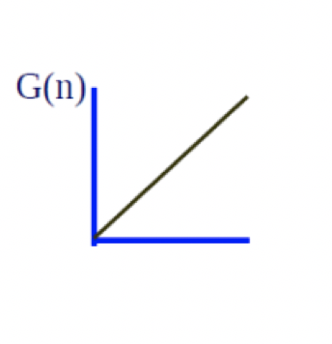
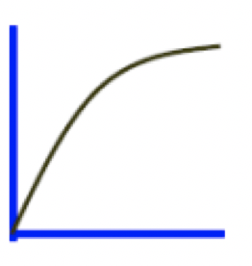

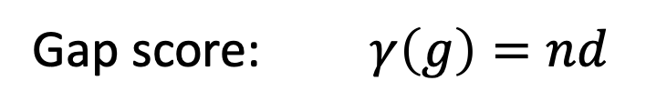
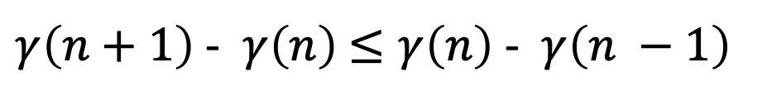

Scoring gaps more accurately
So far we have only considered the simplest gap model:
$$γ\left(g\right)$$
Gap score: $γ\left(g\right)=nd$
This type of score is not ideal for biological sequences where, when gaps do occur, they are often longer than one residue.
$$γ\left(g\right)$$
Concave gap penalty function:
$γ\left(n+1\right)$ - $γ\left(n\right)$ $≤γ\left(n\right)\text{ - }γ\left(n −1\right)$
Decreasing penalty for consecutive gaps

Slide 15
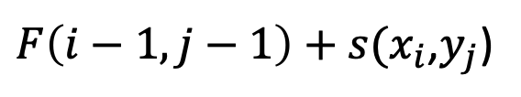

General gap dynamic programming
Initialization: same
Iteration:
$F\left(i−1,j−1\right)+s(x_{i}$,$y_{j}$)
$$F\left(i,j\right)=max$$
$$F\left(k,j\right)+ γ\left(i−k\right), k=0,…, i−1,$$
$$F\left(i,k\right)+ γ\left(j−k\right), k=0,…, j−1,$$
Termination: same

Slide 16

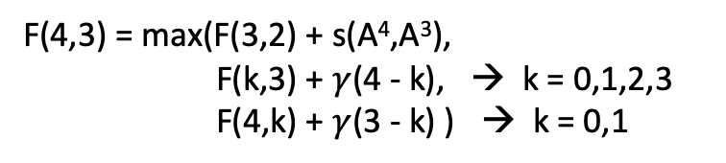
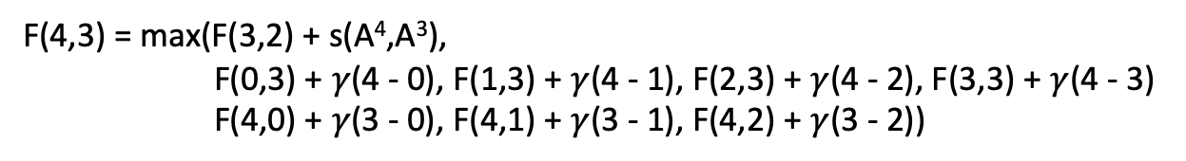


 | 0 | A¹ | A² | A³ | A⁴ | … | Aª
0 | 0 | F(1,0) | F(2,0) | F(3,0) | F(4,0)
B¹ | F(0,1) | F(1,1) | F(2,1) | F(3,1) | F(4,1)
B² | F(0,2) | F(1,2) | F(2,2) | F(3,2) | F(4,2)
B³ | F(0,3) | F(1,3) | F(2,3) | F(3,3) | F(4,3)
F(4,3) = max(F(3,2) + s(A⁴,A³),
F(k,3) + $γ$(4 - k), → k = 0,1,2,3
F(4,k) + $γ$(3 - k) ) → k = 0,1
$F\left(i−1,j−1\right)+s(x_{i}$,$y_{j}$)
$$F\left(k,j\right)+ γ\left(i−k\right), k=0,…, i−1,$$
F(4,3) = max(F(3,2) + s(A⁴,A³),
F(0,3) + $γ$(4 - 0), F(1,3) + $γ$(4 - 1), F(2,3) + $γ$(4 - 2), F(3,3) + $γ$(4 - 3)
F(4,0) + $γ$(3 - 0), F(4,1) + $γ$(3 - 1), F(4,2) + $γ$(3 - 2))
$$F\left(i,k\right)+ γ\left(j−k\right), k=0,…, j−1,$$

Slide 17
Running time
Running time: O(N²M) (assume N>M)
Space: O(NM)
This operation now requires O(N³) operations to align two sequences of length N, rather than O(N²) for the linear gap cost version, because in each cell (i,j) we have to look at i + j + 1 potential precursors, not just three as previously
This is a prohibitively costly increase in computational time in many cases
Under some conditions on the properties of $γ$() the search in k can be bounded, returning the expected computational time to O(N²)

Slide 18
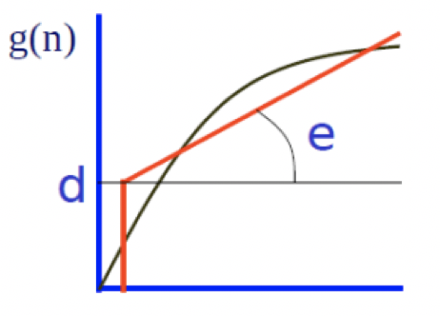
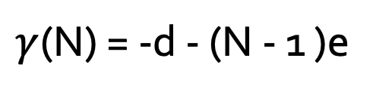

Compromise: alignment with affine gap scores
$γ$(N)
$γ$(N) = -d - (N - 1 )e
d = gap opening, e = gap extension
For this form of gap cost there is once again an O(N²) implementation of dynamic programming
However, we now have to keep track of multiple values for each pair of residue coefficients (i,j) in place of the single value F(i,j):
M(i,j): score of alignment x₁x₂x₃…x_{i} to y₁y₂y₃…y_{j} if x_{i} aligns to y_{j}
I(i,j): score if x_{i} or y_{j} aligns to a gap
IGAx_{i}
LGVy_{j}
AIGAx_{i}
Gvy_{j}--
GAx_{i}--
SLGVy_{j}

Slide 19
Needleman-Wunsh with affine gap: Gotoh algortithm
Global
Local alignment of sequences, affine gap penalty:
gap opening: h + g
gap extension: g
Given two sequences X and Y, with lengths x and y, we introduce three (x + 1)(y + 1) matrices:
M(i,j): score the best alignment between the substrings OX¹X²X³…X^{i} and OY¹Y²Y³…Y^{i} with X^{i} aligned to Y^{j}
I_{x}(i,j): score the best alignment between the substrings OX¹X²X³…X^{i} and OY¹Y²Y³…Y^{i} with X^{i} aligned to a gap
I_{y}(i,j): score the best alignment between the substrings OX¹X²X³…X^{i} and OY¹Y²Y³…Y^{i} with Y^{j} aligned to a gap

Slide 20
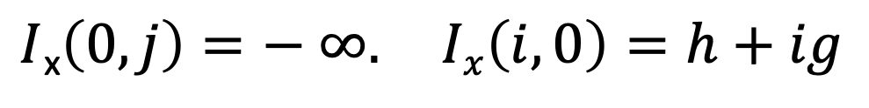
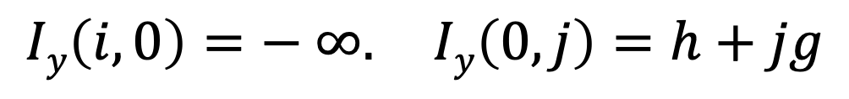
Needleman-Wunsh with affine gap: Gotoh algortithm
Global
Local alignment of sequences, affine gap penalty:
gap opening: h + g
gap extension: g
Initialisation:
$M\left(0,0\right)=0 M\left(0,j\right)=− ∞$ $M\left(i,0\right)=− ∞$
$I$_{x}$\left(0,j\right)=− ∞. Ix\left(i,0\right)=h+ig$
$$Iy\left(i,0\right)=− ∞. Iy\left(0,j\right)=h+jg$$

Slide 21

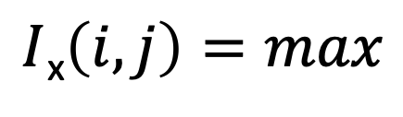

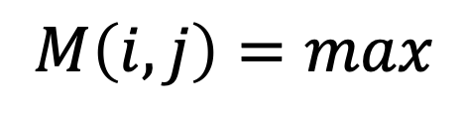




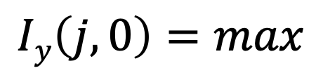

Needleman-Wunsh with affine gap: Gotoh algortithm
Global
gap opening: h + g
gap extension: g
Iteration:
$$M\left(i−1,j−1\right)+s(x_{i }, y_{j})$$
$$M\left(i,j\right)=max$$
$$I_{x}\left(i−1,j−1\right)+s(x_{i }, y_{j})$$
$$I_{y}\left(i−1,j−1\right)+s(x_{i }, y_{j})$$
$I$_{x}$\left(i,j\right)=max$
$$M\left(i−1,j\right)+h+g$$
$$I_{x}\left(i−1,j\right)+g$$
$$M\left(i,j−1\right)+h+g$$
$$Iy\left(j,0\right)=max$$
$$I_{y}\left(i,j−1\right)+g$$

Slide 22
Needleman-Wunsh with affine gap: Gotoh algortithm
Termination
Look at the largest among the rightmost-bottom value:
M(x,y), I_{x}(x,y), I_{y}(x,y)
Backtrace until reaching any of: M(0,0), I_{x}(0,0), I_{y}(0,0)
Note that pointers may traverse all three matrices

