Slide 1
Programming for Bioinformatics
Module 2
Sequence Alignment

Slide 2
Module 2 repository
https://github.com/allegravia/programming-for-bioinformatics
Timetable
Wed 18th Dec 2019, 10h-13h & 14h-17h
Thu 19th Dec 2019, 10h-13h & 14h-17h
Fri 20th Dec 2019, 10h-13h
Tue 14th Jan 2020, 10h-13h
Thu 16th Jan 2020, 10h-13h & 14h-17h
Wed 22th Jan 2020, 10h-13h & 14h-17h
Mid-term exam - Thu 16th Jan 2020
One exercise or an open ended question to assess the ability to discuss substitution matrices
A script assessing the ability to implement a basic pairwise alignment algorithm in Python

Slide 3
Substitution matrices I
Module 2
Sequence Alignment

Slide 4
Topics of Module 2
Structure comparison, a detour
Sequence-to-structure relationship
Homology vs sequence similarity
Protein sequence comparison
The scoring model
Substitution matrices
Pairwise sequence alignment

Slide 5
Protein comparison
Structure comparison, a detour

Slide 8
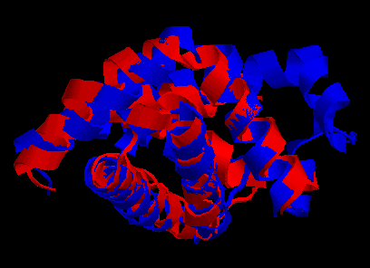
Structure superimposition
Sperm Whale Mioglobin vs bacterial Emoglobin

Slide 9
Structure superimposition problem
A
Correspondence set
B
RMSD or other distance measures
G(B)

Slide 10
Formalizing the structure superimposition problem
Given two sets of points A = (a₁, a₂, …, a_{n}) and B = (b₁,b₂,…b_{m}) in Cartesian space, find the optimal subsets A(P) and B(Q) with |A(P)| = |B(Q)|, and find the optimal rigid body transformation G between the two subsets A(P) and B(Q) that minimizes a given distance metric D over all possible rigid body transformation G, i.e.
where, usually, D is
The two subsets A(P) and B(Q) define a “correspondence”, and p = |A(P)| = |B(Q)| is called the correspondence length. Naturally, the correspondence length is maximal when A(P) and B(Q) are similar.
Therefore there are essentially two problems in structure alignment:
(i.) Find the correspondence set (which is NP-hard), and
(ii.) Find the alignment transform (which is O(n)).
Phil Bourne 2012

Slide 11
Structural superimposition induces a
structural alignment beween the sequences
C
V
1
C
C
A
V
V
P
T
P
P
P
A
A
R
C
V
T
D
R
D
V
2
A
P
V
P
Induced alignment
VC---PVT
ACRDVPAP
.*...*..
Alignment lenght = 8 res
Alignment identity = 2/8

Slide 12
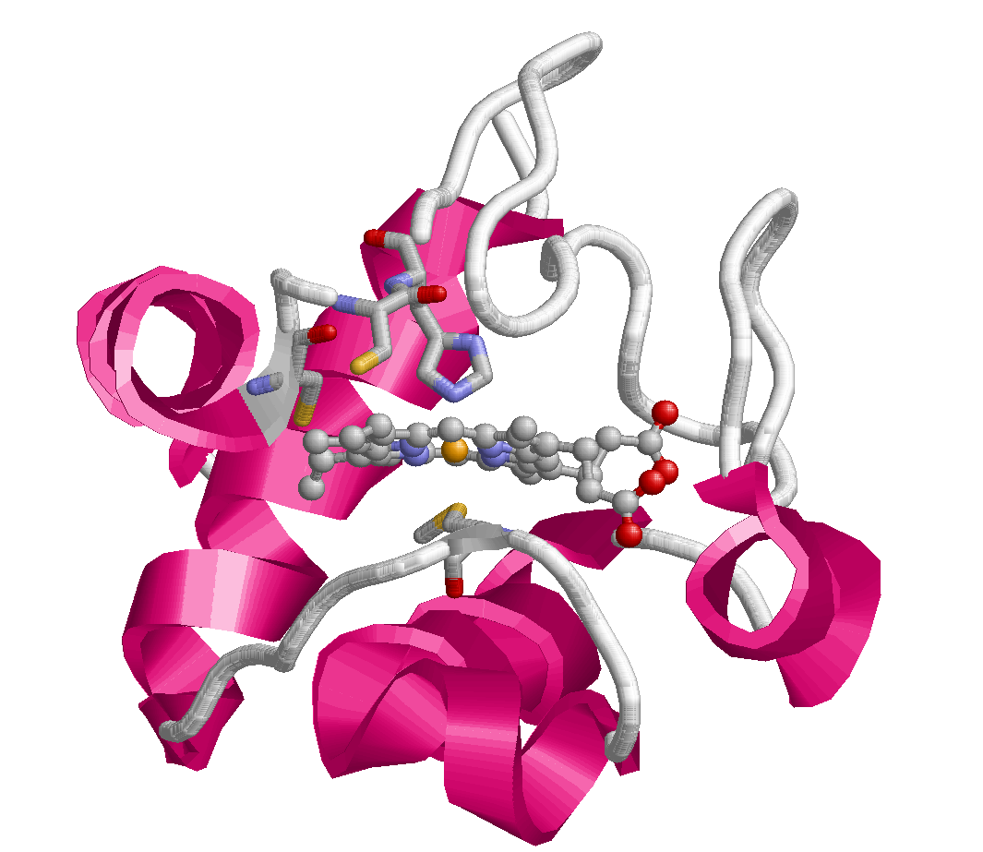
Sequence-to-structure relation: Cytochrome C
Electron carrier protein. The oxidized form of the cytochrome c heme group can accept an electron from the heme group of the cytochrome c1 subunit of cytochrome reductase. Cytochrome c then transfers this electron to the cytochrome oxidase complex, the final protein carrier in the mitochondrial electron-transport chain.
CYS 18
HIS 19
CYS 15
MET 81
UniProt: P99999
Feature key | Position(s) | Length | Description
Binding site^{i} | 15 – 15 | 1 | Heme (covalent)
Binding site^{i} | 18 – 18 | 1 | Heme (covalent)
Metal binding^{i} | 19 – 19 | 1 | Iron (heme axial ligand)
Metal binding^{i} | 81 – 81 | 1 | Iron (heme axial ligand)
PDB: 3zcf:A

Slide 13
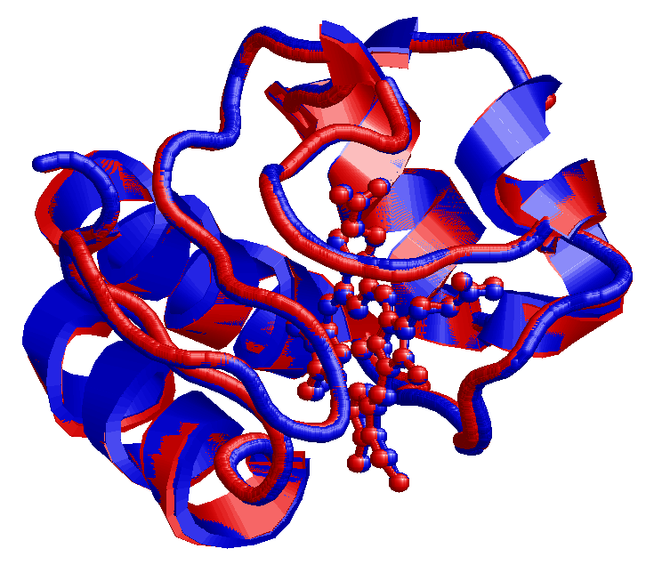
Cytochrome C (Homo vs. Horse)
Human Cytochrome C - Uniprot:P99999. PDB: 3ZCF:A
Equine Cytochrome C – Uniprot: P00004. PDB 3O20:A
Structural alignment:
RMSD= 0,035 nm
1:A 20:A 40:A 60:A
| | . | . | . | . | . | . |
GDVEKGKKIFIMKCSQCHTVEKGGKHKTGPNLHGLFGRKTGQAPGYSYTAANKNKGIIWGEDTLMEYLEN
||||||||||:.||.||||||||||||||||||||||||||||||:.||.|||||||.|.|:||||||||
GDVEKGKKIFVQKCAQCHTVEKGGKHKTGPNLHGLFGRKTGQAPGFTYTDANKNKGITWKEETLMEYLEN
| | . | . | . | . | . | . |
1:A 20:A 40:A 60:A
80:A 100:A
. | . | . |
PKKYIPGTKMIFVGIKKKEERADLIAYLKKATNE
||||||||||||.|||||.||.||||||||||||
PKKYIPGTKMIFAGIKKKTEREDLIAYLKKATNE
. | . | . |
80:A 100:A
88% sequence identity

Slide 14
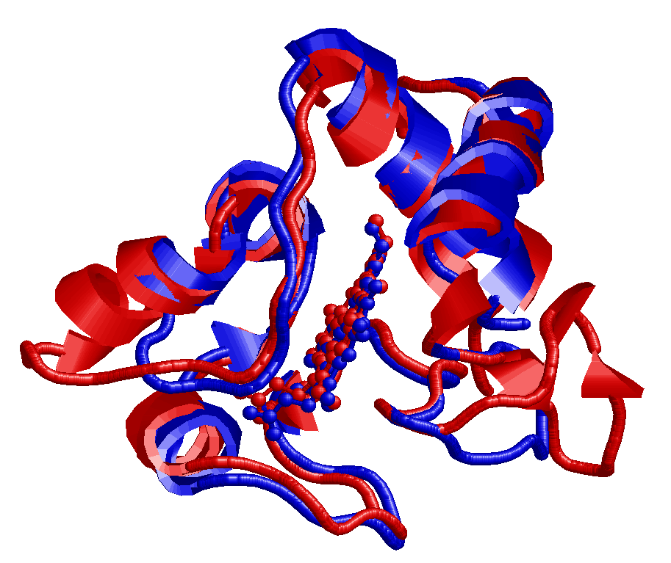
Cytochrome C (Homo vs. Rhodobacter sphaeroides)
Human Cytochrome C - Uniprot:P99999. PDB: 3ZCF:A
Cytochrome C2 Rhodobacter Sph. - Uniprot: P0C0X8. PDB: 1CXC:A
Structural alignment:
RMSD= 0,18 nm
1:A 20:A 40:A
| | . | . | . | . | .
GDVEKGKKIFIMKCSQCHTVEKGG-------KHKTGPNLHGLFGRKTGQAPGYS-YTAANKNKG---IIW
||.|.|.|.|. .|..||.:.... ..||||||:|..||..|....:. |....|..| :.|
GDPEAGAKAFN-QCQTCHVIVDDSGTTIAGRNAKTGPNLYGVVGRTAGTQADFKGYGEGMKEAGAKGLAW
| | . | . | . | . | . | . |
3:A 20:A 40:A 60:A
60:A 80:A 100:A
| . | . | . | . |
GEDTLMEYLENPKKYI--------PGTKMIFVGIKKKEERADLIAYLKKATNE
.|:...:|.:.|.|:: ...||.| .:||..:...:.|||......
DEEHFVQYVQDPTKFLKEYTGDAKAKGKMTF-KLKKEADAHNIWAYLQQVAVR
. | . | . | . | . |
80:A 100:A 120:A
28% sequence identity

Slide 15
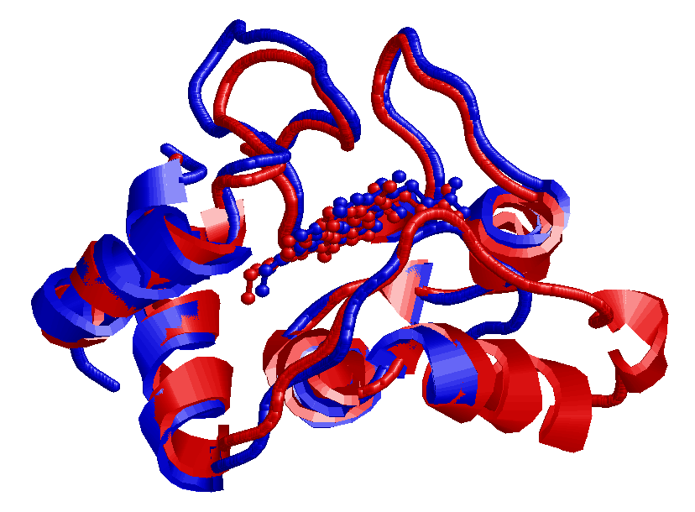
Cytochrome C (Homo vs. Rhodopseudomonas palustris)
Human Cytochrome C - Uniprot:P99999. PDB: 3ZCF:A
Cytochrome C2 Rhodopseudomons pal. – Uniprot: P00091. PDB: 1I8O:A
Structural alignment:
RMSD= 0,13 nm
1:A 20:A 40:A 60:A
| | . | . | . | . | . | .
GDVEKGKKIFIMKCSQCHTVEKGGKHKTGPNLHGLFGRKTGQAPGYSYTAANKNKG---IIWGEDTLMEY
.|...|..:|. .|..||.. .|...||.|.|..|||.|.|.|:.|...|.|.| ::|..|.:..|
xDAKAGEAVFK-QCMTCHRA---DKNMVGPALAGVVGRKAGTAAGFTYSPLNHNSGEAGLVWTADNIVPY
| | . | . | . | . | . | .
1:A 20:A 40:A 60:A
80:A 100:A
| . | . | . |
LENPKKYIP--------------GTKMIFVGIKKKEERADLIAYLKKAT
|..|..::. .|||.| .:...::|.|.:|||....
LADPNAFLKKFLTEKGKADQAVGVTKMTF-KLANEQQRKDVVAYLATLK
| . | . | . | . |
80:A 100:A
29% sequence identity

Slide 16
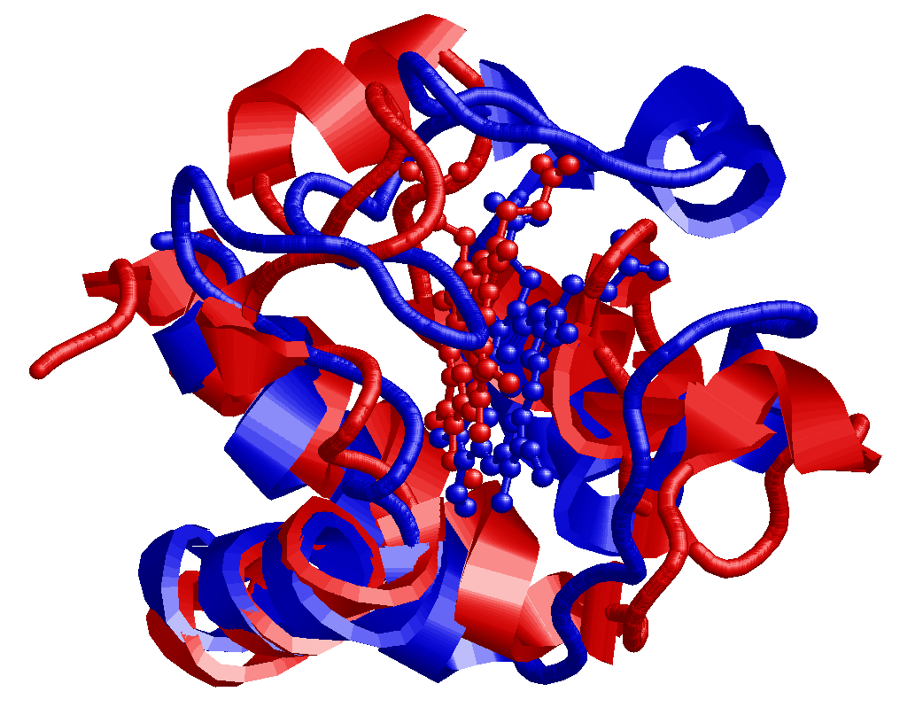
Cytochrome C (Homo vs. Arabidopsis thaliana)
Human Cytochrome C - Uniprot:P99999. PDB: 3ZCF:A
Cytochrome C6A Arabidopsis Thaliana - Uniprot: Q93VA3. PDB 2CE0:A
Structural alignment:
RMSD= 0,35 nm
1:A 20:A 40:A 60:A
| | . | . | . | . | . | .
GDVEKGKKIFIMKCSQCHTVEKGGKHKTGP---NLHG-LFGRKTGQAPGYSYTAANKNKGIIWGEDTLME
.|:::|..:|...|..||... |... . .|.. ...|. .:..|:.:..
LDIQRGATLFNRACAACHDTG--GNII--QPGATLFTKDLERN-----------------GVDTEEEIYR
| | . | . | . | . |
3:A 20:A 40:A
80:A 100:A
| . | . | . |
YLE---------NPKKYIPGTKMIFVGIKKKEERADLIAYLKKATNE
... ..|....|.......:... |...|..:.|....:
VTYFGKGRMPGFGEKCTPRGQCTFGPRLQDE-EIKLLAEFVKFQADQ
. | . | . | . | .
60:A 80:A
13% sequence identity

Slide 17
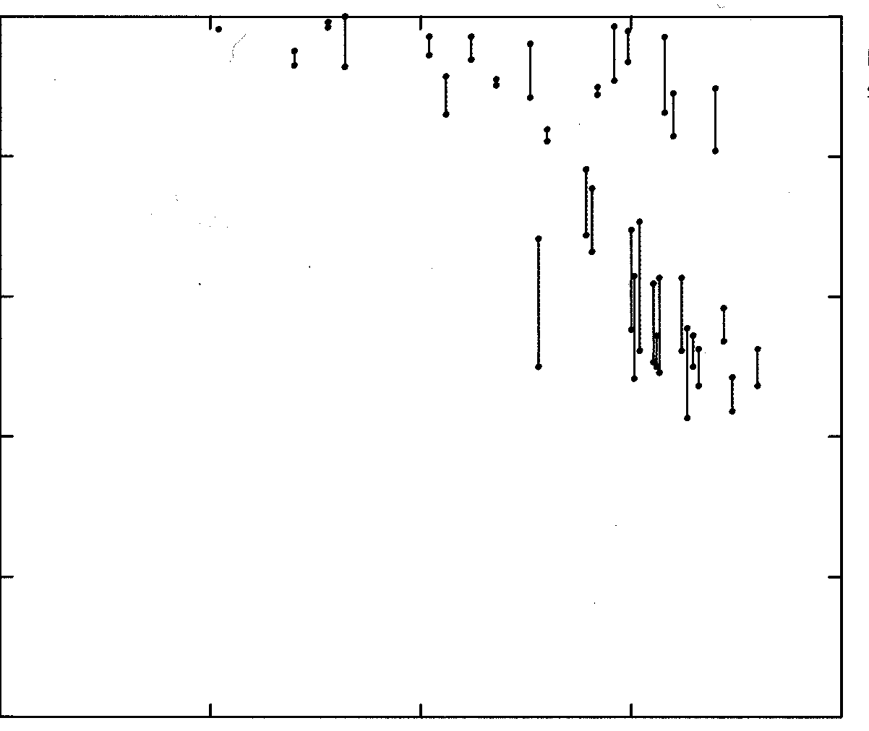
Sequence-to-structure relation
By structurally aligning a large set of strucures:
2.5
1.0
2.0
0.8
1.5
0.6
Fraction of residues in core with RMSD < 0.1 nm
Rmsd of backbone atoms in core
1.0
0.4
0.5
0.2
0.0
0.0
100
50
0
100
50
0
Percent identical residues in core
Percent identical residues in core
Proteins with more than 60% identical have more than 90% of residues that result less than 0.1 nm apart after superimposition
Chothia, C. & Lesk, A. M. (1986). The relation between the divergence of sequence and structure in proteins. EMBO J. 5, 823-826.

Slide 18
Sequence-to-structure relationship
By structurally aligning a large set of strucures:
1
0
0
.
i
d
e
n
t
i
t
y
8
0
Sequence identity imply structural identity
6
0
Sequence identity (%)
4
0
Sequence
identity DO NOT
Imply structural similarity
2
0
0
0
5
0
1
0
0
1
5
0
2
0
0
2
5
0
No of aligned residues
Rost B (1999). The twilight zone of protein alignments. Protein Engineering 12, 85-94.

Slide 19
Sequence identity and structural similarity
Sequences longer than 100 residues and sharing more the 30% of similar residues have similar structures
For shorter sequences the level of identity must be higher
This DO NOT mean that sequences sharing lower identity MUST have different structures
Example: Sperm Whale Mioglobin and bacterial Emoglobin
RMSD = 0.19 nm, Identity: 14%
.

Slide 20
Evolution did it (?)
Evolution: Variability and Natural Selection
Sequences of living organisms have evolved from ancestral sequences
Genomic sequences are continually changing at random
The environment operates a selection of the individuals on the basis of the fitness of their phenotypes
When the products of the modified gene (the proteins, the structural RNAs ….) fit worse with the environment than the original ones, the individual has a lower probability of surviving and the mutation has lower probability to be transmitted
NB. Are mutation always random? Not, at least when the mutation rate is taken into consideration (Radman polymerases)

Slide 21
Significant sequence similarity may imply:
Function similarity
Structure similarity
Homology
Significant similarity between a new sequence and a sequence about which structure and/or function is already known allows the transfer of information about structure and/or function to the new sequence (transfering by homology)

Slide 22
Homology vs sequence similarity
Homology
Sequences are homologous when they derive from a common ancestor
Orthologous when they belong to different species
Paralogous when they are present into the same species (gene duplication)
Similarity
Sequences are similar if they share a significant amount of residues along the sequence
It is a comparative criterion, not an evolutionary one

Slide 23
Homology vs sequence similarity
Homology and similarity are different concepts
However, sequences sharing significant similarity are likely to be homologous
Are homologous sequences always similar?
It depends on how much did they separate after divergence
Are similar sequences always homologous?
Different sequences could have evolved in a convergent way towards similar sequences (similarly to wings, independently evolved in insects, birds and bats)

Slide 24
Protein comparison
Sequence similarity

Slide 25
How can we measure similarity?
WORLD
WORD
Degree of identity
Similarity of text strings
Sequence comparison
The concept of alignment is crucial

Slide 26
How can we measure similarity?
Before the similarity of two sequences can be evaluated, one typically begins by finding a plausible alignment between them
Alignment methods find the best alignment between two strings under some scoring scheme
ACCTCGATCGCTAGCTAACTAGC
ACTCCGTAGGCTGCTTAGTTACC
ACCTCGATCGCTAGCTAACTAGC-
-ACTCCGTACGCTGCTTAGTTACC
+1
+1
-1

Slide 27

Exercise
Write a function
Input: two strings of equal length
Output: similarity score using the following scoring scheme:
S = $\sum_{i}^{len(seq)}{si}$
+1 match
-1 mismatch
where s_{i} =

Slide 28
Pairwise sequence alignment
The process of lining up two sequences to achieve maximal levels of identity for the purpose of assessing the degree of similarity
Pairwise alignment of biological sequences
The process of lining up two sequences to achieve maximal levels of identity (and conservation, in the case of amino acid sequences) for the purpose of assessing the degree of similarity and the possibility of homology

Slide 29
Pairwise sequence alignment
EEELTKPRLLWALYFNMRDALSSG
VEKPRILYALYFNMRDSSDE
EEELTKPRLLWALYFNMRDALSSG-
---VEKPRILYALYFNMRD--SSDE

Slide 30
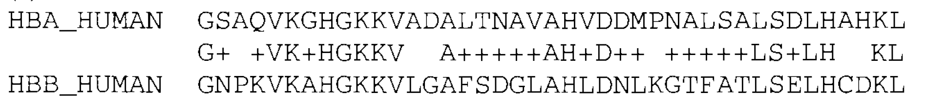
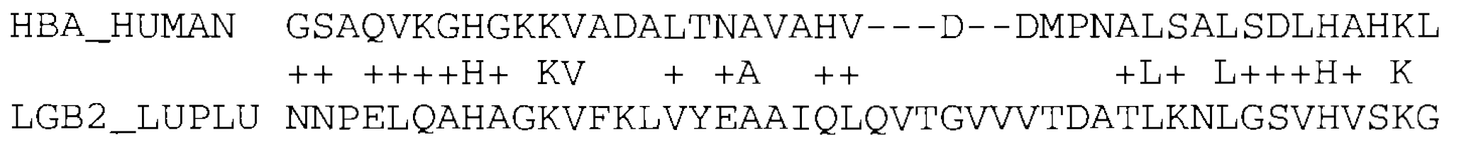
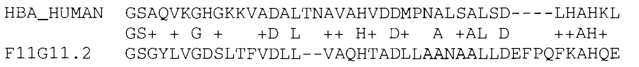
Alignment between human alpha globin and human beta globin
Clear similarity
match
conservative substitution
Alignment between human alpha globin and leghaemoglobin from yellow lupin
Structurally plausible
mismatch
gap
Alignment between human alpha globin and a nematode glutathione S-transferase homologue named F11G11.2
Spurious high-scoring

Slide 31
Sequence alignment
Key issues:
What sorts of alignment should be considered
Amino acid/DNA sequences? Gapped/ungapped alignment? Local/global?
The scoring scheme used to rank alignments
Define a score (or a distance) between two aligned sequences
The algorithm used to find optimal (or good) scoring alignments
Find the best algorithm (exhaustive but slow, euristic but fast) for a given problem
The statistical methods used to evaluate the significance of an alignment score
Statistically evaluate the significance of the alignment: is the alignment more likely to have occurred because the sequences are related or, just by chance?

Slide 32
The scoring scheme
Basic: match = +1; mismatch = -1
Scoring scheme giving the biologically most likely alignment the highest score
Biological molecules have features that constrain their primary sequence evolution
The scoring scheme can be very complex
It is not always possible to distinguish true alignments form spurious alignments

Slide 33
The scoring model
Key issues:
Sequence comparison: searching for evidence that they have diverged from a common ancestor by a process of mutation and selection
Mutational processes → substitutions, insertion and deletions (indels or gaps)
Natural selection screens mutations → some changes may be seen more than others

Slide 34
The scoring model
The total score we assign to an alignment will be a sum of terms for each aligned pair of residues, plus terms for each gap
Notes:
The total score we assign to an alignment will be a sum of terms for each aligned pair of residues, plus terms for each gap.

Slide 35
The scoring model
This corresponds to the logarithm of the relative likelyhood that the sequences are related, compared to being unrelated
Notes:
In our probabilistic interpretation, this will correspond to the logarithm of the relative likelihood that the sequences are related, compared to being unrelated. Informally, we expect identities and conservative substitutions to be more likely in real alignments than we expect by chance, and so to contrinute positive score terms; and non-conservative changes are expected to be less frequently in real alignments than we expect by chance, and so these contribute negative score terms

Slide 36
The scoring model
Using an additive scoring scheme corresponds to an assumption that we can consider mutations at different sites in a sequence to have occurred independently (treating a gap of arbitrary length as a single mutation)
Notes:
The assumption of independence appears to be reasonable approximation for DNA and protein sequences, although we know that interactions betwwn residues play a very critical role in determining protein structure.
However, it is seriously inaccurate for structural RNAs, where base pairing introduces very importan long-range dependencies.
It is possible ro take these dependencies into account, nut doing so gives rise to significant computational complexities.

Slide 37
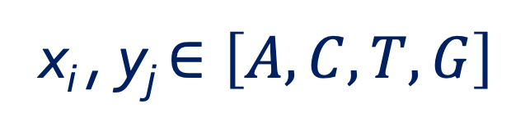
Ungapped global pairwise alignments
The alignment consists of a sequence of paired residues
x: ALASVLIRLITRLYP
y: ASAVHLNRLITRLYP
We need score terms for each aligned residue pair x_{i} , y_{j}:
s(x_{i} , y_{j})
x_{i} , y_{j} $∈\left[A,C,T,G\right]$
x_{i} , y_{j} $∈\left[A,C,D,E,F,G,H,K,I,L,M,N,P,Q,R,S,T,V,W,Y\right]$

Slide 38
Aim: assign a score to the alignment that gives a measure of the relative likelihood that the sequences are related as opposed to being unrelated.
Assign a probability to the alignment in each of the two cases; we then consider the ratio of the two probabilities
random model
Probability sequences are related
P(x,y | R)
=
Probability sequences are unrelated
P(x,y) | M)
match model
Notes:
Aim: assign a score to the alignment that gives a measure of the relative likelihood that the sequences are related as opposed to being unrelated.
We do this by having models that assign a probability to the alignment in each of the two cases; we then consider the ratio of the two probabilities.

Slide 39
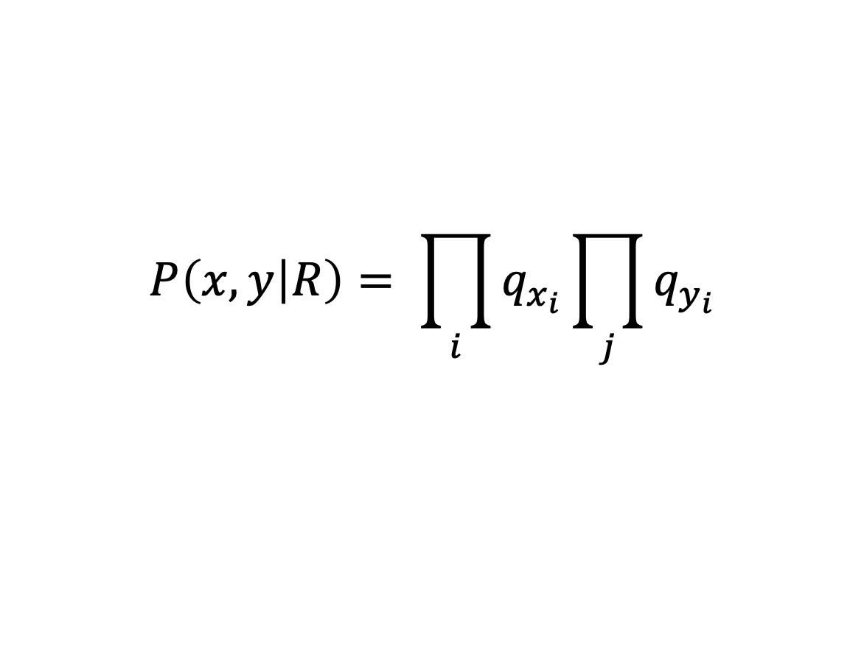
Random model
$$P\left(x,y | R\right)= \prod_{i}{q_{x_{i}}}\prod_{j}{q_{y_{i}}}$$
It assumes that letter a occurs independently with some frequency q_{a}
Hence, the probability of the two sequences is just the product of the probabilities of each amino acid
Notes:
Aim: assign a score to the alignment that gives a measure of the relative likelihood that the sequences are related as opposed to being unrelated.
We do this by having models that assign a probability to the alignment in each of the two cases; we then consider the ratio of the two probabilities.

Slide 40
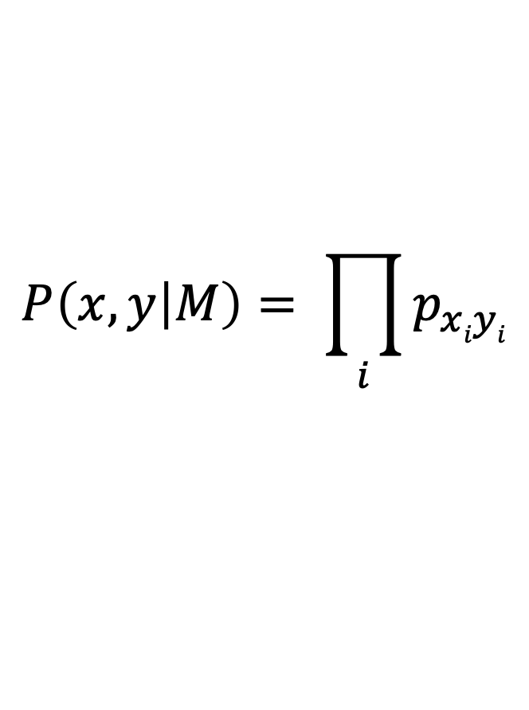

Match model
$$P\left(x,y | M\right)= \prod_{i}{p_{xiyi}}$$
$$p_{ab}$$
= joint probability of aligned pairs of residues
Notes:
Pab can be thought of as the probability that the residues a and b have each independently derived from some unknown original residue c in their common ancestor (c might be the same as a and/or b)

Slide 41

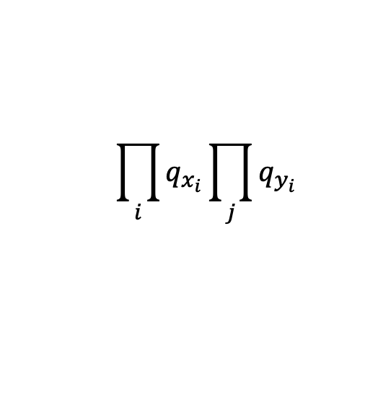
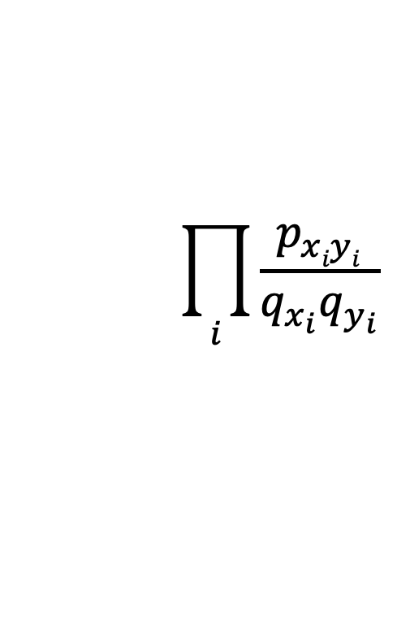
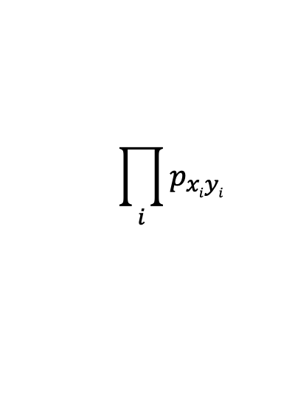

odds ratio
$$\prod_{i}{q_{x_{i}}}\prod_{j}{q_{y_{i}}}$$
$$P\left(x,y | R\right)$$
$$\prod_{i}{\frac{p_{xiyi}}{q_{x_{i}}q_{y_{i}}}}$$
=
=
$$P\left(x,y | M\right)$$
$$\prod_{i}{p_{xiyi}}$$
In order to arrive at an additive scoring system, we take the logarithm of this ratio

Slide 42
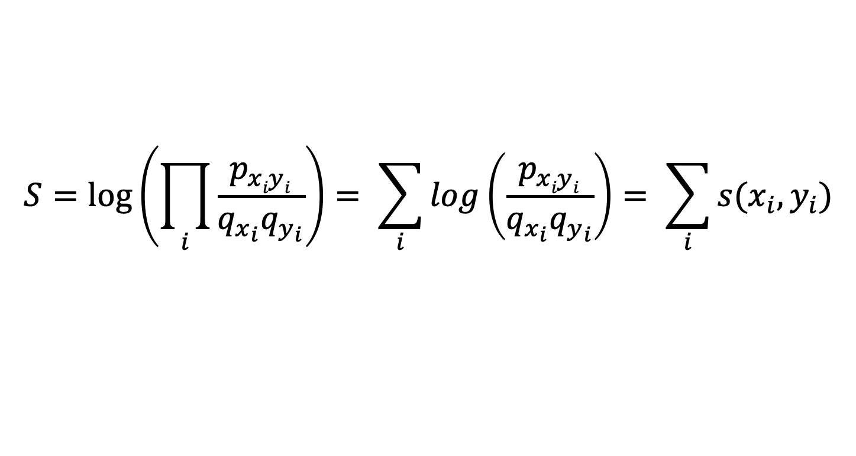
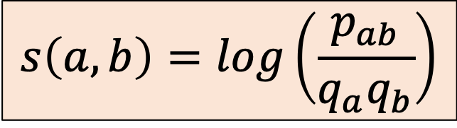
log-0dds ratio
$$S=\log\left(\prod_{i}{\frac{p_{xiyi}}{q_{x_{i}}q_{y_{i}}}}\right)= \sum_{i}{log\left(\frac{p_{xiyi}}{q_{x_{i}}q_{y_{i}}}\right)= \sum_{i}{s(x_{i},y_{i})}}$$
where
log likelihood ratio of the residue pair (a, b) occurring as an aligned pair, as opposed to an unaligned pair
$$s\left(a,b\right)=log\left(\frac{p_{ab}}{q_{a}q_{b}}\right)$$

Slide 43
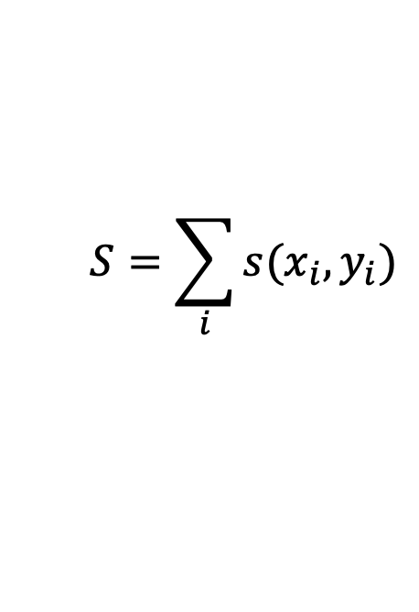
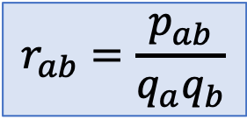
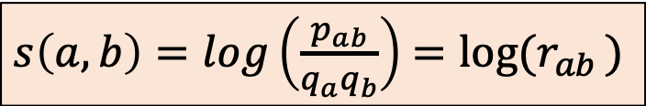
log-0dds ratio
$$S=\sum_{i}{s(x_{i}, y_{i})}$$
$s\left(a,b\right)=log\left(\frac{p_{ab}}{q_{a}q_{b}}\right)$ $=log⁡(r_{ab })$
$$r_{ab}=\frac{p_{ab}}{q_{a}q_{b}}$$
where
The ratio r_{ab} = P_{ab}/P_{a}P_{b}
determines whether the substitution a -> b is more or less frequent than expected by chance (i.e. randomly).
Given an alignment between two sequences
A: SLDPIKHTYRALMNVDSLRTFPIL
B: SFGIKKHTKLAKLPVDTIKSWPIL
the probability of all the substitutions A->B is computed as the product of the ratios r_{ab} : r_{SS} r_{LF} r_{DG} r_{PI} r_{IK} … (assuming the independence among the positions)

Slide 44
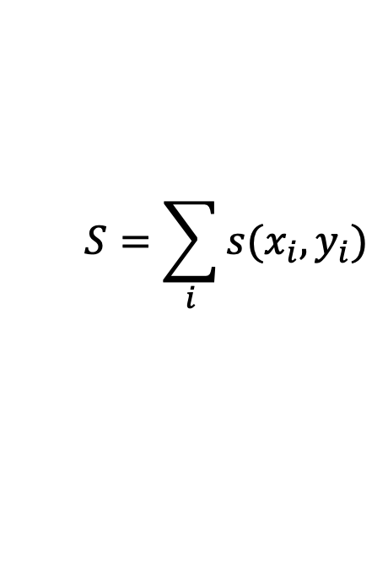
log-0dds ratio
$$S=\sum_{i}{s(x_{i}, y_{i})}$$
$s\left(a,b\right)=log\left(\frac{p_{ab}}{q_{a}q_{b}}\right)$ $=log⁡(r_{ab })$
$$r_{ab}=\frac{p_{ab}}{q_{a}q_{b}}$$
where
SCORE : s(a,b) =int[K log(P_{ab}/P_{a}P_{b})] LOG-ODDS SCORE
Thanks to the logarithm the scores can be added up

Slide 45

Score matrix or substitution matrix
The $s\left(a,b\right)$ scores can be arranged in a matrix
20x20 matrix for proteins
4x4 matrix for DNA

