Slide 1

How are DAGs made?
A journey into modelling price elasticity
Paweł Olszewski data scientist @ Allegro 27.05.2026

Slide 2

Meet Tomek, a newly hired Data Scientist at Allegro.
His first assignment?
Automated price discounts!
Given a fixed monthly budget, decide where to discount and how much to maximize the total effect on sales.

Slide 3
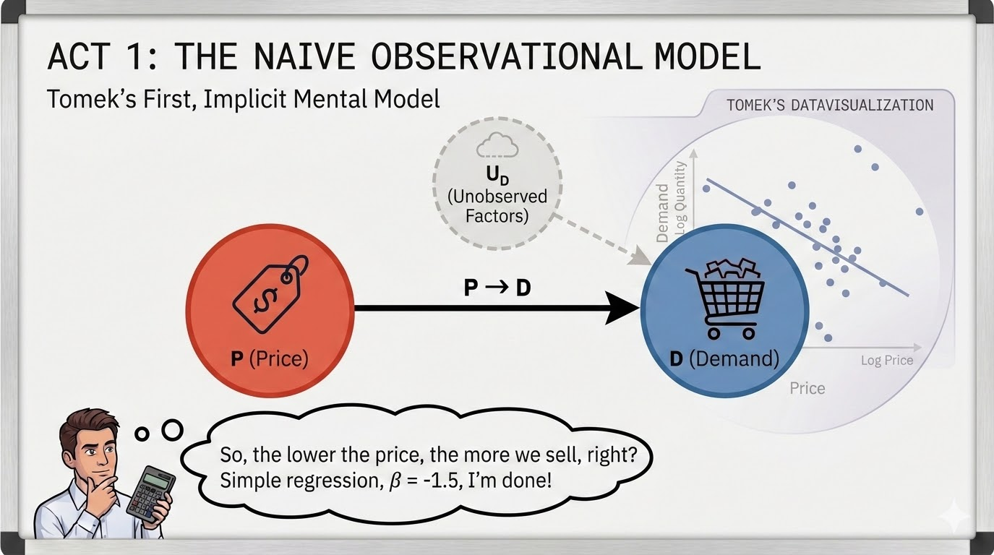

Slide 4
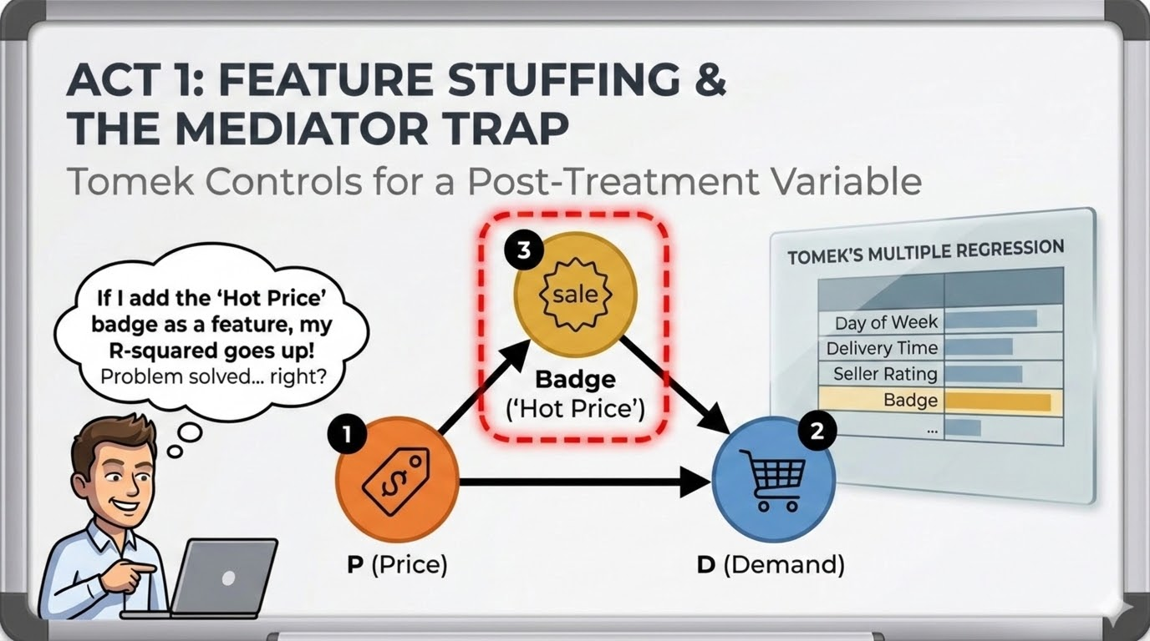

Slide 5
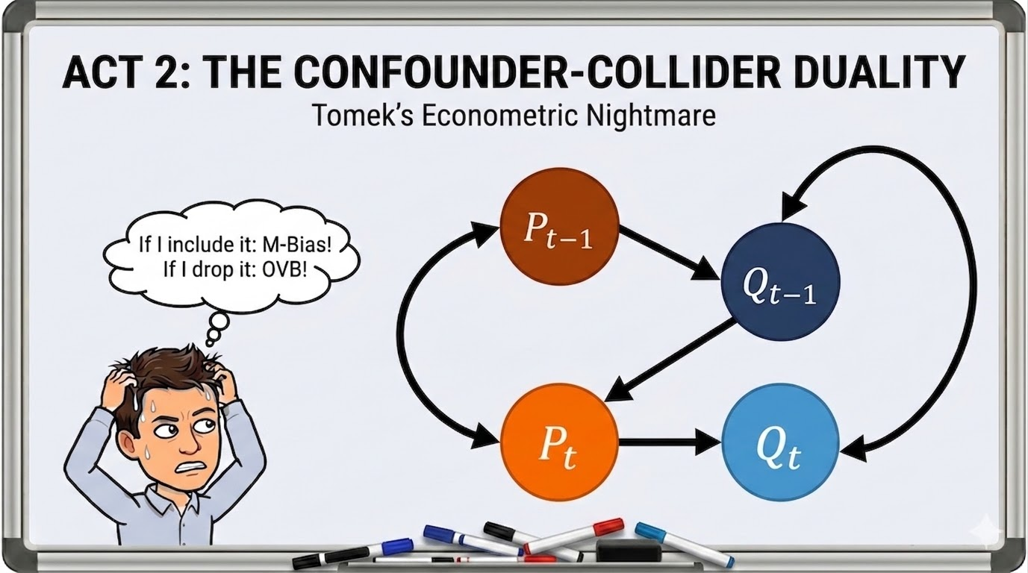

Slide 6
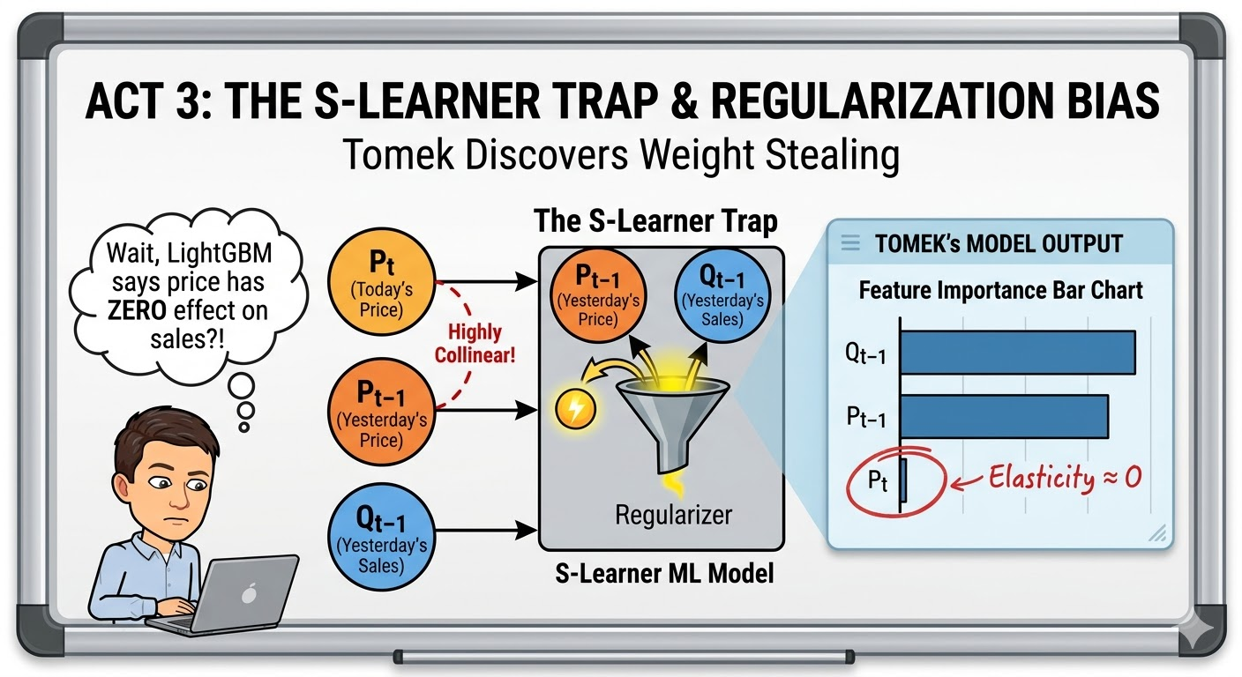

Slide 7
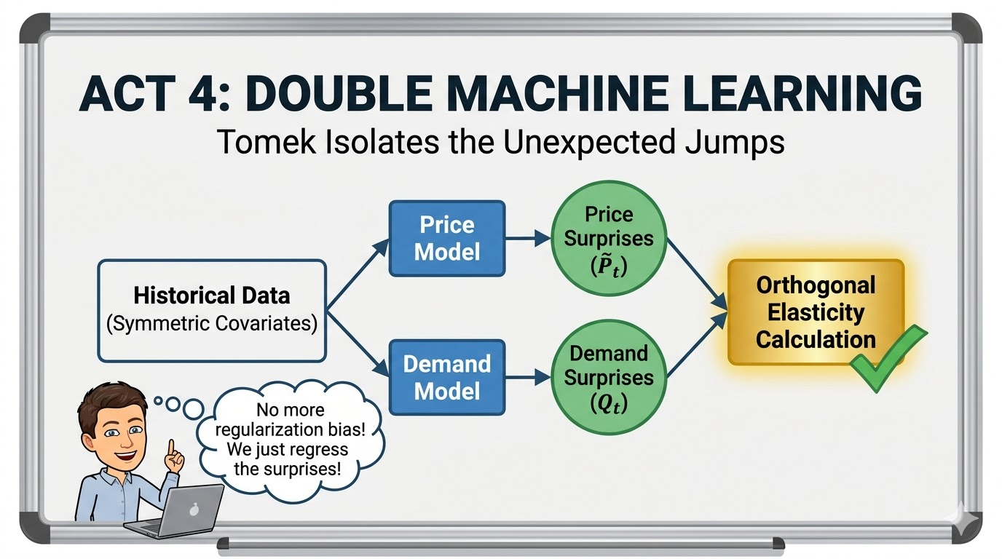

Slide 8
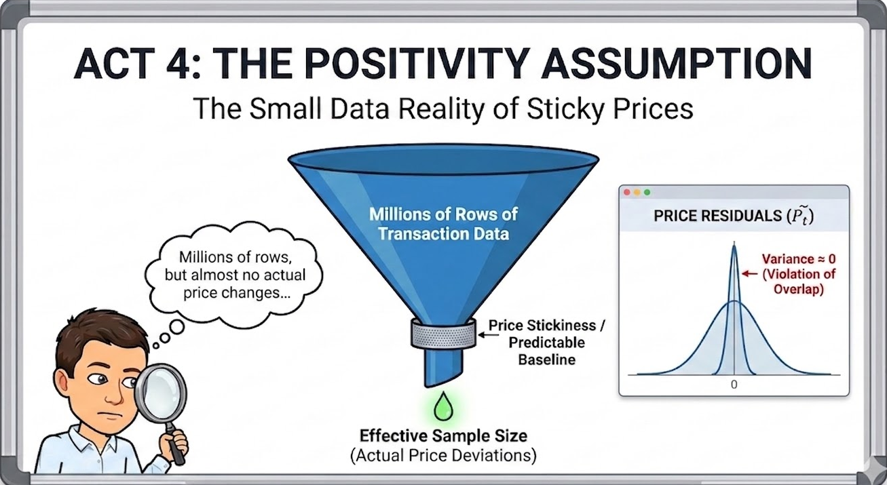

Slide 9
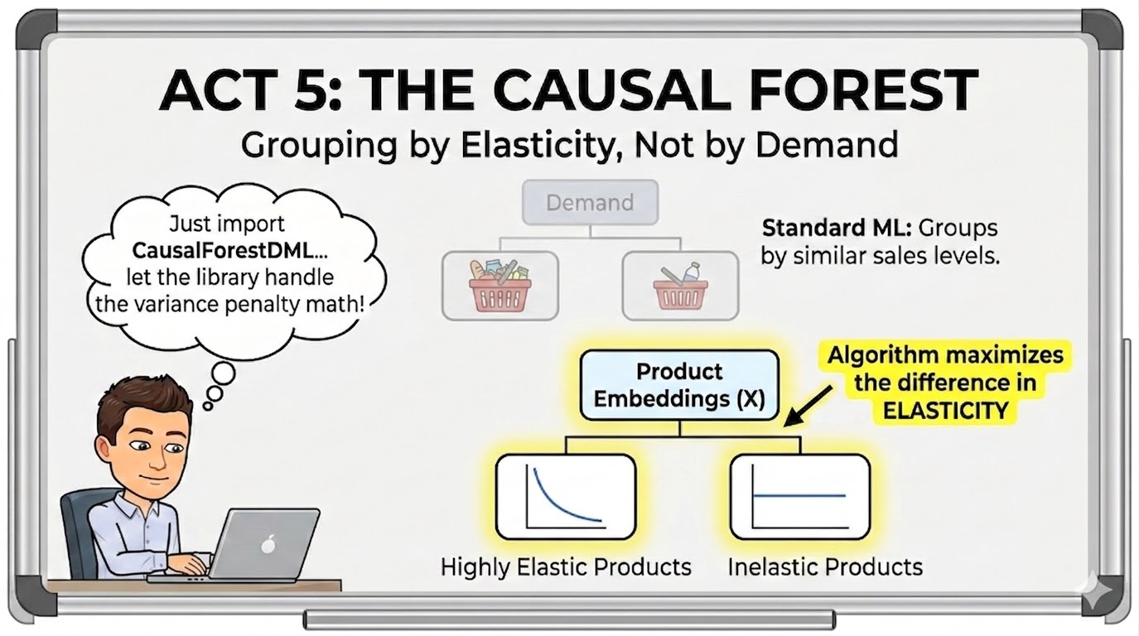

Slide 10
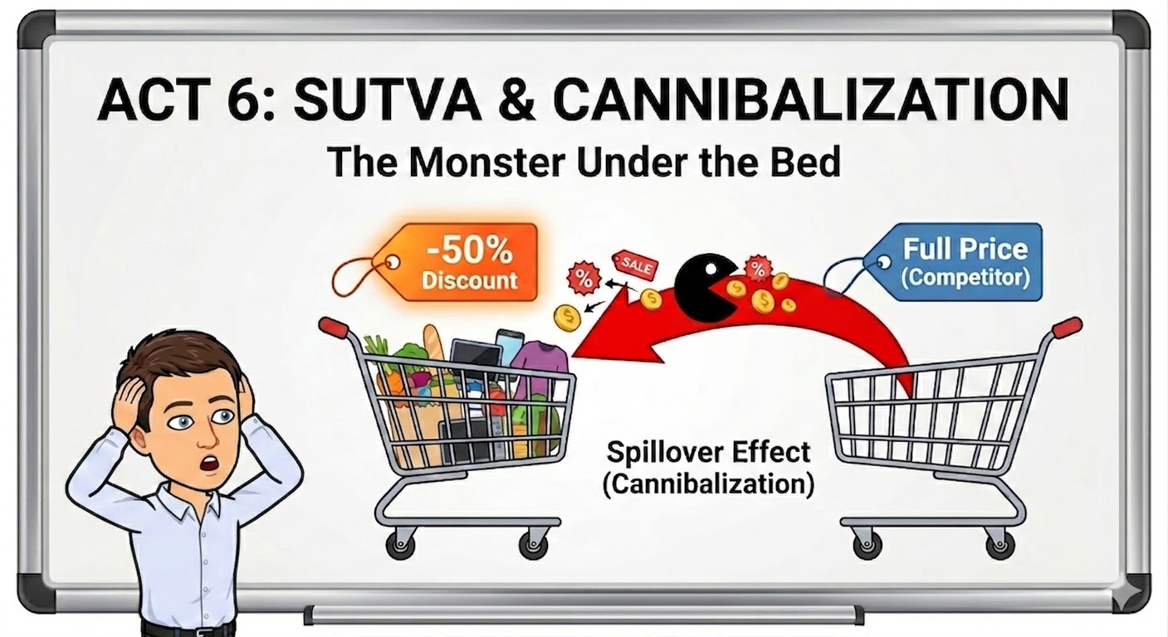

Slide 11
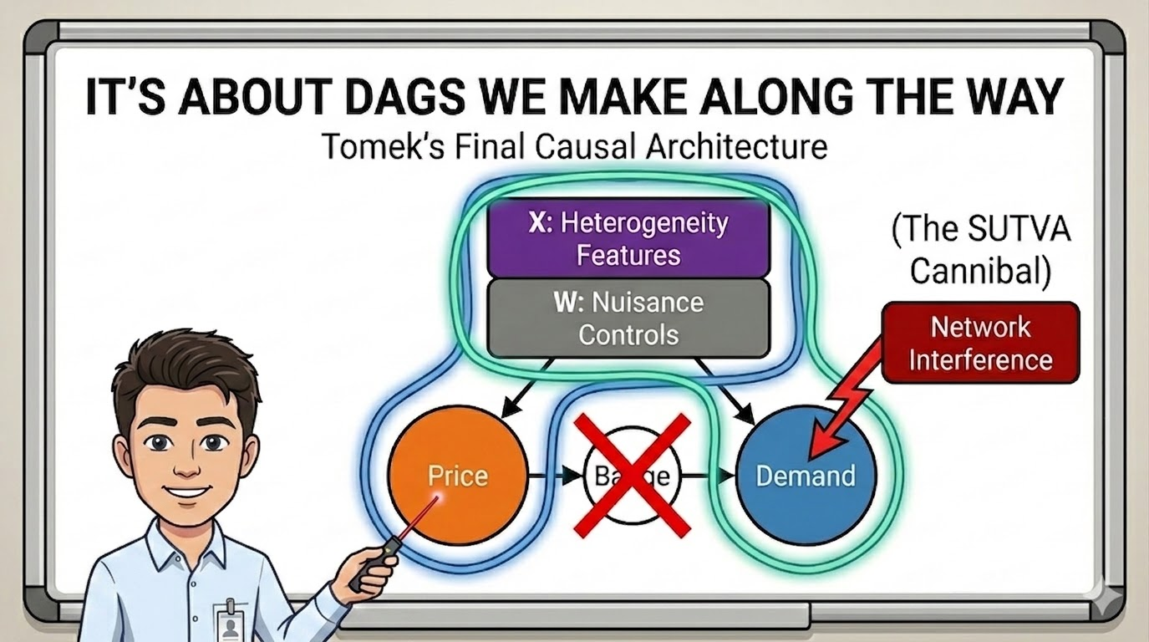

Slide 12
Tips for price elasticity modelling
Identify and exclude mediators (if you cannot model the P→M effect separately).
You probably should include the history of the outcome in your features (autoregression). But don’t forget to include history of the treatment as well.
An ML S-learner will regularize some of your treatment effect towards zero.
Model the treatment to expose problems with positivity.
Estimating heterogeneity of the effect (rather than just ATE) is another level of difficulty. Consider pairing DML with CausalForest (note: the final stage of DML is non-causal).
Chances are no one else is going to want to see your DAG. Draw it anyway :)

