Slide 1
Text Analysis: Matching and Linking for Joining Data
Austin Alleman
November 20, 2019

Slide 2
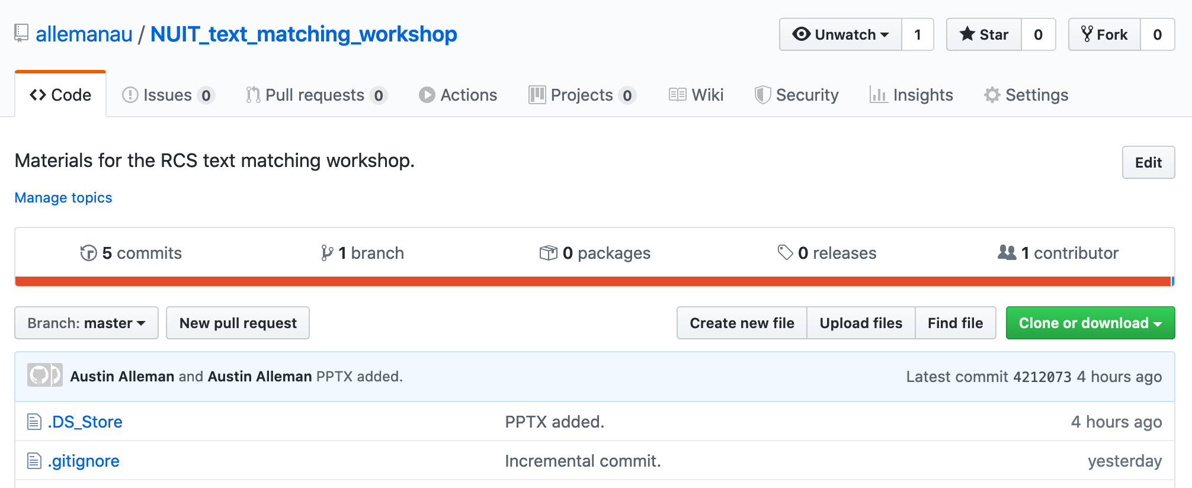
Workshop Resources
All materials, including these slides, R scripts, and an RMarkdown version of this workshop are available here:
https://github.com/allemanau/NUIT_text_matching_workshop

Slide 3
INTRODUCTIONS
Who am I?
Data science research consultant with NUIT RCS
Fuzzy logic evangelist and practitioner
Who are you?
Introduce yourself to your neighbors!
What do you work on? What brings you here?

Slide 4
ORDER OF OPERATIONS
Setup and dependencies
Merging two data sets: joins
Approximate string matching
“Fuzzy” joins
Conclusion

Slide 6
INTRODUCTIONS
Who am I?
Data science research consultant with NUIT RCS
Fuzzy logic evangelist and practitioner
Who are you? Maybe…
Handling manual entry data?
Scraped data
Hand-coded data sets
Dealing with disparate data sources?
Systematic inconsistencies among names
Just curious?
But really, who are you?
Introduce yourself to your neighbors!
What do you work on? What brings you here?

