Slide 1
Text Analysis: Matching and Linking for Joining Data
Austin Alleman
November 20, 2019

Slide 2

Workshop Resources
All materials, including these slides, R scripts, and an RMarkdown version of this workshop (for those who prefer) are available here:
https://github.com/allemanau/NUIT_text_matching_workshop

Slide 3
INTRODUCTIONS
Who am I?
Data science research consultant with NUIT RCS
Fuzzy logic evangelist and practitioner
Who are you?
Introduce yourself to your neighbors!
What do you work on? What brings you here?

Slide 4
WORKSHOP GOALS
String distance functions
When and how you might use fuzzy joins in R
Threshold analysis
Have fun

Slide 5
ORDER OF OPERATIONS
Problem context
Joins
Joins
Fuzzy joins
Conclusion
tidyverse + a fun(?) narrative

Slide 6
ORDER OF OPERATIONS
Problem context
Joins
Fuzzy string matching
Fuzzy joins
Conclusion
Combining data exactly on a key
tidyverse + a fun(?) narrative

Slide 7
ORDER OF OPERATIONS
Problem context
Joins
Fuzzy string matching
Fuzzy joins
Conclusion
Combining data exactly on a key
tidyverse + a fun(?) narrative
String distance functions

Slide 8
ORDER OF OPERATIONS
Problem context
Joins
Fuzzy string matching
Fuzzy joins
Conclusion
Combining data exactly on a key
Combining data on near-matching keys
tidyverse + a fun(?) narrative
String distance functions

Slide 9
ORDER OF OPERATIONS
Problem context
Joins
Fuzzy string matching
“Fuzzy” joins
Conclusion
Combining data exactly on a key
Combining data on near-matching keys
tidyverse + a fun(?) narrative
String distance functions
Recap and next steps

Slide 10
ANALYZING SCRAPED DATA
Problem context
Joins
Fuzzy string matching
Fuzzy joins
Conclusion

Slide 11
Today, let’s step into the shoes of an R-saavy grad school applicant.

Slide 12

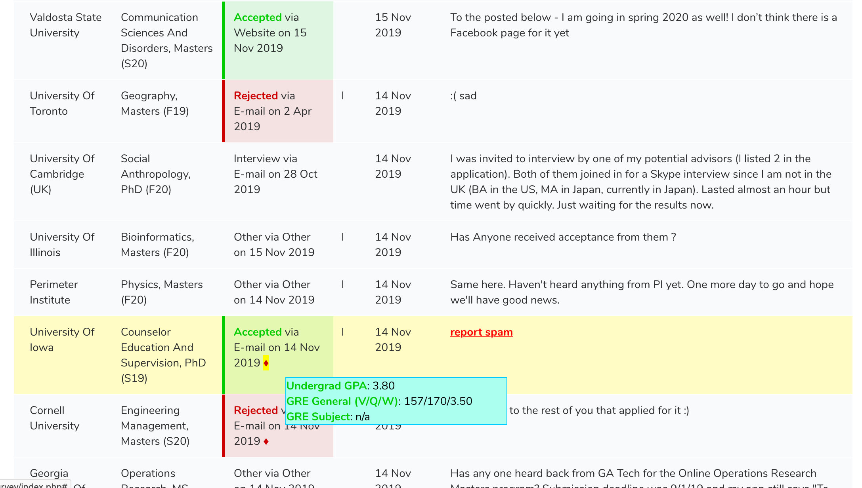
Degree
Subject
Application year
School name
Decision
Decision date
Misc

Slide 13
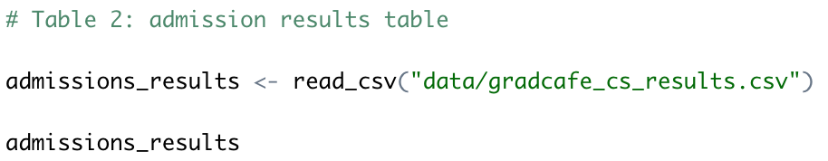
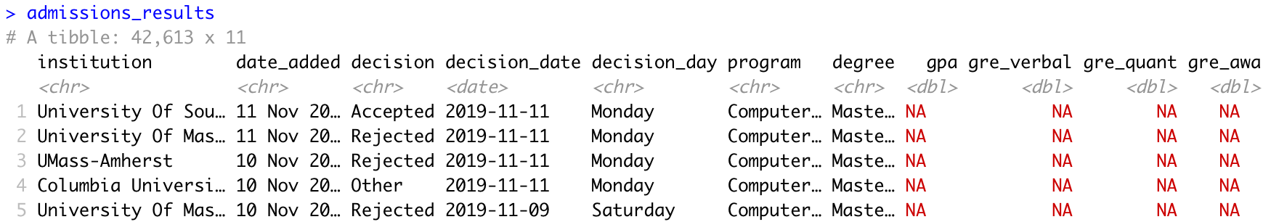

Slide 14
Exercise: use tidyverse-compliant functions to investigate the admissions results data! (See handout.)
Compute the mean GPA for PhD applicants only
Compute the mean total GRE scores for PhD applicants only
Print the 50 schools with the most results overall in descending order

Slide 15
COMBINING DATA SETS
Problem context
Joins
Fuzzy string matching
Fuzzy joins
Conclusion

Slide 16


Slide 17
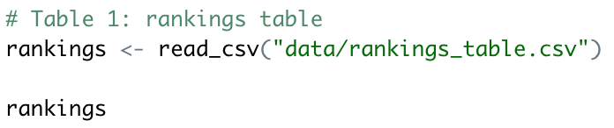
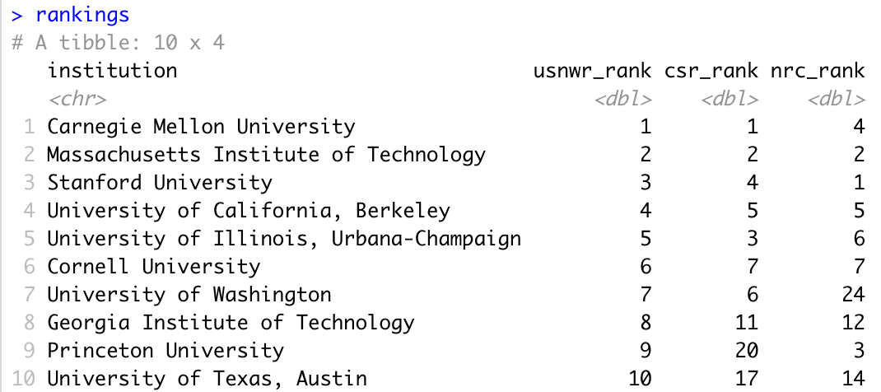

Slide 18
Goal: we want to combine the rankings from the first table with the admissions results from the second table where the institution name matches into a single table – otherwise known as a join or inner join.
x: name of first table
y: name of first table
by: name of the column with values to be matched between x and y

Slide 19
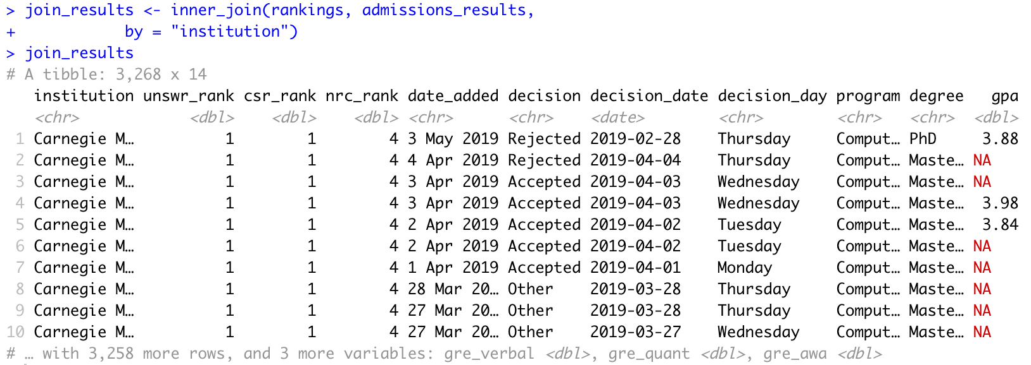
Using inner_join() from tidyverse, we get around ~3300 results matched to our top 10 programs:

Slide 20
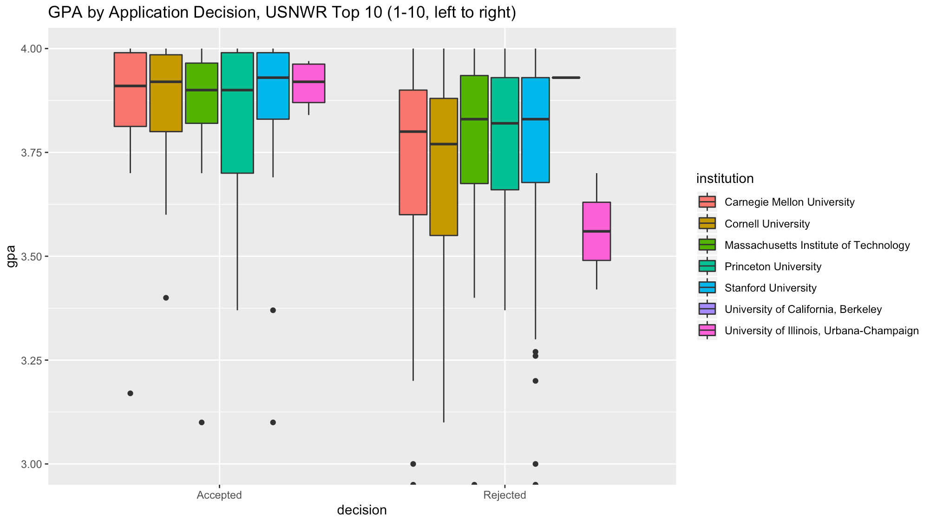
Visualizing the results, we see only 7 institutions matched results…?

Slide 21
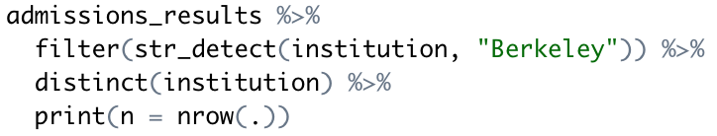
Let’s take a look at entries containing “Berkeley” in admissions_results:

Slide 22
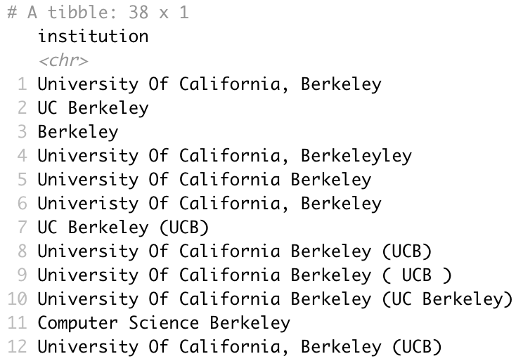
There are 38 different schools containing “Berkeley”! (And these are just the ones that spelled “Berkeley” right somewhere.) Here are the first 12:

Slide 23
FINDING PAIRS OF NEARLY-MATCHED STRINGS
Problem context
Joins
Fuzzy string matching
Fuzzy joins
Conclusion

Slide 24
The difference between two strings can be measured by a string distance function. These functions come in many different flavors and are useful in different contexts – we’ll discuss four of them.
string a = first string
string b = second string
method = distance function name
… = auxiliary arguments

Slide 25
Levenshtein distance: given two strings, how many character insertions, deletions, and substitutions would it take to transform the first string to a second string?
“Northwestern”

Slide 26
Levenshtein distance: given two strings, how many character insertions, deletions, and substitutions would it take to transform the first string to a second string?
“Northwestern” → “Northeestern”

Slide 27
Levenshtein distance: given two strings, how many character insertions, deletions, and substitutions would it take to transform the first string to a second string?
“Northwestern” → “Northeestern” → “Northeastern”
lv(“Northwestern”, “Northeastern”) = 2
Check for yourself:

Slide 28
q-gram distance: given two strings, divide them into grams of size q, throwing out duplicates. How many grams are not shared by the strings?
(q = 2)
Northwestern
No

Slide 29
q-gram distance: given two strings, divide them into grams of size q, throwing out duplicates. How many grams are not shared by the strings?
(q = 2)
Northwestern
or
No
Northwestern

Slide 30
q-gram distance: given two strings, divide them into grams of size q, throwing out duplicates. How many grams are not shared by the strings?
(q = 2)
Northwestern
Northwestern
or
th
No
rt
Northwestern
Northwestern
hw
es
Northwestern
Northwestern
st
we
Northwestern
Northwestern
te
rn
er
Northwestern
Northwestern
Northwestern

Slide 31
q-gram distance: given two strings, divide them into grams of size q, throwing out duplicates. How many grams are not shared by the strings?
Northwestern
Northeastern
or
th
or
th
No
rt
No
rt
hw
es
he
as
st
we
st
ea
te
rn
te
rn
er
er

Slide 32
Levenshtein distance ratio: given two strings, compute the Levenshtein distance. Then, divide by the length of the longer of the two strings.
lv(“Northwestern”, “Northeastern”) = 2

Slide 33
Levenshtein distance ratio: given two strings, compute the Levenshtein distance. Then, divide by the length of the longer of the two strings.
lv(“Northwestern”, “Northeastern”) = 2
max(str_length(“Northwestern”, “Northeastern”))) = 12

Slide 34
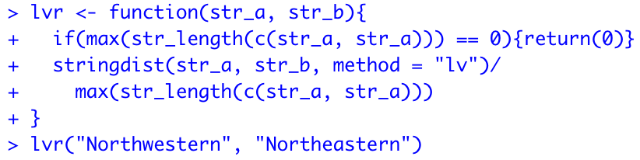
Levenshtein distance ratio: given two strings, compute the Levenshtein distance. Then, divide by the length of the longer of the two strings.
lv(“Northwestern”, “Northeastern”) = 2
max(str_length(“Northwestern”, “Northeastern”))) = 12
lvr(“Northwestern”, “Northeastern”) = 2/12 = .167

Slide 35
Jaccard distance: given two strings, compute the q-gram distance, and divide by the number of unique grams between the two strings.
es
hw
ea
we
he
as

Slide 36
Jaccard distance: given two strings, compute the q-gram distance, and divide by the number of unique grams between the two strings.
es
hw
ea
we
he
as
as
or
th
No
rt
he
hw
es
st
we
ea
te
rn
er

Slide 37
Jaccard distance: given two strings, compute the q-gram distance, and divide by the number of unique grams between the two strings.
es
hw
ea
we
he
as
6
=
=
.429
as
14
or
th
No
rt
he
hw
es
st
we
ea
te
rn
er

Slide 38
Exercise: find the closest match (smallest distance) among the pairs of strings below by (a) Levenshtein distance ratio; (b) Jaccard distance.
Are the best matches the same?

Slide 39
NEARLY-MATCHed KEYS IN JOINS
Problem context
Joins
Fuzzy string matching
Fuzzy joins
Conclusion

Slide 41
EXTENSIONS AND RECAP
Problem context
Joins
Fuzzy string matching
Fuzzy joins
Conclusion

