Slide 1

Practical Lessons from Predicting Clicks on Ads at Facebook: A case study with the Kaggle Avazu Click-through-rate Dataset
STAT 350 Spring ‘18 Final Project:
Frank Fineis, Abby Smith, Sebastian Rodriguez

Slide 2
The data

Slide 3


The Avazu Click-through rate dataset
Click-through marketing data: in web advertising, marketers want to optimize who to advertise to, seek to maximize the click through rate, i.e. % of people to whom an ad is advertised who click on ad.
Kaggle: company, hosts public Data Science competitions. Ran competition on behalf of Avazu, a marketing firm, in 2015.

Slide 4
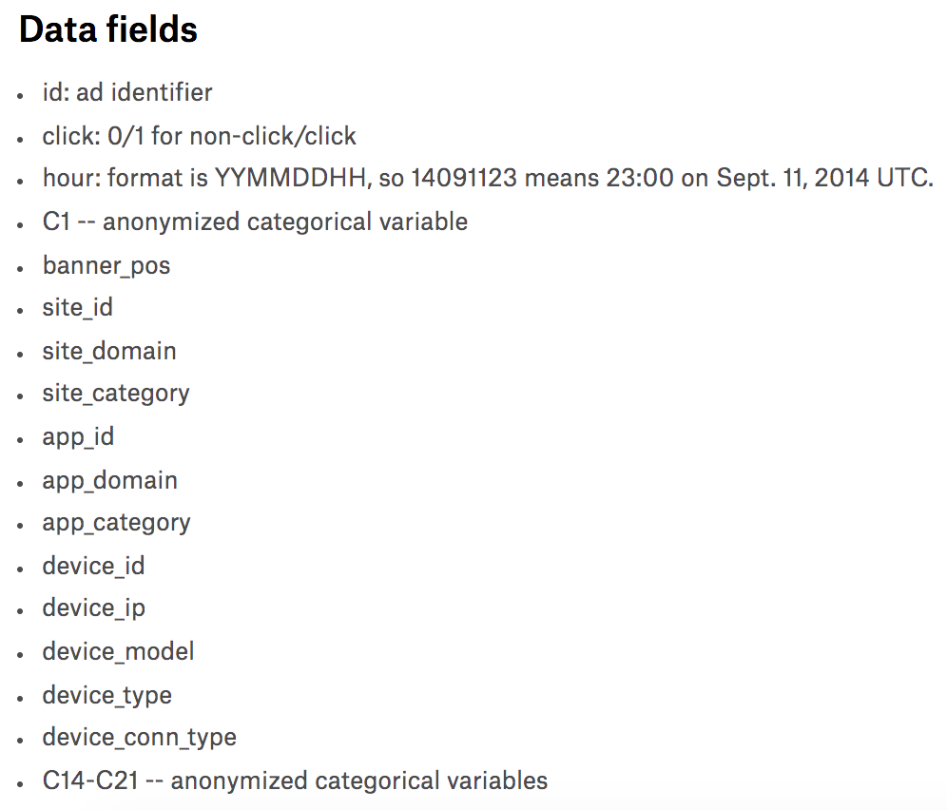
Features

Slide 5
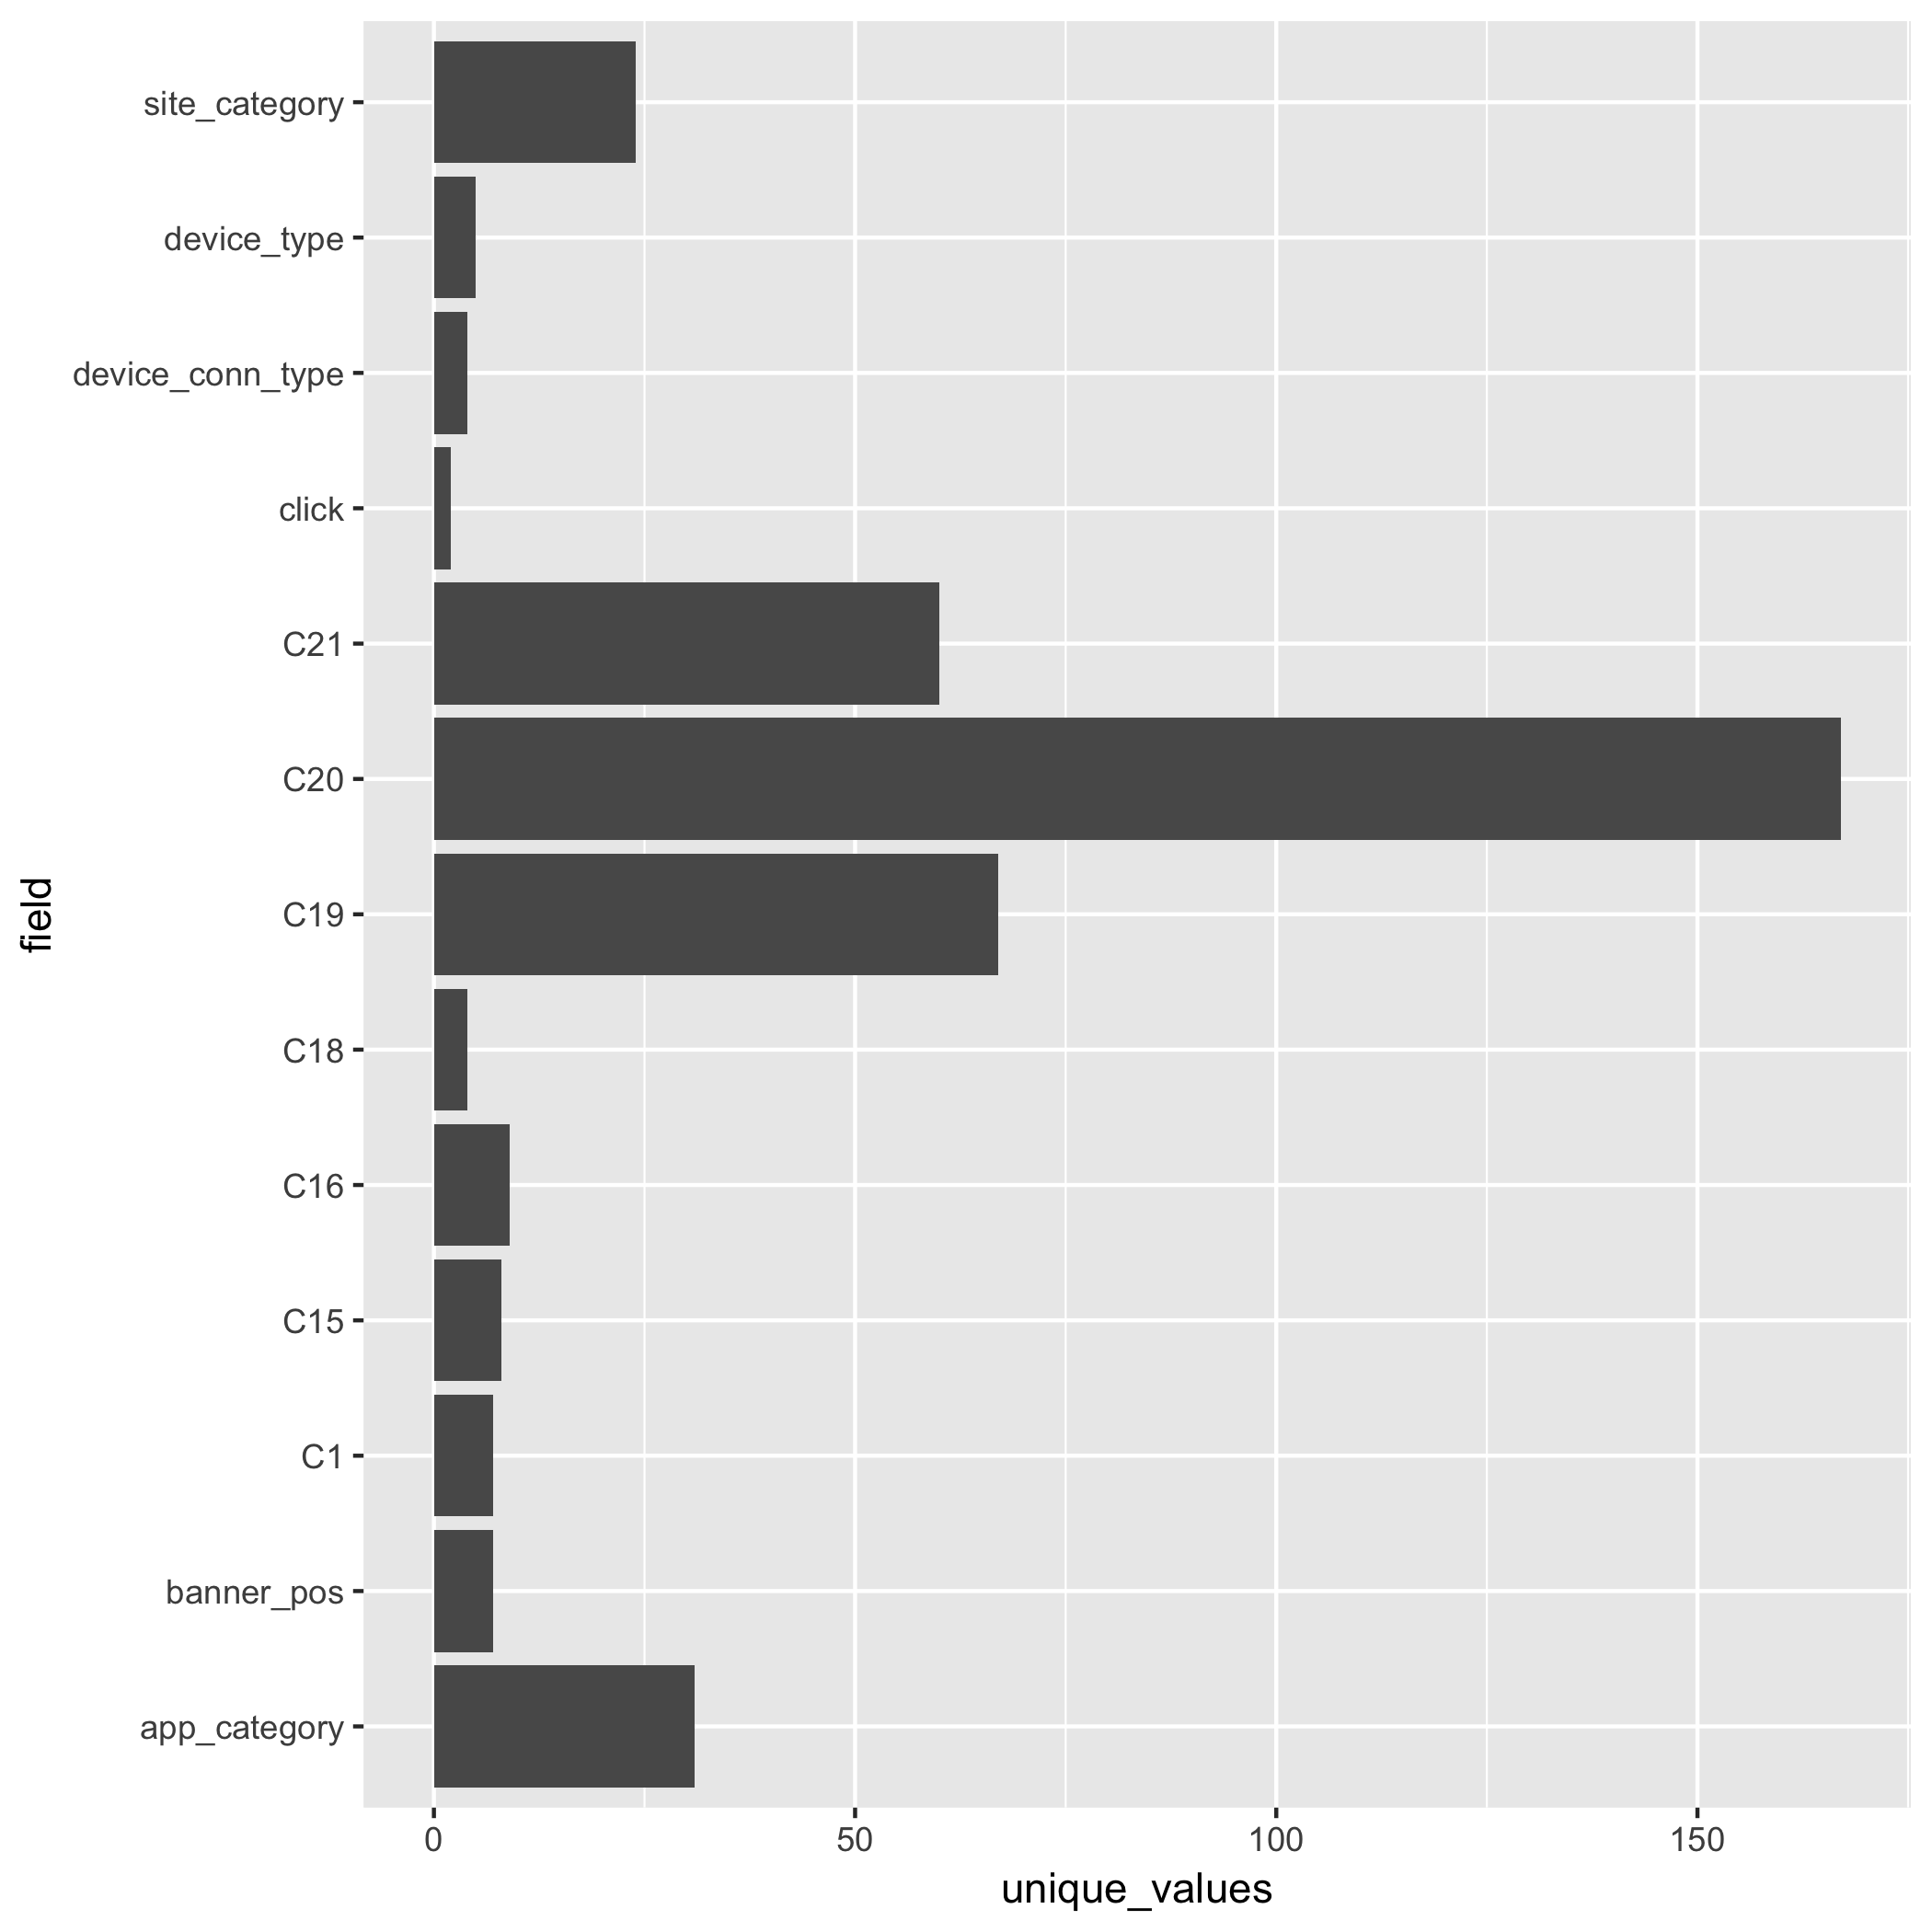
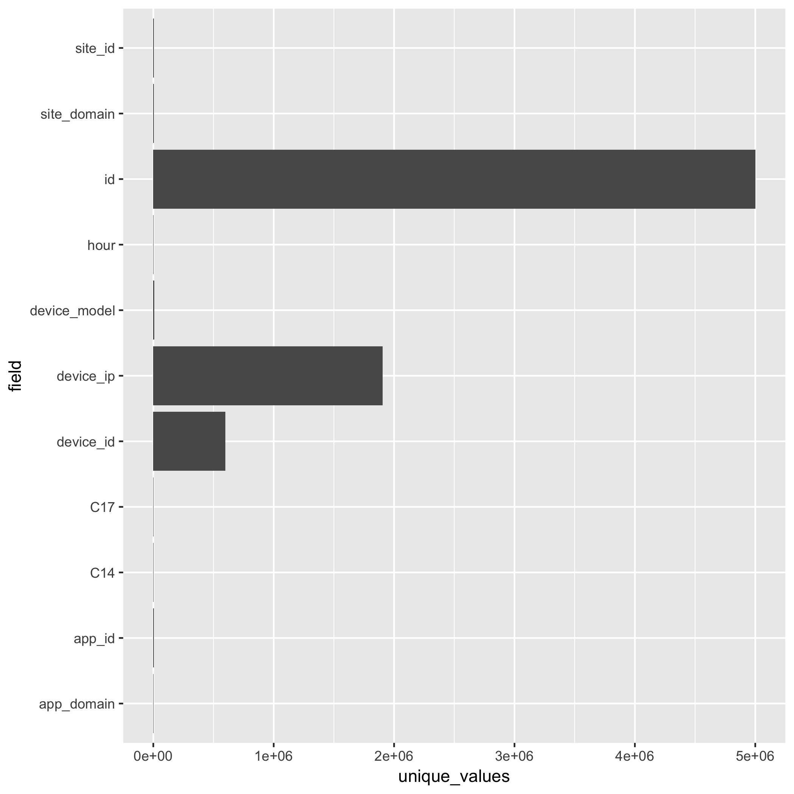
“Brutally categorical” features
Variables with < 200 unique values
Variables with >= 200 unique values

Slide 6
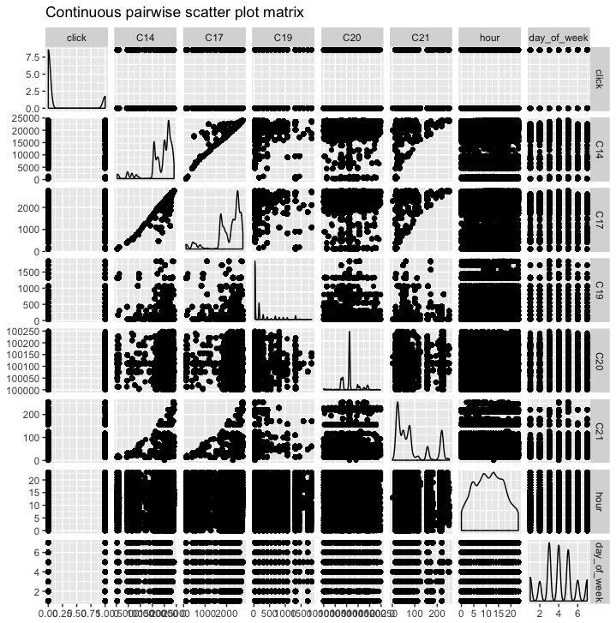
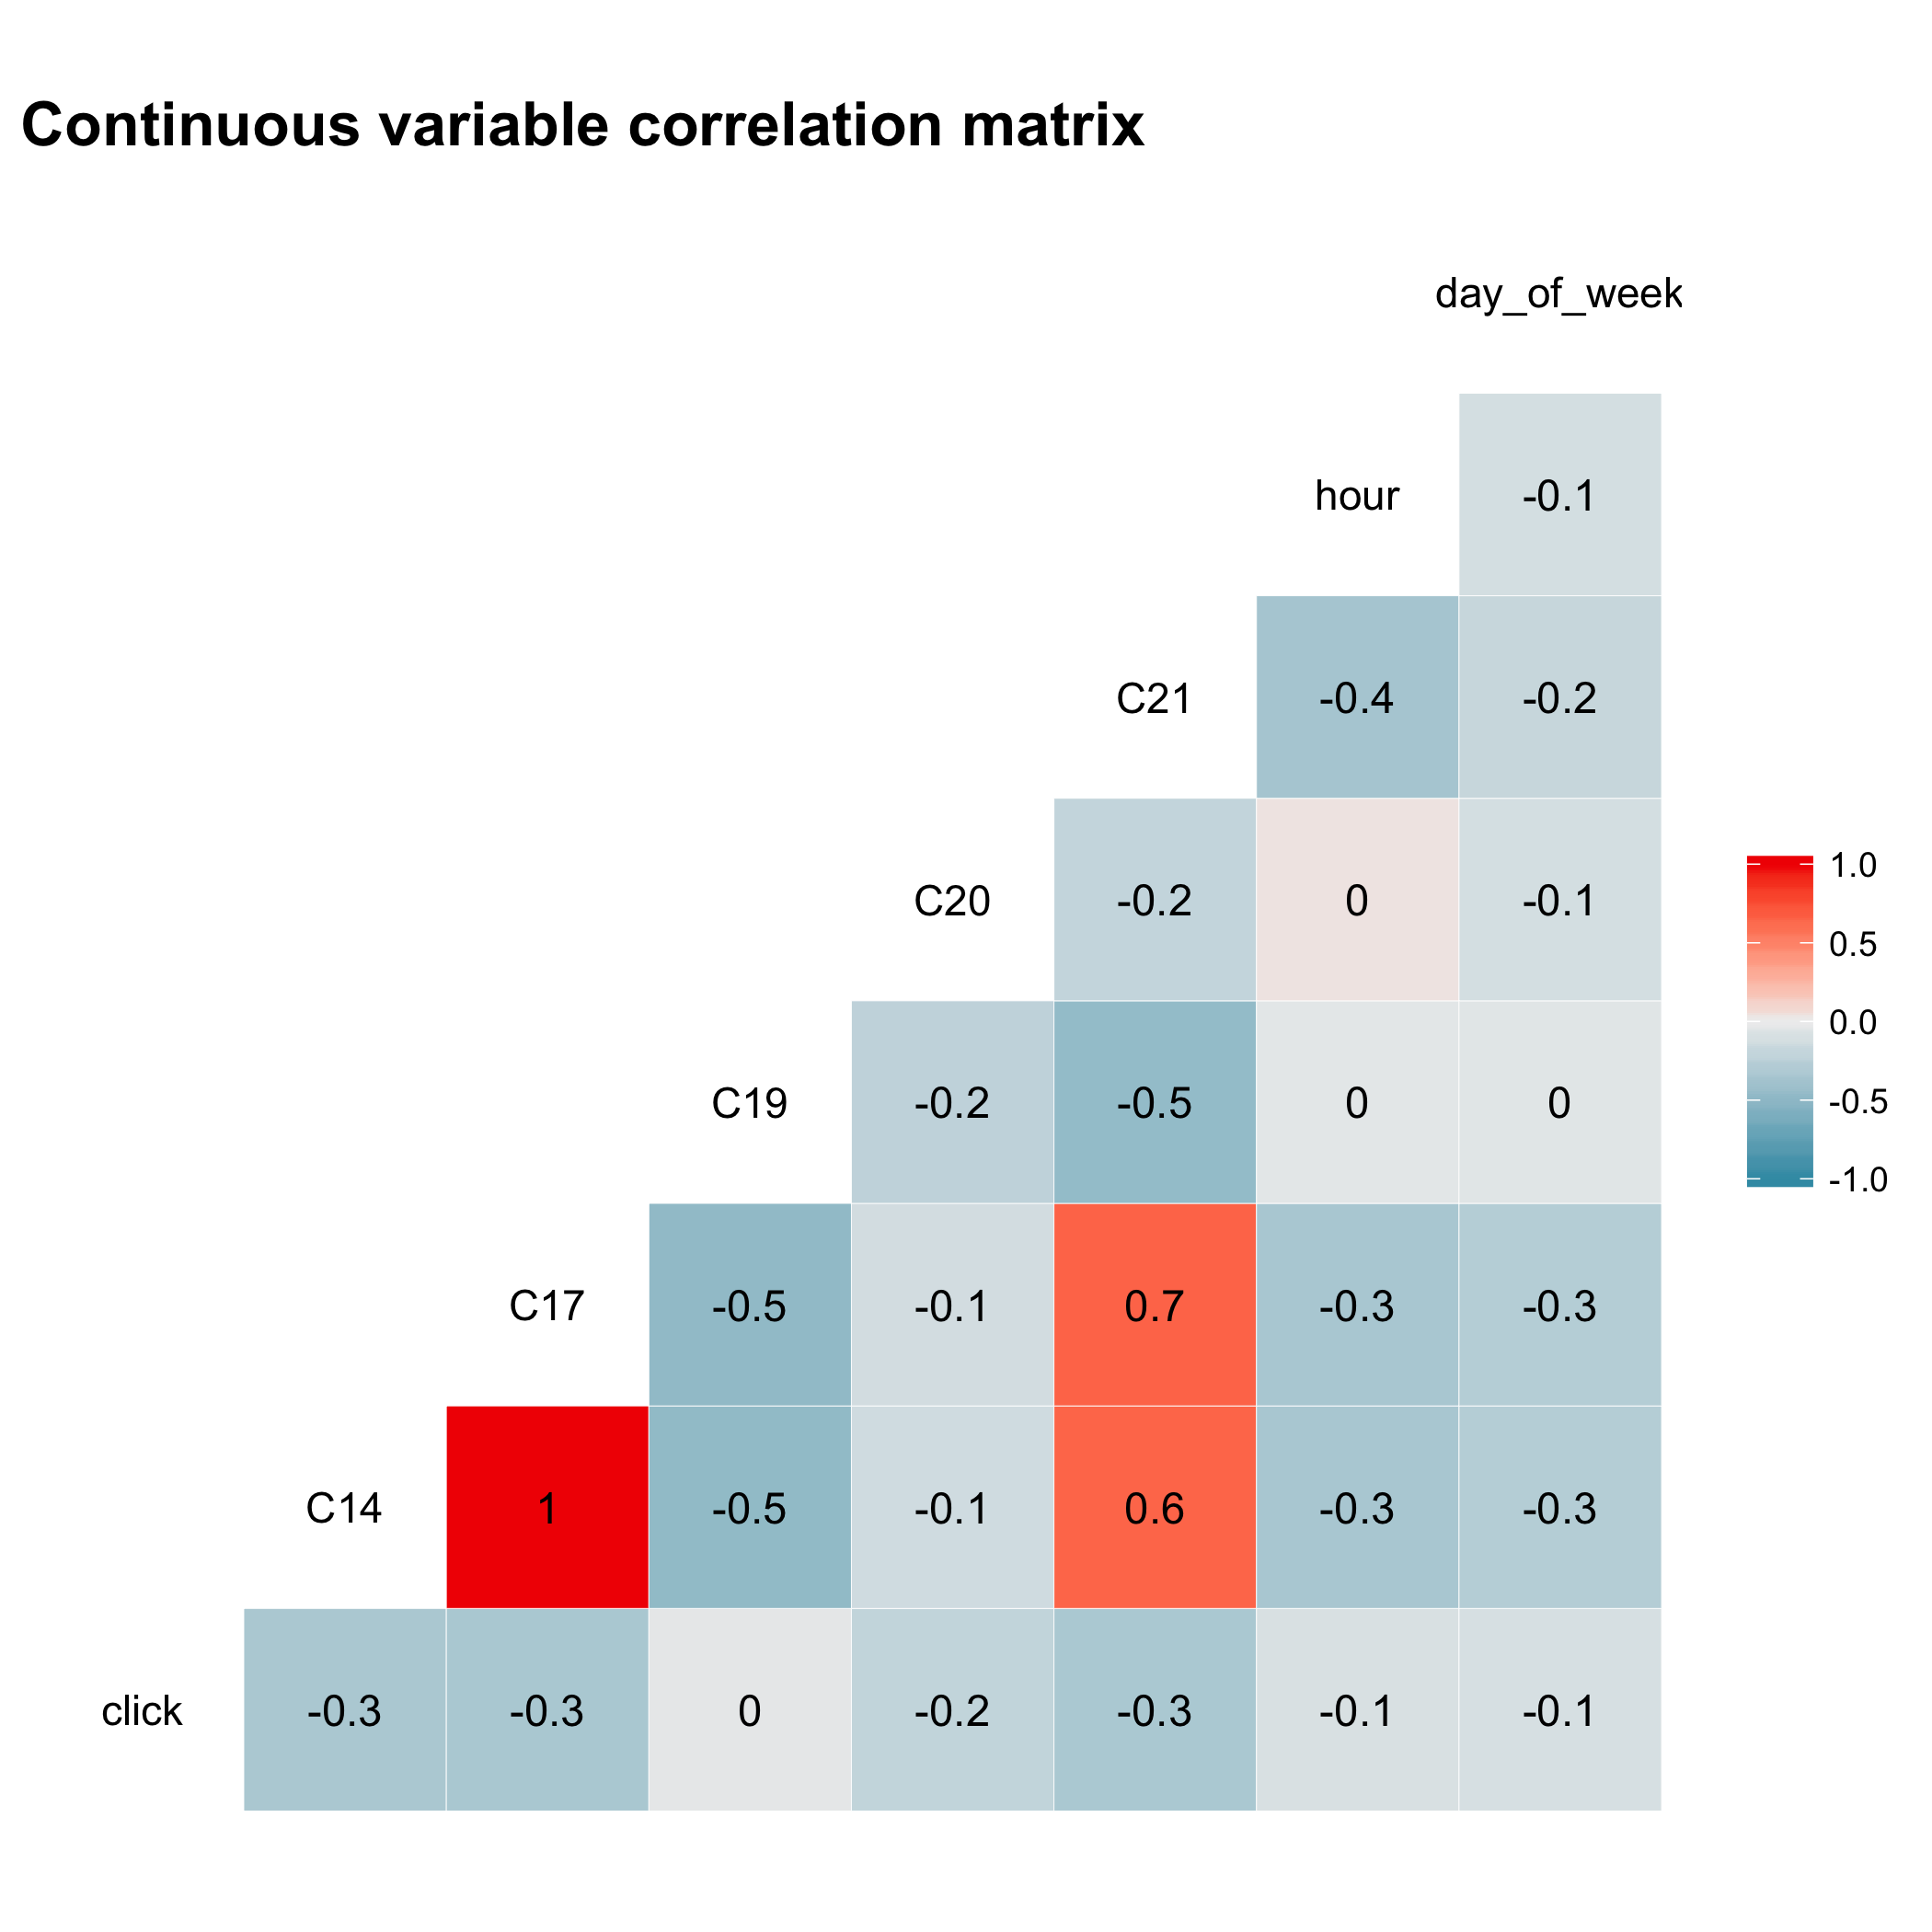
The data

Slide 7
The models

Slide 8
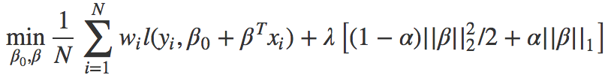
Generalized linear model with elasticnet penalty
Solves
Models fit with glmnet package in R.
λ controls overall coefficient norm penalty.
α controls L1 vs. L2 norm contribution to norm penalty.
Can train with gradient descent, online training. Missing data not allowed.
Boosted decision trees
Additive decision tree model: at the end of one iteration, add the next tree that fits the residual at the current iteration, h(x) = y – F_{m}(x)
F_{m+1}(x) = F_{m}(x) + h(x) = y (update step)
F_{M}(x) = Σγ_{i}h_{i}(x) + c (final model)
h_{i}(x) models are called “weak learners.” Are “shallow” decision trees.
Cannot train in online fashion. But can handle missing data!

Slide 9
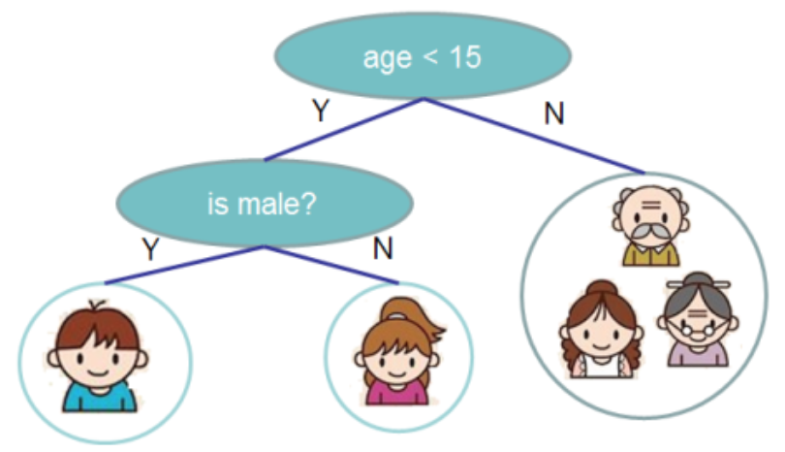
Example of a decision tree
Age and gender are the “split variables”
This tree has 3 terminal nodes (leaves)

Slide 10
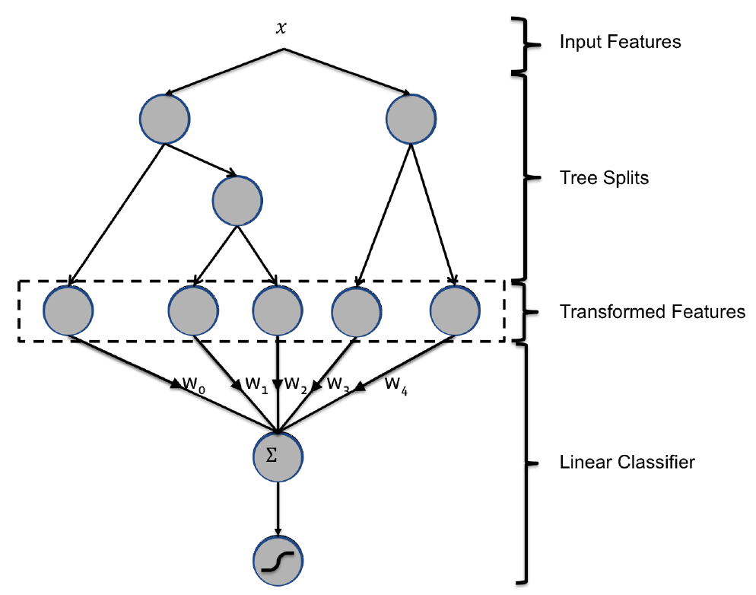
Facebook’s hybrid boosted/linear model
Fit boosted decision tree model to CTR data training set with cross validation.
“Send data through trees” – boosted model is comprised of M weak learners. Each tree has p terminal nodes. Represent each observation an (1 x pM) vector by “following” trees. All data will fall into M terminal nodes. Each feature corresponds to a set of decisions, e.g. “device_type == ‘type 3’ & site_category == ‘bcf865d9’ & hour > 3”. Use XGBoost package.
Train penalized linear model to learn important rules.
Get benefits of XGBoost (non linearity, automatic, robust feature selection) with the benefits of linear models (online training, explainability)!

Slide 11

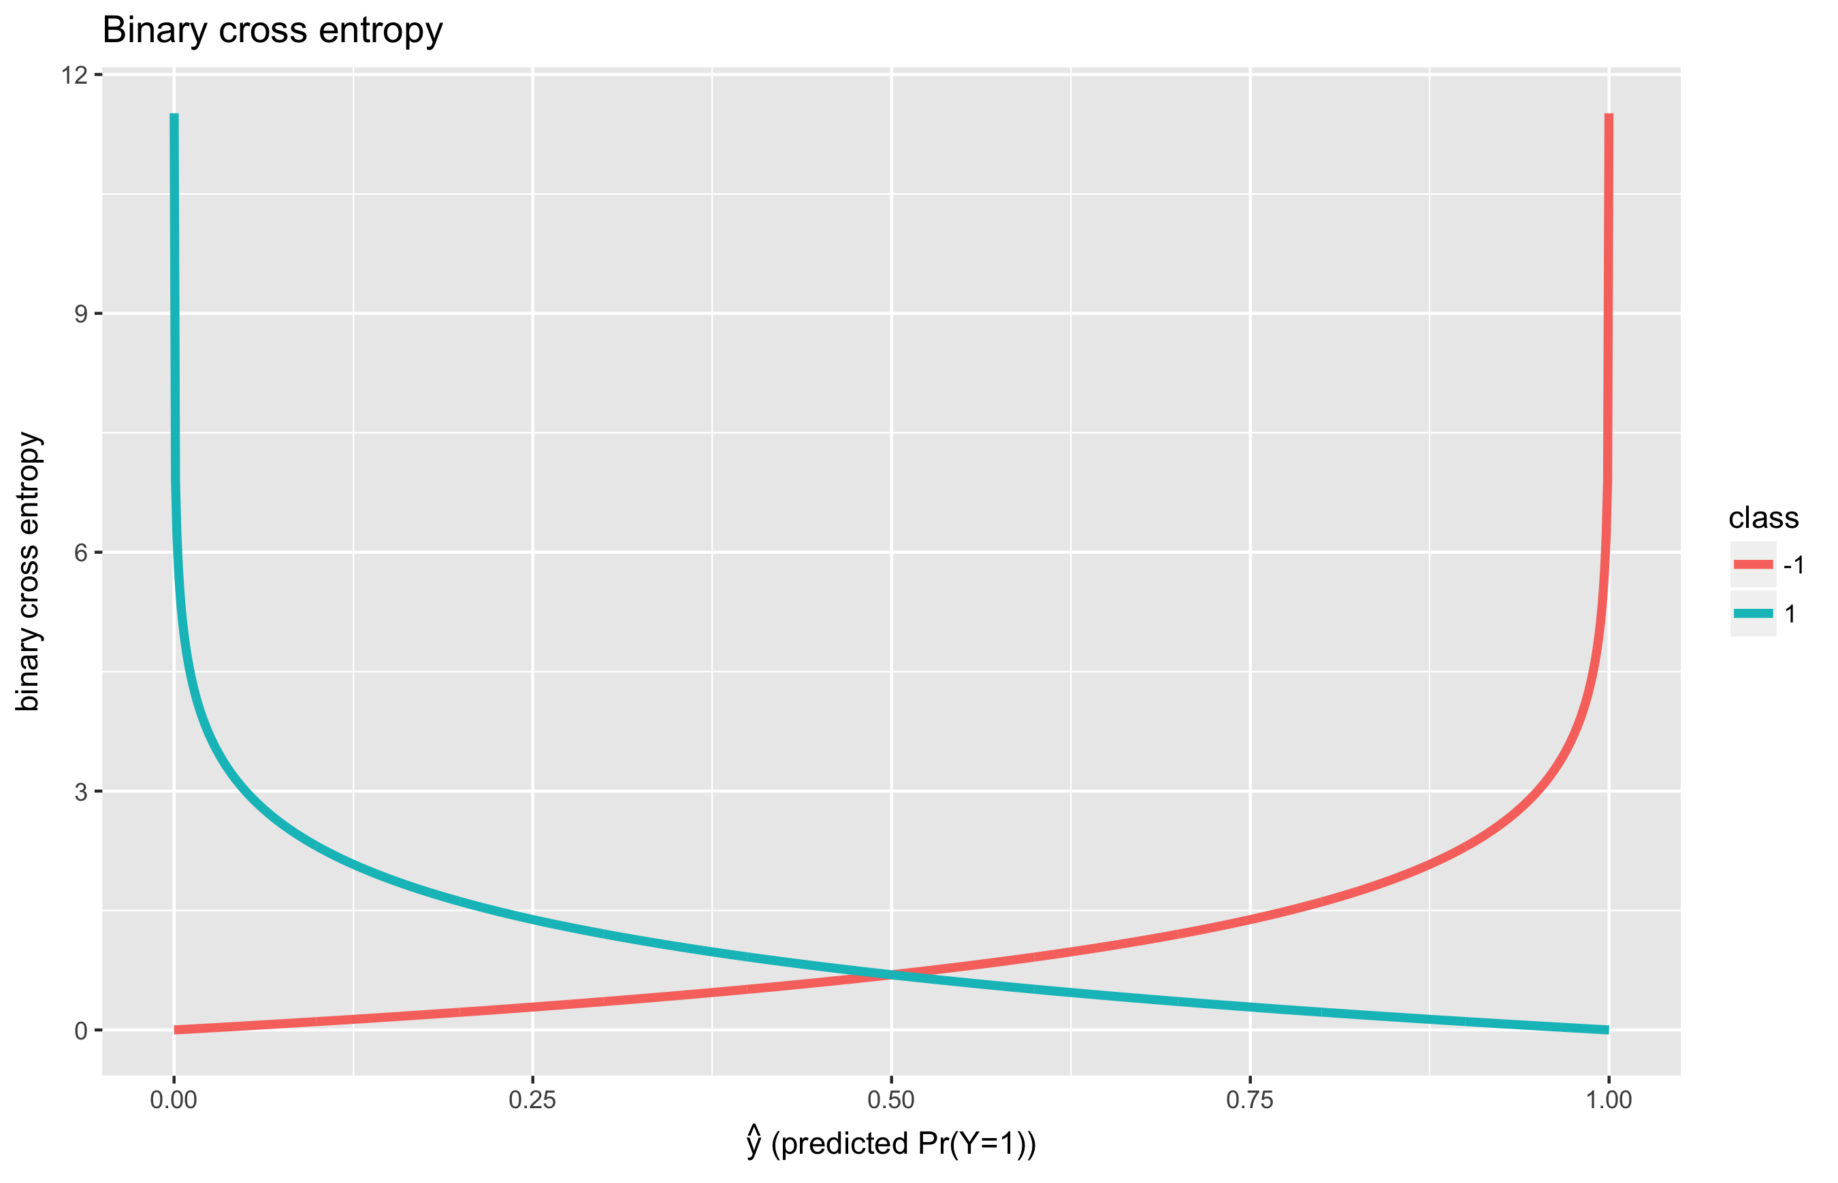
The objective function
Want to maximize accuracy of click prediction by minimizing “Normalized Entropy,” similar to “binary cross entropy” function.

Slide 12
Our goals
Compare 3 models: who performs the best?
Facebook’s hybrid boosted tree/linear model, modified so that the linear model is actually a Lasso penalized regression model
A regular Lasso penalized regression model
A regular boosted tree model
Explore benefits of the hybrid model:
The features in the hybrid model become actual decision rules. If we use a Lasso model for feature selection, what are the most important rules learned?

Slide 13
Online learning

Slide 14
Overview
Data is arriving in a sequential stream
Prediction accuracy degrades as the delay between training and test set increases
Use incoming data to update model coefficients
Optimizing logistic loss with SGD, incorporate fresh data into batches for new iterations

Slide 15
Model Results
For both models, NE can be reduced by 1% when going from training weekly to daily
s

Slide 16
Simulation with Toy Dataset

Slide 17
Data preprocessing

Slide 18
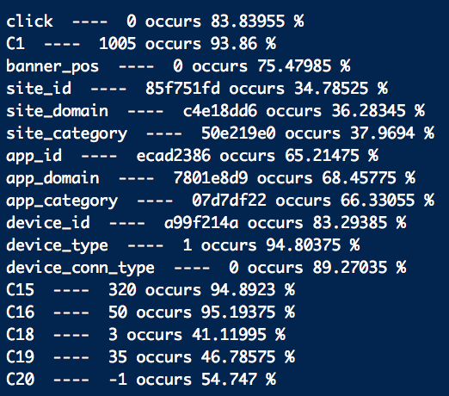
Eliminating “brutally categorical” features, etc.
Binarized for presence of corresponding modal value
Also…
Hour turned into hour of day, day of week quantitative variables.
Dropped id, device_ip, device_model variables (too categorical)
Continuous variables were standardized.
Remaining categorical variables were one-hot-encoded.
For plain Lasso model, impute C20 variable’s missing values with mean

Slide 19
Results of preprocessing, embedding
Plain, preprocessed dataset:
Training set: 300,000 x 89
Test set: 200,000 x 89
Embedded dataset:
Training set: 300,000 x 4908
Test set: 200,000 x 4908

Slide 20
Results

Slide 21
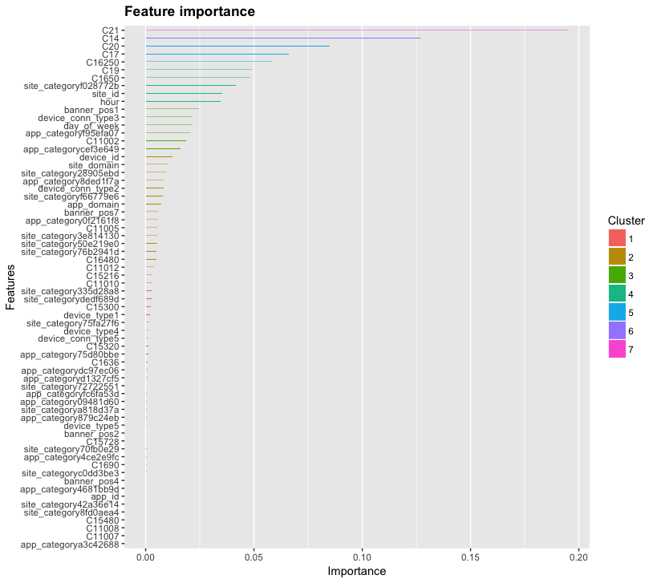
Xgboost: feature importance plot

