Slide 1
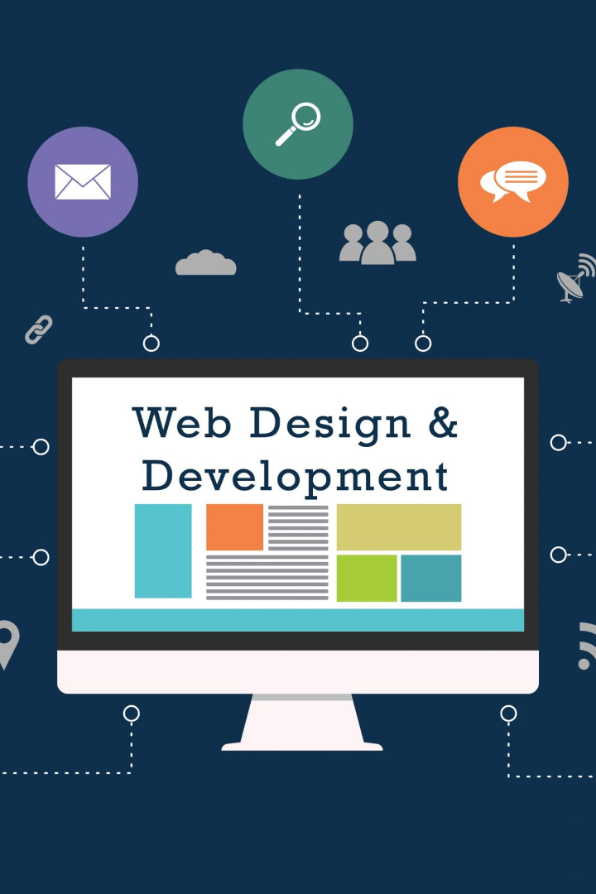

Introduction to Web Development
Web development has revolutionized the world we live in. It has enabled us to connect, learn, and do business in new and amazing ways. In this presentation, we'll introduce you to web development and some of the exciting technologies used to create websites and web applications.

Slide 2



The Importance of Web Development
Connectivity
Mobile Access
Web development has enabled a global network of connections, linking communities and businesses together.
With the exponential growth of mobile devices, web development has become more important than ever before, enabling access from anywhere, at any time.
Digital Commerce
Online shopping has exploded, with billions of dollars transacted every year. Web development has played a critical role in enabling this revolution.

Slide 3
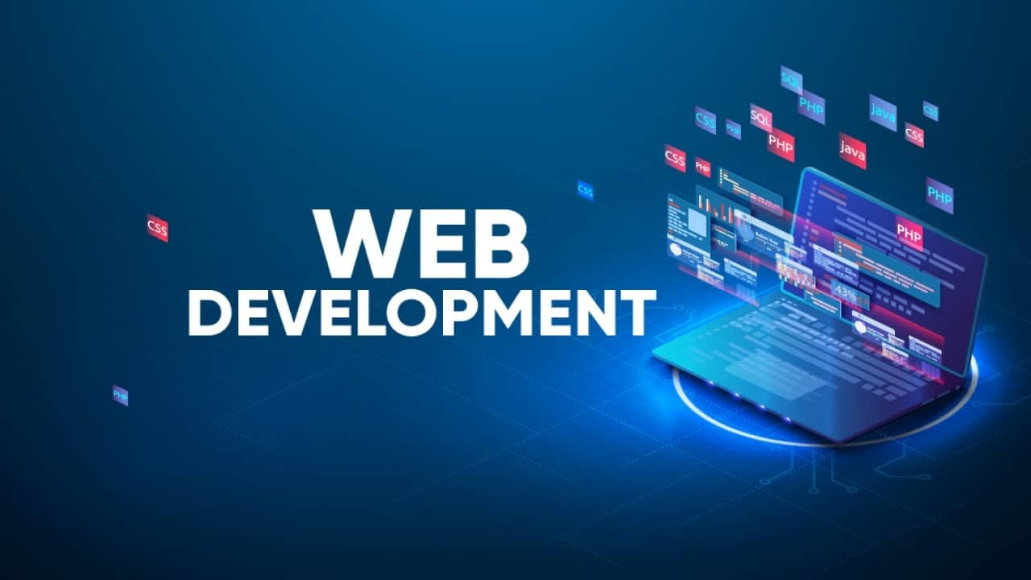
The Definition of Web Development
Web Development is the process of creating websites and web applications that are accessed over the internet. It encompasses a wide range of skills, including coding, database management, server-side scripting, and client-side scripting.

Slide 4
HTML (HyperText Markup Language)
Structure
Clean Code
New Features
HTML provides the underlying structure and content of web pages, including text, images, and other media.
Well-written HTML is easy to understand and maintain, making it important for accessibility and search engine optimization (SEO).
HTML5 introduces many new features that enhance web development, including multimedia support and web storage API.

Slide 5
CSS (Cascading Style Sheets)
1
Style Separation
CSS separates the presentation layers (i.e., style and layout) from the content of a web page, improving aesthetics and usability
Reuse and Efficiency
2
CSS enables efficient use of code, making it easier to maintain and update.
3
Responsive Design
CSS has become more important with the growth of mobile devices, enabling responsive design and adaptation to various screen sizes.

Slide 6
JavaScript
1
Client-side Functionality
Server-side Functionality
2
JavaScript is used on the client-side of web development to build interactive features, such as drop-down menus and slideshows.
With Node.js, JavaScript can now be used on the server-side, opening new doors to development capabilities.
3
Frameworks and Libraries
JavaScript has an enormous ecosystem of frameworks and libraries, enabling developers to build complex and scalable applications.

Slide 7
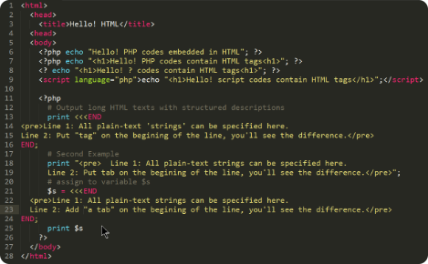


PHP (Hypertext Preprocessor)
Server-side Language
Database Integration
PHP is a server-side language used to build web applications, powering popular sites like Facebook and Wikipedia.
PHP can be used to integrate web applications with databases, enabling storage, retrieval and management of data.
WordPress Platform
PHP is used as the underlying programming language for WordPress, enabling accessible and customizable content management systems.

Slide 8
Ruby
1
Web Frameworks
Ruby has many powerful and popular web frameworks, like Ruby on Rails, that enable fast and clean web development.
2
Better Code
Ruby is an object-oriented language, which makes it easier to write cleaner, more efficient, and more organized code.
3
Test-Driven Development
Ruby enables test-driven development, in which test cases are built before applications are developed, ensuring the final result meets the required standards.

Slide 9
Python
Easy to Learn
Cross-Platform and Scalable
Machine Learning and AI
Python is known for its simplicity and readability, making it an easy language to learn for beginners.
Python is cross-platform, meaning it can be run on any operating system. It is also scalable, making it an ideal choice for building complex web applications.
Python has become a popular language for machine learning and Artificial Intelligence development, enabling new insights, predictions and capabilities.

Slide 10
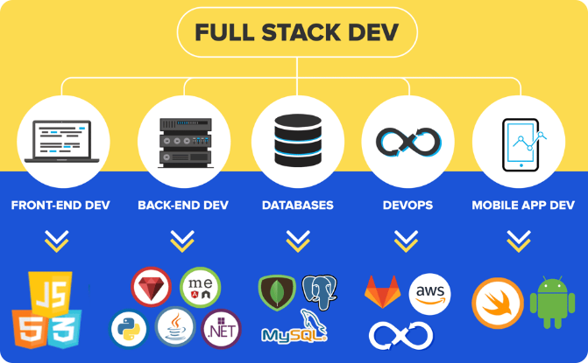
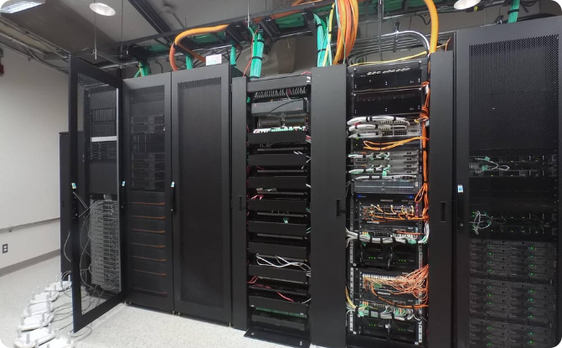
The Role of each technology in web development
Front-End Development
Back-End Development
HTML, CSS, JavaScript are the backbone of front-end development, providing structure, style and interactivity to web pages.
PHP, Python, Ruby are used for server-side scripting, managing databases, and building the backbone architecture of web applications.

Slide 11

Benefits of Learning Web Development
1
Creative Outlet
2
Flexible Career Path
3
Continuous Learning
Web development provides a creative outlet for designing and building new and innovative websites and applications.
Web development offers a flexible career path with numerous job opportunities and career advancement possibilities.
Web development is a constantly evolving field with new technologies and frameworks emerging constantly, making it a great career choice for those who enjoy continuous learning.

