Slide 1
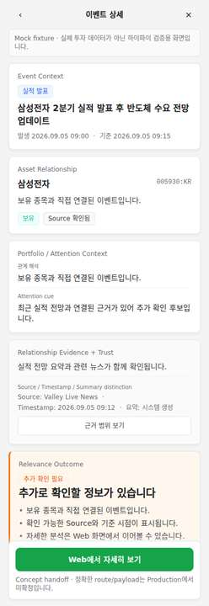
01 · GATE SUMMARY
Portfolio-aware Event Triage
A mobile triage concept that explains event relevance through personal context, evidence, and explicit limits.
Current gate
High-fidelity design, static QA, and Chromium visual QA passed.
The frame set remains concept/mock bounded.
Production, screen reader, and real app/web back remain unresolved.
Production BLOCKED
Portfolio-aware Event Triage · 01
High-fidelity concept · Production blocked
Notes:
[Sources]
docs/CURRENT_STATE.md
docs/DESIGN_QA.md
artifacts/high-fidelity/visual-qa-report.json
artifacts/high-fidelity/390x844-normal.png
Boundary: High-fidelity concept/mock fixture only. Screen Reader NOT_TESTED. Real App/Web Back NOT_TESTED. Production BLOCKED.

Slide 2
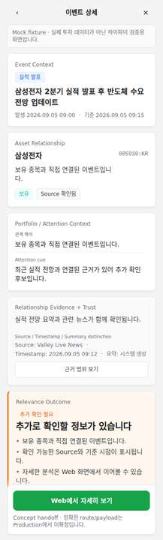
02 · PROBLEM CONTEXT
Mobile has to answer relevance before analysis.
The key job is not to compress the web workspace. It is to help users understand what happened, what it touches, and whether the evidence is enough to inspect further.
Market events are noisy unless tied to a specific asset relationship.
Personal context must separate Holding, Watchlist, Related-only, and Unconnected.
Evidence and data limits appear before a check-status outcome.
Portfolio-aware Event Triage · 02
High-fidelity concept · Production blocked
Notes:
[Sources]
docs/DESIGN.md screen purpose
docs/PORTFOLIO_PRESENTATION_STRUCTURE.md
artifacts/high-fidelity/360x800-normal.png
Boundary: High-fidelity concept/mock fixture only. Screen Reader NOT_TESTED. Real App/Web Back NOT_TESTED. Production BLOCKED.

Slide 3
03 · ROLE SPLIT
Mobile triages. Web analyzes.
The mobile screen gives enough context to decide whether to continue; the web workspace remains responsible for deeper financial research.
Mobile · Triage Layer
Web · Analysis Workspace
Event context
Deep research
Asset relationship
Financial tables
Evidence and limits
Documents and transcripts
Concept handoff entry
Advanced charting
Portfolio-aware Event Triage · 03
High-fidelity concept · Production blocked
Notes:
[Sources]
docs/DESIGN.md mobile/web boundary
design-system/patterns/investment-analysis-screen.md
Boundary: High-fidelity concept/mock fixture only. Screen Reader NOT_TESTED. Real App/Web Back NOT_TESTED. Production BLOCKED.

Slide 4
04 · LOCKED IA
The screen reads evidence before outcome.
Visual emphasis follows the approved order so the outcome does not feel like an unsupported score.
1
Event
2
Asset
3
Context
4
Evidence
5
Outcome
6
Handoff
Outcome is visible, but it appears after relationship evidence and trust cues.
Portfolio-aware Event Triage · 04
High-fidelity concept · Production blocked
Notes:
[Sources]
docs/DESIGN.md locked information hierarchy
docs/FIGMA_DECK_DESIGN_EXTRACTION.md
artifacts/high-fidelity/390x844-normal.png
Boundary: High-fidelity concept/mock fixture only. Screen Reader NOT_TESTED. Real App/Web Back NOT_TESTED. Production BLOCKED.

Slide 5
05 · SERVICE SCREEN ANATOMY
A real service frame, not a QA screen.
Section
Purpose
Event Context
What happened and when
Asset Relationship
Which asset is linked and how
Portfolio / Attention
Holding, Watchlist, Related, or Unconnected
Evidence + Trust
Summary, source, timestamp, data state
Outcome
Non-advisory check-status
Handoff
Concept path to deeper web analysis
Portfolio-aware Event Triage · 05
High-fidelity concept · Production blocked
Notes:
[Sources]
prototype/high-fidelity/index.html
docs/FIGMA_DECK_DESIGN_EXTRACTION.md
artifacts/high-fidelity/360x800-normal.png
Boundary: High-fidelity concept/mock fixture only. Screen Reader NOT_TESTED. Real App/Web Back NOT_TESTED. Production BLOCKED.

Slide 6
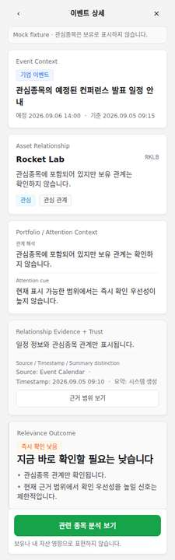
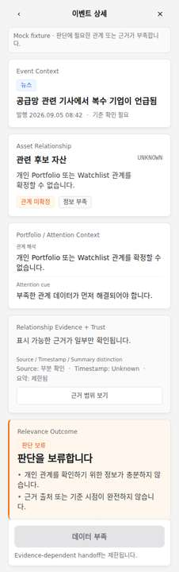
06 · OUTCOME MODEL
Outcomes are check-statuses.
CHECK_FURTHER
NO_IMMEDIATE_CHECK_NEEDED
INSUFFICIENT_DATA
More information is worth checking based on visible relationship and evidence.
Visible evidence does not raise immediate check priority.
Relationship or evidence data is insufficient for a check-status judgment.
Portfolio-aware Event Triage · 06
High-fidelity concept · Production blocked
Notes:
[Sources]
docs/DESIGN.md outcome semantic contract
docs/DESIGN_QA.md financial safety
artifacts/high-fidelity/360x800-normal.png
artifacts/high-fidelity/360x800-watchlist.png
artifacts/high-fidelity/360x800-insufficient.png
Boundary: High-fidelity concept/mock fixture only. Screen Reader NOT_TESTED. Real App/Web Back NOT_TESTED. Production BLOCKED.

Slide 7
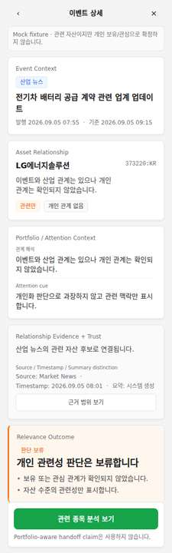
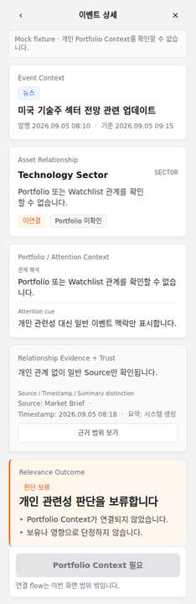
07 · PORTFOLIO CONTEXT
Portfolio contexts stay separate.
The design avoids turning interest context into ownership or exposure.
Holding
Watchlist
Related-only
Unconnected
No account amount, exposure metric, return claim, or personal-asset scoring is introduced.
Portfolio-aware Event Triage · 07
High-fidelity concept · Production blocked
Notes:
[Sources]
docs/DESIGN.md portfolio context
docs/DESIGN_QA.md portfolio/watchlist separation
artifacts/high-fidelity/360x800-normal.png
artifacts/high-fidelity/360x800-watchlist.png
artifacts/high-fidelity/360x800-related.png
artifacts/high-fidelity/360x800-unconnected.png
Boundary: High-fidelity concept/mock fixture only. Screen Reader NOT_TESTED. Real App/Web Back NOT_TESTED. Production BLOCKED.

Slide 8
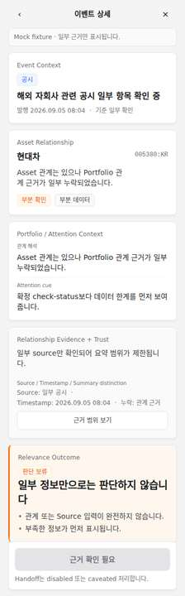
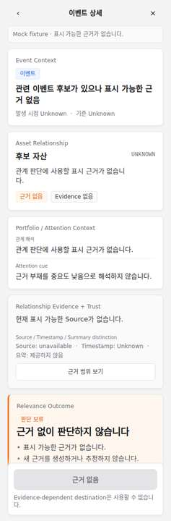
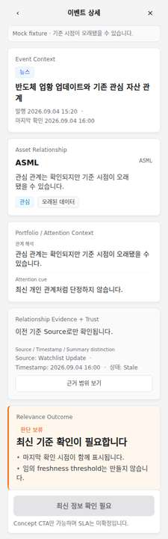
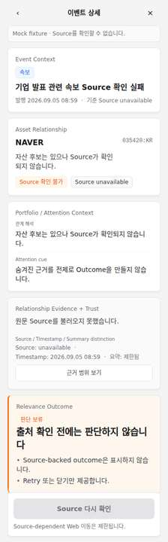
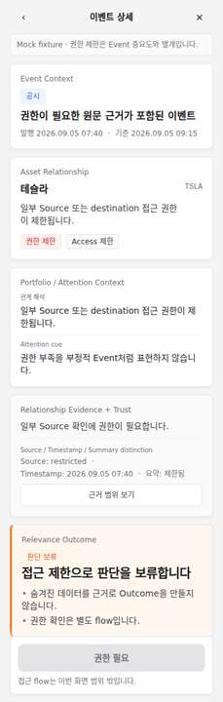
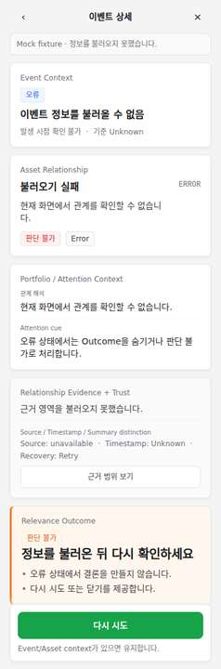
08 · TRUST STATES
Uncertainty is visible.
Partial, empty, stale, source unavailable, permission, and error states preserve trust by exposing the limitation.
Partial
Empty
Stale
Source unavailable
Permission
Generic error
Evidence cards keep source, timestamp, summary distinction, and data state visible before the outcome.
Portfolio-aware Event Triage · 08
High-fidelity concept · Production blocked
Notes:
[Sources]
docs/DESIGN.md state matrix
design-system/patterns/trust-and-data-state.md
artifacts/high-fidelity trust state screenshots
Boundary: High-fidelity concept/mock fixture only. Screen Reader NOT_TESTED. Real App/Web Back NOT_TESTED. Production BLOCKED.

Slide 9
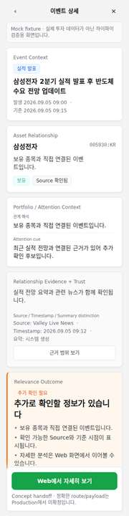
09 · RESPONSIVE QA
One implementation holds across widths.
320 stress
360 full state set
390 full state set
Portfolio-aware Event Triage · 09
High-fidelity concept · Production blocked
Notes:
[Sources]
artifacts/high-fidelity/320x800-normal.png
artifacts/high-fidelity/360x800-normal.png
artifacts/high-fidelity/390x844-normal.png
artifacts/high-fidelity/visual-qa-report.json
Boundary: High-fidelity concept/mock fixture only. Screen Reader NOT_TESTED. Real App/Web Back NOT_TESTED. Production BLOCKED.

Slide 10
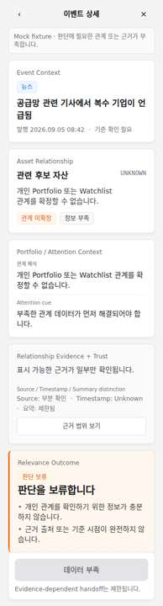
10 · VISUAL QA RESULT
Chromium evidence supports high-fidelity PASS.
Check
Result
Static QA
PASS
Chromium screenshots
34 generated
360x800
15 states PASS
390x844
15 states PASS
320x800 stress
4 states PASS
BLOCKER / MAJOR
0 confirmed in visual review
Production remains BLOCKED
Portfolio-aware Event Triage · 10
High-fidelity concept · Production blocked
Notes:
[Sources]
artifacts/high-fidelity/visual-qa-report.json
artifacts/high-fidelity/static-qa-report.json
docs/DESIGN_QA.md
Boundary: High-fidelity concept/mock fixture only. Screen Reader NOT_TESTED. Real App/Web Back NOT_TESTED. Production BLOCKED.

Slide 11
11 · DESIGN-SYSTEM MAPPING
The deck follows the Git reference system.
Tokens and reference components provide visual continuity without changing Product policy.
Area
Design-system source
Surface
--nf-surface-dashboard-mobile, --nf-surface-card, --nf-surface-card-muted
Text
--nf-font-sans, --nf-text-* scale, --nf-weight-*
Cards / badges
cards-and-surfaces.md, badges-tabs-filters.md
Evidence / trust
data-and-evidence.md, trust-and-data-state.md
Feedback / CTA
feedback-states.md, buttons-and-cta.md
Outcome surfaces
--nf-outcome-* as secondary cue only
New components: NONE
Portfolio-aware Event Triage · 11
High-fidelity concept · Production blocked
Notes:
[Sources]
design-system/README.md
design-system/tokens/valley-reference-tokens.css
design-system/components/
design-system/patterns/
docs/FIGMA_DECK_DESIGN_EXTRACTION.md
Boundary: High-fidelity concept/mock fixture only. Screen Reader NOT_TESTED. Real App/Web Back NOT_TESTED. Production BLOCKED.

Slide 12
12 · REMAINING LIMITS
The case study ends with the work that is still unresolved.
Still not tested
Production remains blocked
Screen reader manual behavior
Data contract and fields
Real App/Web back route
Outcome logic and freshness SLA
Real user validation
Handoff payload and API integration
Next: transfer these frames into Figma or a final portfolio platform, preserving the same claim boundary.
Portfolio-aware Event Triage · 12
High-fidelity concept · Production blocked
Notes:
[Sources]
docs/CURRENT_STATE.md
docs/DESIGN_QA.md
docs/PORTFOLIO_PRESENTATION_STRUCTURE.md
Boundary: High-fidelity concept/mock fixture only. Screen Reader NOT_TESTED. Real App/Web Back NOT_TESTED. Production BLOCKED.

