Slide 1
Using Food to Teach Argumentation, Research and Media Literacy by Lauren Goldberg
High School English teacher
Northern Highlands Regional High School, Allendale, NJ
Doctoral student
Fordham University, New York, NY
Email: lgoldberg9@fordham.edu
Twitter: LGreader

Slide 2
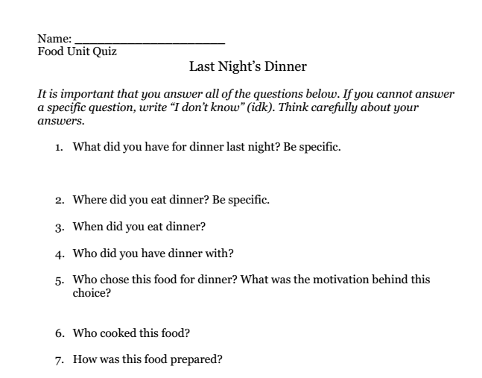
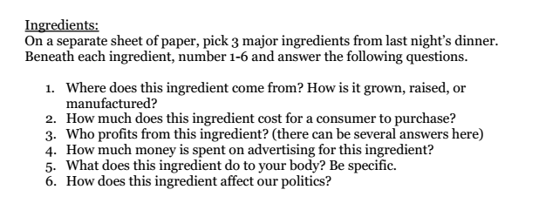
A Quiz to Whet Students’ Appetites
Students Realize How Little They Know

Slide 3
The Goal:
Make an Argument About Food
The Process for Students
Think and read critically about food
Track questions and topics of interest
Analyze the techniques of model texts in several genres (e.g., editorial, news article, documentary, “TED Talk” speeches)
Conduct your own research and present your findings in a format of your choice

Slide 4
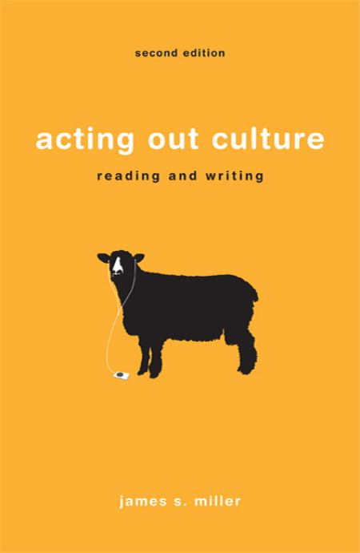
Share Provocative, Whole-Class Texts
to Pique Students’ Interest
Chapter 3 - “How We Eat”: Introduction to
Food as a Subject of Inquiry

Slide 5
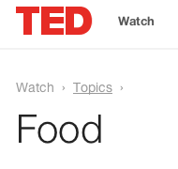
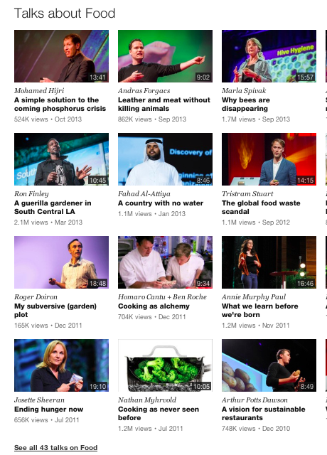
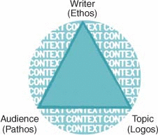
Share Provocative, Whole-Class Texts
to Pique Students’ Interest
Students Choose and Analyze TED Talks Using Aristotle’s Rhetorical Triangle

Slide 6
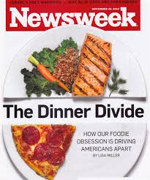
Share Provocative, Whole-Class Texts
to Pique Students’ Interest
Food as a Class Marker (Socioeconomics)

Slide 7
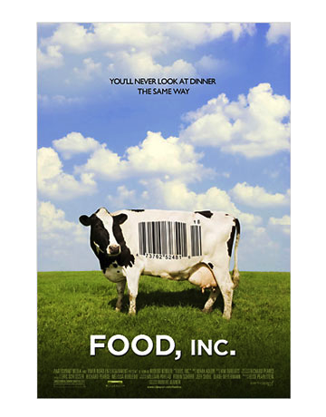
Share Provocative, Whole-Class Texts
to Pique Students’ Interest
Raises a Wide Range of Questions About:
health & nutrition
economics
politics & legislation
ethics
the environment
animal welfare

Slide 8


Share Provocative, Whole-Class Texts
to Pique Students’ Interest
A Portrait of Childhood Hunger in America &
A Call for Action
http://www.foodnetwork.com/videos/hunger-hits-home-0183570.html

Slide 9
Students Conduct Extensive Research on a Topic of Interest
Help students locate resources (through the school library, local library, and online)
Encourage students to reach out to real experts and organizations (model ways to contact people through websites, email, and Twitter)
Guide students to refer to model texts as exemplars for their own presentations
Provide mini-lessons as needed (e.g., critically evaluating sources, citing electronic sources, interviewing, thesis development)

Slide 10
Sample Student Research Topics
Is organic food worth the extra cost?
Which is healthier: cafeteria fries or cookies?
What is the “honey bee crisis” and how can I help?
How do energy drinks impact teen athletes?
What would happen if my family stopped eating sugar for ten days?
Why is Starbucks so successful?
What should consumers know about farm-raised fish?
How does McDonald’s affect me if I don’t eat there?

Slide 11

Student Research Project: Ian

Slide 12

Student Research Project: Ariel

Slide 13
My English Journal Article: Free Online Access
Goldberg, L. (2013). Herbivores, carnivores, and literavores: Argument and appetite in the classroom. English Journal, 102 (6), 40-45.
Available under “Resources” on
http://www.foodcurriculum.com

Slide 14
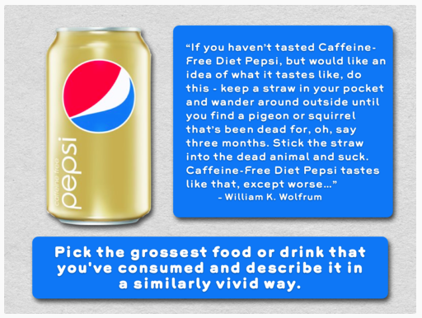
Food Writing Prompts by Luke Neff
http://writingprompts.tumblr.com/post/56544095055/writing-prompts-for-a-food-unit

Slide 15
References
Food, inc. [Motion picture]. (2009). Magnolia Home Entertainment.
Goldberg, L. (2013). Herbivores, carnivores, and literavores: Argument and appetite in the classroom. English Journal, 102 (6), 40-45.
Hunger hits home [Motion picture]. (2012). Food Network.
How we eat. (2011). In Acting Out Culture: Reading and Writing (pp. 179-276). Boston: Bedford/St. Martin's.
Miller, L. (2010, Nov. 22). Divided we eat: What food says about class in america and how to bridge the gap. Newsweek, 42-48.
Neff, L. (2013). Writing Prompts for a Food Unit. Retrieved from http://writingprompts.tumblr.com/post/
56544095055/writing-prompts-for-a-food-unit
TED: Ideas worth spreading. Retrieved from
http://www.ted.com/ [Search by topic for “Food”]

Slide 16
Using Food to Teach Argumentation, Research and Media Literacy by Lauren Goldberg
High School English teacher
Northern Highlands Regional High School, Allendale, NJ
Doctoral student
Fordham University, New York, NY
Email: lgoldberg9@fordham.edu
Twitter: LGreader

