Slide 1
Beyond the Classroom by Steffany Comfort Maher
Field Trips Community Activities
Service Learning New Foods
Speakers Projects

Slide 2

Loaves and Fishes Food Pantry: Kalamazoo, MI
Gave 2.3 million lbs. of food in 2013/14 fiscal year
Hunger Stories:
“If I hadn’t come to you today, my kids would’ve had nothing to eat.”
“As soon as I work my way out of this, how can I volunteer?”
“I never expected to have to ask for food from anybody.”

Slide 3
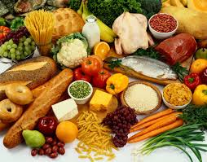
Student Tour & responses
We Toured:
Call center
Food distribution center
Food storage center
Food packaging center
Student backpack packaging center
Student Responses:
“The food inequality surprised me. I was surprised to see that people are hungry here just like they are at home (in metro Detroit).”
“I learned that I’m not alone. Others can’t afford things, either. And I have resources: I can go to the food pantry if I need to.”

Slide 4

The people’s food co-op
Nutritious, wholesome foods free of chemicals, preservatives, and additives
Purchase from local growers and processors – this kept over $300,000 in Kalamazoo community last year
Students toured store and were able to sample foods and learn about food inequality in the Kalamazoo area

Slide 5
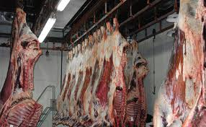
JBS Packerland: Plainwell, mi
JBS is largest animal protein processor in the world with 140 production facilities
Produce food, leather, pet products, biodiesel
The plant we visited in Plainwell, MI slaughters nearly 2,000 head of cattle every day

Slide 6
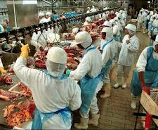
Student tour & responses
“I was pleased to see that conditions at JBS are nowhere close to the horrors we’re reading about in The Jungle.”
“I was happy to hear they check for antibiotics or hormones before they kill the cattle and that they take so many precautions regarding injured or diseased cattle.”
“I was shocked by how young the workers are.”
“The actual act of killing the animals still greatly saddens me and was hard to watch, but I feel better knowing that JBS's goal is to treat them as humanely as possible up to that point.”
“The hardest part was seeing the cows literally walk into their own deaths. I could NEVER EVER work in a slaughterhouse.”

Slide 7
Service learning
Volunteer at Food Pantry
Bag food items, hand out/help others shop for food items, sit and talk with people, answer phones
Volunteer in a Soup Kitchen
Serve food, clean, wash dishes, prepare food, transport food, etc.
Volunteer in a Community Garden
Several food pantries and shelters grow fresh fruits and vegetables in community gardens or gardens created by religious organizations.
Plant, weed, harvest, etc.
Volunteer to bring dinner to a Homeless Shelter
Assemble Thanksgiving Baskets
Conduct a Canned / Imperishable Food Drive
Often collecting money is more beneficial
Raise money for wells in Africa
Create Food Bags for the Homeless
Work with a local pantry/religious organization to fill small bags with nonperishable foods to distribute to people asking for food out in public
Several shelters/pantries need volunteers in non-food-related capacities:
Write & send thank-you cards to donors
Write and send newsletters
Mow grass, plant flowers, shovel snow, etc.
Ask a local food pantry/shelter what help they may need.

Slide 8
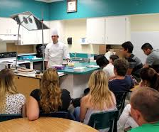
Classroom speakers
Our class:
Former employee of JBS Packerland, Plainwell
Expert on Climate Change
Other ideas:
Chef to teach students how to cook a few healthy dishes
People from:
Food Pantry
Homeless Shelter
Community Garden
Local Restaurants/ Businesses
Support local
Fair Trade

Slide 9
Make use of local resources
Community Activities
Food in your Classroom
Kalamazoo District Library
Authors
Chefs
Films/Documentaries
Farmers
Local Farmers/Farmer’s Market
FFA Chapter
Students share food
Jewish
Australian
Ethnic/Religious Foods
Check with local synagogues/mosques
Parents of students

Slide 10
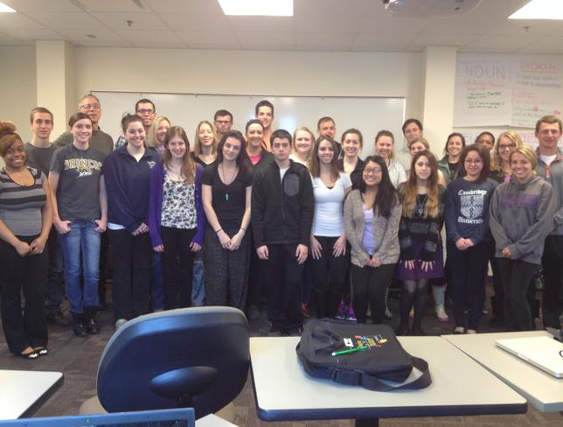
Student projects
Real-world work: Every student had worked in the food industry
Grocery store research:
Compared prices at various stores in Kalamazoo
Compared regular food to comparable organic food
Local Student Restaurant:
Teamed with Environmental Studies students
Basement of Student Center
Local, healthy food
Warm atmosphere where student musicians can play & students can hang out
Need money/support from university – students are still working on this
On-line Student Cookbook
Wikispaces – user-friendly
Healthy, low-cost meals
Food Resources & Recipes
http://collegecookbook.wikispaces.com/home

