Slide 1
The Hunger Games & Food Justice
Allen Webb
allen.webb@wmich.edu

Slide 2
Literature and Food Course
Food Justice
Climate Change
Classic & Contemporary Literature
Diverse Assignments: personal essay, close reading, literary analysis, “Ted Talk”
Blogging / Wiki
Service Learning
Beyond Classroom Activities

Slide 3
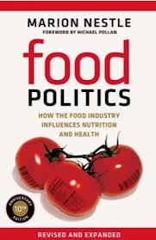
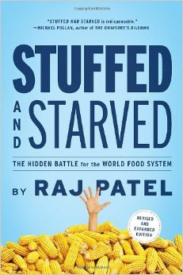
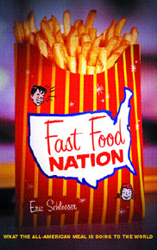
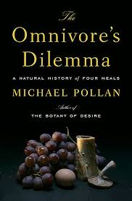
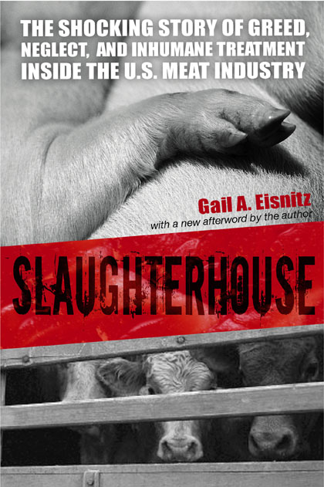

Contemporary Food Discussion

Slide 4
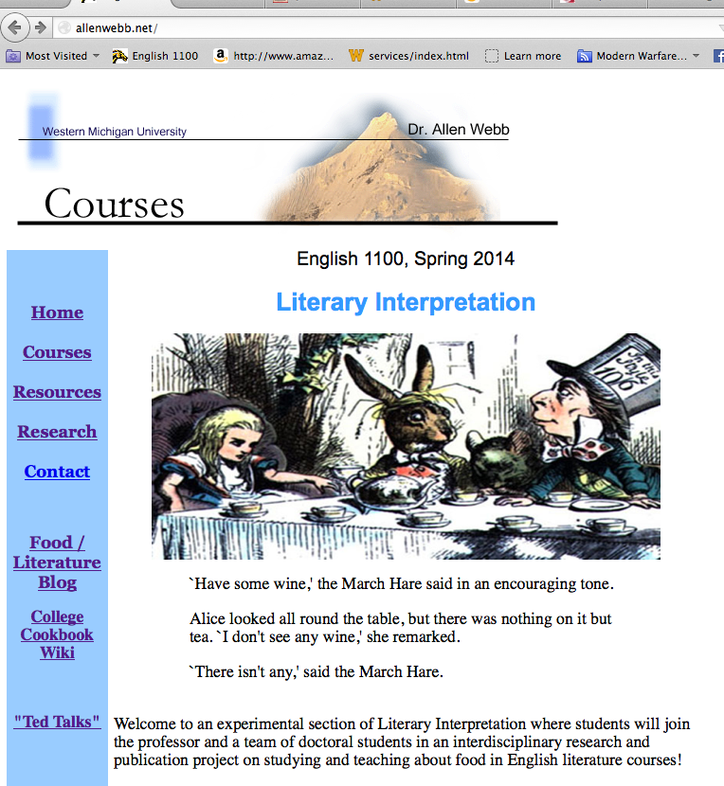
On-line syllabus
See
FoodCurriculum.com

Slide 5
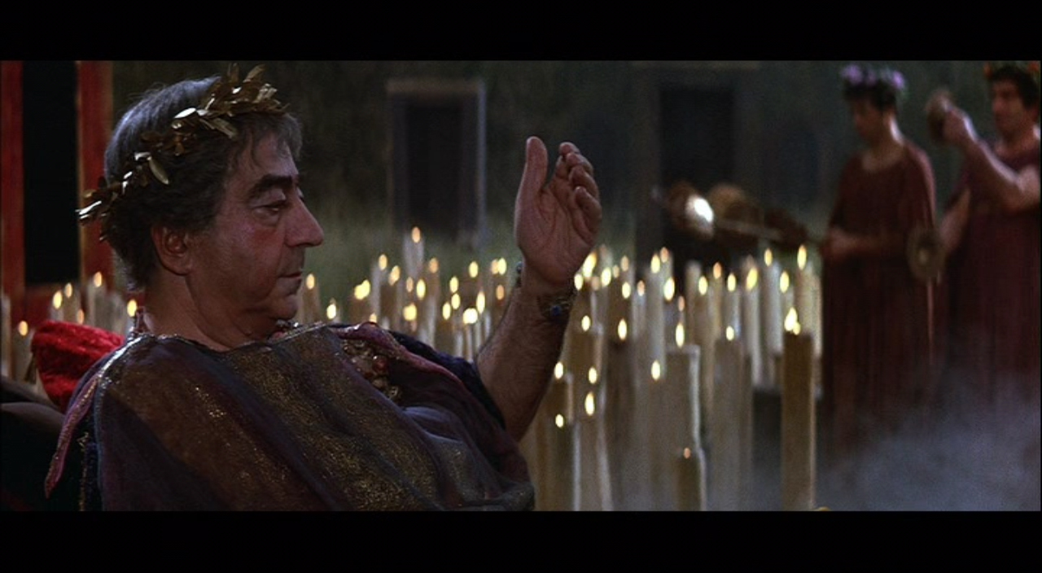
“Dinner with Trimalchio” from The Satyricon (1st C BC, time of Nero)

Slide 6
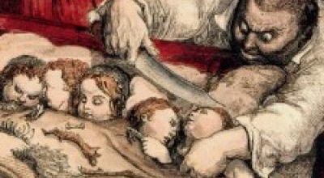
A Modest Proposal (1729)

Slide 7
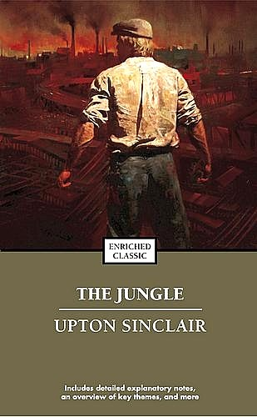
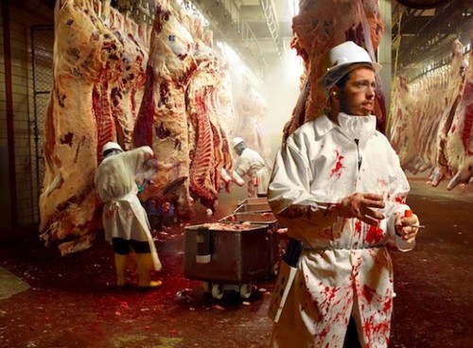
The Jungle (1906)

Slide 8
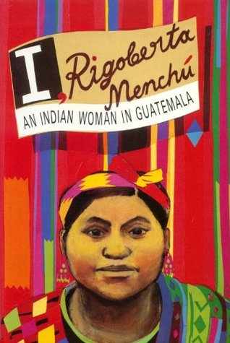

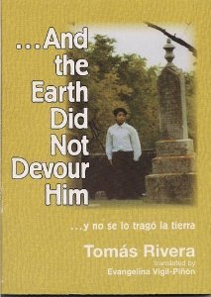
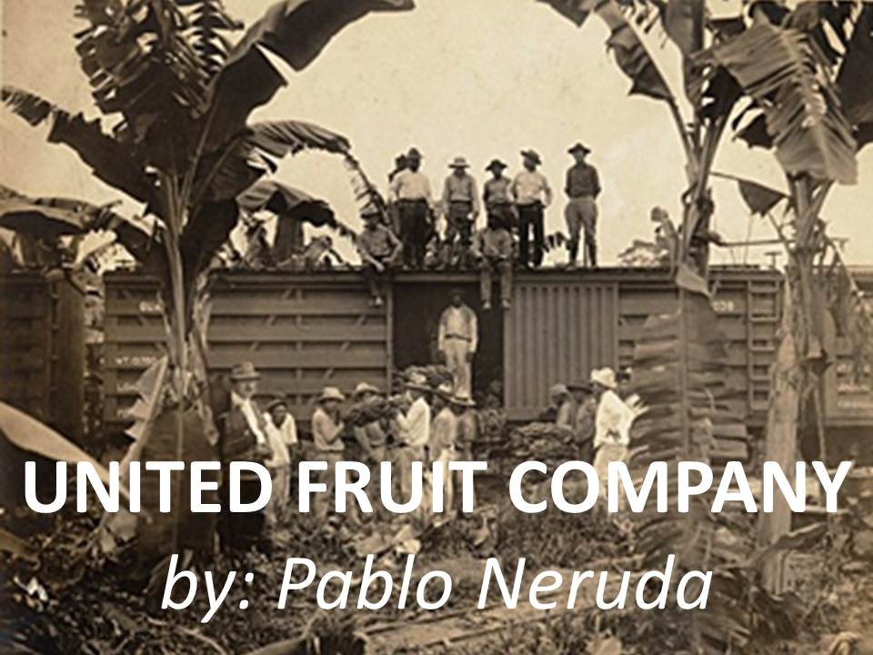
Migrant Worker Literature

Slide 9
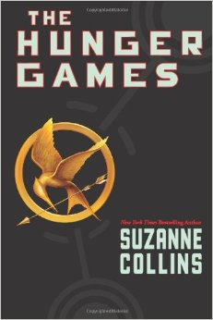
The Hunger Games
Key Issues
“Stuffed and Starved”
Economic Inequality
Political Oppression
Violence
Media Depiction

Slide 10
Student Reactions
When I first learned that we would be reading The Hunger Games, I was surprised that the book was apart of my college course. To my surprise, the book has hit on multiple similar points [as the other works] we have talked about as apart of our class.
-- Lexie
This reminds me a lot of third world countries in our world currently. Even though no one is forcing the kids to fight, most of them have to learn to survive on what they have. Poverty is high and kids starve everyday due to a lack of resources. Even some countries are forcing their kids to fight. A few years ago we had the "Kony 2012" ordeal where a ravenous leader was making the children become soldiers. Some places don't seem too far off from the idea of this book, and that frightens me.
-- Josh

Slide 11
I know the book is fictional based but there are some similarities throughout I could relate to the world in which we live. Some people in society are better off than others. A person’s financial or social status can easily dictate whether a person will become homeless or go hungry similar to the tributes fighting in the games. The tributes from district 12 are poor and dying from starvation where as the people from the Capitol seems to have all the wealth and plenty of food. The districts uneven distribution of food is no different from our uneven distribution of wealth. People in the U.S are deciding whether to pay bills or buy groceries and there are plenty of wealthy corporations that could fight or eliminate hunger but their main focus is their current interest and profits.
-- Anita

