Slide 1
GPU driver及 Nvidia-docker安裝

Slide 2
GPU driver及 Nvidia-docker安裝
注意章節，會細分為是否要用docker
個人電腦可不使用docker，公用伺服器建議開帳號再使用docker
目前使用docker會當成VM來做使用(應該通訊協定有差異，這部份待查)，docker環境會與主機環境分開而互不影響
docker環境灌壞關掉即可

Slide 3

Ubuntu 燒錄
1.準備 USB
2. 下載Ubuntu 16.04或18.04的iso檔
3. 使用isotousb的軟體燒錄(http://201708.mediafire.com/file/6r4syo2c4u8dhsb/ISOtoUSBPortable_1.5_azo.exe) 注意：燒錄時會整個格式化，清先備份重要檔案
4. 重開機進入bios，改boot option優先啟用USB即可重開
5. 進入ubuntu安裝細節就不細說了

Slide 4
Nvidia Driver 安裝
In terminal
sudo apt-get update
sudo apt-get upgrade
sudo add-apt-repository ppa:graphics-drivers/ppa
sudo apt-get update
sudo apt-get install nvidia-418
查詢當前顯卡做適合的driver版本
NVIDIA DRIVER DOWNLOAD:
http://www.nvidia.co.jp/Download/index.aspx
→PC reboot

Slide 5
不使用docker做法

Slide 6
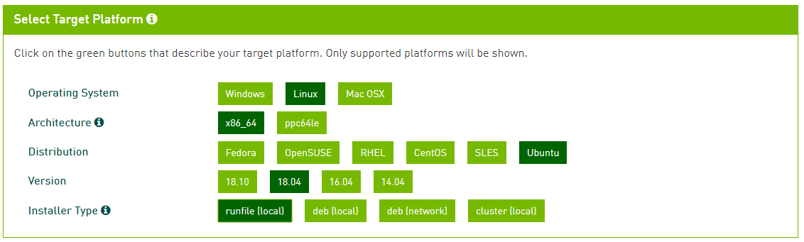
CUDA 10.1 安裝
下載CUDA網站 https://developer.nvidia.com/cuda-downloads

Slide 7
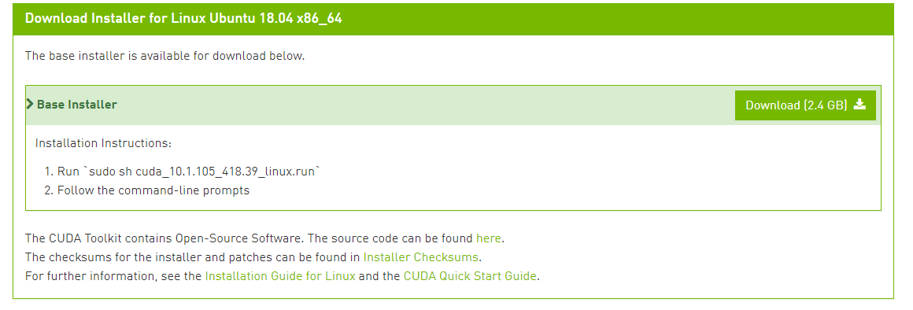
CUDA 安裝

Slide 8
CUDA 安裝
Terminal(Downloaded directory)
sudo sh cuda-10.X.XX_linux.run
--------------------------
Preface
-------
The following contains specific license terms and conditions
for four separate NVIDIA products. By accepting this
agreement, you agree to comply with all the terms and
conditions applicable to the specific product(s) included
herein.
Do you accept the previously read EULA?
accept/decline/quit: accept

Slide 9
CUDA 安裝
Install NVIDIA Accelerated Graphics Driver for Linux-x86_64 361.62?
(y)es/(n)o/(q)uit: n
Install the CUDA 8.0 Toolkit?
(y)es/(n)o/(q)uit: y
Enter Toolkit Location
[ default is /usr/local/cuda-8.0 ]:
Do you want to install a symbolic link at /usr/local/cuda?
(y)es/(n)o/(q)uit: y
Install the CUDA 8.0 Samples?
(y)es/(n)o/(q)uit: y
Enter CUDA Samples Location
[ default is /home/textminer ]:
Installing the CUDA Toolkit in /usr/local/cuda-8.0 ...
Installing the CUDA Samples in /home/textminer ...
Copying samples to /home/textminer/NVIDIA_CUDA-8.0_Samples now...
Finished copying samples.
press enter
press enter

Slide 10
Restart computer!!!!!!

Slide 11
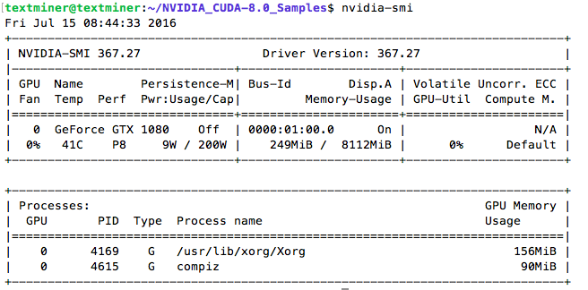
CUDA 安裝
Terminal
nvidia-smi
If these are displayed, It works
安裝ssh 就可以遠端進行剩下的工作

Slide 12
使用docker (Nvidia-docker)

Slide 13
Docker 安裝
https://docs.docker.com/install/linux/docker-ce/ubuntu/
如果需要移除舊版docker再下這個
sudo apt-get remove docker docker-engine docker.io containerd runc
安裝步驟正式開始

Slide 14
Docker 安裝
sudo apt-get update
sudo apt-get install \
apt-transport-https \
ca-certificates \
curl \
gnupg-agent \
software-properties-common

Slide 15
Docker 安裝
curl -fsSL https://download.docker.com/linux/ubuntu/gpg | sudo apt-key add –
sudo apt-key fingerprint 0EBFCD88
sudo add-apt-repository \
"deb [arch=amd64] https://download.docker.com/linux/ubuntu \
$(lsb_release -cs) \
stable"

Slide 16
Docker 安裝
sudo apt-get update
sudo apt-get install docker-ce docker-ce-cli containerd.io

Slide 17
Nvidia Docker 安裝
https://github.com/NVIDIA/nvidia-docker
docker volume ls -q -f driver=nvidia-docker | xargs -r -I{} -n1 docker ps -q -a -f volume={} | xargs -r docker rm -f
sudo apt-get purge -y nvidia-docker
curl -s -L https://nvidia.github.io/nvidia-docker/gpgkey | \
sudo apt-key add -
distribution=$(. /etc/os-release;echo $ID$VERSION_ID)
curl -s -L https://nvidia.github.io/nvidia-docker/$distribution/nvidia-docker.list | \
sudo tee /etc/apt/sources.list.d/nvidia-docker.list
sudo apt-get update

Slide 18
Nvidia Docker 安裝
sudo apt-get install -y nvidia-docker2
sudo pkill -SIGHUP dockerd

Slide 19
加入新使用者帳號
sudo adduser ‘name’
自行設定密碼
登入看看
ssh name@1.2.3.4
name’s password
當前資料夾入徑為‘/home/name/’

Slide 20
Nvidia Docker 使用 Tensorflow
Nvidia-docker 會連接資料夾，建議先創建好資料夾，防止資料夾權限為root
Ex. /home/name/test
sudo nvidia-docker run -it -v /home/name/test:/workspace markliou/python3-tensorflow-gpu bash
所以在/home/name/test底下，東西都還看的到

Slide 21
其餘問題

Slide 22
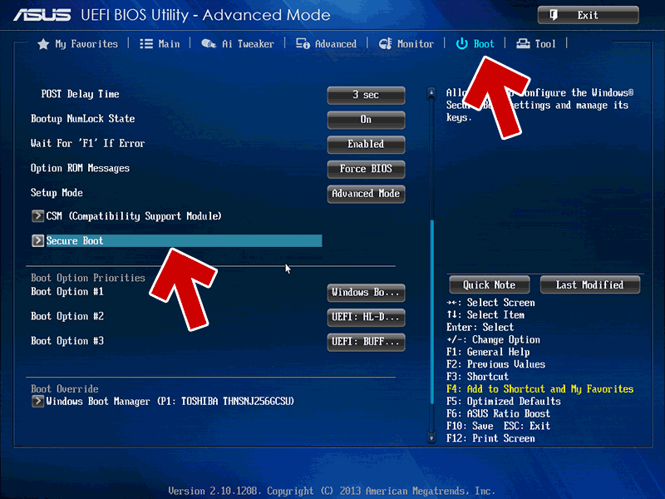
CUDA 安裝security mode
SecureMode be changed on the UEFI screen.
Please restart the PC and press boot key(probably F2).
Case: ASUS PC
Choose “Boot” Tab
Choose SecureBoot

Slide 23
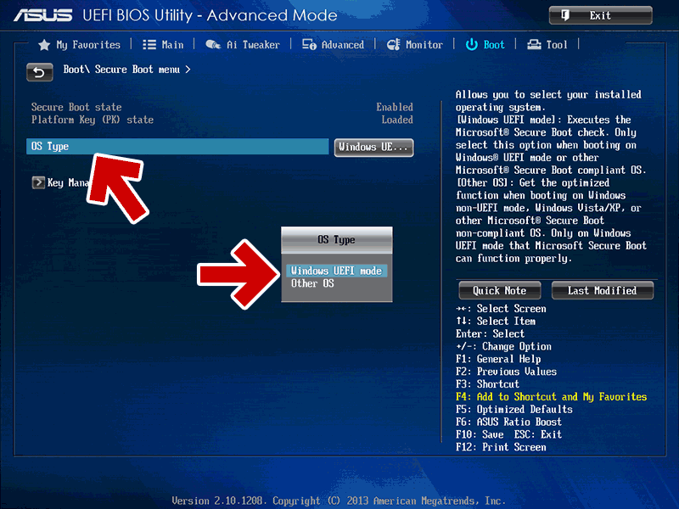
CUDA 安裝security mode
SecureMode be changed on the UEFI screen.
Please restart the PC and press F2.
Choose “OS Type” Tab
Change
OtherOS→WindowsUEFImode
After changing,
select "Save & Exit" and restart PC.

Slide 24
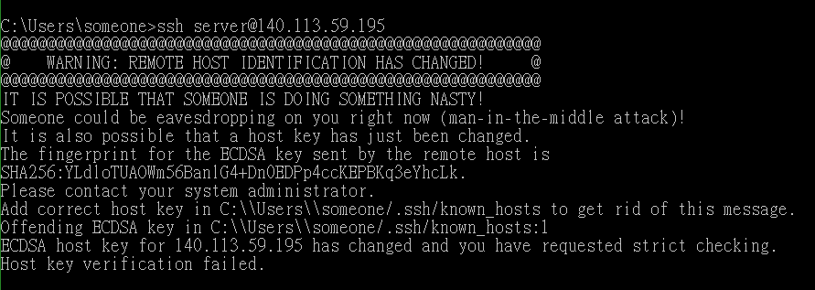
path name of the old key

Slide 25
Windows 10 ssh登入過的金鑰問題
path name of the old key

Slide 26
Windows 10 ssh登入過的金鑰問題
https://support.rackspace.com/how-to/ssh-remote-host-identification-has-changed/
Use following methods to change to the new RSA host key:
sed -i '/1.2.3.4/d' /home/scott/.ssh/known_hosts
IP path name of the old key

