Slide 1
Simian Army
Janitor Monkey

Slide 2

What Janitor Monkey Do
Automatically cleanup the resources that are no more needed
Mark the resources
Notify the owners
Cleanup the resources
Notes:
根據某些規則 (RuleEngine) 決定怎樣的 Resource 算是 unneeded
跟 Owner 確認這些 Resource 真得不要了 (會給 termination time)

Slide 3
Requirement Statements
Janitor Monkey marks resources that are no more needed, a.k.a invalid.
For each resource type, there are some rules determining whether the resource is valid. For example, type ASG has OldEmptyASG and SuspendedASG rules, while type ELB has OrphanedELB and OldDetachedELB rules.
After marking the resources, Janitor Money will send a notification email to the owner of the each marked resource. After that, Janitor Monkey will cleanup the marked resources.
Notes:
根據某些規則 (RuleEngine) 決定怎樣的 Resource 算是 unneeded
跟 Owner 確認這些 Resource 真得不要了 (會給 termination time)

Slide 4
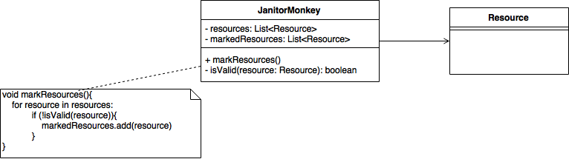
Requiremen₁
Janitor Monkey marks resources that are no more needed, a.k.a invalid.
Notes:
根據某些規則 (RuleEngine) 決定怎樣的 Resource 算是 unneeded
跟 Owner 確認這些 Resource 真得不要了 (會給 termination time)

Slide 5
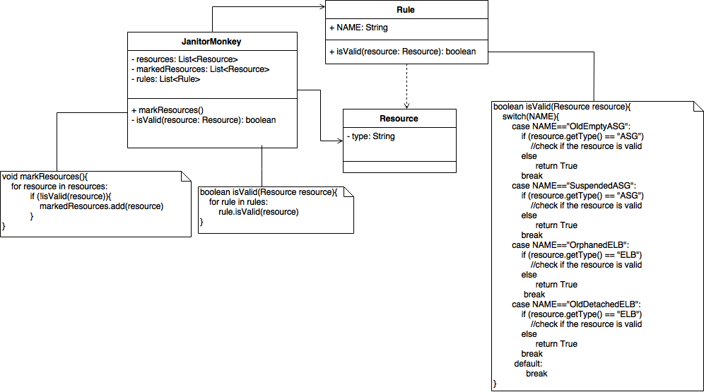
Requiremen₂
For each resource type, there are some rules determining whether the resource is valid. For example, type ASG has OldEmptyASG and SuspendedASG rules, while type ELB has OrphanedELB and OldDetachedELB rules.
Notes:
根據某些規則 (RuleEngine) 決定怎樣的 Resource 算是 unneeded
跟 Owner 確認這些 Resource 真得不要了 (會給 termination time)

Slide 6
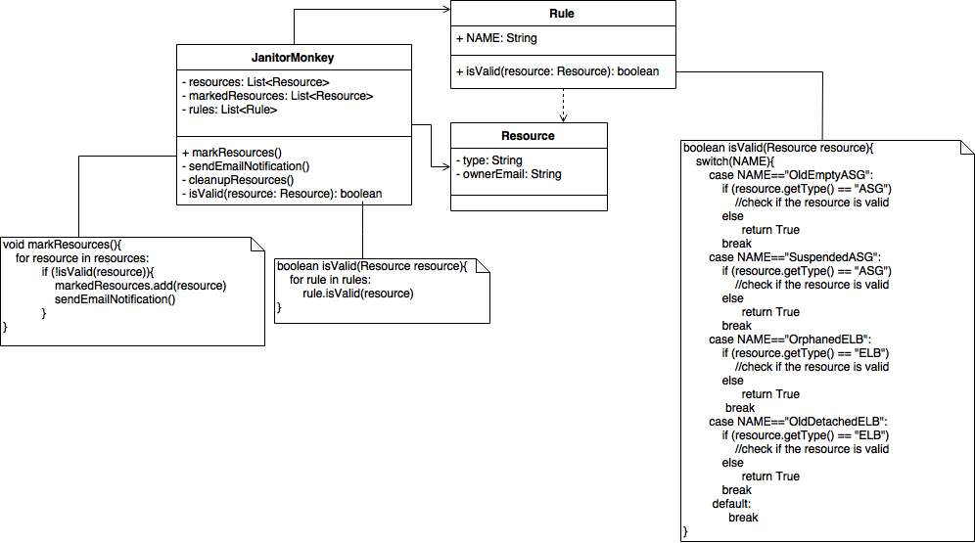
Requiremen₃
After marking the resources, Janitor Money will send a notification email to the owner of the each marked resource. After that, Janitor Monkey will cleanup the marked resources.
Notes:
根據某些規則 (RuleEngine) 決定怎樣的 Resource 算是 unneeded
跟 Owner 確認這些 Resource 真得不要了 (會給 termination time)

Slide 7
Initial Design
If we want to add new rules, we have to modified existed class, which violates
Open/Closed Principle
Notes:
根據某些規則 (RuleEngine) 決定怎樣的 Resource 算是 unneeded
跟 Owner 確認這些 Resource 真得不要了 (會給 termination time)

Slide 8
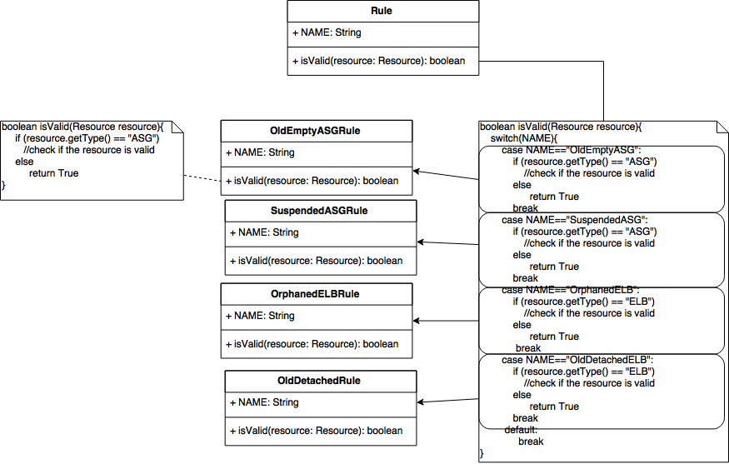
Encapsulate what varies
Encapsulate each rule into a concrete class.
Notes:
根據某些規則 (RuleEngine) 決定怎樣的 Resource 算是 unneeded
跟 Owner 確認這些 Resource 真得不要了 (會給 termination time)

Slide 9
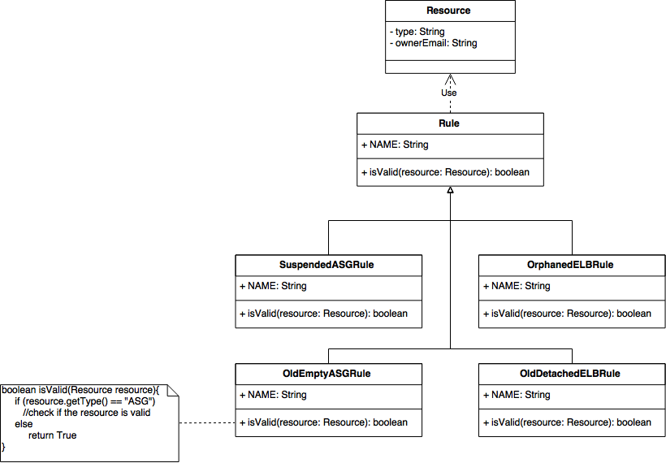
Abstract Common Behaviors (1)
Make each rule extend the abstract class Rule.
Notes:
根據某些規則 (RuleEngine) 決定怎樣的 Resource 算是 unneeded
跟 Owner 確認這些 Resource 真得不要了 (會給 termination time)

Slide 10
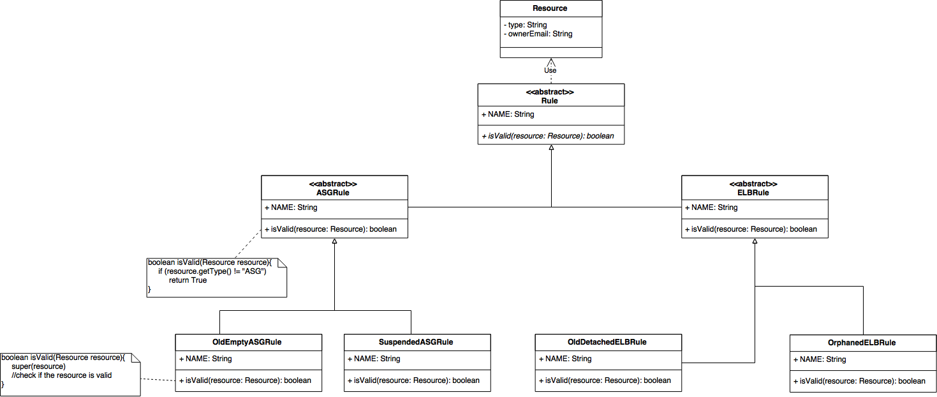
Abstract Common Behaviors (2)
Use an abstract class to classify rules based on resource type they deal with, and implement type check in the abstract class.
Notes:
根據某些規則 (RuleEngine) 決定怎樣的 Resource 算是 unneeded
跟 Owner 確認這些 Resource 真得不要了 (會給 termination time)

Slide 11
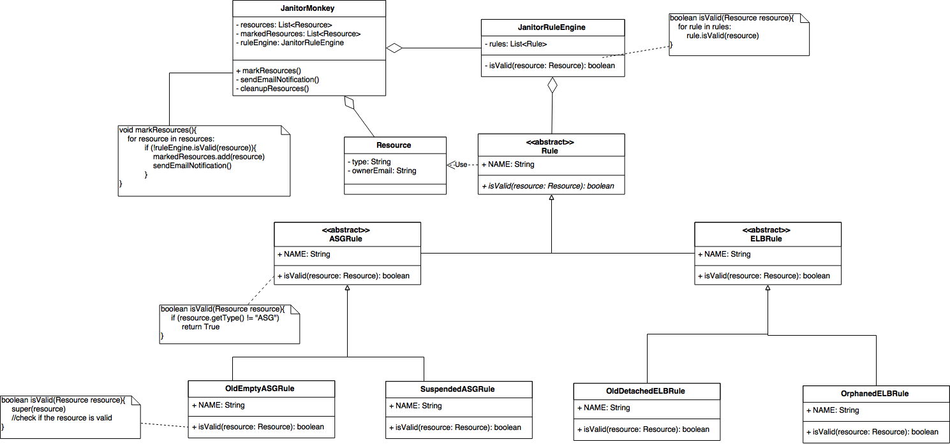
Single Responsibility Principle
Add JanitorRuleEngine to deal with all the stuff about rules.
Notes:
根據某些規則 (RuleEngine) 決定怎樣的 Resource 算是 unneeded
跟 Owner 確認這些 Resource 真得不要了 (會給 termination time)

Slide 12
Refactored Design
Notes:
根據某些規則 (RuleEngine) 決定怎樣的 Resource 算是 unneeded
跟 Owner 確認這些 Resource 真得不要了 (會給 termination time)

