Slide 1
Crawler

Slide 2
_{Objective}
Use AWS API or EDDA API to query data by either “ID” or “Region” from cloud server, and transform them into List<Cluster> or List<Resource> type for Conformity monkey and Janitor monkey to use.

Slide 3
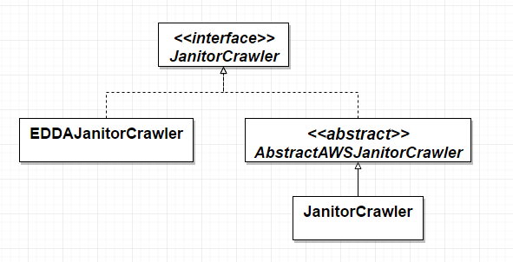
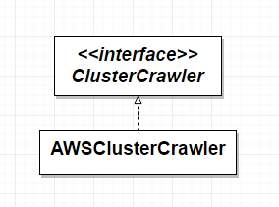
Simplified Architecture

Slide 4
How to achieve?
AWS-based :
take InstanceJanitorCrawler as an example
EDDA-based:
take EDDAInstanceJanitorCrawler as an example

Slide 5
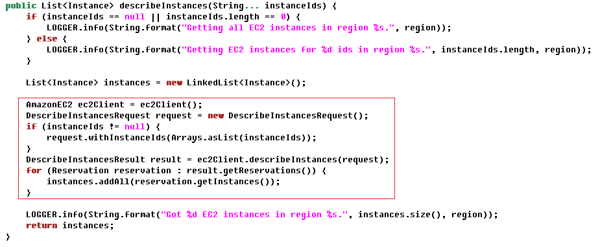
AWS-based

Slide 6
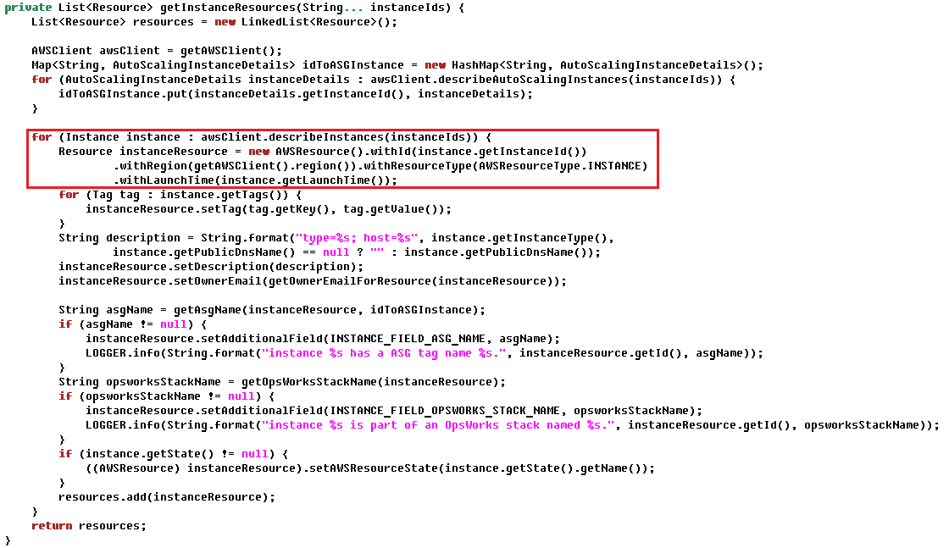

Slide 7
EDDA-based

Slide 8
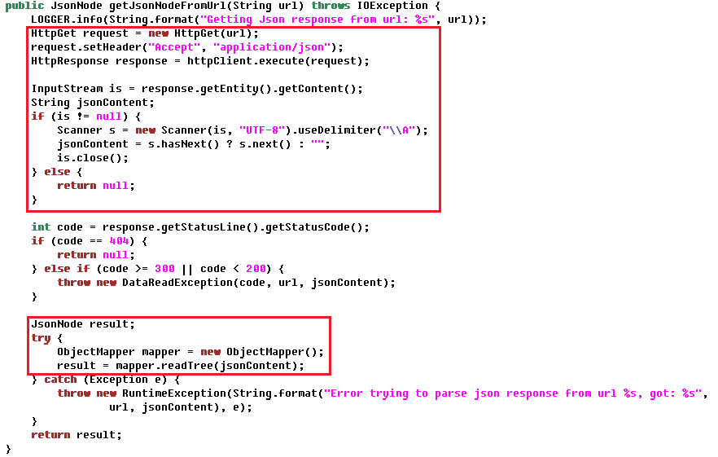

Slide 9
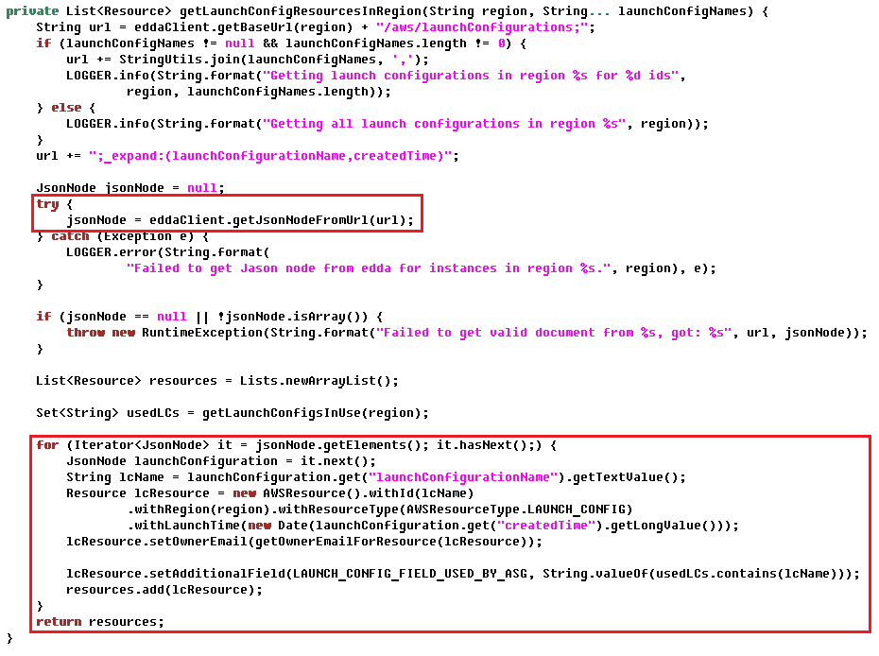

Slide 10
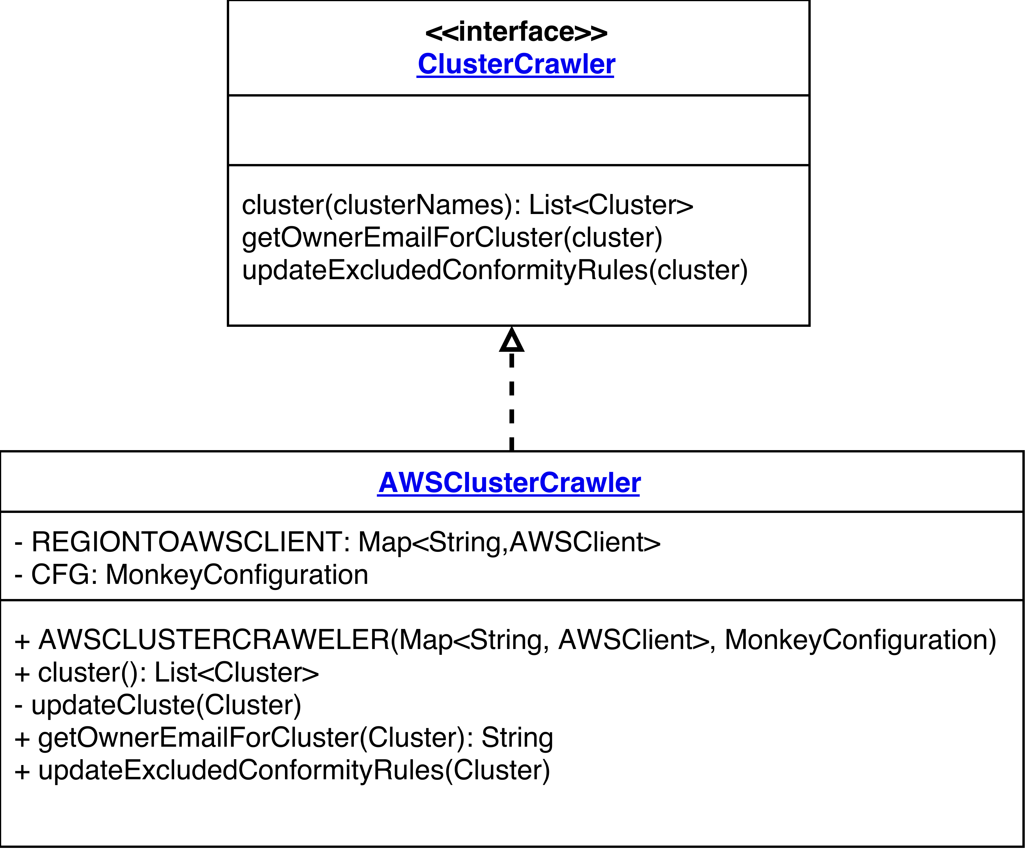
Class Diagram

Slide 11
Question 1
Why do each cloud service need a corresponding crawler?
Any way to increase code reusability?

Slide 12
Answer 1
Each crawler have similar functionality, but with different parameter, description, additional field, tags, Logger message.
Take getInstanceResources() and getELBResources() as example

Slide 13
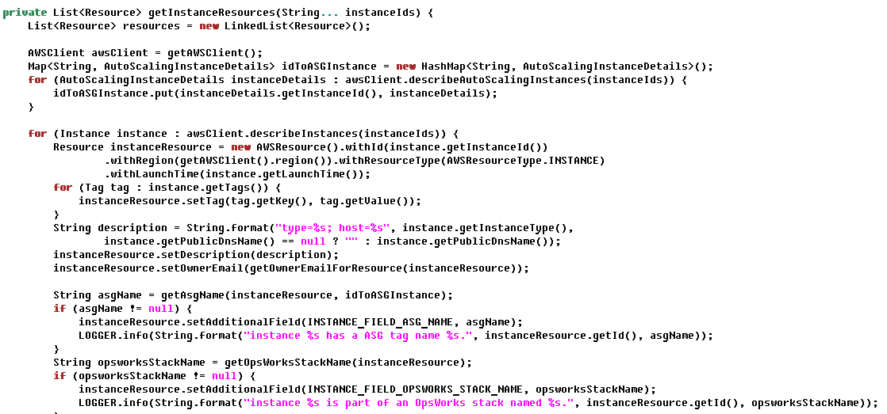

Slide 14
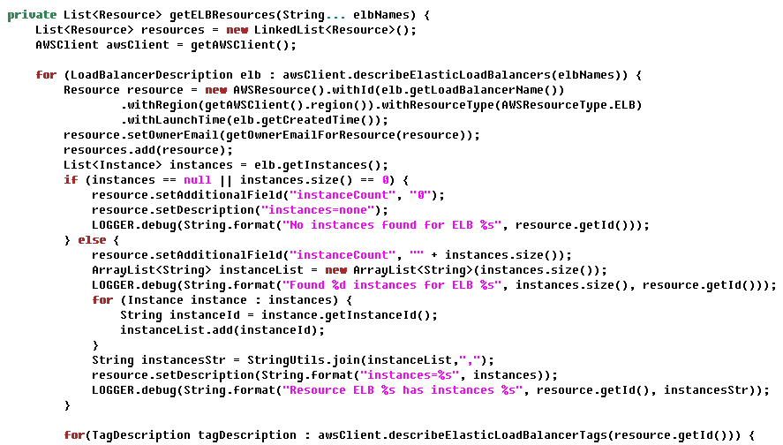

Slide 15
Question 2
Conformity monkey and Janitor monkey both use AWS-based crawler, is it possible to share common crawler?

Slide 16
Answer 2
Conformity monkey use Cluster as a basic unit, however Janitor monkey use Resource as a basic unit.
Both crawlers have similar functionality, but different return datatype, tag, description, Logger message …

Slide 17
Coding Style

Slide 18
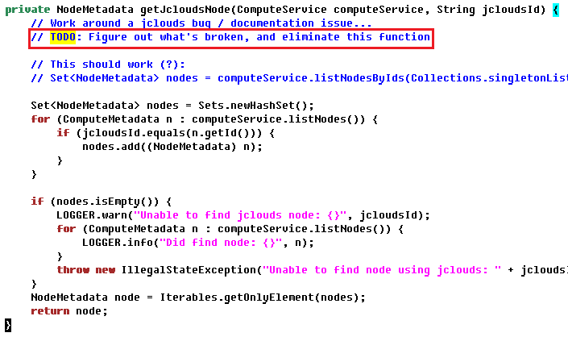
TODO comment

Slide 19
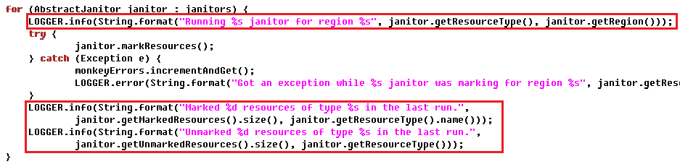
Logger

Slide 20
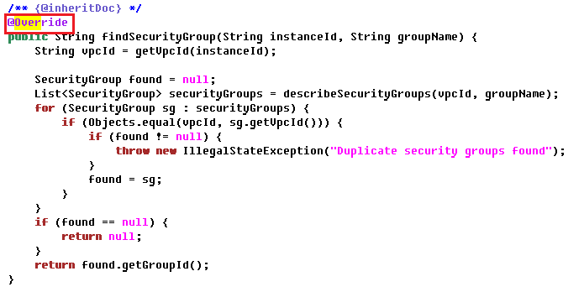
Annotations

Slide 21
Javadoc comment

Slide 22
