Slide 1
Crawler

Slide 2
_{Objective}
Use AWS API or EDDA API to query data by either ID or region from cloud server, and transform them into list<Cluster> or list<Resource> type for Conformity monkey and Janitor monkey to use.

Slide 3
Architecture

Slide 4
How to achieve?
AWS-besed :
take InstanceJanitorCrawler as an example
EDDA-besed:
take EDDAInstanceJanitorCrawler as an example

Slide 5
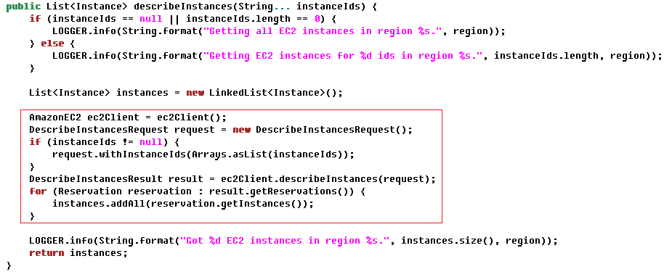
AWS-based

Slide 6
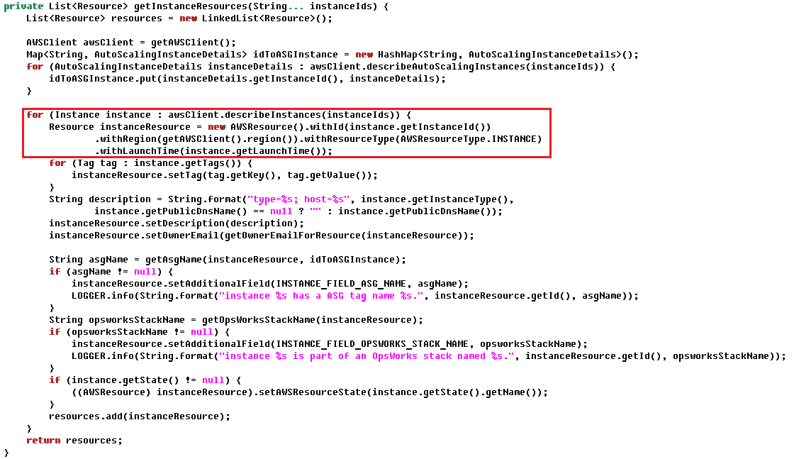

Slide 7
EDDA-based

Slide 8
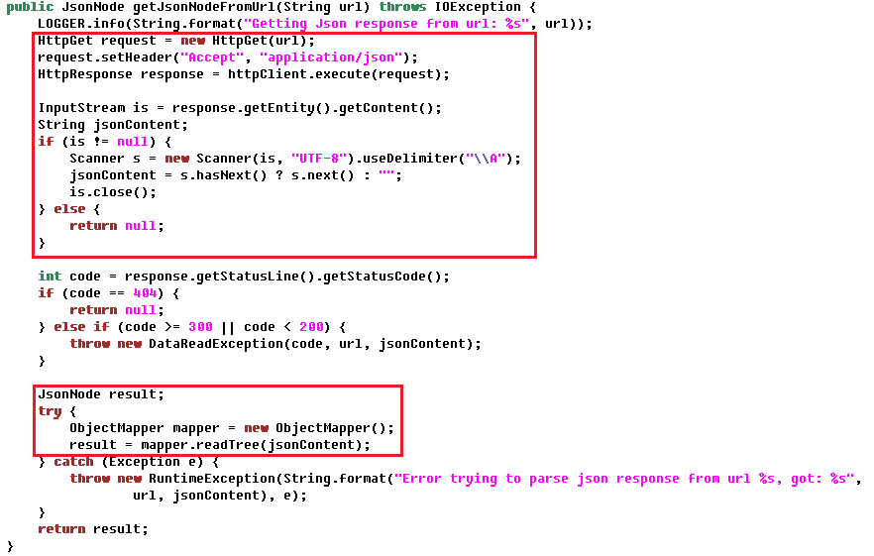

Slide 9
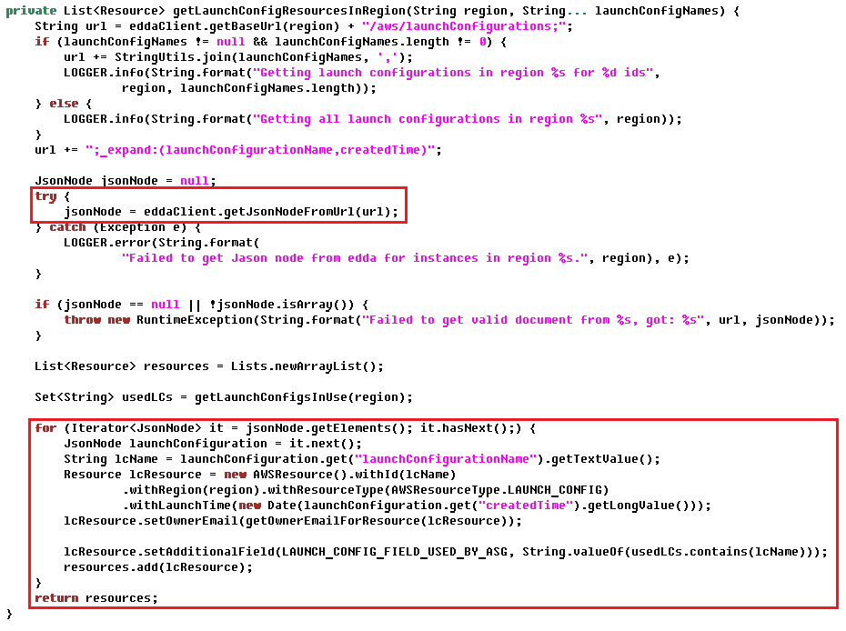

Slide 10
Architecture

Slide 11
Question 1
為什麼每一種cloud service都需要有一個對應的crawler？

Slide 12
Answer 1
AWS的API要求request的時候必須指定type，所以沒辦法做abstraction

Slide 13
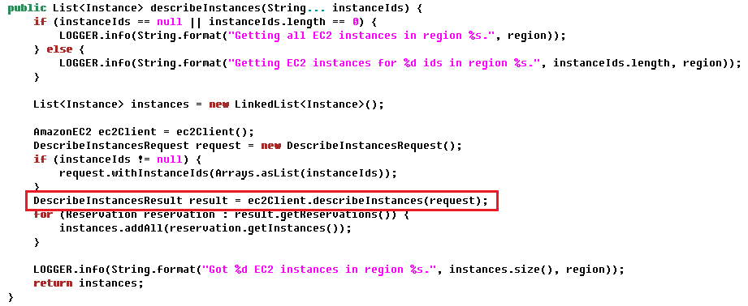

Slide 14
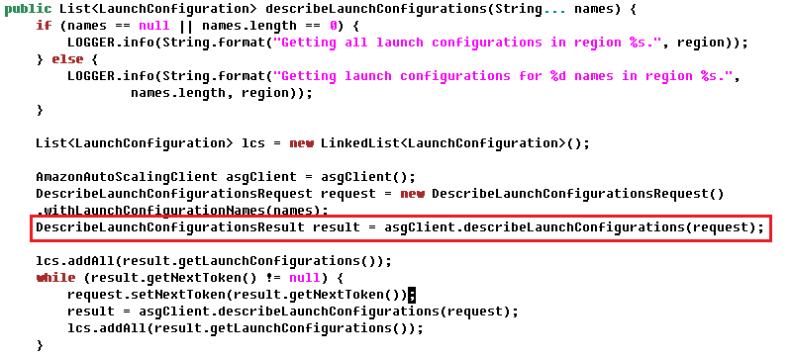

Slide 15
Answer 1
AWS的API要求request的時候必須指定type，所以沒辦法做abstraction
違反Single Responsibility Principle

Slide 16
Question 2
Conformity monkey也是使用AWS-based crawler，為什麼Conformity monkey和Janitor monkey不共用AWS-based crawler?

Slide 17
Answer 2
Conformity monkey是以Cluster做為基本工作單位，
而Janitor monkey是以Resource做為基本工作單位。
違反Single Responsibility Principle

Slide 18
Coding Style

Slide 19
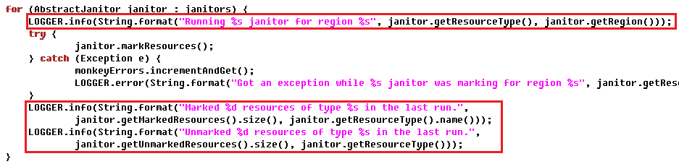
Logger

Slide 20
文件式註解

Slide 21
