Slide 1
Week 5 Class Diagrams
Group 5

Slide 2
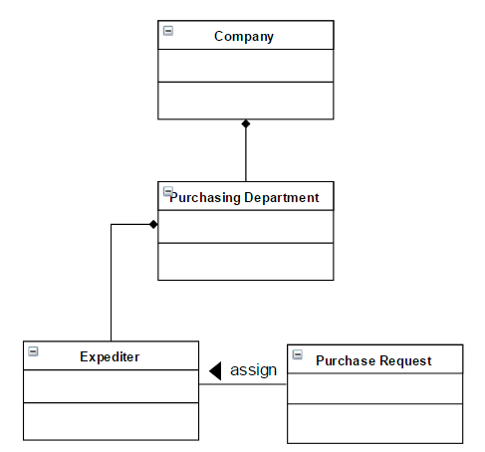
Purchasing Department₁
In the Purchasing Department at one company, a purchase request may be assigned an expediter within the Purchasing Department.

Slide 3
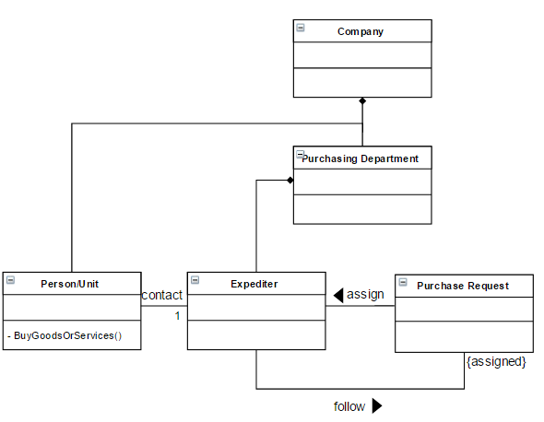
Purchasing Department₂
This expediter follows the purchase request through the entire purchasing processes and acts as the sole contact person with the person or unit within the company buying the goods or services.

Slide 4
Purchasing Department₃
The Purchasing Department refers to its fellow employees buying goods and services as customers. The purchasing process is such that purchase requests from certain special customers must go out for bid to vendors, and the associated Request-for-Bids for these requests must be approved by the Purchasing Department.

Slide 5
Purchasing Department₄
If the purchase is not by a special customer, the product or service can simply be bought from any approved vendor, but the purchase request must still be approved by the Purchasing Department, and the department must issue a Purchase Order. For “special customer” purchases, the Purchasing Department can issue a Purchase Order once the winning bid is accepted.

Slide 6
Purchasing Department₅ Final Diagram

Slide 7
Milk Delivery System₁
A system is to be produced which holds details of deliveries of different brands of milk in a small town.
System
Milk Brand
Milk Brands
details of deliveries

Slide 8
Milk Delivery System₂
As well as recording which households take which brand(s) of milk, this system also includes billing details and details of customer vacations when milk will not be delivered.
System
Milk Brand
Milk Brands
details of deliveries
hash <household, billing details>
hash <household, vacations>
hash <household, milk brands>
recordMilkBrandOfHousehoud()

Slide 9
Milk Delivery System₃
The household will phone the delivery company to change the personal information, like address, to inform of the vacation, and to change the order of milk.
System
Milk Brand
Company
Milk Brands
details of deliveries
-body: System
hash <household, billing details>
hash <household, vacations>
hash <household, milk brands>
changeInfo()
recordMilkBrandOfHousehoud() doChangeOrderOfMilk()
doUpdateVacation()
Household
phone
changeInfo()

Slide 10
For each delivery person, the system prints a daily list of which brands of milk are to be delivered to which households. The system should also be able to produce summary information showing how many liters of each milk type were sold each day of the week.
Delivery Person
give list
System
Milk Brand
Company
Milk Brands
details of deliveries
-body: System
hash <household, billing details>
hash <household, vacations>
hash <household, milk brands>
changeInfo()
recordMilkBrandOfHousehoud() doChangeOrderOfMilk()
doUpdateVacation()
printList()
produceDailySummary()
Household
changeInfo()

Slide 11
Milk Delivery System₅
Bills for each customer are printed at the end of each month and delivered with the first delivery of the following month.
Delivery Person
deliver
print bill
give list
System
Milk Brand
Company
hash <household, billing details>
hash <household, vacations>
hash <household, milk brands>
details of deliveries
-body: System
changeInfo()
recordMilkBrandOfHousehoud() doChangeOrderOfMilk()
doUpdateVacation()
printList()
produceDailySummary()
phone
Household
changeInfo()

Slide 12
Milk Delivery System₆ Final Diagram
Delivery Person
deliver
print bill
give list
System
Milk Brand
Company
hash <household, billing details>
hash <household, vacations>
hash <household, milk brands>
details of deliveries
-body: System
changeInfo()
recordMilkBrandOfHousehoud() doChangeOrderOfMilk()
doUpdateVacation()
printList()
produceDailySummary()
phone
Household
changeInfo()

Slide 13
Tools for creating UML
https://creately.com/app/?tempID=h165rwt81&login_type=demo#
https://www.draw.io/

