Slide 1
Abstract Monkey
SimianArmy

Slide 2
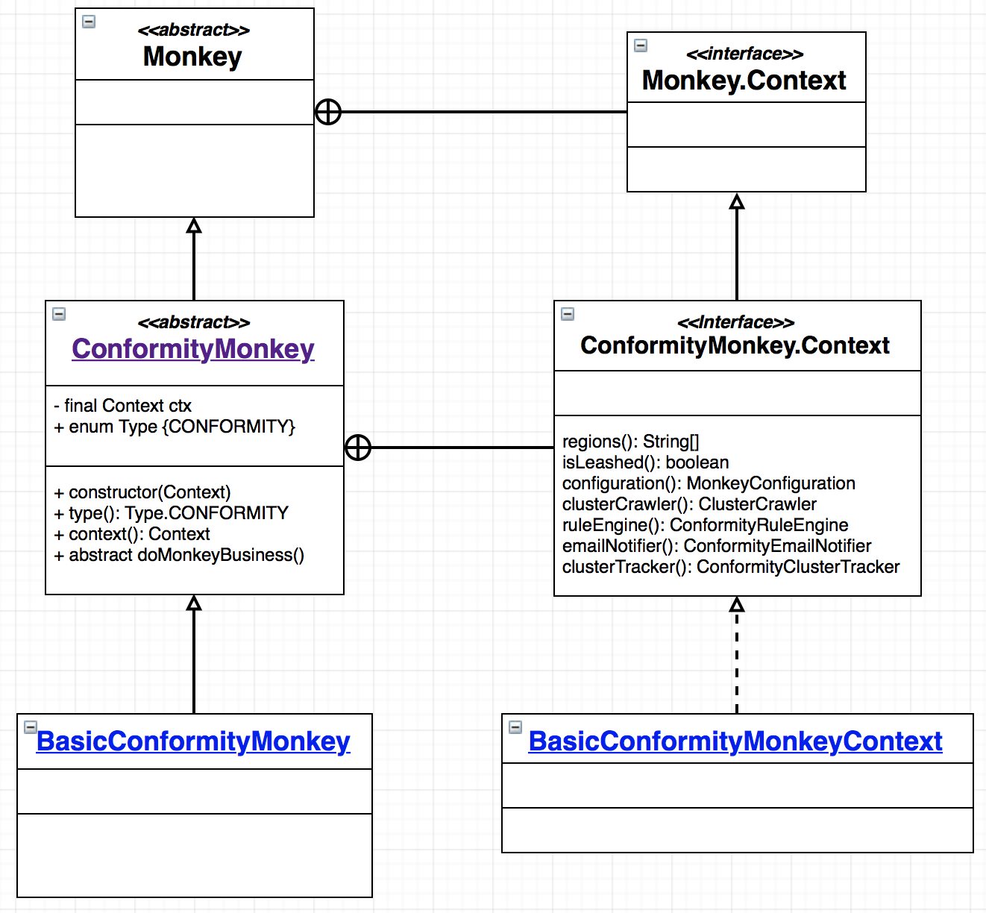
Top Level Monkey
<<abstract>> Monkey
Lots of Contexts * Namespace
Inner (Nested) Interfaces

