Slide 1
Simian Army
Adapter

Slide 2
Scenario
Simian Army defines a new class NotFoundException
Problem: Some outside exceptions should also be classified as NotFoundException
Solution: Use a wrapper to wrap those exceptions

Slide 3
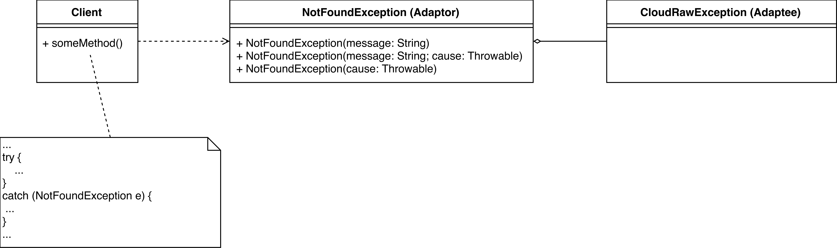
Class diagram
Notes:
Client -> any class trying to catch NotFoundException
First constructor in Adaptor -> for inside exceptions; The other constructors -> for outside exceptions
Adaptor aggregates Adaptee -> next slide

Slide 4
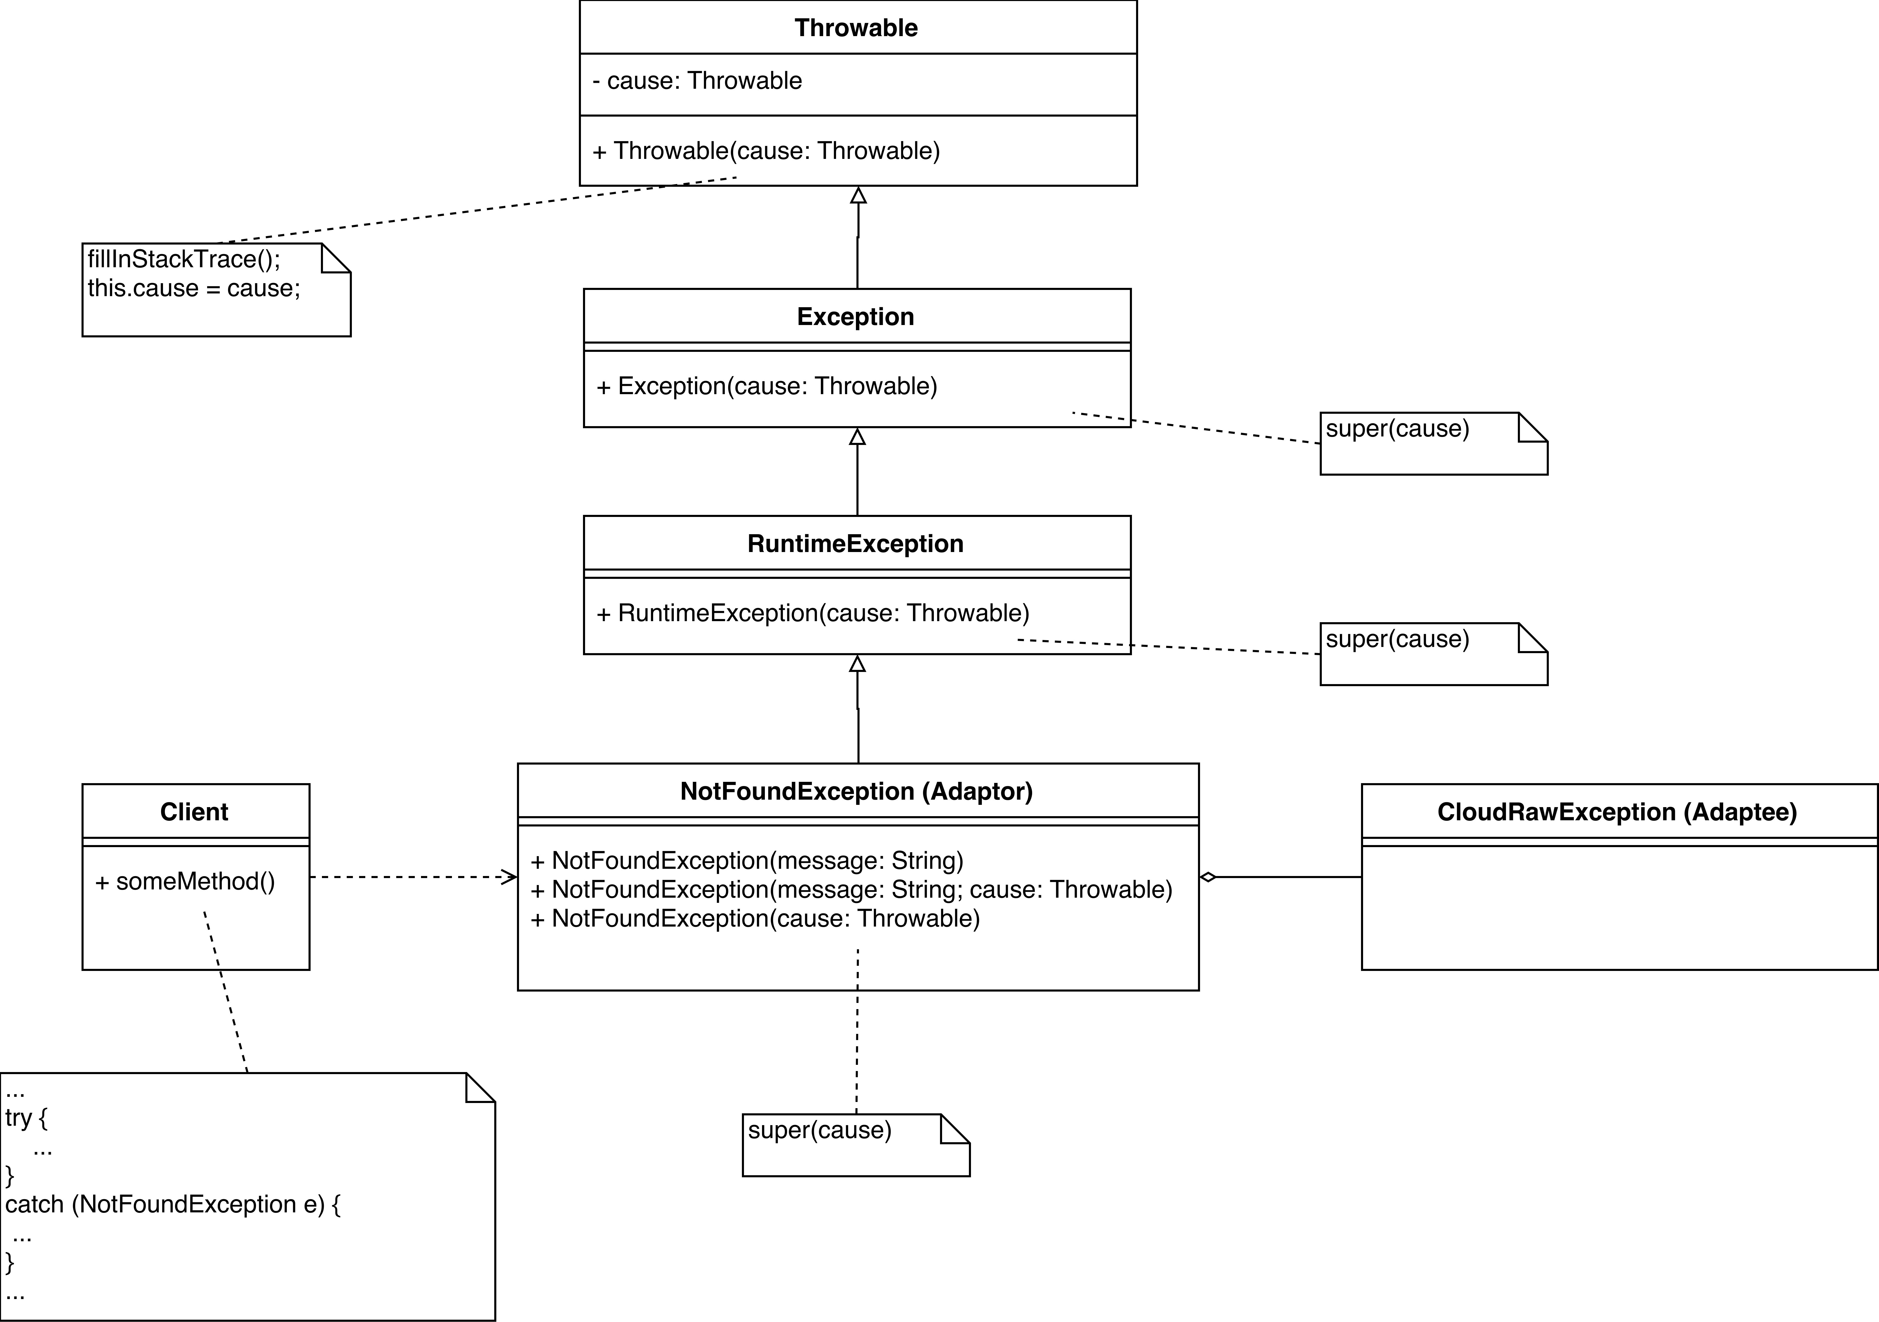
Class diagram
Notes:
Only depicts one constructor, but the concept of the other one is the same

Slide 5
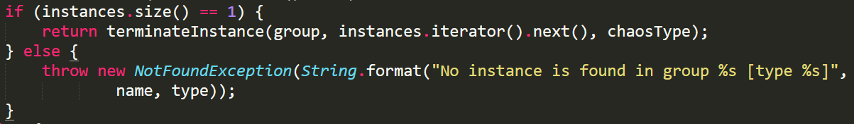
Inside SimianArmy
terminateNow() in BasicChaosMonkey.java

Slide 6
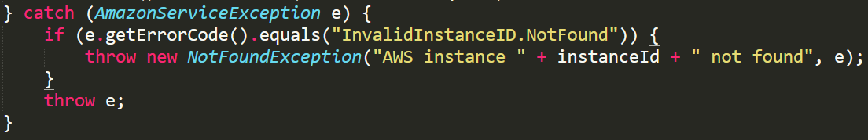
Outside SimianArmy
detachVolume() in AWSClient.java

Slide 7
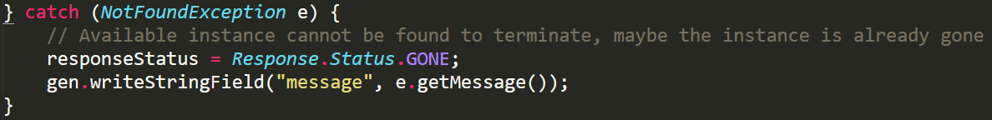
Client
addTerminationEvent() in ChaosMonkeyResource.java
The client only needs to know the exception belongs to NotFoundException, the adapter hides all the other details.
Notes:
If it is a NotFoundException, then doSomething()

