Slide 1
Simian Army
Singleton

Slide 2
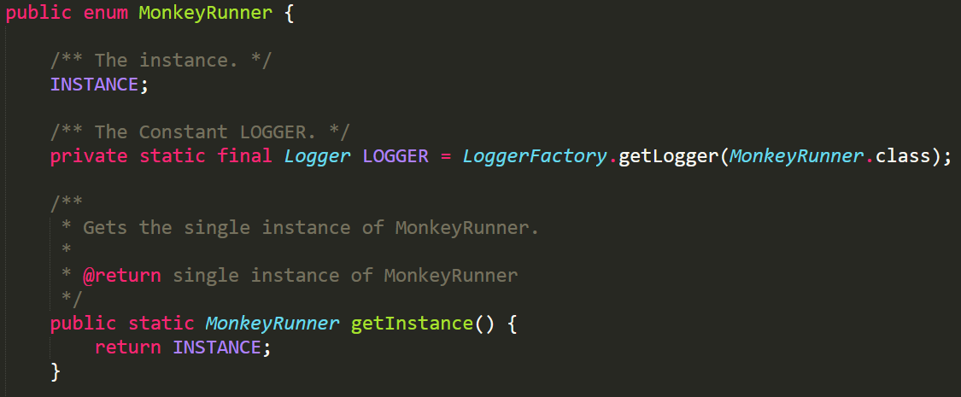
Singleton Class
MonkeyRunner

Slide 3
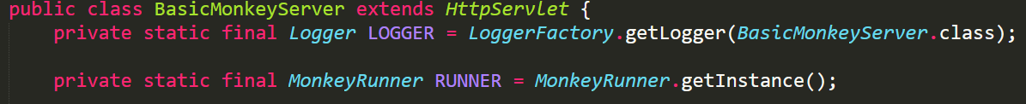
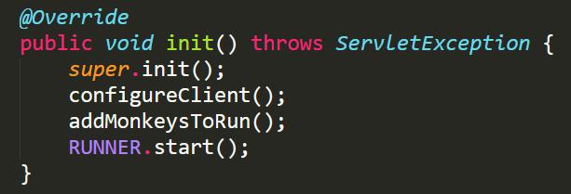
Client
BasicMonkeyServer

Slide 4
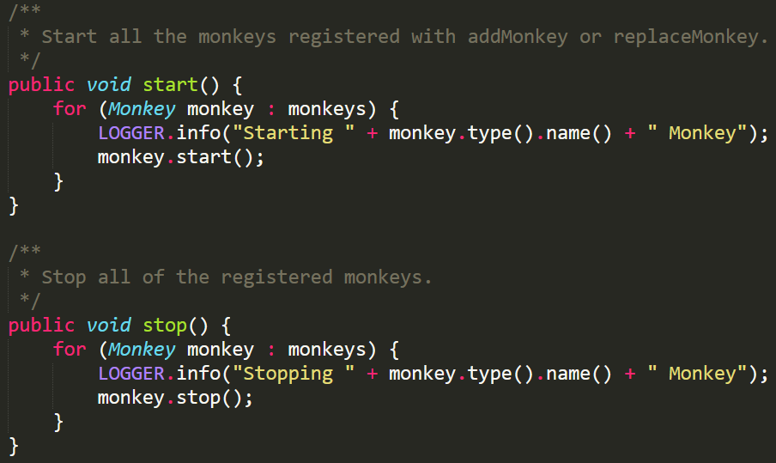
Role of MonkeyRunner
In charge of Monkeys

Slide 5
Enum Singleton
Easy to write
Lazy loaded
Thread-safe
Automatically handle serialization
Notes:
相較 double check locker
Enum 裡面每一個 Instance 都是第一次被 referenced 的時候才 instantiated
後兩項由 JVM 保證 (Enum)
//readResolve to prevent another instance of Singleton private Object readResolve(){ return INSTANCE; } Read more: http://javarevisited.blogspot.com/2012/07/why-enum-singleton-are-better-in-java.html#ixzz4hrkzyHYW

