Slide 1
Simian Army
Initialization

Slide 2
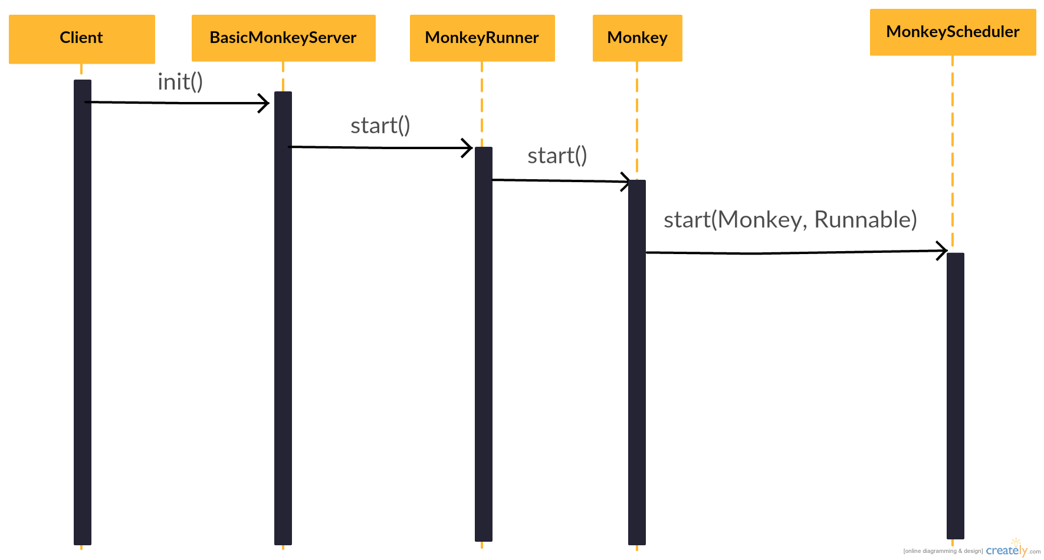
Sequence Diagram

Slide 3
Class diagram
Notes:
BasicMonkeyServer overrides init() and destroy(), in init() it loads configuration and call start() of MonkeyRunner
Monkey start() uses run(), and run() will handle scheduler and EventReport then calls doMonkeyBusiness()
Monkey gets an scheduler from its inner interface Context

Slide 4
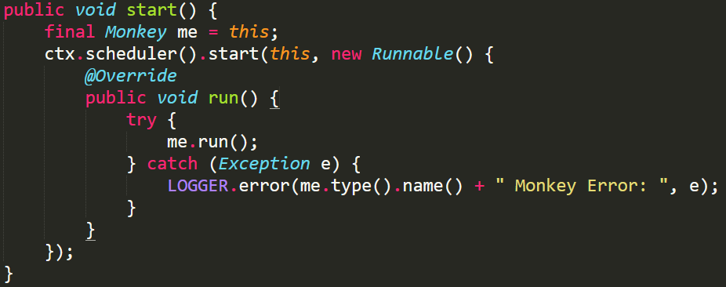
Command Pattern?
Receiver (Monkey) with an action (run) ?
Notes:
Final -> to access ‘me’ in anonymous class

Slide 5
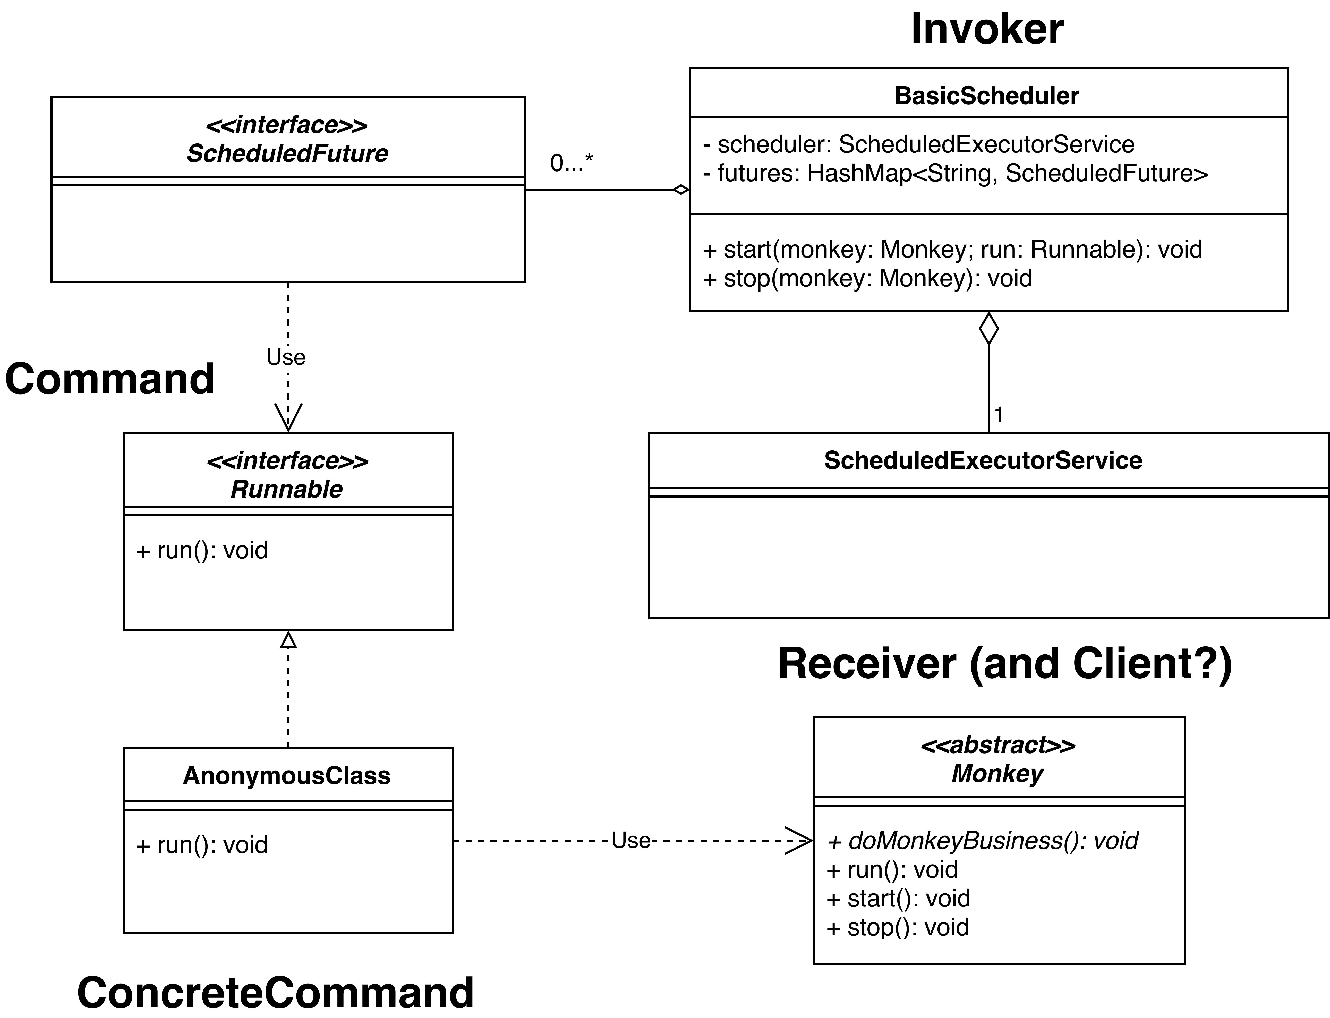
Command Pattern – Class Diagram
Notes:
BasicScheduler uses ScheduledExecutorService to turn Runnable into ScheduledFuture
BasicScheduler keeps a HashMap to stop execution of threads
Use ? -> final modifier to access it

