Slide 1
Simian Army
Janitor Monkey

Slide 2
What Janitor Monkey Do
Mark the resources
Notify the owners
Cleanup the resources

Slide 3
Hierarchy
JanitorMonkey
JanitorA
ResourceA1
ResourceA2
JanitorB
ResourceB1

Slide 4
Janitor Monkey
Opt in resources
Opt out resources

Slide 5
Abstract Janitor
markResources()
cleanupResources()
markedResources
cleanedResources
unmarkedResources
failToCleanResources

Slide 6
Mark a resource
JanitorRuleEngine
Rule
Exclusion Rule

Slide 7
Abstract Janitor – flexibility
Leashed: boolean
JanitorResourceTracker

Slide 8
Abstract Janitor – abstract operation
postMark()
cleanup()
postCleanup()

Slide 9
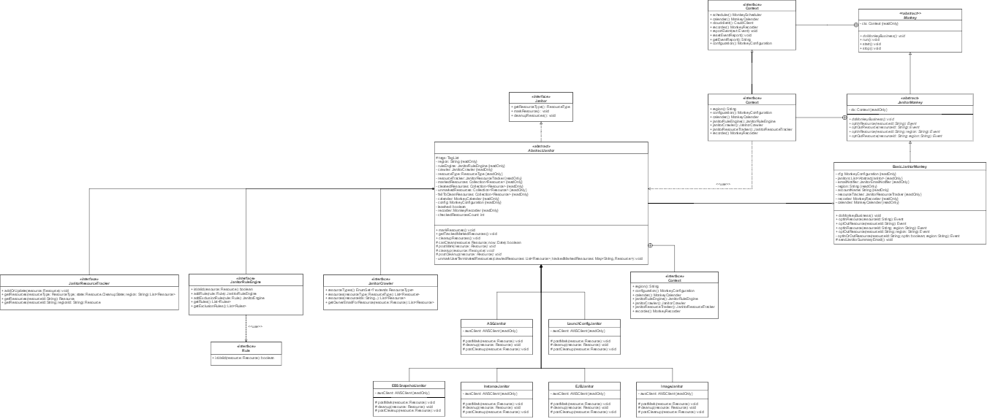
Class Diagram

