Slide 1
议论文题型分类大全
搞定这一步，稳稳上6.5分！

Slide 2


Slide 3
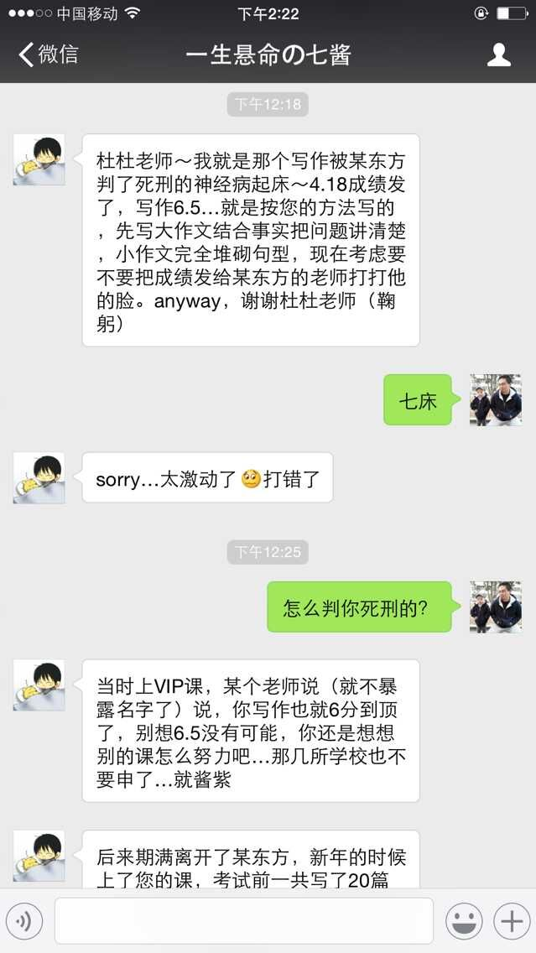

Slide 4
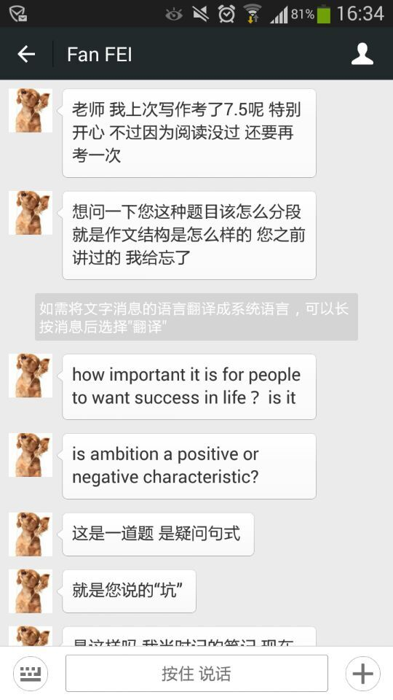

Slide 5
第一种议论文题型
Discuss both views and give your opinion.
讨论双方观点，并且给出你的个人意见。

Slide 6
第一种议论文题型
Discuss both views and give your opinion.
两种可能
1). 一方弱一方强，先写弱再写强，最后重复总结自己的观点；
2). 两个观点必须共存，或者要看情况而定；

Slide 7
Discuss both views and give your opinion.
第一种情况
这个题目里的两个观点让你感觉一瞬间就找到了弱强的区别，所以你打算按照“虽然…..但是….”的逻辑来展开讨论。

Slide 8
Discuss both views and give your opinion.
1). People have different opinions about 疑问句……… In my opinion, (although)………., (but)…………..
2). On the one hand, 核心段
3). On the other hand, I would argue that………核心段(最好能在某个部分针对第二段进行反驳)
4). In conclusion, I admit that………., but……………………. （一般来说，提出恰当的建议是很合理的）

Slide 9
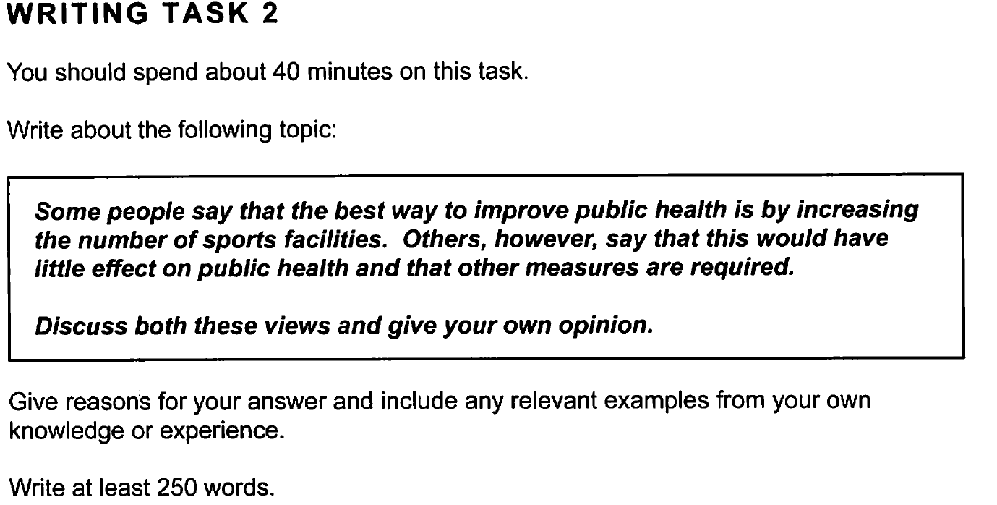

Slide 10
People have different opinions about how to tackle the problem of the declining level of health in the general population. In my opinion, although increasing the number of sports facilities may encourage people to be physically active, it is not the most effective method to improve the level of health and other measures are necessarily needed.
On the one hand, advocates of the increase in the number of sports facilities believe that it helps to encourage people to stay healthy. 1). If there were more easy-to-reach local sports centres, people would be more likely to make exercise a regular part of their lives. Rather than just collapse in front of the screen every evening, they would spend some quality time swimming or jogging, which contributes positively to good health and fitness. 2). In addition, the variety of sports that could be offered would cater for all ages, levels of fitness and interests. For example, those with painful memories of PE at school might be happier in the swimming pool than on the football pitch.

Slide 11
On the other hand, however, I believe that increasing the number of facilities for physical activities is not the best solution to health-related problems. 1). My first reason is that interest in sport is not universal, so additional facilities might simply attract the already fit, not those who most need them. 2). In addition, as well as physical activity, there are several measures that can be used to raise the level of public health level. For example, high tax penalties could be imposed on high-fat food products, tobacco and alcohol, as excessive consumption of any of these contributes to poor health. Even improving public transport would help, because it takes longer to walk to the bus stop than to the car.
In conclusion, my view is that focusing on sports facilities is too narrow an approach and would not have the desired results. People should be encouraged not only to be more physically active but also to adapt a healthier lifestyle in general.

Slide 12
必须注意第二种情况

Slide 13
你实在懒得分出A/B的强弱，那就在核心段写出一个平衡结构。但是请注意，个人观点在同样需要在第一段就直接给出。

Slide 14
Some people think that museums should be enjoyable places to entertain people, while others believe that the purpose of museums is to educate. Discuss both views and give you own opinion

Slide 15
People have different views about the role and function of museums. In my opinion, museums can and should be both entertaining and educational.
On the one hand, it can be argued that the main role of a museum is to entertain. Museums are tourist attractions, and their aim is to exhibit a collection of interesting objects that many people will want to see. The average visitor may become bored if he or she has to read or listen to too much educational content, so museums often put more of an emphasis on enjoyment rather than learning. This type of museum is designed to be visually spectacular, and may have interactive activities or even games as part of its exhibitions.

Slide 16
On the other hand, some people argue that museums should focus on education. The aim of any exhibition should be to teach visitors something that they did not previously know. Usually this means that the history behind the museum’s exhibits needs to be explained, and this can be done in various ways. Some museums employ professional guides to talk to their visitors, while other museums offer headsets so that visitors can listen to detailed commentary about the exhibition. In this way, museums can play an important role in teaching people about history, culture, science and many other aspects of life.
In conclusion, it seems to me that a good museum should be able to offer an interesting, enjoyable and educational experience so that people can have fun and learn something at the same time.

Slide 17
discuss 类型的介绍段
1). 总结A/B的共同讨论点；
2). 回答个人观点
题目： 有人认为玩电脑游戏对孩子在方方面面都有坏处，而有的人认为这些游戏对孩子的发展有好处。
People have different views about whether children should be allowed to play computer games. In my opinion, while there have been complaints about problems caused by playing these games, the effects are not absolutely negative.

Slide 18
discuss 类型的介绍段
1). 改写引出题目中的事实；
2). 回答个人观点
题目： Several languages are in danger of extinction because they are spoken by very small numbers of people. Some people say that governments should spend public money on saving these languages, while others believe that would be a waste of money. Discuss both these views and give your opinion.
It is true that some minority languages may disappear in the near future. Although it can be argued that governments could save money by allowing this to happen, I believe that these languages should be protected and preserved.

Slide 19
discuss 类型的介绍段
1). 写出题目中存在的事实；
2). 回答个人观点
题目： Nowadays animal experiments are widely used to develop new medicines and to test the safety of other products. Some people argue that these experiments should be banned because it is morally wrong to cause animals to suffer, while others are in favour of them because of their benefits to humanity. Discuss both views and give your own opinion.
It is true that medicines and other products are routinely tested on animals before they are cleared for human use. While I tend towards the viewpoint that animal testing is morally wrong, I would have to support a limited amount of animal experimentation for the development of medicines.

Slide 20
discuss 类型的介绍段
1). 陈述A/B观点的事实
2). 尽可能详细地给出个人观点
题目： 有人认为高楼林立的城市对人们的生活和工作有很多好处，而有的人认为房屋低矮的城市对人们更好。
Some cities have a large number of high-rise buildings, while in others there is a limit to the height of commercial and residential architectures. From my point of view, both types of constructions are equally important to people’s life and work but they should be located in different parts of a city to make the best use of them.

