Slide 1
议论文题型分类大全
搞定这一步，稳稳上6.5分！

Slide 2
Two Questions=Reports
原因分析+ 解决方案
原因分析+ 有何影响
原因分析+ 随机(鬼才知道会问什么)
造成的问题+ 解决方案---特别注意
你有可能遇到其中任何一种组合

Slide 3
Two Questions=Reports
What do you think are the causes?
What problems does it cause?

Slide 4
往年真题
很多人不认识自己的邻居。(原因+解决)
全世界的城市越来越相似。(原因+影响)
爸妈在家扮演的角色有很大不同。(原因+会不会有改变)
人类寿命越来越长。(导致的问题+解决)

Slide 5
report类型的核心段(原因+解决方案版本)
1. 直接改写原题，不需要背景引出(扩充或者缩减原题) + 承上启下(提前总结原因/空话过渡)
2. One of the reasons is that 第一个原因分析。(idea--support)
3. In addition, 第二个原因分析。(idea--support)
4. ~~~(能引出后半句的过渡句)~~~~so measures should be taken to combat this situation. 切实可行(政府基本上必须出来)
5. 总结(重复原因/解决方案)

Slide 6
分析原因的角度
1. 不能只局限在中国；
2. 通过年代对比找到原因(至关重要)；
3. 必须从事实出发去写原因；

Slide 7
到底都有哪些事实？
1. 现代人-忙/钱多/懒/不动
2. 现代媒体(更多关注negative reports);
3. 现代工作(变得越来越knowledge-based)；
4. 现代家庭(孩子减少，溺爱孩子);
5. 现代教育(更专注孩子的all-round development);
6. 现代城市(越来越multicultural/ethnically-mixed/racially-mixed)；

Slide 8
解决方案--切实可行
1. 政府---至关重要(收税/花钱/颁布法律)；
1). The government could impose higher taxes on ……so that …….
2). What the government should do is to invest in…../financially support…../spend money doing……….
3). The government ought to require …..to …...
2. 个人
3. 家长
4. 学校
5. 公司
6. authorities

Slide 9
范文-1
1. 第一段超简单；
2. 原因只写了一个，大量的support解释；
3. 解决方案先粗略，然后很仔细；

Slide 10
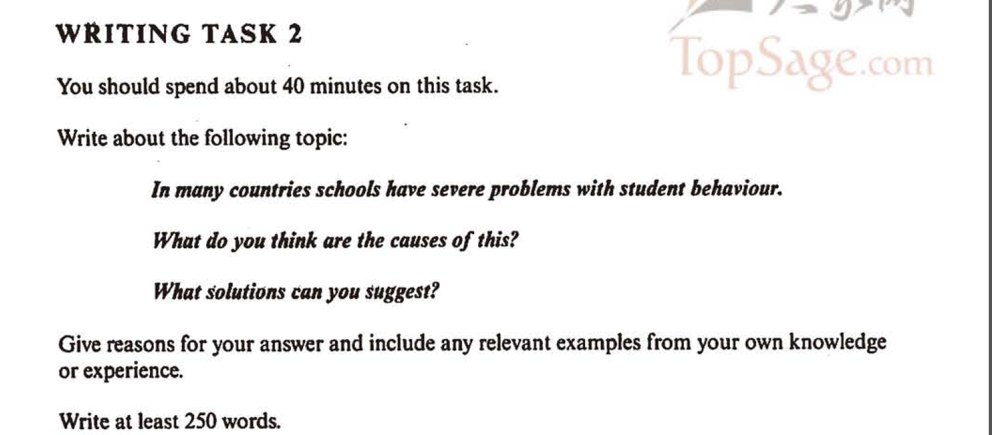

Slide 11
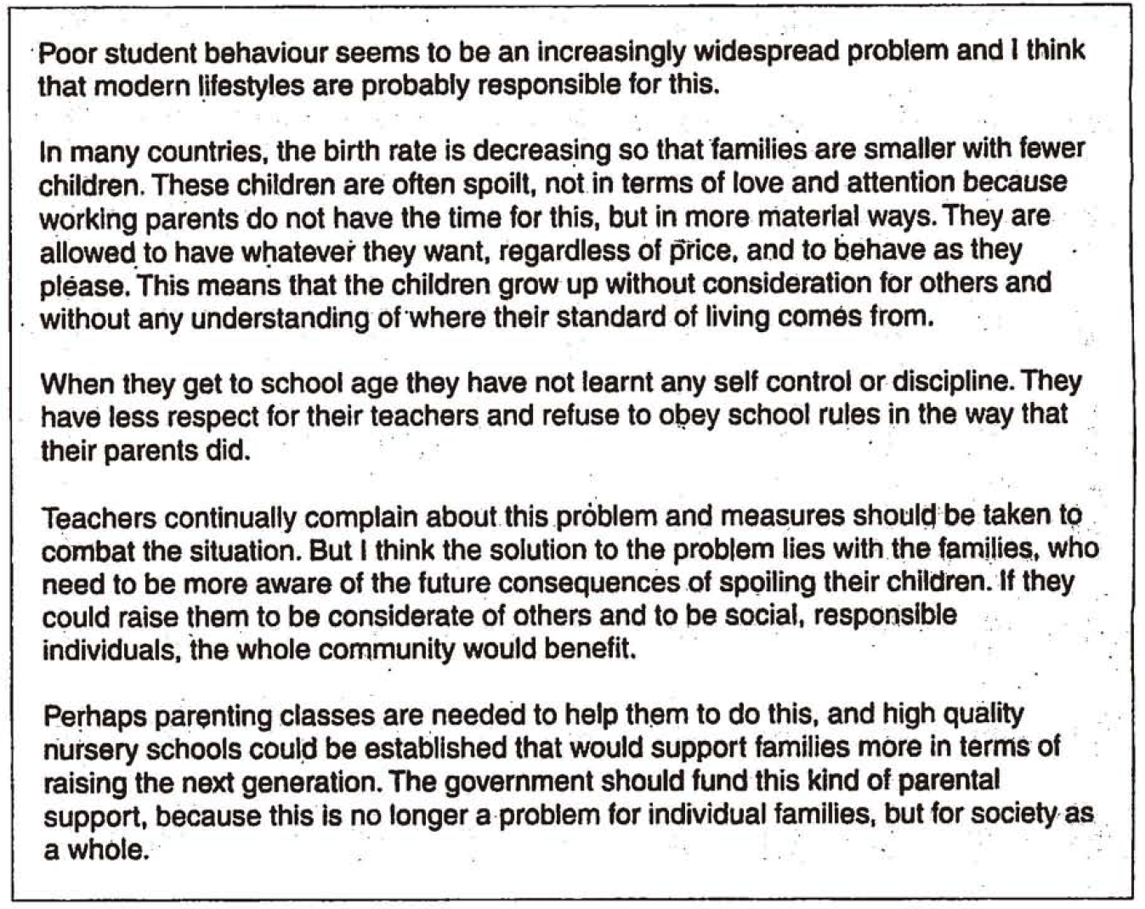

Slide 12
范文-2
1. 第一段后半部分太繁琐；
2. 原因分析给了两个idea，非常标准；
3. 解决方案非常精确；
4. 结尾段清晰；
5. 整个结构非常标准；

Slide 13
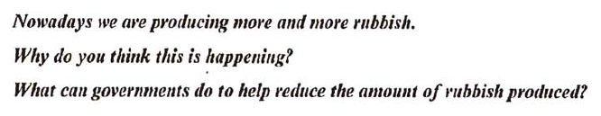

Slide 14
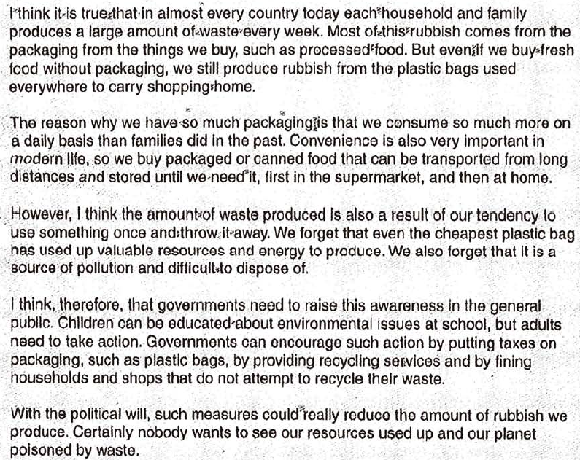

Slide 15
范文-3
1. 剑桥考生范文，分数是6.5；
2. 语法错误很多，但是大部分时候表达清晰；
3. 原因分析太偏向不健康的饮食，对缺乏锻炼解释太少；
4. 解决方案很细致，考官会喜欢；
5. 这个范文是给大家增加信心用的；

Slide 16
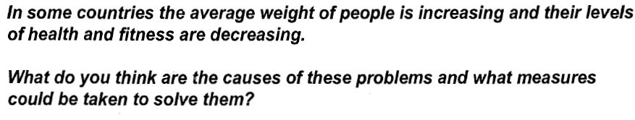

Slide 17
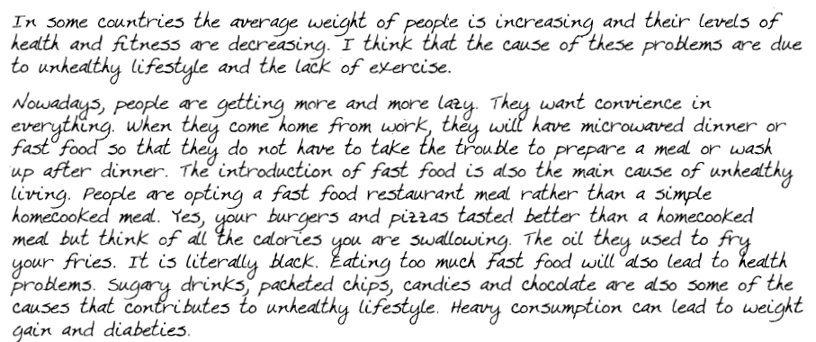
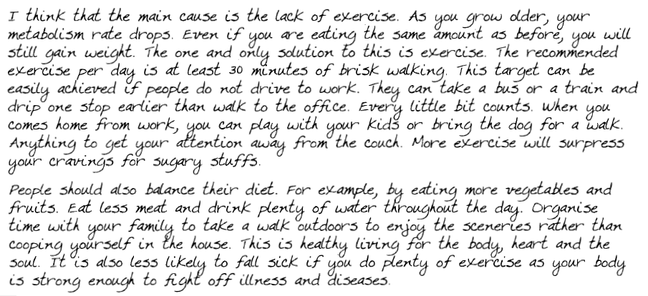

Slide 19
report类型的核心段(原因+有何影响版本)
1. 直接改写原题，不需要背景引出(扩充或者缩减原题) + 承上启下(提前总结原因/空话过渡)
2. One of the reasons is that 第一个原因分析。(idea--support)
3. In addition, 第二个原因分析。(idea--support)
4. 过渡句---To my knowledge, there are 完全取决于你自己(好/坏/虽然….但是…..)
5. 总结(重复原因/影响)

Slide 20
Some employers think that formal academic qualifications are more important than life experiences and personal qualities when they look for an employee. Why is it the case? Is it a positive or negative development?

Slide 21
Nowadays , more importance is attached to formal educational qualifications than life experience and personal qualities when a company is recruiting new employees. The reasons behind this phenomenon are multiple, and I believe it is a positive development in the long-run.
First of all, university qualifications provide direct proofs of candidates’ competencies. Employers can have a clear picture of what universities and course the candidates have attended, and what scores they have achieved . Unlike life experiences and personalities, qualifications are quantifiable data that can be measured easily and quickly.
In addition, people holding qualifications could adapt to the new job much more smoothly. They normally need less on-job training when starting a job, and unlike those without higher education, they have better ability in terms of critical thinking, problem-solving and expertise acquired in university education.
To my knowledge, giving priority to higher qualifications results in more advantages than disadvantages. The most obvious benefit is that it encourages young people to pursue higher academic education, which broadens their career prospects. From the society perspective, it will create a highly educated and developed society if everyone chooses to receive higher education.
In conclusion, university qualifications are needed in this knowledge-based society and I believe this trend brings more benefits than drawbacks. If governments allocate more money to tertiary education, it will surely bring about long-term benefits to both individuals and the society as a whole .

Slide 22


Slide 23
Report 类型的第一段一般不需要背景句，题目中的现象本身就是背景，所以只需要直接开始改写的工作就可以了。

Slide 24
report类型的介绍段(主语总结话题的能力)
1) In many countries schools have severe problems with students’ behavior. What do you think are the causes? What solutions do you suggest?
Poor student behavior seems to be an increasingly widespread problem in many countries. I think that their behaving poorly can be explained by the following reasons.

Slide 25
report类型的介绍段(主语总结话题的能力)
2). The average weight of citizens has been increasing in many countries. What do you think are the causes? What solutions do you suggest?
The increase in the average weight of people seems to be an increasingly widespread problem in many countries. This essay will analyse possible reasons for this and try to suggest some solutions.

Slide 26
report类型的介绍段(主语总结话题的能力)
3). People know little about their neighbors. What do you think are the causes? What solutions do you suggest?
The lack of communication and interaction between neighbors is not uncommon in many countries. I believe that modern lifestyles are responsible for this and that measures should be taken to change this situation.

Slide 27
report类型的介绍段(There be句型的基础能力)
4). Children and teenagers are committing more crimes than before. What do you think are the causes? How should they be punished?
There has been an increase in the number of crimes committed by children and teenagers. I think there are two major reasons that can explain this.

Slide 28
report类型的介绍段(把题目里的概念细化一下)
5). There are some activities that are harmful to people's health, but they are still popular with many people. What do you think are the causes? What solutions do you suggest?
改：It is common sense that activities like smoking cigarettes or staying up late result in health problems. Unfortunately, a considerable proportion of people are still obsessed with them. I thinkl this can be explained by the following reasons.

Slide 29
report类型的结尾段
类型一：直接重复“原因+解决方案”
In conclusion, unhealthy eating habits and sedentary lifestyle have caused the rise in obesity. Solutions to this problem lie with the government which could take measures mentioned above to improve the level of health among the general population.

Slide 30
report类型的结尾段
类型二：你们最喜欢的升华
In conclusion, measures proposed above should be taken to minimize the adverse effects of increasing juvenile delinquency. This is no longer a problem for individual families, but the society as a whole.

Slide 31
report类型的结尾段
类型三：好看的语法能力
In conclusion, the sooner human beings begin to take actions, the fewer species will disappear from the earth. Therefore, measures proposed above should be taken to minimize the adverse effects of massive extinction of living creatures.

