Slide 1
Course 3: Transform

Slide 2

Use Your Illusion

Slide 3


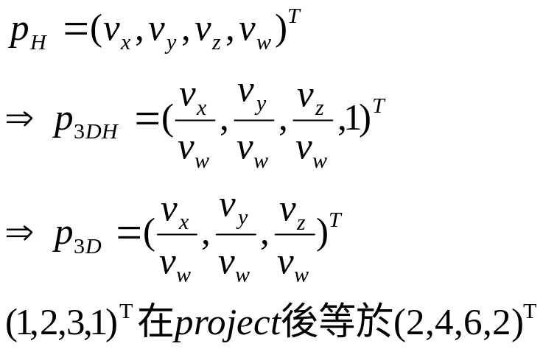
Homogeneous coordinate
4 Element vectors
  Vector
  Point
4D -> 3D projection
  Project onto w==1 hyper plane

Slide 4
Homogeneous coordinate
vector + vector = vector
point + vector = point
point – point = vector
point + point = …point

Slide 5
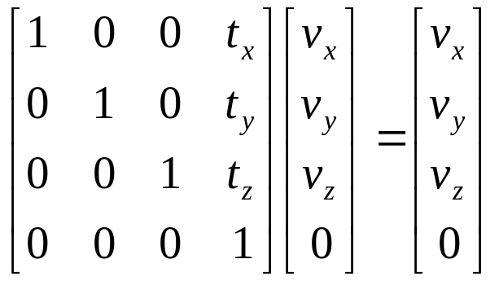
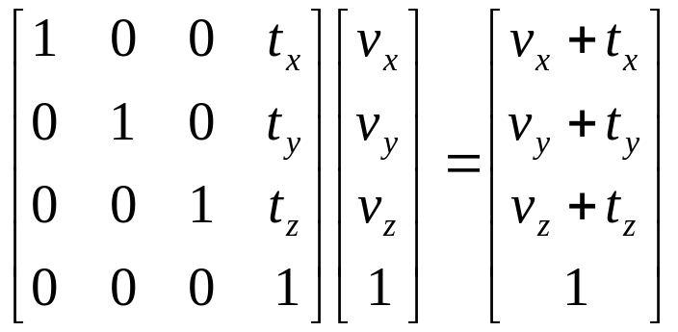
Basic Transform
Translation
  Vector
  Point

Slide 6
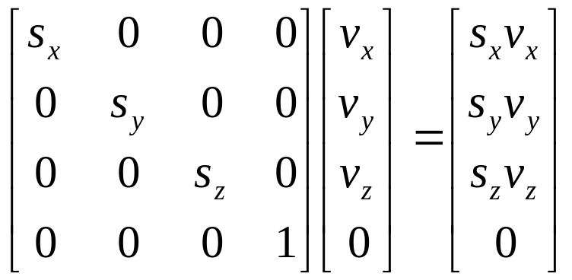
Basic Transform
Scaling

Slide 7
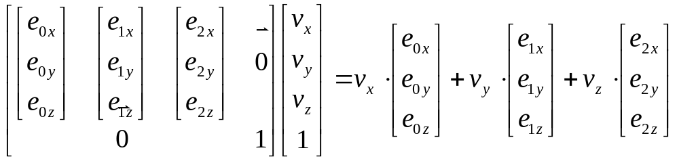
Basic Transform
Rotation
z
e2
z
e1
y
y
x
x
e0

Slide 8
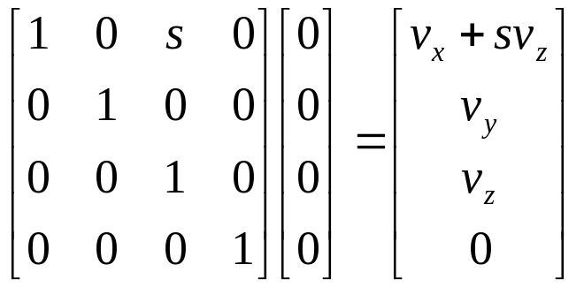
Basic Transform
Shearing
z
z
1
1
1
x
1
x

Slide 9
Matrix
Column major, row major?
Column vector, row vector?
Matrix * vector… or vector*Matrix

Slide 10
Derive view matrix from scratch

Slide 11
Simple perspective, 3D->2D projection

Slide 12
4D->3D projection
下集

Slide 13
Truth in advertising
Jim Blinn’s corner p73
  (Basically I just put in enough minus signs after the fact to make it work.) Al Barr refers to this technique as “making sure you have made an even number of sign errors.” Signs are always a nuisance in this business(e.g., clockwise/counterclockwise, inward/outward pointing normal vectors, etc.). You analyze and analyze and still only have a 50% chance of getting it right.

Slide 14
Exercise
1. 3D animated demo scene
2. 減少API calls/fancy OpenGL API (code + present)
  減少draw calls: Static batching/ Instancing
  Constant buffer object
  Separated shader stages
3. Contribute to course API

Slide 15
Draw call explained
Drawcall, batch, prim count
  glDrawElements, glDrawArrays, etc.
  Enemies of graphics programmer
  Normal people count sheeps to fall asleep. Graphics programmers count drawcalls, hence the lack of sleep
Why we need so many draw calls
  State breaker
    Different shader, shader parameter, texture, etc…

Slide 16
下集預告
Perspective matrix derivation
Z buffer
Frame buffer & frame buffer operation

