Slide 1
Letter Recognition By Strokes
Team 14
0616309 王祥任
0616031 李昀奇
0616098 黃秉茂

Slide 2
Outline
Motivation
Related Works
Data Collection
Data Preprocessing
Model
KNN
Random Forest
SVM
ANN
Conclusion & Future Work

Slide 3
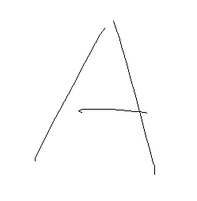
Motivation
A

Slide 4
Related Works
Keyword: Letter detection by strokes

Slide 5
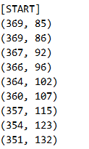
Data Collection - Tool
Painter wrote by ourselves
Record the sample points of each stroke

Slide 6

Data Collection
About 760 records
Each letter has about 25 records.
Upper case only.
No cursive.

Slide 7
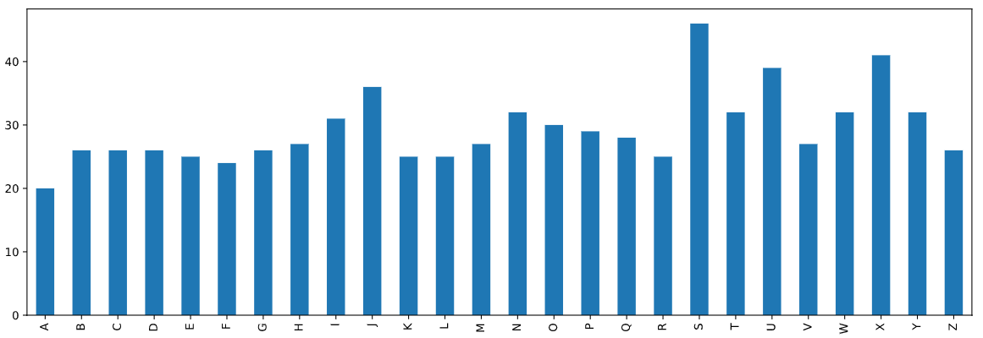
Data Collection - Statistics

Slide 8

Data Collection - Statistics

Slide 9
Data Preprocessing - Problem
Number of Dimension
The number of samples of each stroke is different.
The number of strokes of each letter is different.
Curve
Not all the stroke is straight line.
How to represent it?

Slide 10
Data Preprocessing - Problem
Coordinate & Size
The coordinate of starting point is various.
The font size of each letter is different.

Slide 11
Data Preprocessing - Features of each letter
The upper bound of the number of strokes of each letter is 4.
Zero-padding for those # of strokes is lower than 4.
[Letter][Stroke#1][Stroke#2][Stroke#3][Stroke#4]

Slide 12
Data Preprocessing - Features of each stroke
Angle (角度)
Displacement Length (位移長度)
Path Length (路徑長度)
Ratio (路徑長相較位移長之倍率)
Offset (該筆劃之起點相較第一筆劃起點之距離)
Number of Sign Change of X-axis (斜率於X軸上變號之次數)
Number of Sign Change of Y-axis (斜率於Y軸上變號之次數)

Slide 13
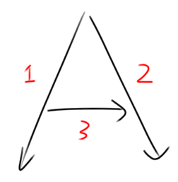
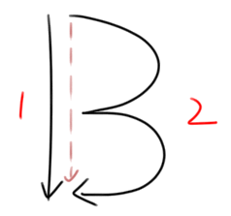
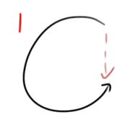
Data Preprocessing - Stroke

Slide 14
Data Preprocessing - Stroke
One-stroke letter is hard to identify by feature 1 to 5.
Feature 6 and feature 7 to identify the change of slope.
C L O S U

Slide 15
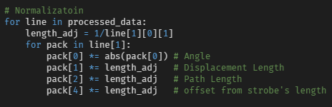
Data Preprocessing - Enhancement
Angle is the most important feature, so sign-square itself to enhance it.

Slide 16
Data Preprocessing - Normalization
The size of bounding box of each record may be different.

Slide 17
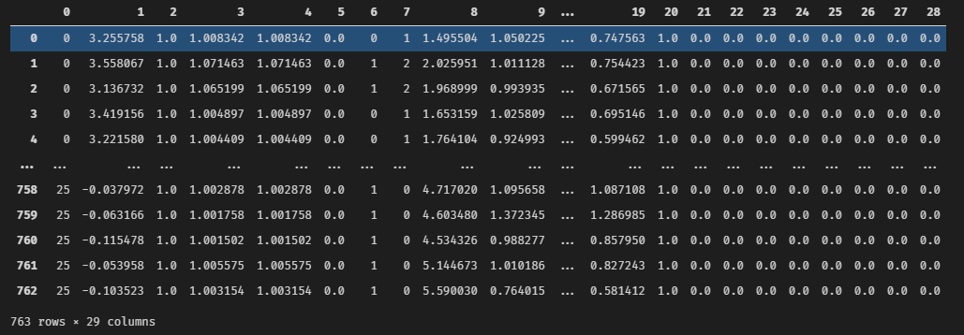
Data Preprocessing - Result

Slide 18
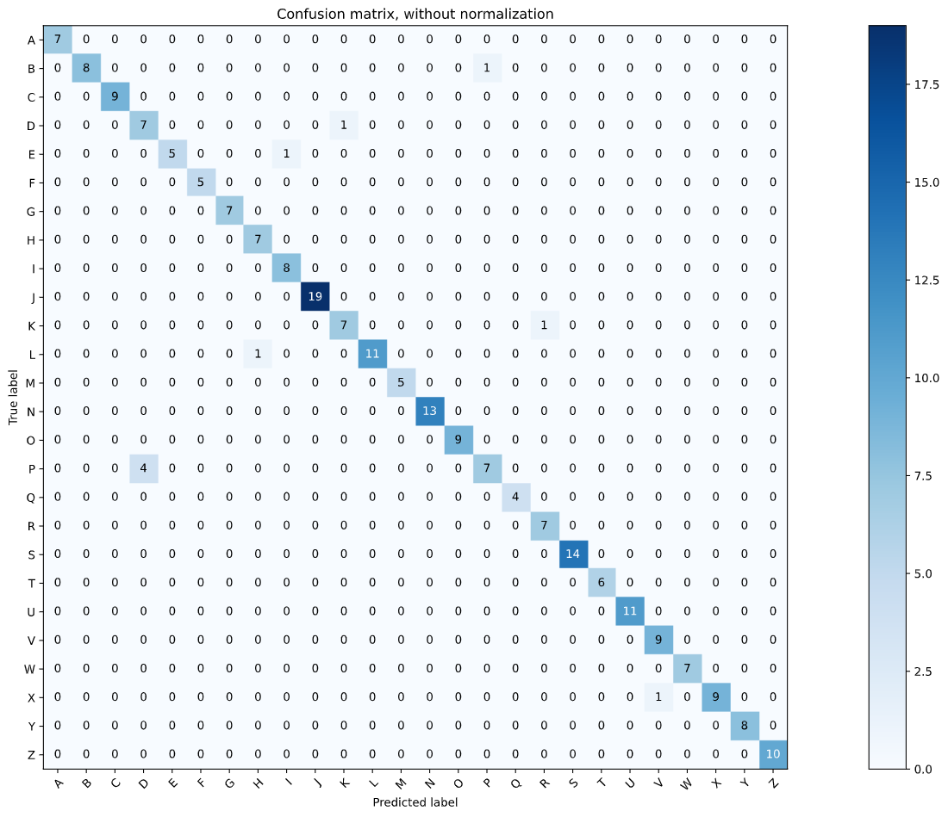
Model - KNN
Accuracy : 0.96
P-D (4)
B-P (1)
D-K (1)
E-I (1)
K-R (1)

Slide 19
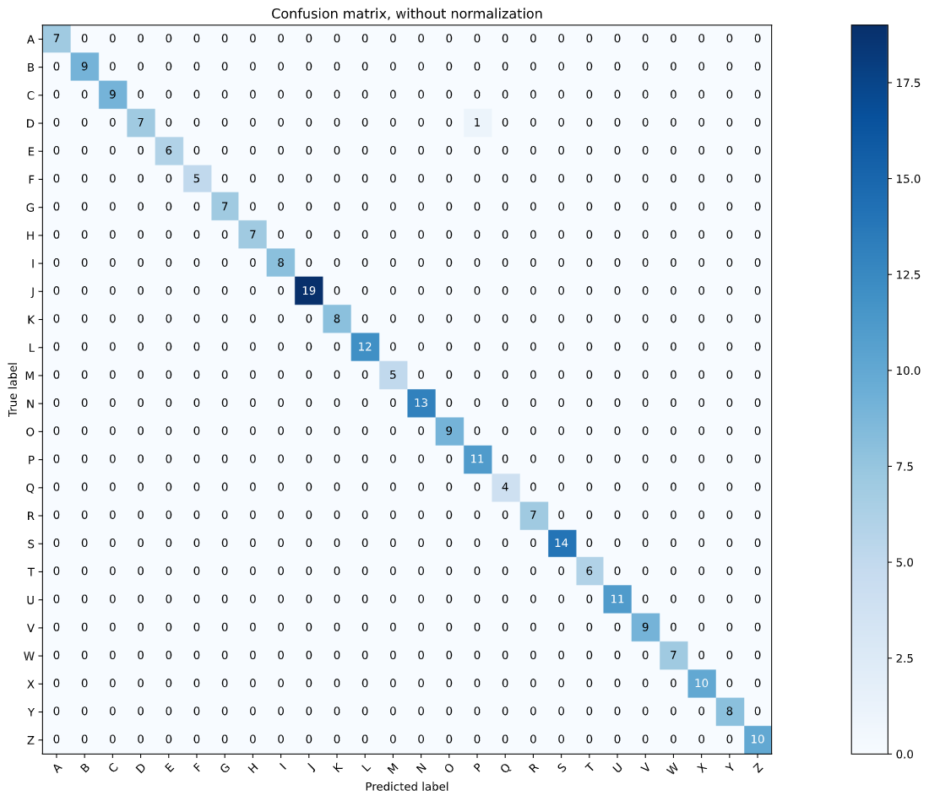
Model - Random Forest
Accuracy : 1.00
D-P (1)

Slide 20
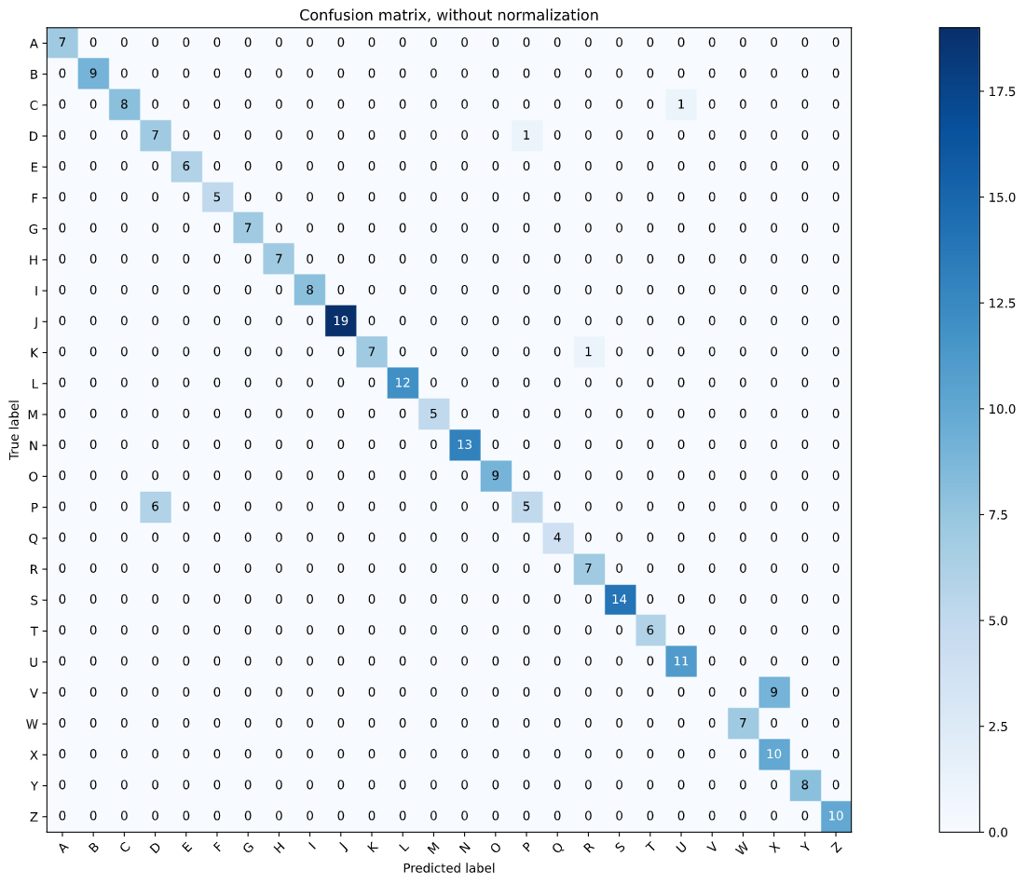
Model - SVM
Accuracy : 0.92
V-X (9)
D-P (6+1)
K-R (1)
C-U (1)

Slide 21
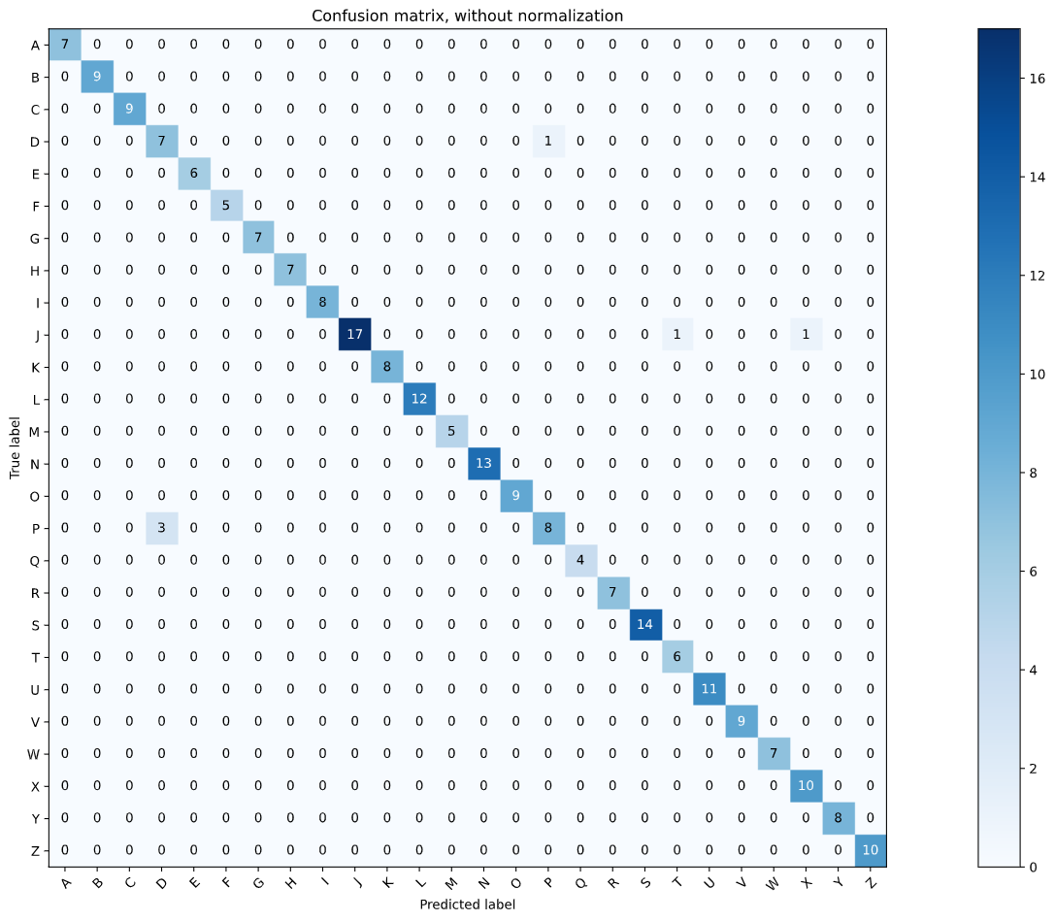
Mondel - ANN
Accuracy : 0.97
D-P (3+1)
J-T (1)
J-X (1)

Slide 22
Conclusion & Future Work
Only need 28 features for each data
Accuracy is high (for same writer)
D-P is hard to recognition
Not very general
Highly depends on user

Slide 23
Distribution
 | 0616309 王祥任 | 0616031 李昀奇 | 0616098 黃秉茂
Percentage | 40% | 20% | 40%

